Slide 1
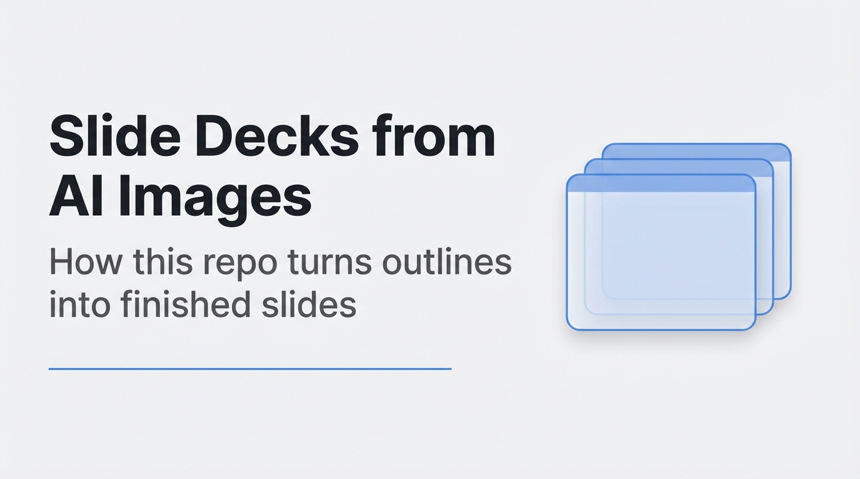
Notes:
Open with the core idea: this repo takes structured slide descriptions and
uses Gemini to render full slide images in a consistent visual style.

Slide 2
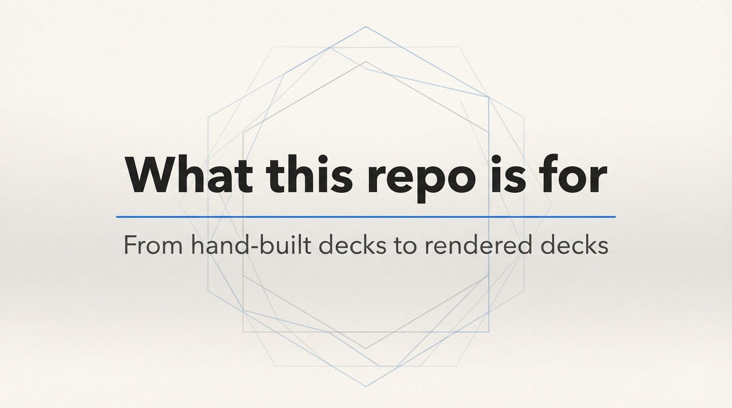
Notes:
Short transition slide to mark the "motivation / overview" part of the talk.

Slide 3
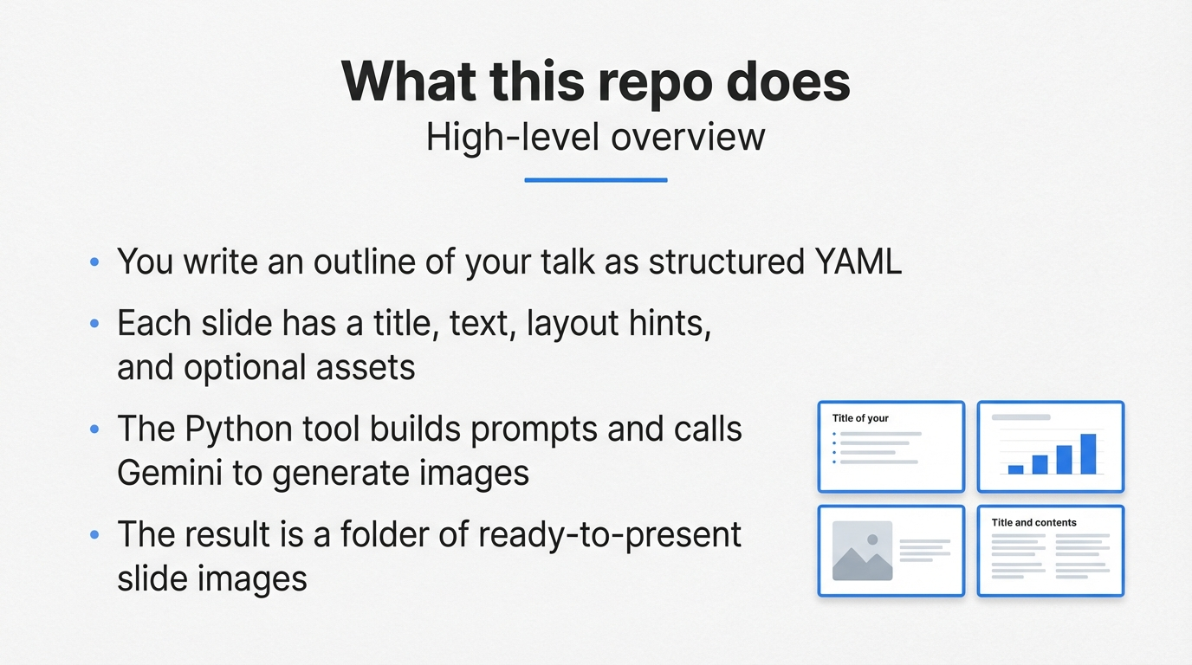
Notes:
Explain that the repo is an "outline + style in, slide images out" system,
not an automatic summariser of random PDFs.

Slide 4
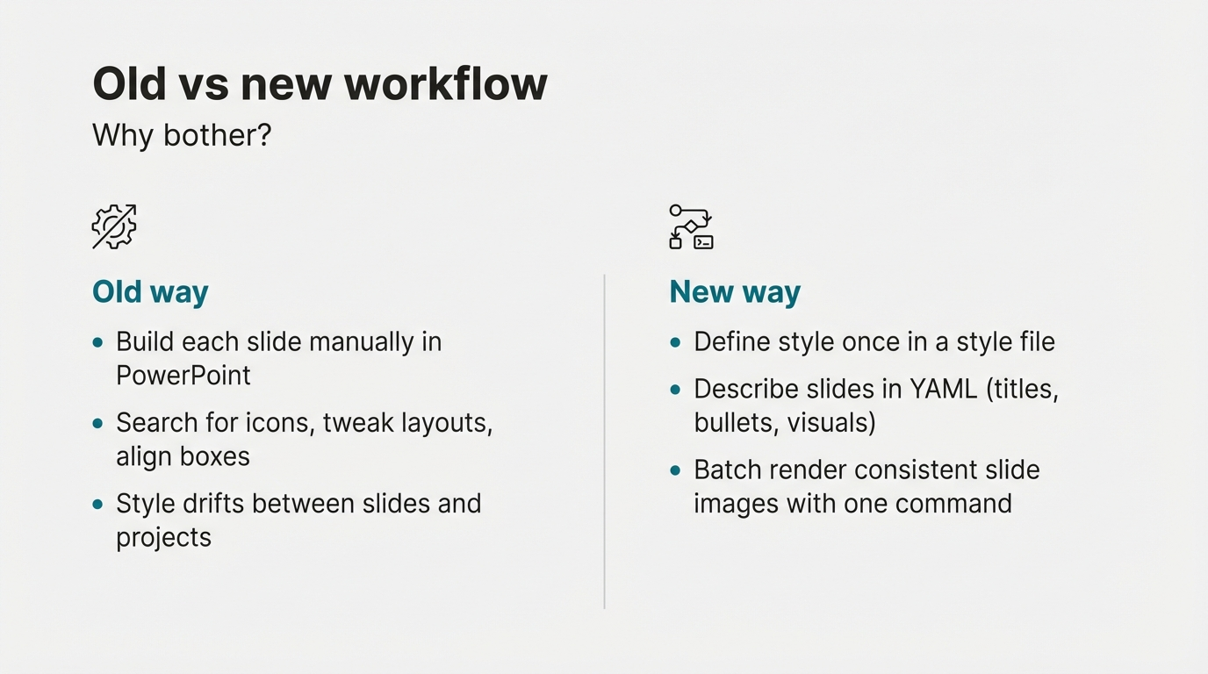
Notes:
Contrast manual deck-building against the generative approach, both in
effort and in visual consistency.

Slide 5
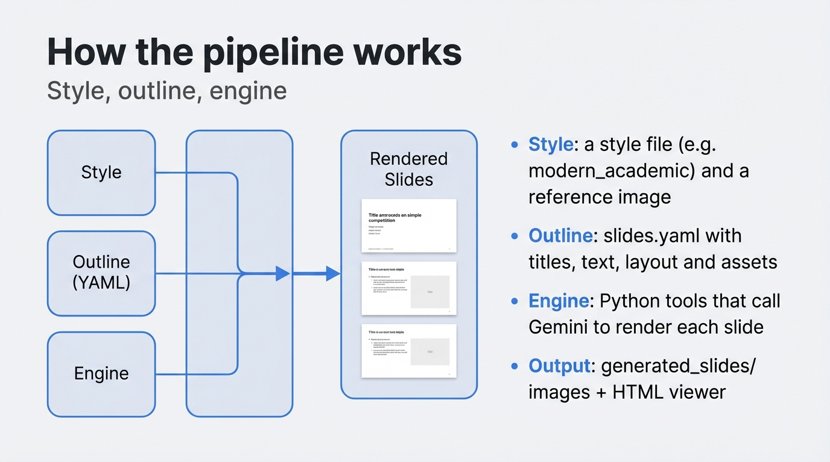
Notes:
This slide is the conceptual architecture: inputs (style + outline),
processing (tools/generate_slides.py, gemini_generate_image.py), and
outputs (images + index.html).

Slide 6
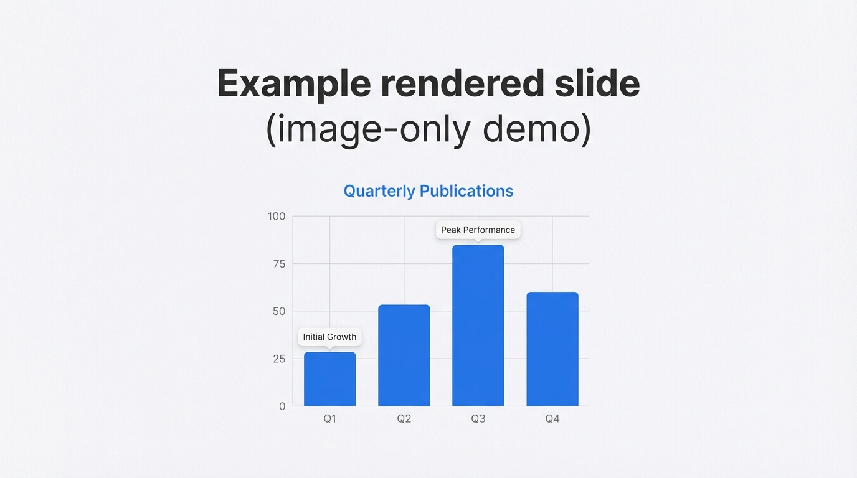
Notes:
This slide is meant to be almost entirely visual: a single strong example
of what the model will generate for you. The title and subtitle can be
present as part of the image.

Slide 7
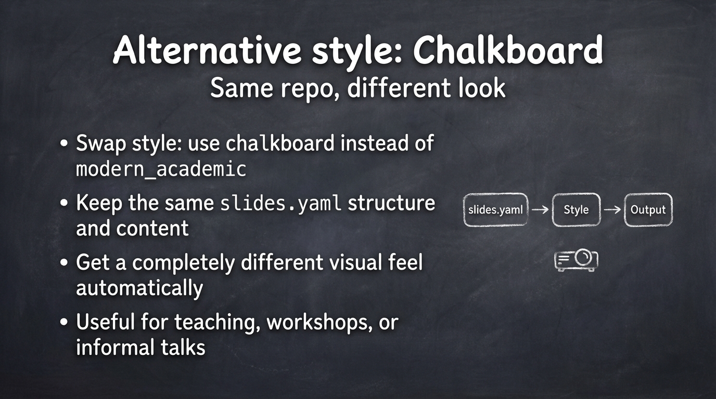
Notes:
Show that styles are pluggable: the same pipeline and slide YAML can render
into very different visual treatments by changing the style file and style
code on each slide.

