Slide 1
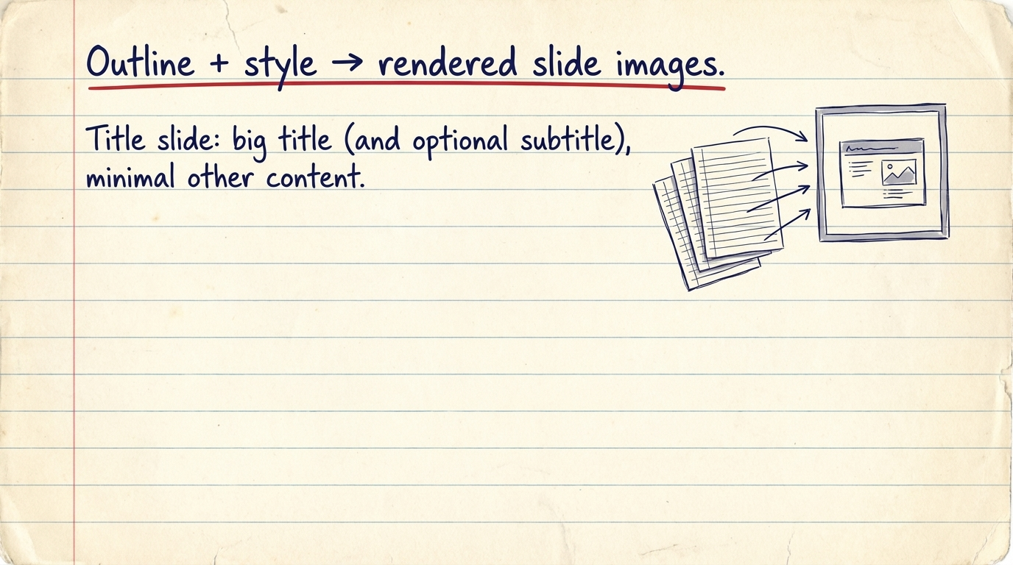
Notes:
Outline + style → rendered slide images.

Slide 2

Notes:
Transition into the motivation/overview.

Slide 3
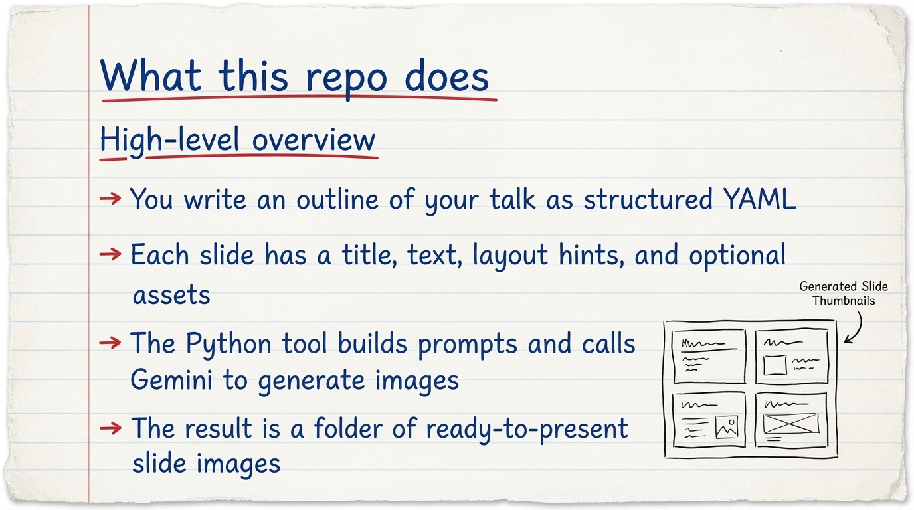
Notes:
Outline + style in, slide images out; not a PDF summariser.

Slide 4
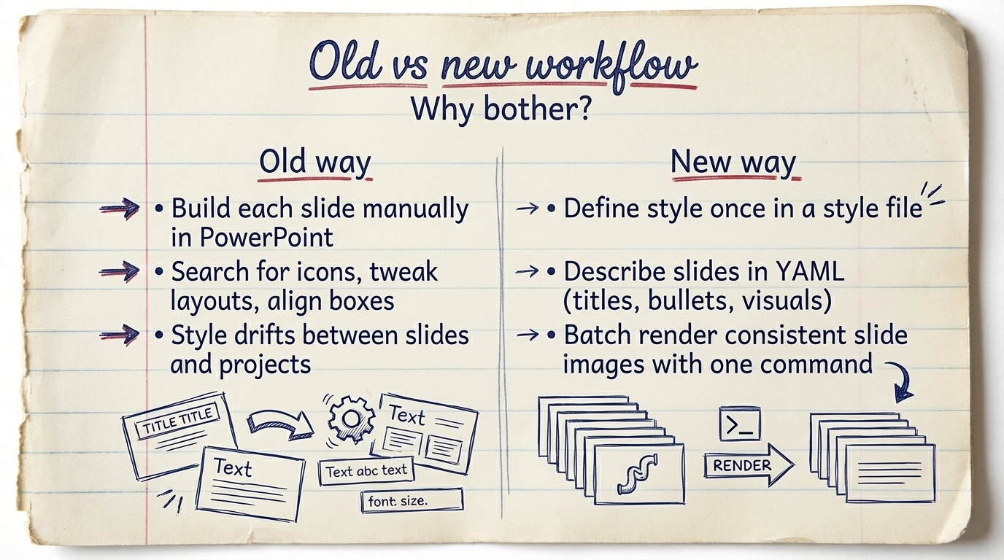
Notes:
Contrast effort and consistency.

Slide 5
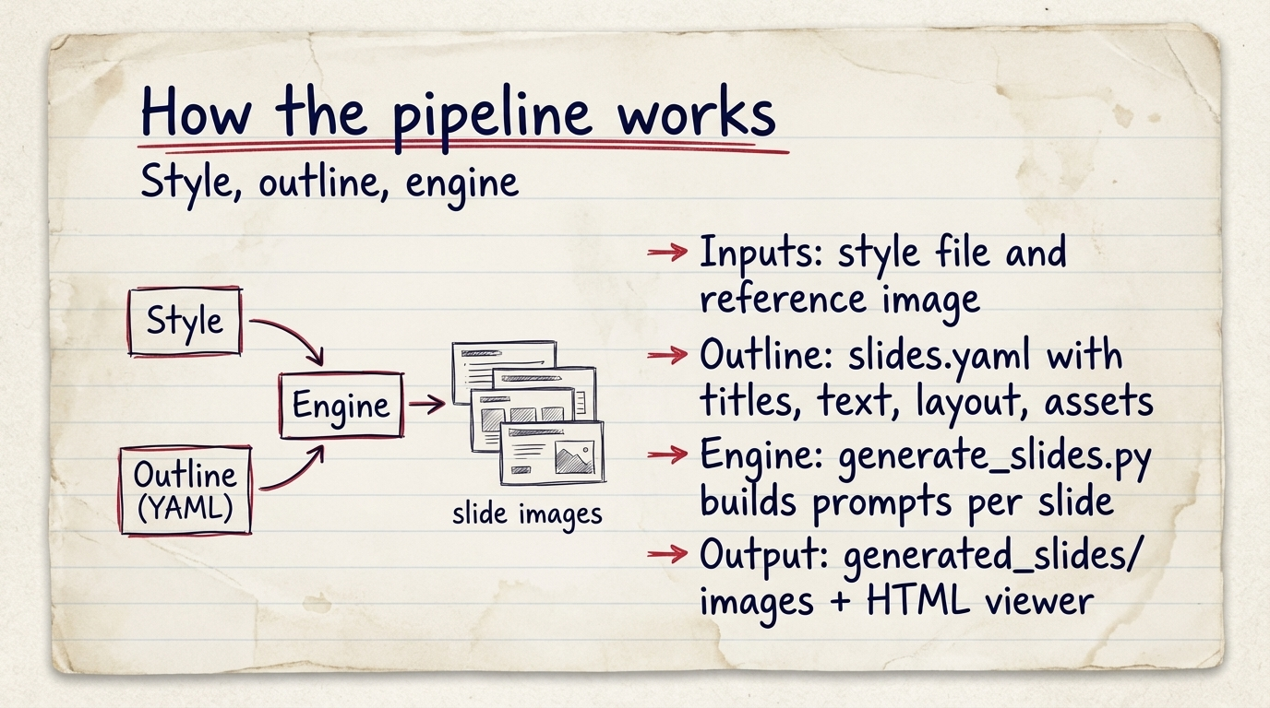
Notes:
Inputs → processing → outputs.

Slide 6
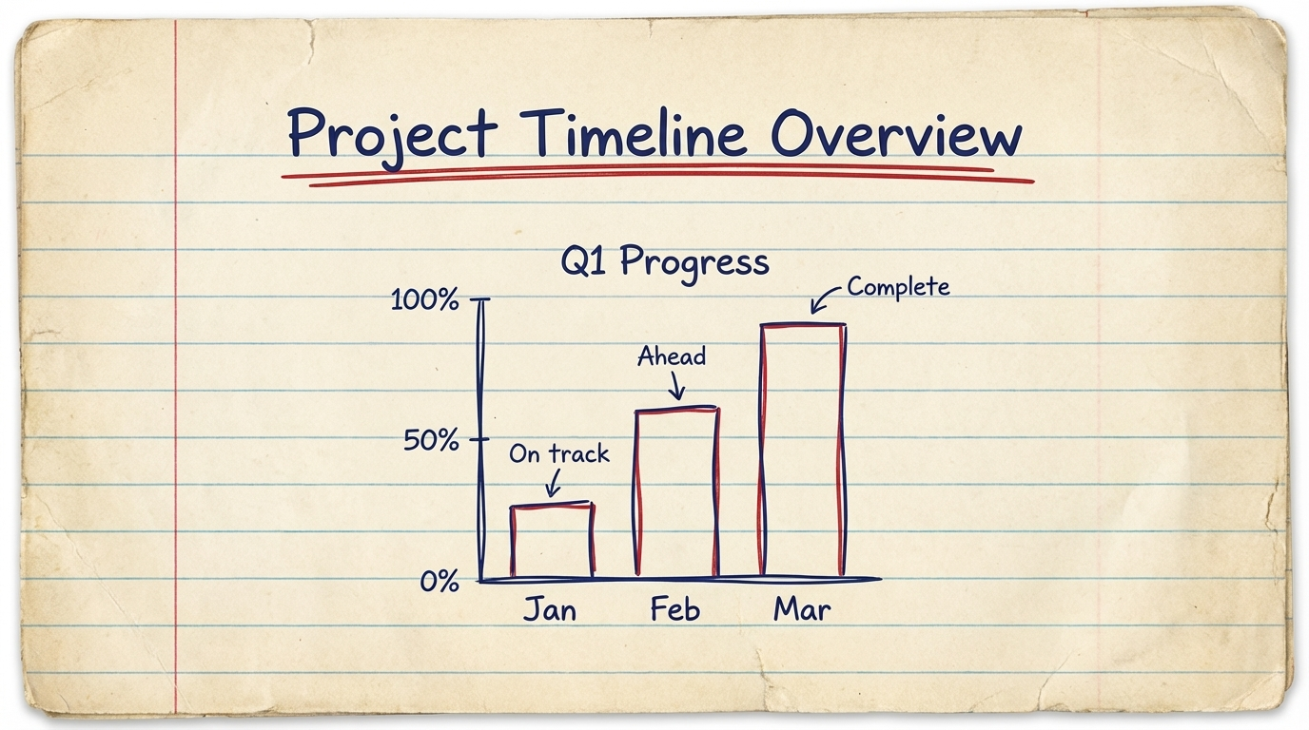
Notes:
Visual proof of what the generator produces.

