Slide 1


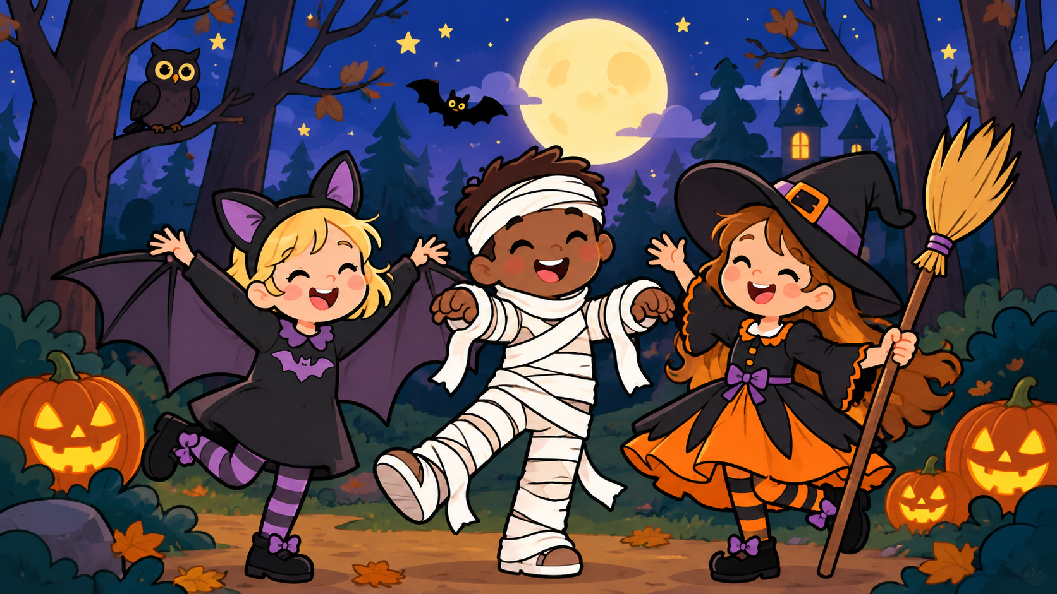

SHAN ENGLISH TIME • HALLOWEEN
HAPPY HALLOWEEN!
HAPPY HALLOWEEN!
✦
✦
✧
✧
Are you ready?
BOOOOO!
✧
✦
Notes:
Say: Happy Halloween!
Wave and say BOOO together.

Slide 2
SHAN ENGLISH TIME • HALLOWEEN
WHAT CAN YOU SEE?
✦
✦
Look! Point! Say it!
✧
✧
A GHOST!
A PUMPKIN!
A BAT!
✧
✦
Notes:
Elicit: ghost, pumpkin, bat.
Point and repeat together.

Slide 3
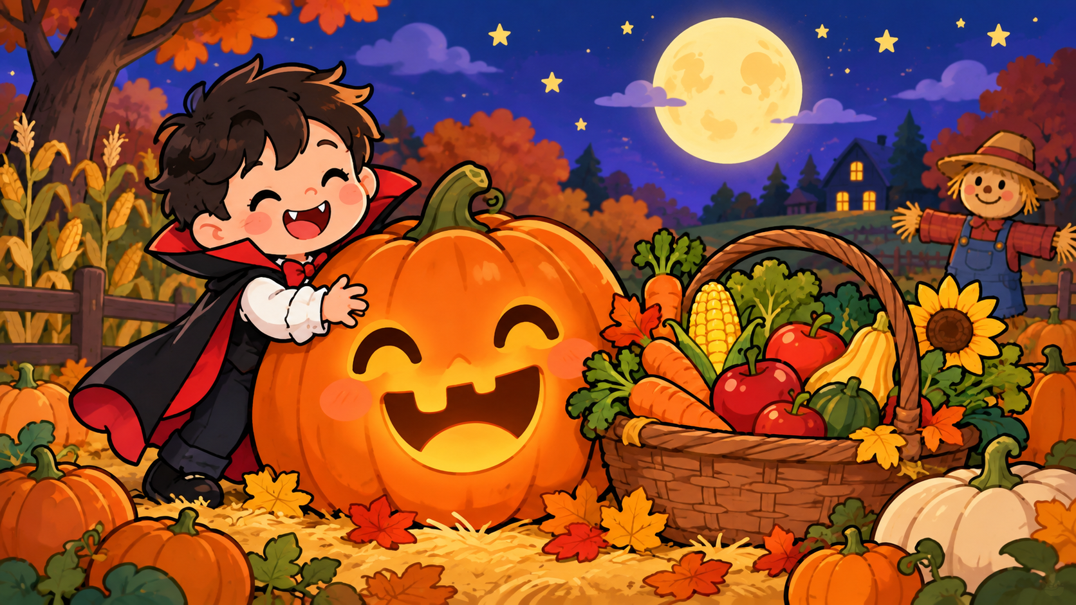
SHAN ENGLISH TIME • HALLOWEEN
WHY DO WE CELEBRATE HALLOWEEN?
Halloween began a long, long time ago.
Today, we dress up and have fun!
Notes:
Spend 30–45 seconds: Halloween began a long time ago. Today people wear costumes and have fun. No detailed history for kindergarten.

Slide 4
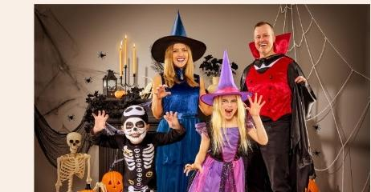
SHAN ENGLISH TIME • HALLOWEEN
DRESS UP!
✦
✦
Look! Halloween costumes!
✧
✧
What can you see?
A WITCH!
A SKELETON!
A VAMPIRE!
✧
✦
Notes:
Show the real costume photo.
Ask: What can you see? A witch? A skeleton? A vampire?

Slide 5
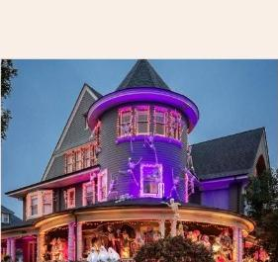
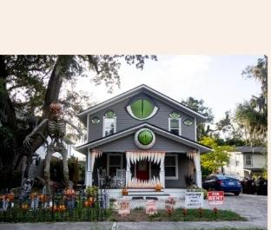
SHAN ENGLISH TIME • HALLOWEEN
SPOOKY HOUSE!
✦
✦
Look! A spooky house!
✧
✧
Is it scary? Ooooooo!
✧
✦
Notes:
Show the spooky houses.
Prompt: spooky house, scary, wow!

Slide 6
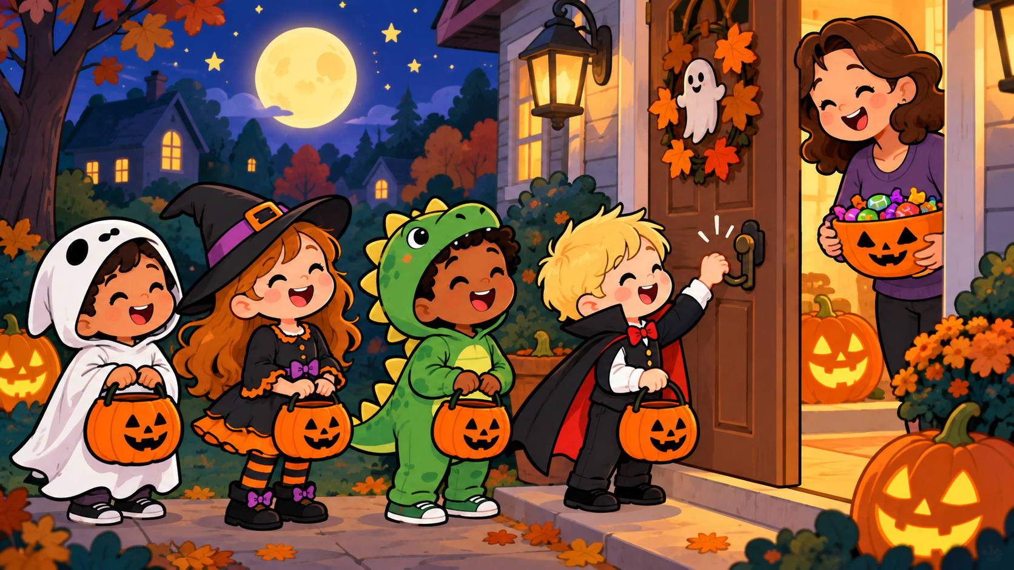
SHAN ENGLISH TIME • HALLOWEEN
KNOCK, KNOCK!
Look! Children are going trick-or-treating!
Knock, knock!
Trick or treat!
Notes:
Point to the children at the front door. Ask: Where are the children? Model knock knock. Class knocks in the air, then says Trick or treat! Adults should accompany children when real trick-or-treating.

Slide 7


SHAN ENGLISH TIME • HALLOWEEN
TRICK OR TREAT!
✦
✦
Say it together!
✧
✧
TRICK OR TREAT!
“Here you go!” → “Thank you!”
✧
✦
Notes:
Practice trick or treat together.
Model: Here you go / Thank you.

Slide 8
SHAN ENGLISH TIME • HALLOWEEN
FLY, LITTLE GHOST!
✦
✦
Hold up your hands like a ghost
✧
✧
LOW, LOW!
HIGH, HIGH!
ROUND & ROUND!
BOOOOO!
✧
✦
Notes:
Use the ghost chant/song with their crafts.

Slide 9

SHAN ENGLISH TIME • HALLOWEEN
HAPPY HALLOWEEN!
✦
✦
✧
✧
Great job, everybody!
BYE-BYE!
✧
✦
Notes:
Say Happy Halloween and goodbye.

