Slide 1
Phase I (Collecting Documents)

Slide 2
Accumulating Data for Sports Articles
The Naïve Bayer Classification method was used to read the articles and identify the topics selected.
The articles were found in a website which had an archive of sports related articles with their links
I randomly selected 10 articles with differing topics to diversify the searches and saved them as HTML in my local hard drive.

Slide 3
Phase II(Features Extraction)
I used the web crawler developed to scrape the HTML documents.
The vectors were extracted through the thought process of what the most frequent words related the Dataset.
The ten vectors used were; Hockey, Golf, Football, Soccer, Basketball, Baseball, Play, Sports, Run, Kick

Slide 4
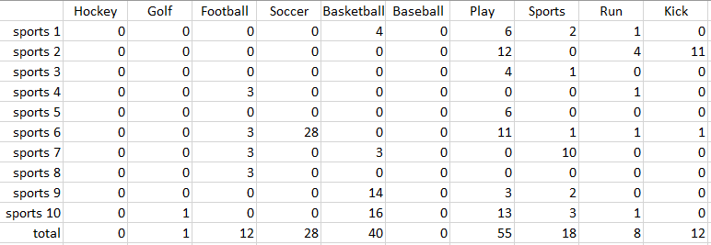
Data Analysis
This table allows us to view the total values from the data set of sports articles and the target word frequency. The target word “play” was repeated a total of 55 times with a high frequency rate whereas, the “hockey” and “baseball” were skipped over and ignored in the calculations due to the lack of the term in the article.

