Slide 1
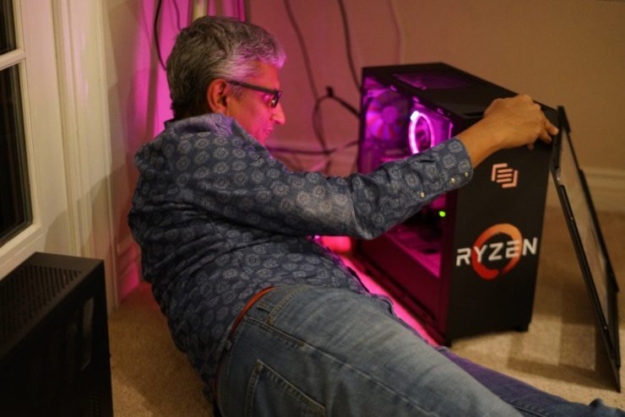
CS401 Computer Architecture Final Project
Levi Russell, Rudy Keopuhiwa, Shane Snediker, Stephen Haugland, Madi Binyon

Slide 2
Project Goals
No initial inclinations
Cryptography?
Hashing!
Keyboard input, VGA output
Notes:
Shane

Slide 3
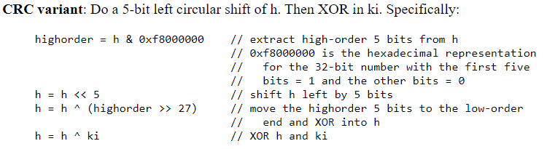
Hashing Algorithm

Slide 4
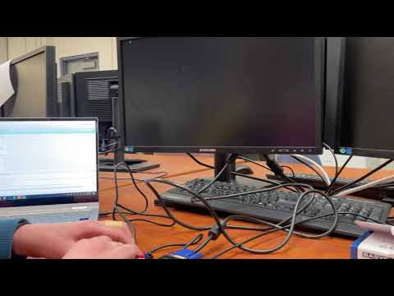
Demo
Notes:
Madi

Slide 5
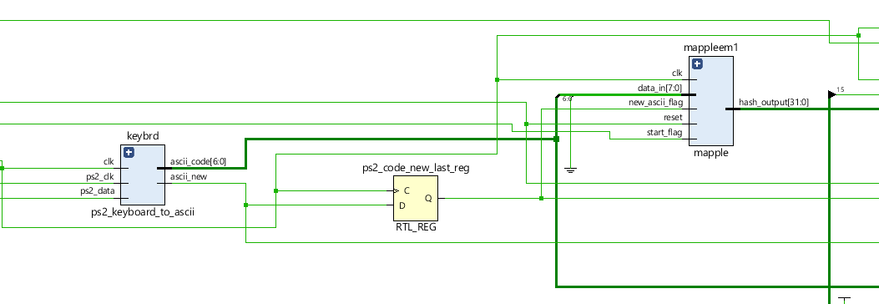
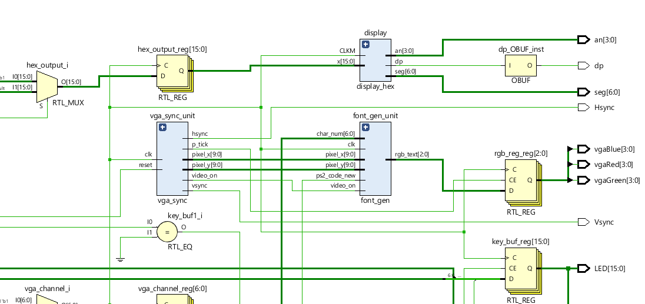
Hardware Diagrams
Notes:
Levi

Slide 6
Challenges
ALU reformation
Timing
Memory
Advanced output
Notes:
Rudy
Shiffting the wrong way,
Timing is always an issue, the clock could be moving too quick for everything to sync up. Sometimes when getting an input from the keyboard to output on the vga it will be outputting more than once
Memory we had some miswires and some basic
Advanced Output - first we wanted to output the entire hash at once but it was janky, so we decided to output each hash one at a time using the switches

Slide 7
WE MADE IT! WE’RE FREE!! SEND IT!
A special thanks goes out to the wonderful alumni who pour into Whitworth and the CS department so that we have the privilege of having Basys3 boards in our hands for debugging, playing around and testing purposes.
And finally, Dr. Jones you are an inspiration to so many, and we just want to thank you for your undying eagerness to help your students and everything you do for Whitorth!
CLASS OF 2021

