Slide 1
EBGN645: First Day

Slide 2

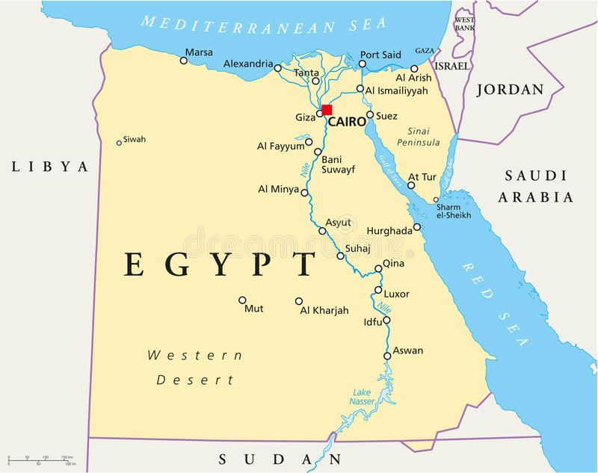
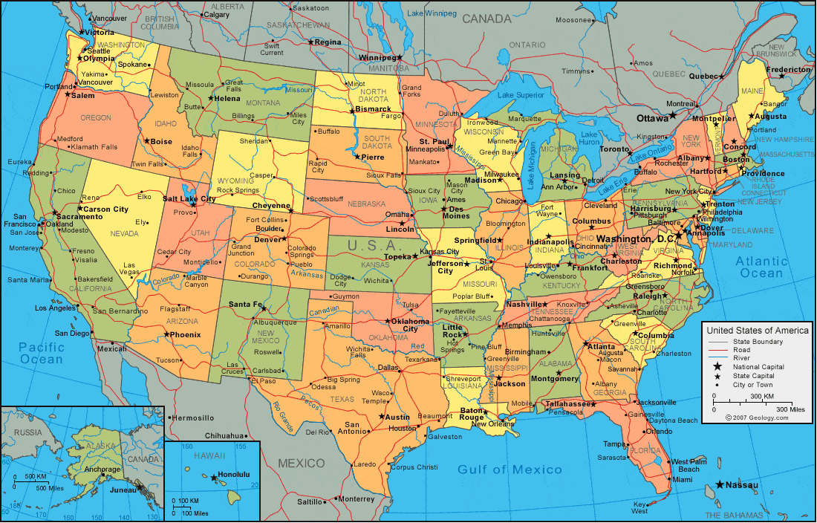





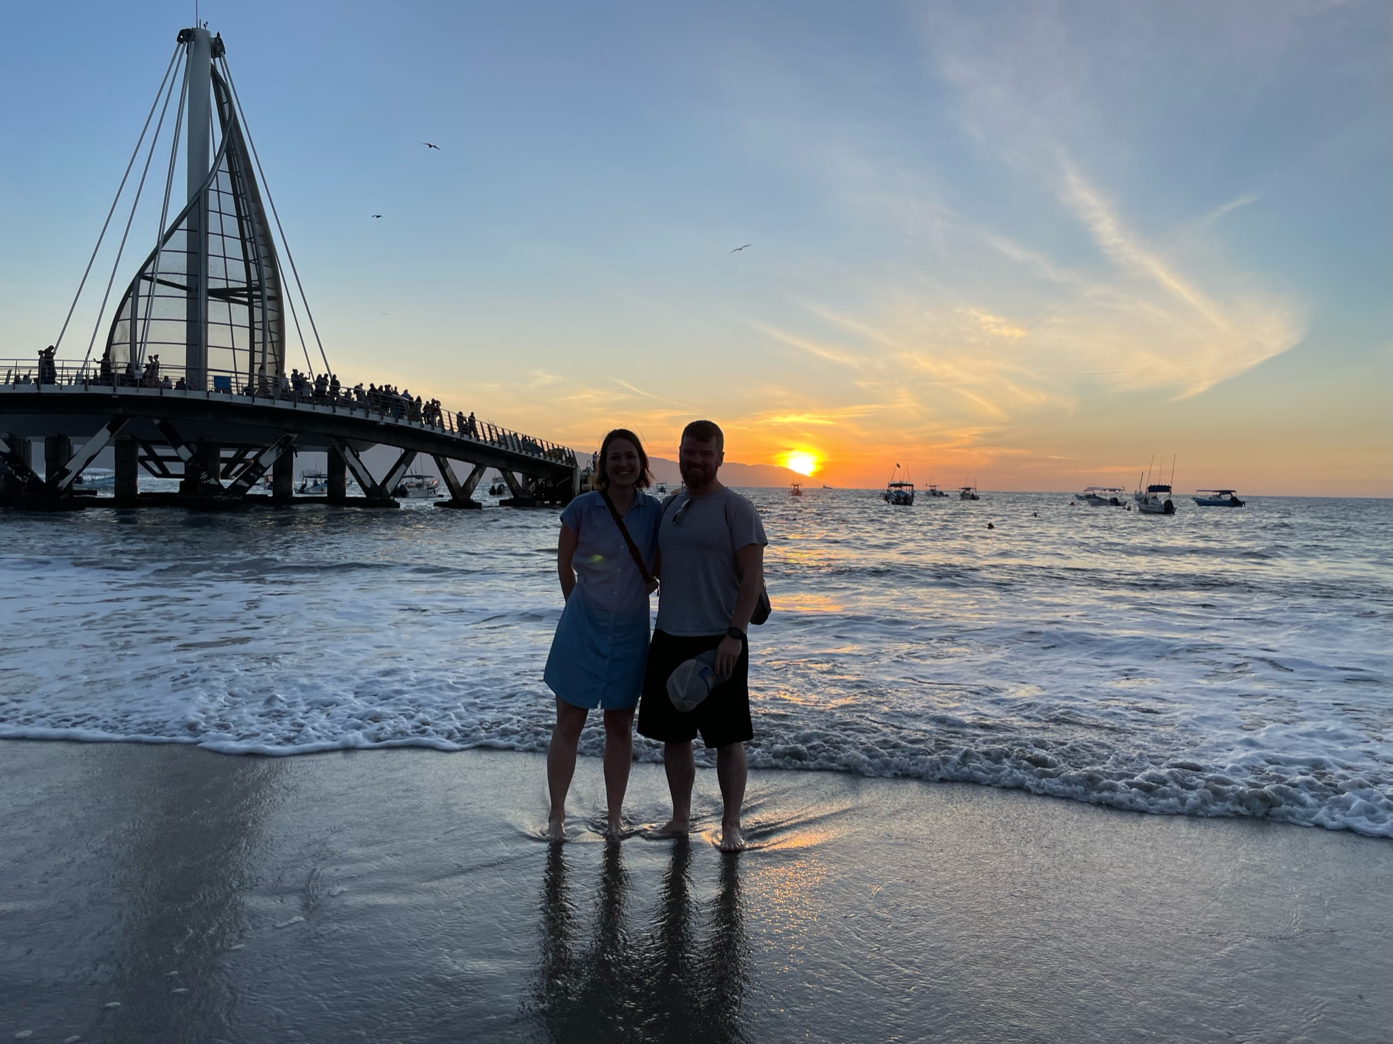


My Background
Notes:
North Dakota State College of Science (2004-2006)
North Dakota State University (2006-2010)
University of Maine (2010-2012)
Oak Ridge National Laboratory (2012-2017)
Colorado School of Mines (2013-2017)
Critical Materials Institute
Payne Institute for Earth Resources
National Renewable Energy Laboratory (2016-Present)
Colorado School of Mines (2019-Present)

Slide 3
Recent/ongoing projects – more on Wednesday
Lead developer on Regional Energy Deployment System (ReEDS)
Lead re-development in ~2017; R&D100 award in ~2020
All sorts of policy analysis (IRA, 111, …)
Currently: OBBBA, material demands, Nature paper
ReEDS-USREP, distributional and macroeconomic impacts of increased NG exports
Lead developer on Fuels and Industry Integrated Optimization (FINITO)
UN BTR report
Google project
Work with EMTEC
Lithium/copper market modeling with KAPSARC
Electricity procurement strategies for industrial consumers

Slide 4
Some admin items
I rarely use Canvas, mostly Google drive
I communicate via email
Office hours are Thursday 10-noon in my office (EH318)

Slide 5
Teaching philosophy
Nothing needs to be overly/intentionally difficult or stressful
We should look forward to and enjoy our time together
You should learn the core concepts well – “5-year takeaways”
Goal should be an intuitive understanding of the material
ie – why is this important? when will I ever use this?
Mutual respect
Teacher and students
Among students

Slide 6
Recording
Classes will be recorded
Uploaded to Google Drive
…. you still need to attend class

Slide 7
Punishments for…
Anything that creates an unsafe learning environment
Discrimination, bigotry, threats, violence, …
Academic misconduct (cheating)
I take these very seriously --
You will be punished to the full extent of university policy

Slide 8
Purpose of this course
Main goals:
Exposure to and knowledge of various modeling techniques
Using software as a vehicle for those techniques to solve problems in economics and engineering
Secondary goals:
Application of knowledge/skills to the real world
Modeling a topic of interest via the final project

Slide 9
Topics covered
Programming
GitHub
Command line tools, scripting
Mainly using GAMS - Other languages: Python, Julia as examples
Computing systems
Linear programs <- HW1
Non-linear programs
Duality
Mixed complementarity problems <- HW2
Avoiding ‘solve’ – analytical methods for modeling
Integrated assessment models
Model linkages – iterative and co-optimized
Computable General Equilibrium models
Mathematical Programs with Equilibrium Constraints (MPECs) <- HW3
Equilibrium Programs with Equilibrium Constraints (EPECs)

Slide 10
Grading
Course grade determined by:
Homework x3: 25%
Presentation: 25%
Final projects: 50%
Research proposal: 10%
Draft: 15%
Final paper: 25%
Late homework will not be accepted – the due date/time will be clearly printed on the assignment
I reserve the right to curve any/all work – Students will never be negatively impacted by grade adjustments

Slide 11
Your final project
Broken into stages.. (dates subject to change)
2-page proposal due September 24th
Draft of paper due November 12th
Final paper due December 12th
“Can I do my project on… ?” – Yes (most likely)
“Can I use the class project to work towards my dissertation?” - Yes
Drafts, final papers, and presentations that do not clearly state a research question (or statement) will be heavily penalized

Slide 12
Some advice
Start strong, it will pay off
My office hours got packed towards the last couple weeks of class

Slide 13
Coding
This class will move fast in the beginning for some of you
All code be made available through the GitHub repository
Anyone can learn to code – it is a language
I will not write your code for you

Slide 14
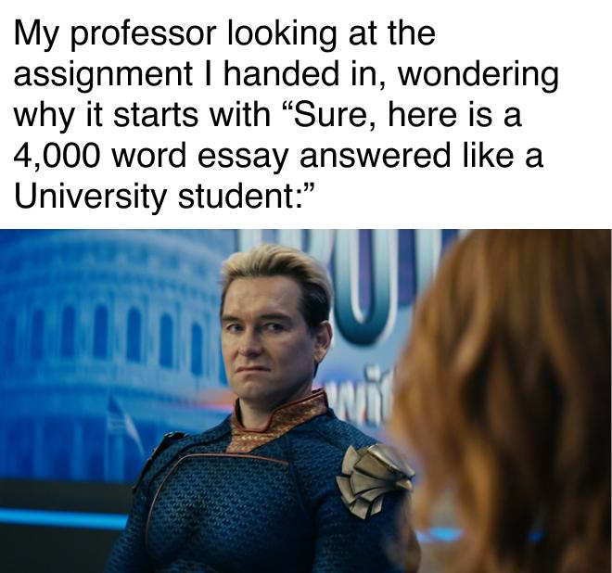
AI Policy
There are no AI restrictions (mainly because I can’t police it) but…
I can tell if AI wrote your paper, it is not hard, and you will be judged for it
AI sucks at writing optimization problems and esp GAMS code
I can tell when AI writes your code – several easy flags to find
I will not help debug your AI-written code.. you are on your own
AI overuse creates learned helplessness.. you need to learn how to write the code and how the models work

Slide 15
Scheduling
Most of you have similar schedules
Do not want to overlap with other exams or project due dates
Will try to work around schedules to make sure we don’t overlap
See google sheet to list out any problem dates

Slide 16
Absences, delays
Should any personal issues arise that requires you to miss extended periods of class, please reach out ASAP
Homework extensions or special accommodations for the final project will require at least 72 hours notice and will be evaluated on a case-by-case basis

Slide 17
Disabilities, counseling
Will always do my best to accommodate any disability
Should any personal issue arise, Mines has a great counseling center
Avoid burn-out

Slide 18


Textbooks
No required text – some recommendations for later in the course

Slide 19
Advice for the program/life
A degree is just a piece of paper if you’re just jumping through the hoops
Goals should be to..
Acquire skills and knowledge that make you more valuable/employable
Become well-rounded in the space of minerals and/or energy
Pursue your passion
Talk to people, network, go to events
Get to know people’s research (esp PhD students)
Create a work life balance
Whatever you do, try

Slide 20
Your first assignments – will also send an email
Add any date conflicts to the google sheet
Download/install the most recent version of GAMS
Add license to GAMS (will send this)
Create a GitHub account
Download/install the most recent version of GitHub Desktop
Unnecessary if already familiar with Git command line
Download/install Visual Studio Code as well as the GAMS extension
If you’ve never done so before, open your command prompt or terminal and type in a command:
For windows: dir
For linux/mac: ls

Slide 21
Questions?
Other notes:
I talk fast when I get excited – can remind me to slow down
Can ask questions at any time

