Slide 1
EBGN645: Day 2

Slide 2
Question [I]
Why bash/command prompt and not python?
Normally will script operations – e.g. creation of files/directories, pre- and post-processing of results, model runs, …
Can do this in either python or bash/dos… e.g. in bash:
mkdir my_dir
and in python:
os.mkdir(“my_dir”)
.. This amounts to personal preference
For routine things (“unscripted development”) it’s much faster just to do these things via dos/bash
Helpful to know bash when on non-GUI machines

Slide 3
Question [I] follow-up
Naïve parallelization easy via bash/powershell
In bash (mac/linux): “nohup sh myscript.sh > log.out”
In powershell (windows): “start myscript.bat”
Python
queueing capabilities
Can send example of this if people are interested

Slide 4
Questions [II] – Final Project
Due dates:
2-page proposal due September 24th
Draft of paper due November 12th
Final paper due December 12th
Don’t hesitate to share ideas
I won’t discourage you from doing something big but better to take on a reasonable amount of work.. Build up to a bigger model but always have a backup

Slide 5
Questions [III] – Model relationships
“How do all these model types relate and
why are we going in this order?”
CGE
MCP
LP
NLP
MPECS
EPECS
MPECS
EPECS
LP

Slide 6
Questions [IV] – OS Choice
”Why do you use a Mac?”
A1: Because other people pay for my computers :0)
A2: Linux/unix running under the hood.. Anything I do on this machine can (usually) transfer to HPC – No longer the case with Windows Subsystem for Linux (WSL)
A3: I drank the Kool-Aid and now everything I have is Apple-based

Slide 7
Question [V] – Dissertation chapters
“Why is it harder to write a comp-econ based dissertation chapter?”
Short answers:
A1: it requires a theoretical argument first, modeling to support
A2: you cannot do policy analysis, that isn’t adding the base of economics knowledge
This isn’t to say you can’t do it.. but you will need to start forming your argument earlier
My favorite example of a solid theory/computational paper is in the shared drive (holland_emitreduct.pdf)

Slide 8
Not a question but..
You get a free Tableau license as a student
https://www.tableau.com/academic/students

Slide 9

Guest speakers
Jared Woollacott – EIA Chief Economist, modeler, AI enthusiast
Adam Christensen - GAMS
Sauleh Siddiqui – AU, formerly EIA Chief Modeler
Charalampos Aavram – NREL modeler
Jon Becker – Formerly EPA, MEE grad
.. Some others pending

Slide 10
Some unsolicited career advice
Always look for opportunities…
Even when you’re at your dream job, options bring leverage
Nobody ever wants to give you more money
Keep improving, demonstrating value, staying competitive
When starting out, make mistakes on someone else’s dime

Slide 11
An aside on computing hardware [I]
“Most people are afraid of computers.. they’re these scary beasts that just want to be loved” – Brian Kaplin, my computer engineering professor
“Because computers are dumb, pedantic beasts, programming is fundamentally tedious and frustrating” - Marijn Haverbeke, Eloquent JavaScript: A Modern Introduction to Programming
Motherboard = connects it all together
CPU = Brain.. coordinates all functions
RAM = Short-term memory
Working on a math problem…
Hard Drive = Long-term memory
Books, education, …
That embarrassing thing you did in 8th grade
Cache = instant memory (L1/L2 cache on CPU)
L1 = Notes on your desk when working .. Super fast
L2 = your bookshelf .. Pretty fast but not as fast as L1
North Bridge = Fast reflex pathways, connects CPU to RAM, GPU
South Bridge = Background system manager, connects CPU to HD, USB, …
Power Supply = Heart/lungs
GPU = Imagination/visualization
BIOS = Instincts

Slide 12
An aside on computing hardware [II]
Servers are just computers, just like your laptop except..
Beefier
Using a different operating system
High performance computing (HPC) environments
A collection of servers or ‘nodes’
Still, just a bunch of computers connected together
AWS/Google Cloud/… are customizable machines you can rent
Parallelization:
Fancy word for multi-tasking
CPU – can handle a few different tasks at once – a single painter
GPU – can handle many of the same task – 1000s of painters
Generally, optimization only works on CPU.. Current work to enable on GPU
Currently – parallelization only enabled with barrier algorithm for LPs
Usually parallelization done across scenarios as opposed to within a solve

Slide 13
Agenda for today
GitHub
Creating a class repo
Committing a file
Creating a branch
Merging changes
Resolving merge conflicts
Writing out models: Ripley’s restaurant (math and code)

Slide 14
Git terms
Repository (”repo”): a collection of files saved on a server
branch: a version of the code you are working on
commit: save code to your branch on your local machine
push: save code to the repository
pull: update local code from the repository
merge: combine the code/files from one branch into another
merge conflict: code that was updated on both branches
and git doesn’t know which to choose

Slide 15
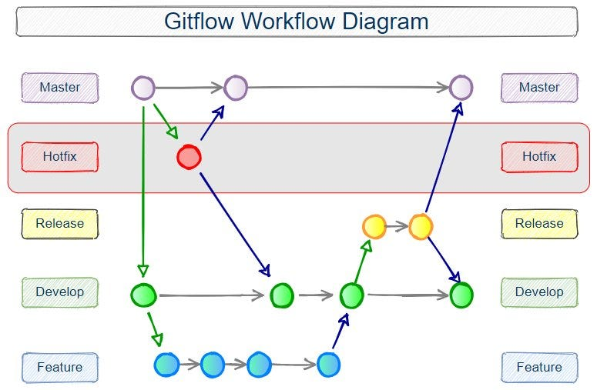
Git diagram

Slide 16
GitHub Desktop Example
Commands for git are pretty simple
GitHub Desktop more friendly for beginners
Git LFS can be cumbersome

Slide 17
Ripley’s restaurant – A very simple model
Ripley works 40 hours per week making hamburgers, hot dogs, and french fries. The net revenue and time to make for each of the items is in the table below.
What is Ripley’s profit-maximizing production choice?
Item | Revenue | Cost | Hours
Hamburger | 1.5 | 0.75 | 0.5
Hot dog | 0.75 | 0.1 | 0.2
French fries | 0.25 | 0.05 | 0.1

Slide 18
Ripley’s restaurant
Warning.. The images I’m about to show are disturbing

Slide 19
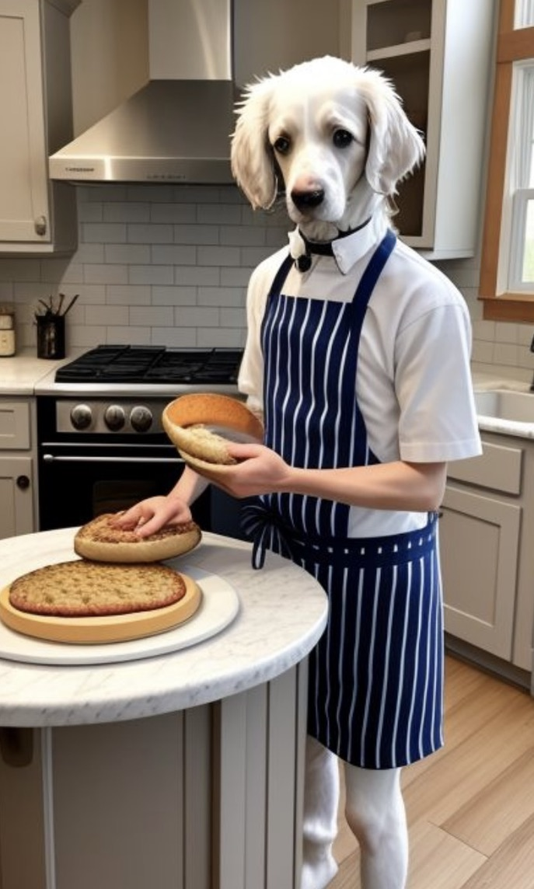
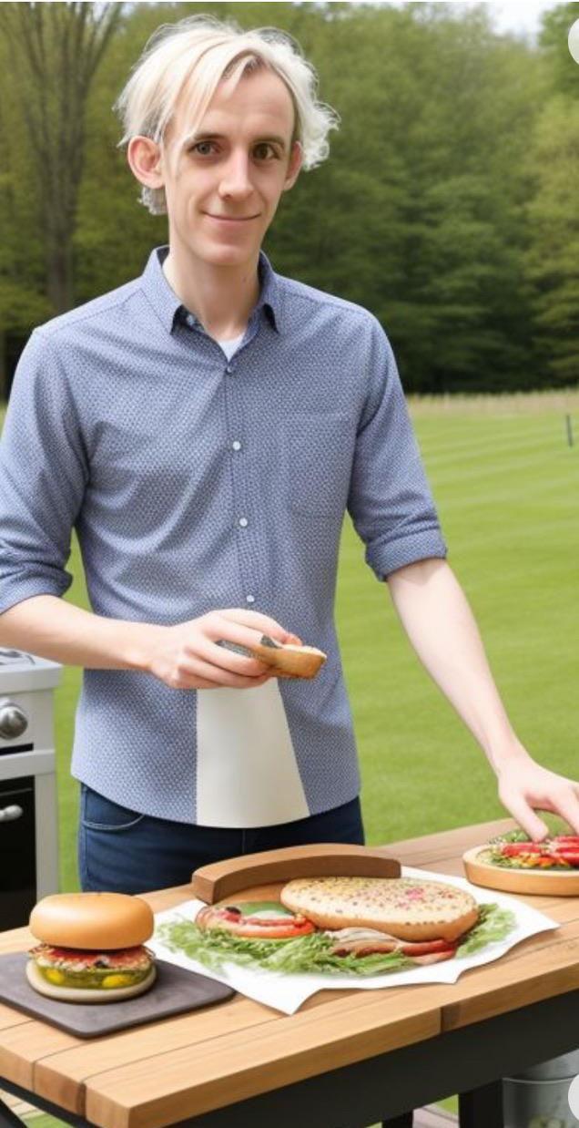
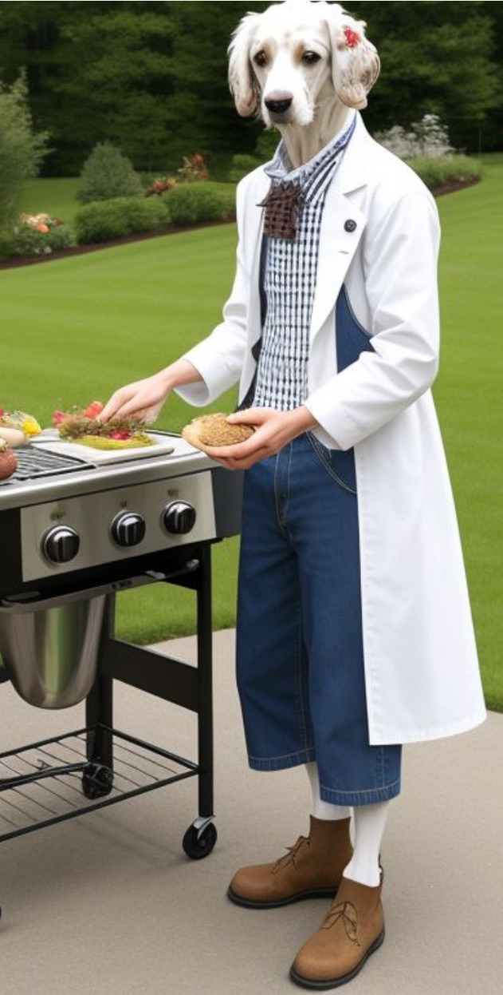
Ripley’s restaurant – visualized by (janky) AI

Slide 20
Writing a model
Always go in this order:
Sets/indices
Parameters
Variables
Objective function
Constraints
See explanation/examples in INFORMS (Grievel et al.) or CCS papers

Slide 21
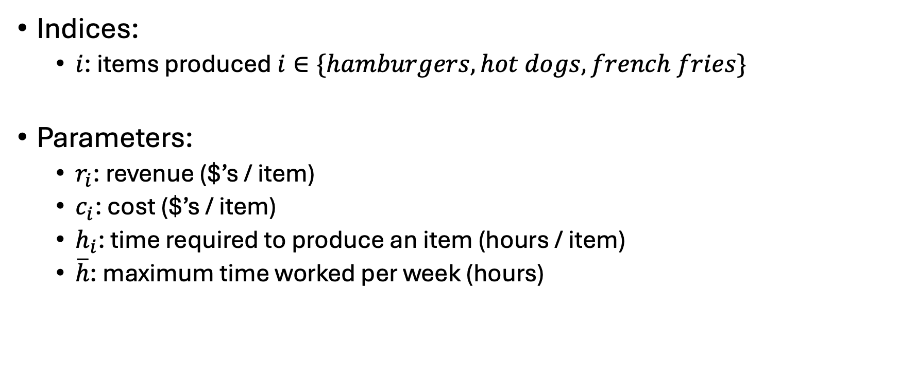
Ripley’s restaurant
Indices:
$i$: items produced $i∈\{hamburgers, hot dogs, french fries\}$
Parameters:
$r_{i}$: revenue ($’s / item)
$c_{i}$: cost ($’s / item)
$h_{i}$: time required to produce an item (hours / item)
$\overline{h}$: maximum time worked per week (hours)
Item | Revenue | Cost | Hours
Hamburger | 1.5 | 0.75 | 0.5
Hot dog | 0.75 | 0.1 | 0.2
French fries | 0.25 | 0.05 | 0.1

Slide 22
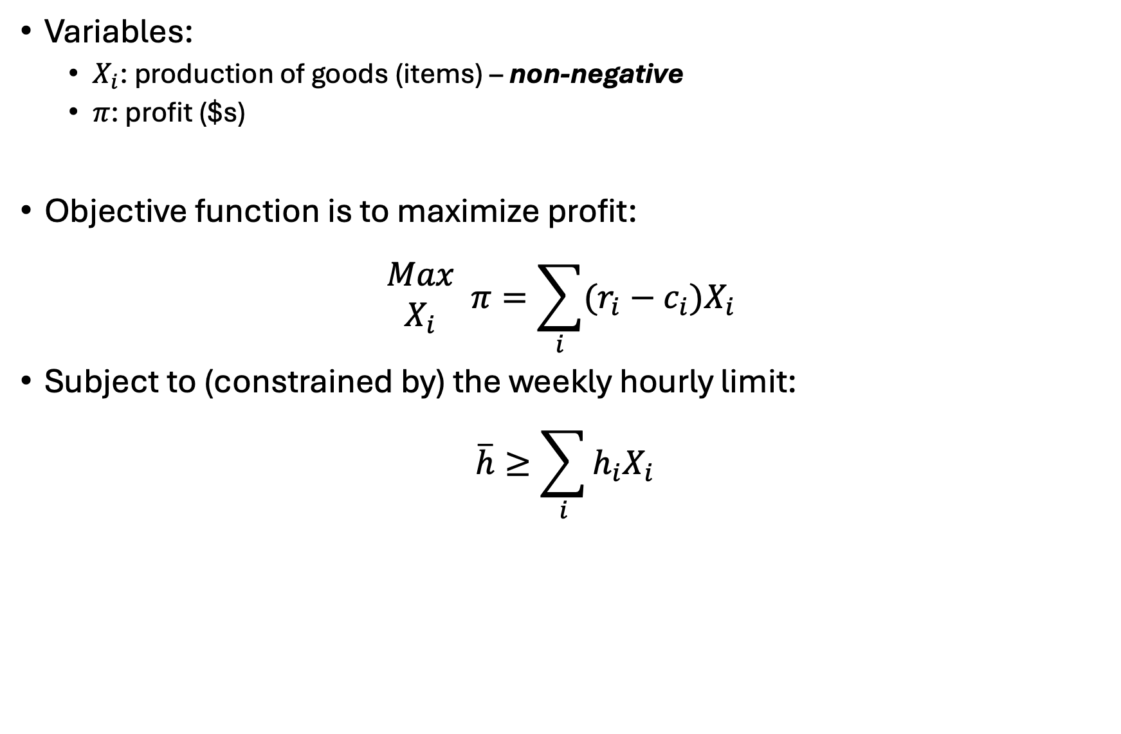
Ripley’s restaurant
Variables:
$X_{i}$: production of goods (items) – non-negative
$π$: profit ($s)
Objective function is to maximize profit:
$$\begin{matrix}Max \\ X_{i}\end{matrix} π=\sum_{i}{(r_{i}−c_{i})X_{i}}$$
Subject to (constrained by) the weekly hourly limit:
$$\overline{h}≥\sum_{i}{h_{i}X_{i}}$$

Slide 23
Ripley’s restaurant
Let’s code this up in GAMS…

Slide 24
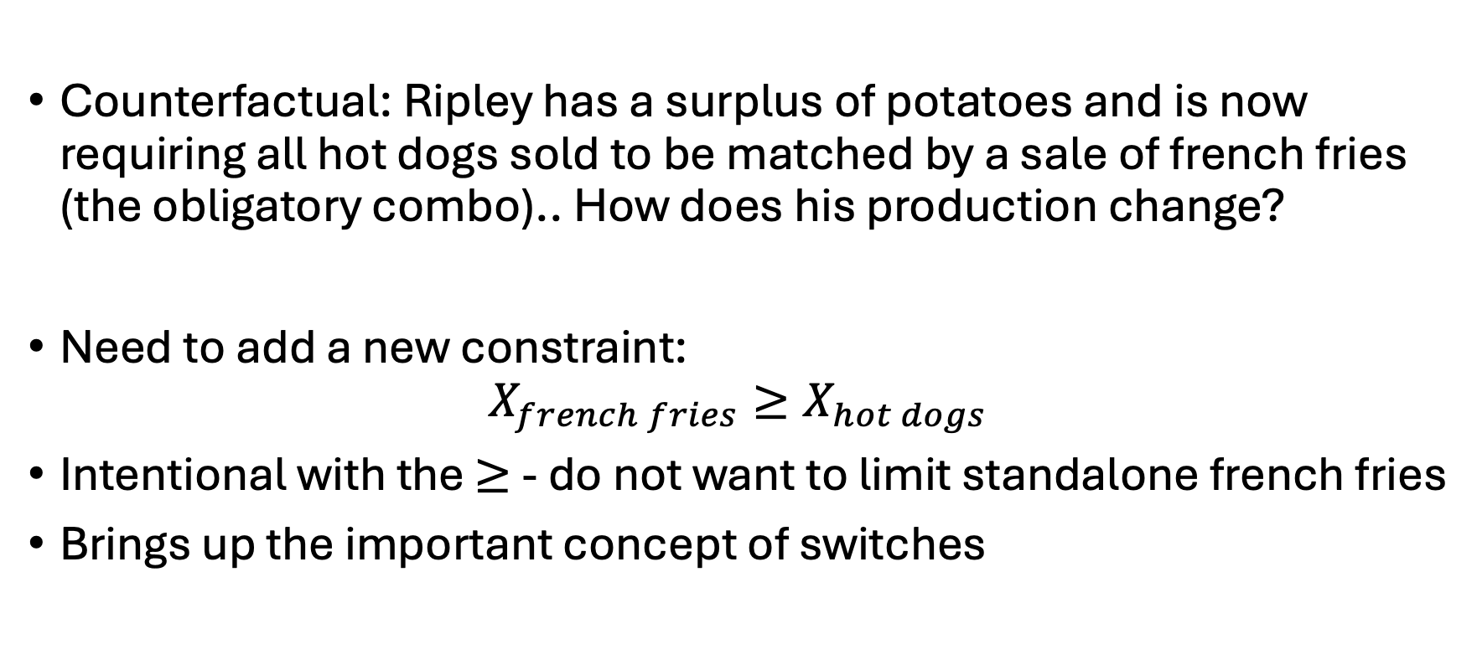
Ripley’s restaurant
Counterfactual: Ripley has a surplus of potatoes and is now requiring all hot dogs sold to be matched by a sale of french fries (the obligatory combo).. How does his production change?
Need to add a new constraint:
$$X_{french fries}≥X_{hot dogs}$$
Intentional with the $≥$ - do not want to limit standalone french fries
Brings up the important concept of switches

Slide 25
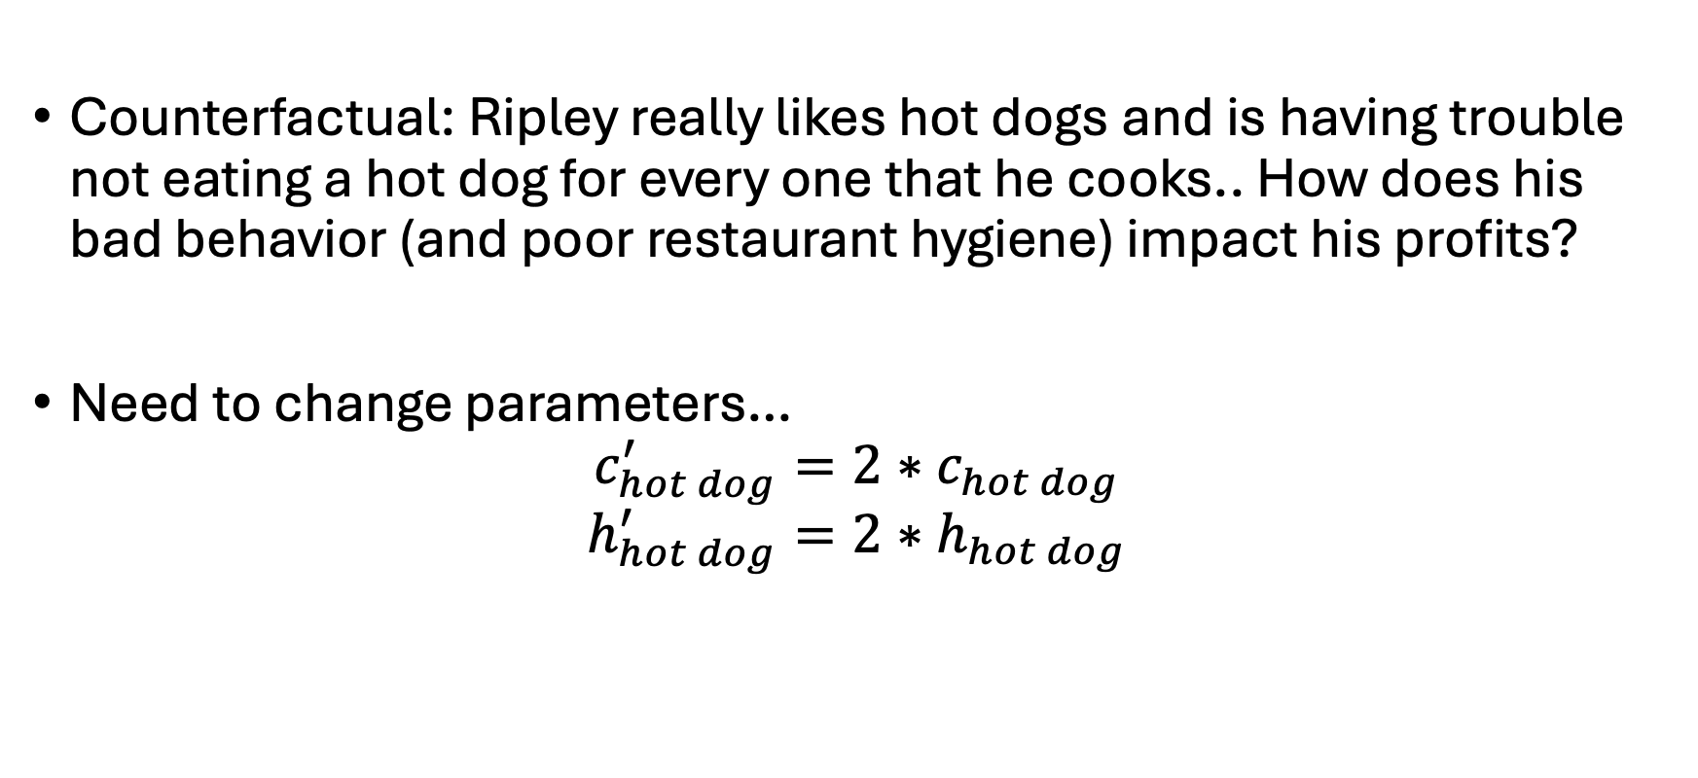
Ripley’s restaurant
Counterfactual: Ripley really likes hot dogs and is having trouble not eating a hot dog for every one that he cooks.. How does his bad behavior (and poor restaurant hygiene) impact his profits?
Need to change parameters…
$$c_{hot dog}^{′}=2∗c_{hot dog}$$
$$h_{hot dog}^{′}=2∗h_{hot dog}$$

Slide 26
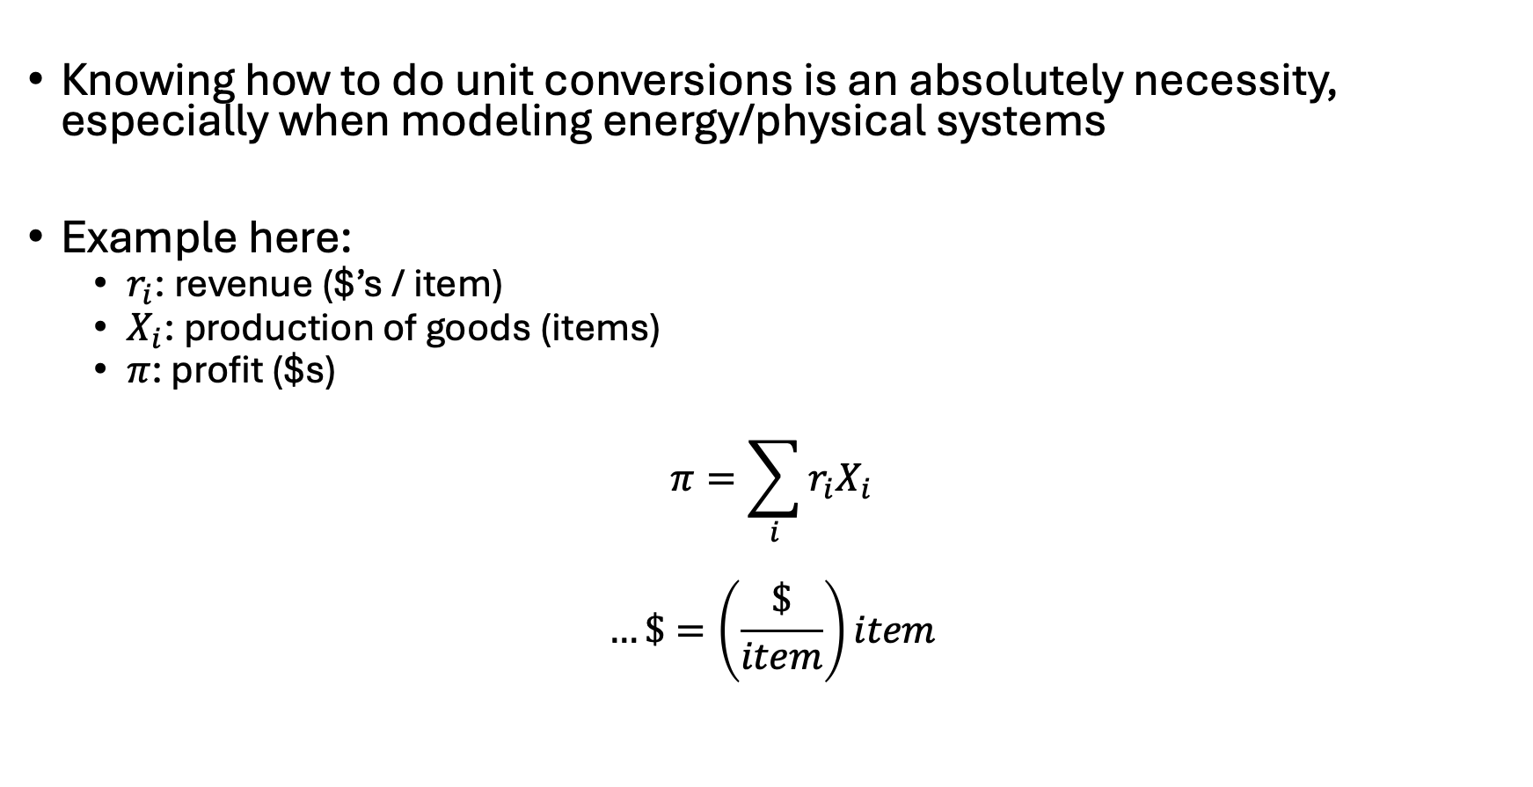
Notes on unit conversions
Knowing how to do unit conversions is an absolutely necessity, especially when modeling energy/physical systems
Example here:
$r_{i}$: revenue ($’s / item)
$X_{i}$: production of goods (items)
$π$: profit ($s)
$$π=\sum_{i}{{r_{i}X}_{i}}$$
$$…\$=\left(\frac{\$}{item}\right)item$$

