Slide 1
EBGN645: Day 7

Slide 2
Questions, notes
Proposal due today at 11AM
Office hours tomorrow 10-noon
Two-part homework sent

Slide 3
Agenda
Practicing GAMS/GitHub
(Very) Simple examples
Review: sparse matrix construction
$ operations on equations, summations, …
Ursula’s utility
Introducing time via Franzi’s Forestry
Elmo’s electricity
Saves/restarts
Alongside:
Piece-wise linear approximation
Hotelling model of non-renewable resources
Renewable resources modeling:
Fisheries management
(actual) Forestry modeling via Faustman
Non-linear models

Slide 4
Writing a model
Always go in this order:
Sets/indices
Parameters
Variables
Objective function
Constraints
See explanation/examples in INFORMS (Grievel et al.) or CCS papers

Slide 5

Example 3: Franz Forestry
Franz owns land that produces lumber. Franz makes $100 net profit for every tree cut down. There is an initial stand of 100 trees and the trees grow at 1%* per year. Franz has a discount rate of 2%*. What is Franz profit-maximizing harvesting behavior?
*: Varied in counterfactuals

Slide 6
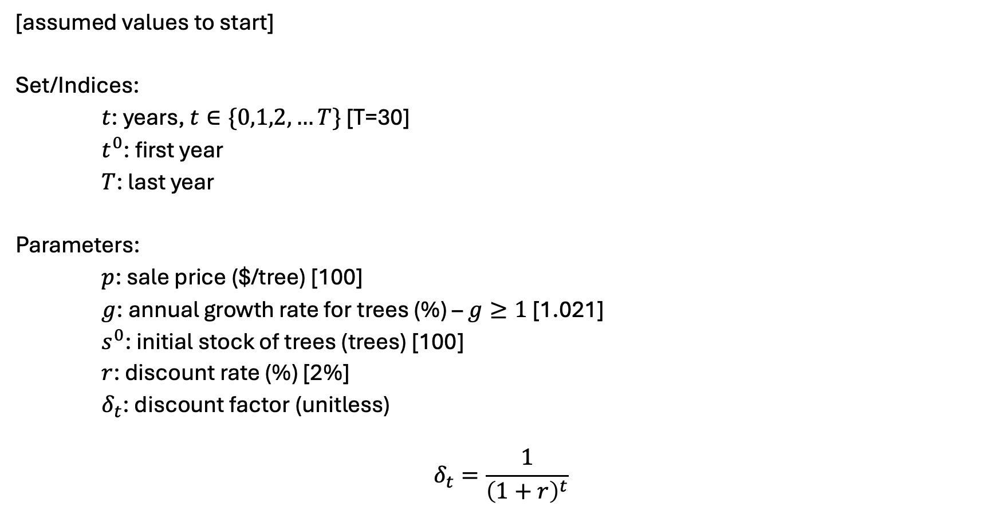
Franz Forestry [I] – sets and parameters
[assumed values to start]
Set/Indices:
$t$: years, $t∈\{0,1,2,…T\}$ [T=30]
$t^{0}$: first year
$T$: last year
Parameters:
$p$: sale price ($/tree) [100]
$g$: annual growth rate for trees (%) – $g≥1$ [1.021]
$s^{0}$: initial stock of trees (trees) [100]
$r$: discount rate (%) [2%]
$δ_{t}$: discount factor (unitless)
$$δ_{t}=\frac{1}{{\left(1+r\right)}^{t}}$$

Slide 7
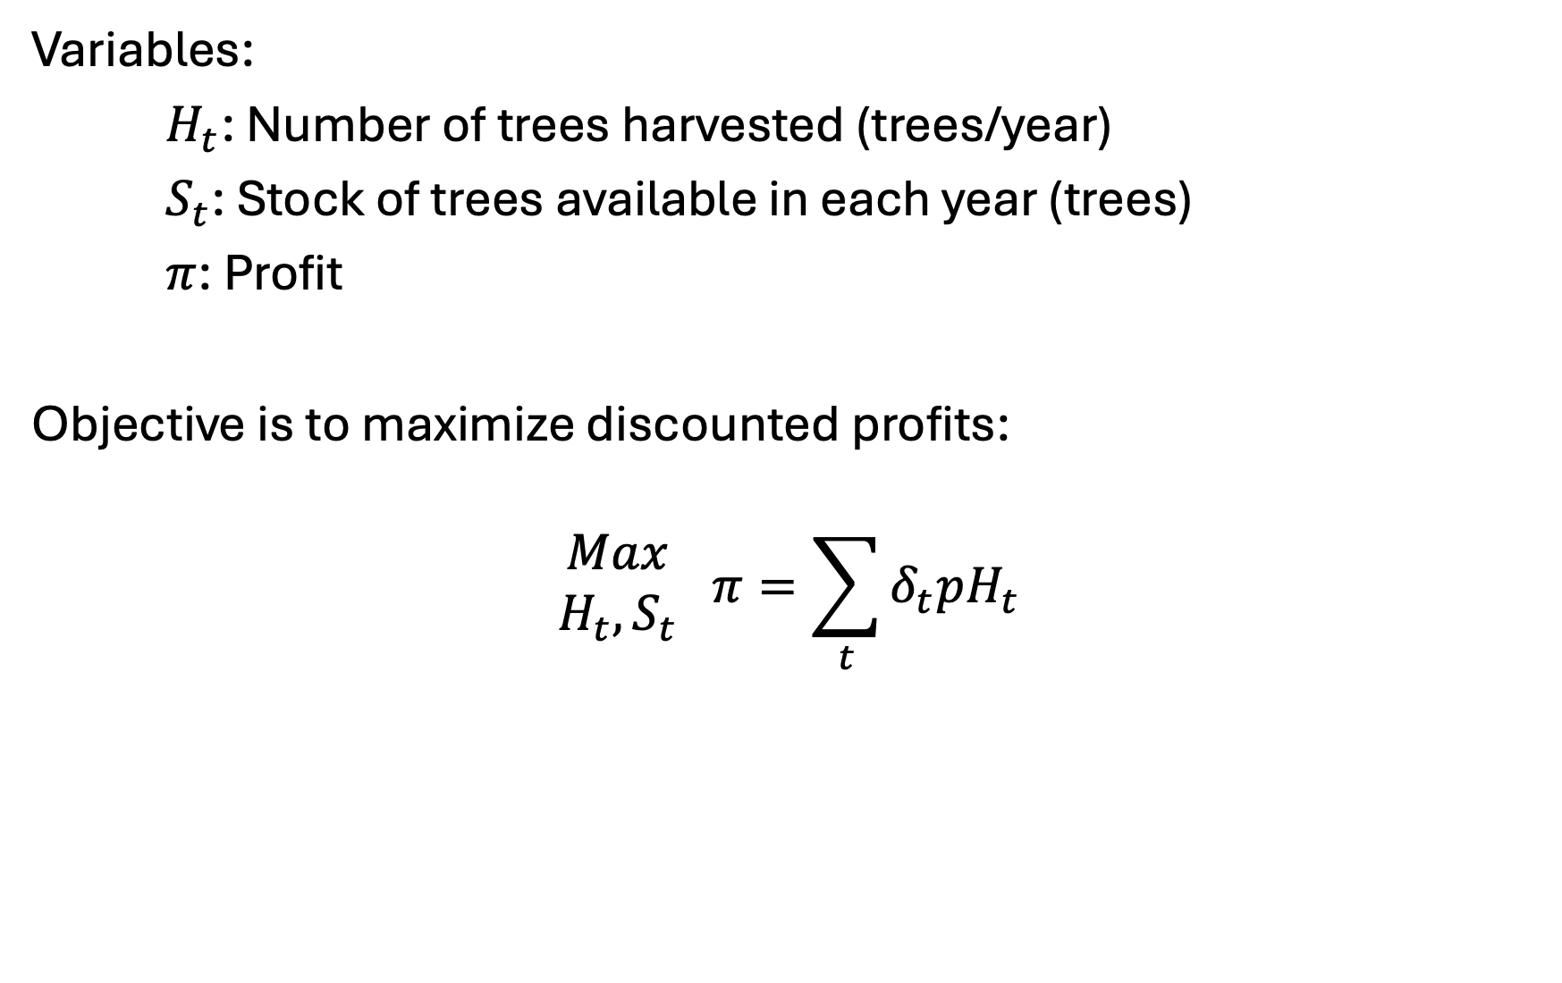
Franz Forestry [II] – variables and objective
Variables:
$H_{t}$: Number of trees harvested (trees/year)
$S_{t}$: Stock of trees available in each year (trees)
$π$: Profit
Objective is to maximize discounted profits:
$$\begin{matrix}Max \\ H_{t},S_{t}\end{matrix} π=\sum_{t}{δ_{t}pH_{t}}$$

Slide 8
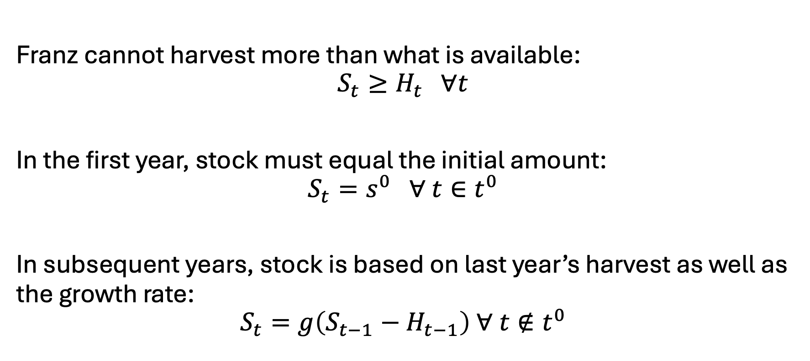
Franz Forestry [III] - constraints
Franz cannot harvest more than what is available:
$$S_{t}≥H_{t} ∀t$$
In the first year, stock must equal the initial amount:
$$S_{t}=s^{0} ∀ t∈t^{0}$$
In subsequent years, stock is based on last year’s harvest as well as the growth rate:
$$S_{t}=g\left(S_{t−1}−H_{t−1}\right) ∀ t∉t^{0}$$

Slide 9
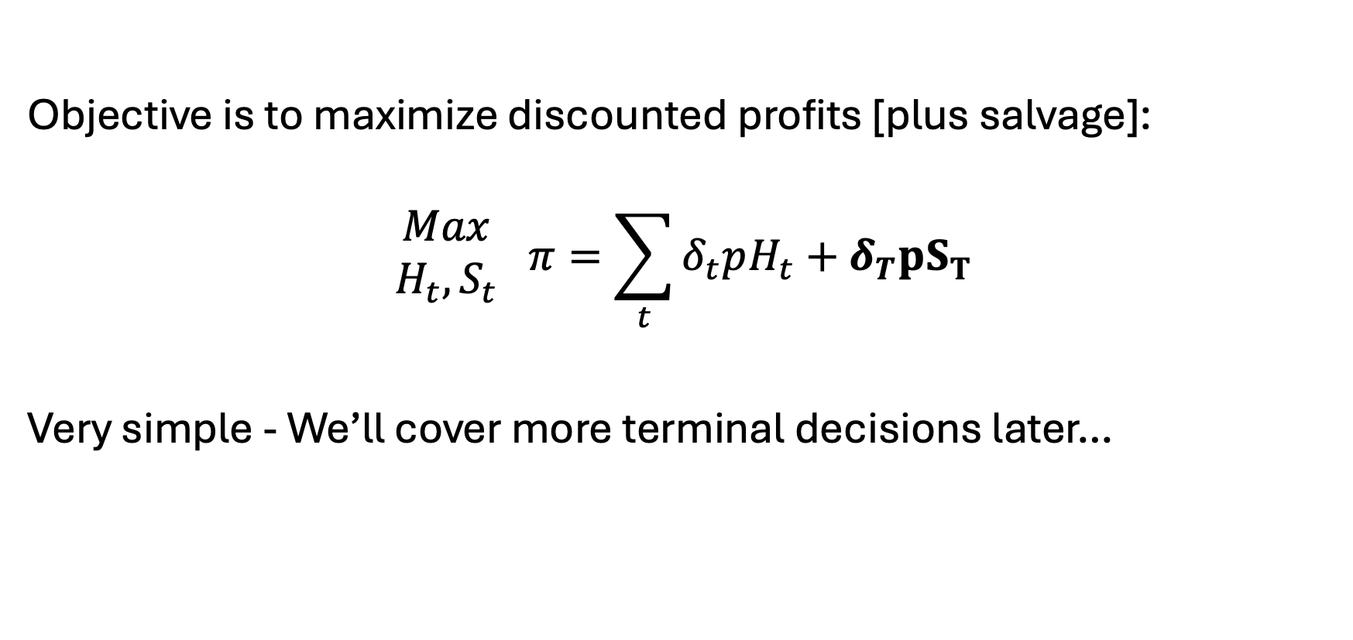
Salvage value?
Objective is to maximize discounted profits [plus salvage]:
$$\begin{matrix}Max \\ H_{t},S_{t}\end{matrix} π=\sum_{t}{δ_{t}pH_{t}}+δ_{T}pS_{T}$$
Very simple - We’ll cover more terminal decisions later…

Slide 10

Example 4: Elmo’s Electricity
Elmo runs a small electricity utility. He has three electricity facilities: coal, gas, and wind. Each technology has its own cost and capacity. He must meet the hourly demand of his small town. What is Elmo’s cost-minimizing set of operational decisions?

Slide 11
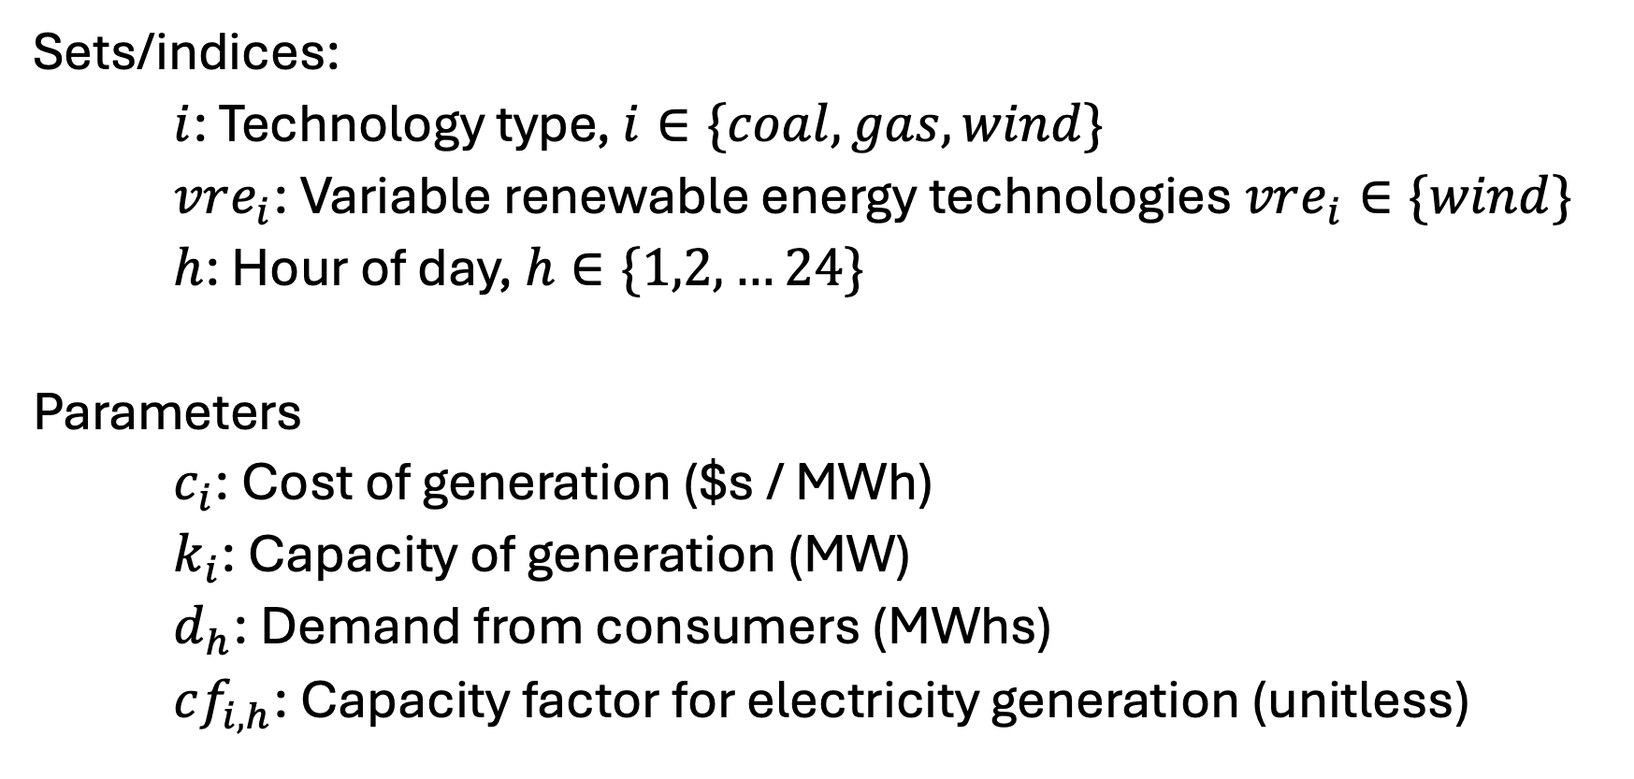
Elmo’s Electricity [I] – Sets and parameters
Sets/indices:
$i$: Technology type, $i∈\{coal, gas, wind\}$
$vre_{i}$: Variable renewable energy technologies $vre_{i}∈\{wind\}$
$h$: Hour of day, $h∈\{1,2,…24\}$
Parameters
$c_{i}$: Cost of generation ($s / MWh)
$k_{i}$: Capacity of generation (MW)
$d_{h}$: Demand from consumers (MWhs)
$cf_{i,h}$: Capacity factor for electricity generation (unitless)

Slide 12
Elmo’s electricity [II] - data
See spreadsheet - EBGN645_Data_Day3.xlsx

Slide 13
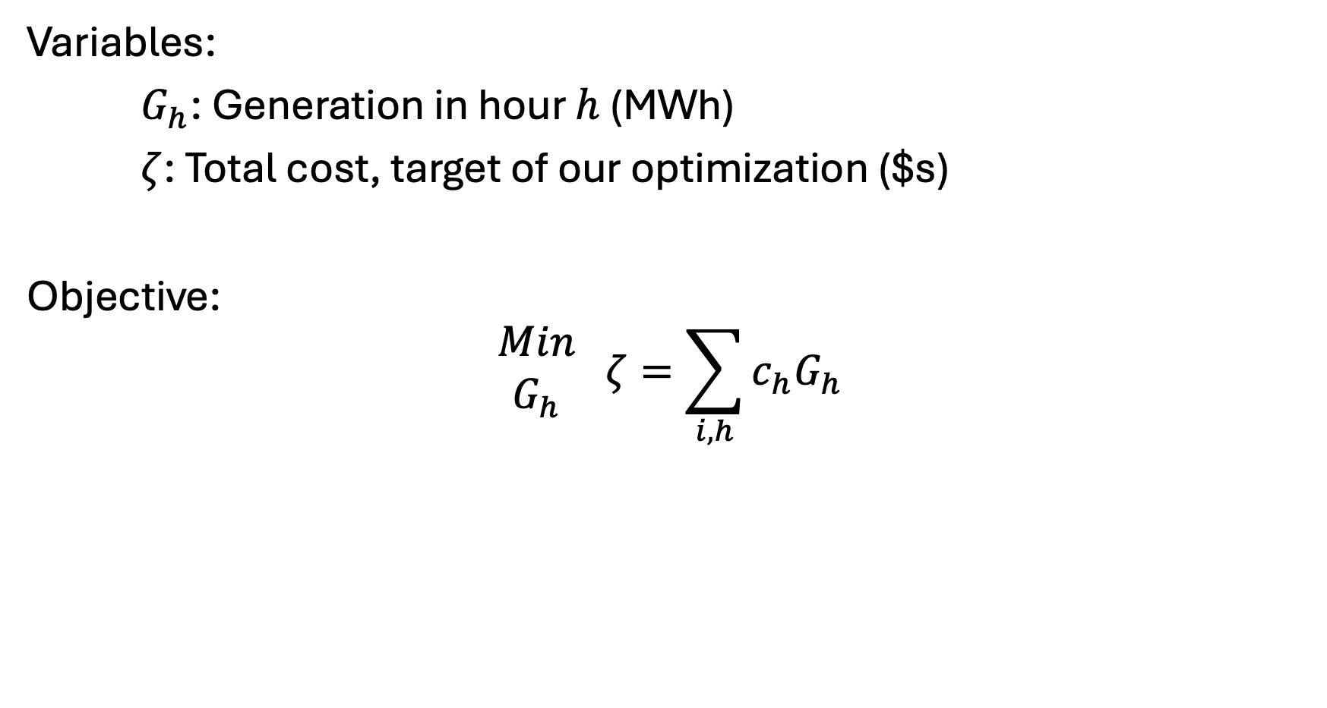
Elmo’s Electricity [III] – Variables and objective
Variables:
$G_{h}$: Generation in hour $h$ (MWh)
$ζ$: Total cost, target of our optimization ($s)
Objective:
$$\begin{matrix}Min \\ G_{h}\end{matrix} ζ=\sum_{i,h}{c_{h}G_{h}}$$

Slide 14
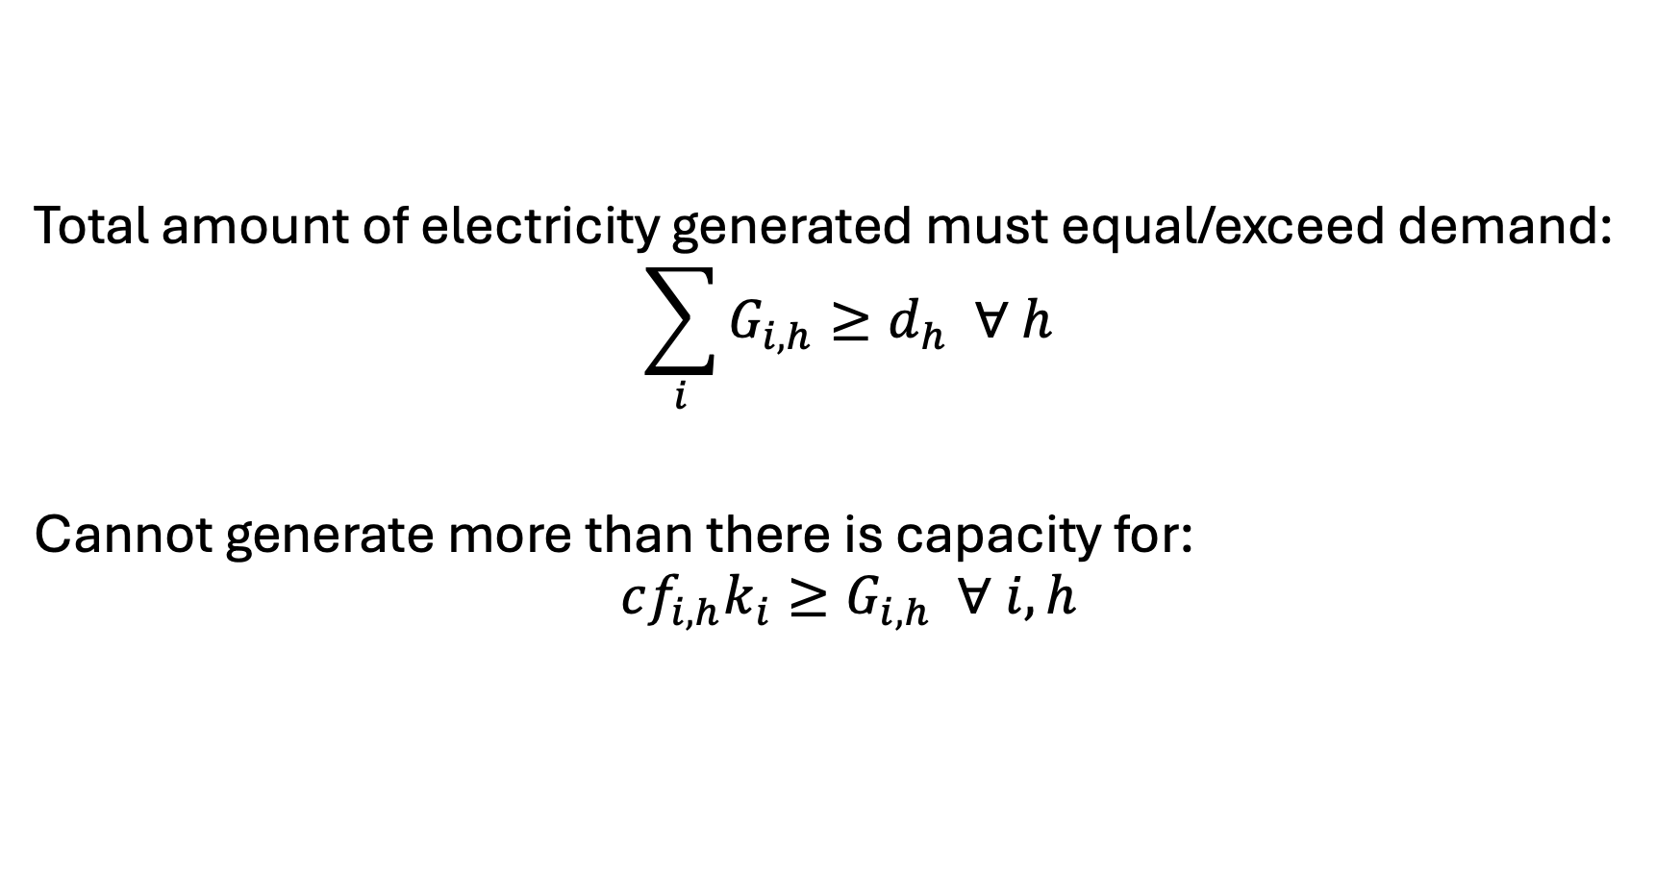
Elmo’s Electricity [IV] - Constraints
Total amount of electricity generated must equal/exceed demand:
$$\sum_{i}{G_{i,h}}≥d_{h} ∀ h$$
Cannot generate more than there is capacity for:
$$cf_{i,h}k_{i}≥G_{i,h} ∀ i,h$$

Slide 15
Now… Models of resource management
Non-renewable resource management via Hotelling
Renewable resource management
Fisheries
Forestry

Slide 16
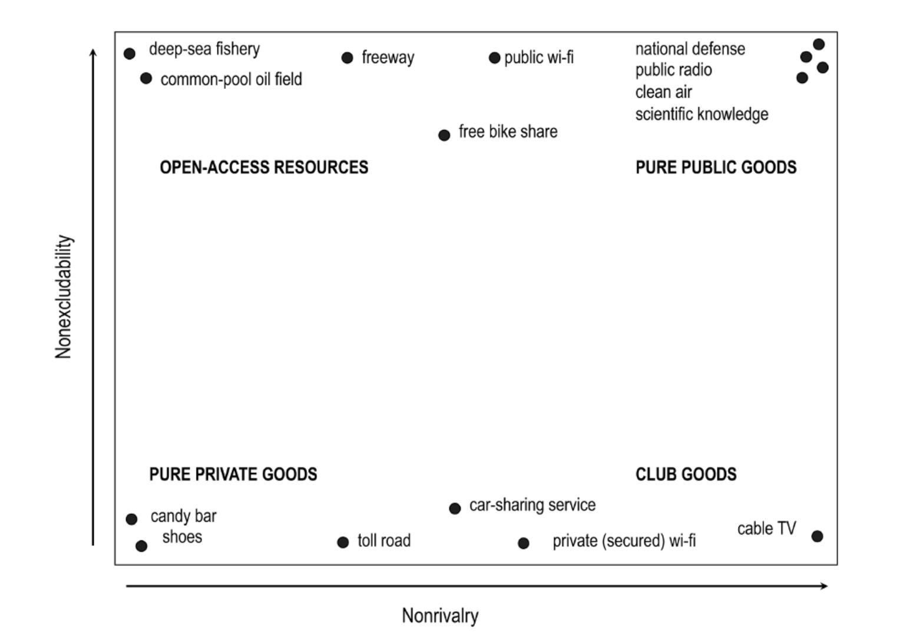
OARs and PPGs
Main focus is now on…
Private goods
Privately-owned mine, an oil-field, ..
Personal farm
Open access resources
Common-pool oil field
Fisheries
Groundwater
Forests
Require different management strategies

Slide 17
Three models for resources management
Hotelling model (non-renewable resources)
How resource owners decide extraction rates
Main point: price of resource should rise at the rate of interest
Policy relevance: how do subsidies and regulation alter extraction paths?
Gordon-Schaefer model (for Fisheries Management)
Models relationships between fishing effort, stocks, and sustainable harvest levels
Main point: Maximum Sustainable Yield determines largest harvest w/o depleting fish stocks
Policy relevance: quotas, property rights
Faustmann model (for Forestry management)

Slide 18
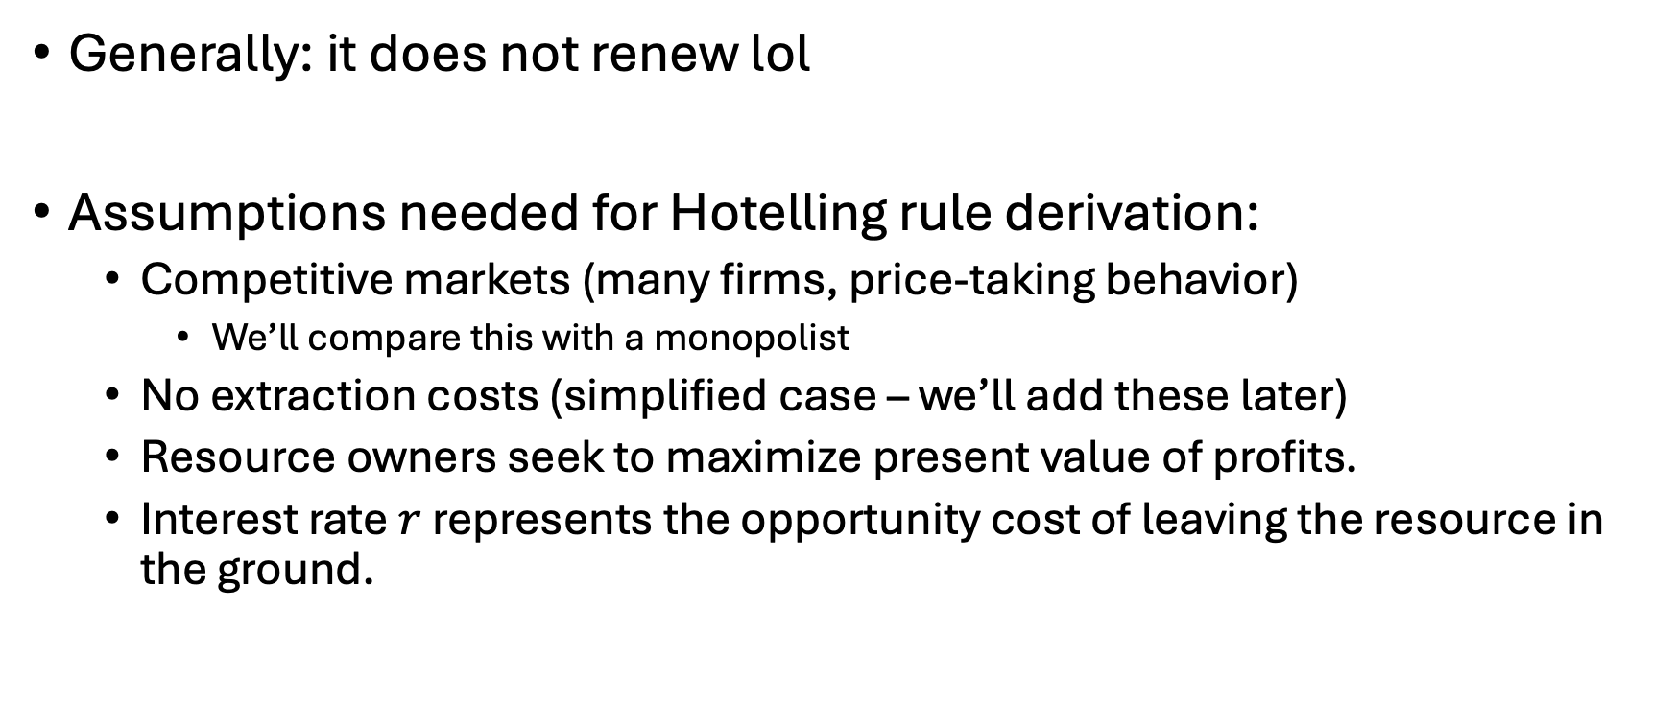
Characteristics of non-renewable resources
Generally: it does not renew lol
Assumptions needed for Hotelling rule derivation:
Competitive markets (many firms, price-taking behavior)
We’ll compare this with a monopolist
No extraction costs (simplified case – we’ll add these later)
Resource owners seek to maximize present value of profits.
Interest rate $r$ represents the opportunity cost of leaving the resource in the ground.

Slide 19
Prompt
If you owned an exhaustible resource (oil field, or coal mine, or lithium mine, or natural gas well, …), how would you choose when to extract and how much?

Slide 20
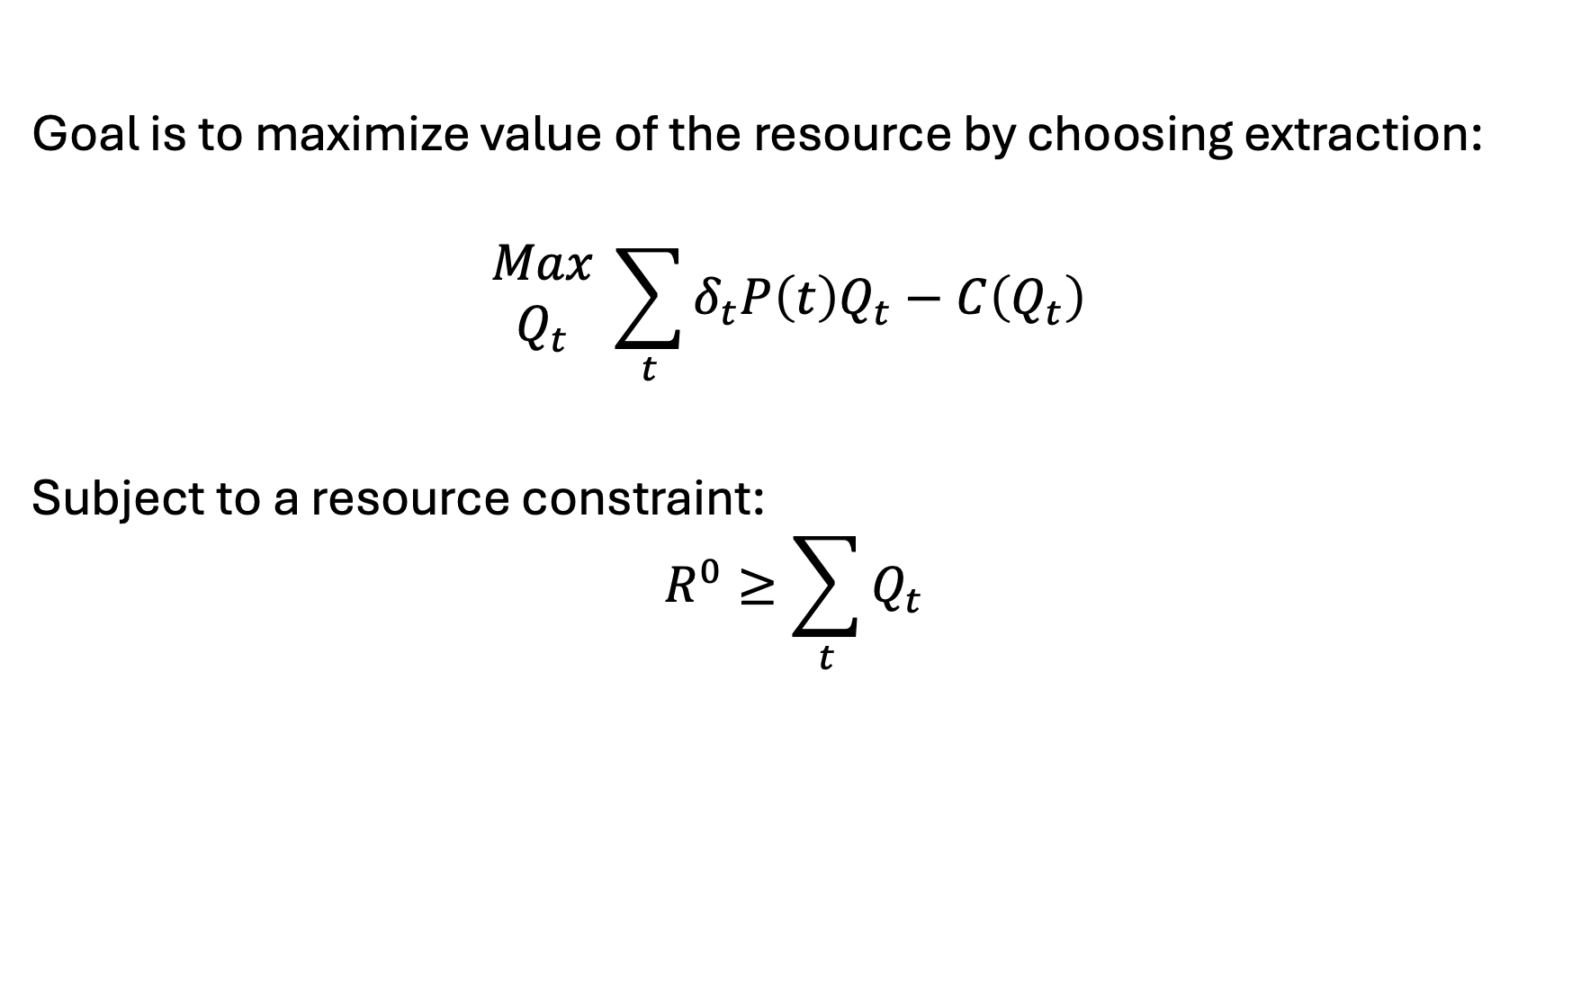
Review of Hotelling’s model
Goal is to maximize value of the resource by choosing extraction:
$$\begin{matrix}Max \\ Q_{t}\end{matrix} \sum_{t}{δ_{t}P\left(t\right)Q_{t}−C\left(Q_{t}\right) }$$
Subject to a resource constraint:
$$R^{0}≥\sum_{t}{Q_{t}}$$

Slide 21
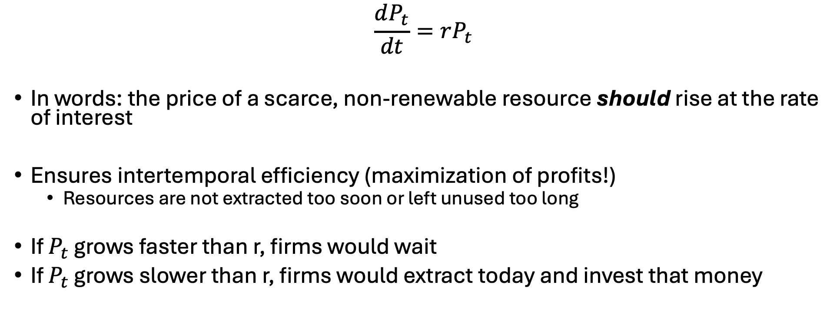
Importance of Hotelling’s rule
$$\frac{dP_{t}}{dt}=rP_{t}$$
In words: the price of a scarce, non-renewable resource should rise at the rate of interest
Ensures intertemporal efficiency (maximization of profits!)
Resources are not extracted too soon or left unused too long
If $P_{t}$ grows faster than r, firms would wait
If $P_{t}$ grows slower than r, firms would extract today and invest that money

Slide 22
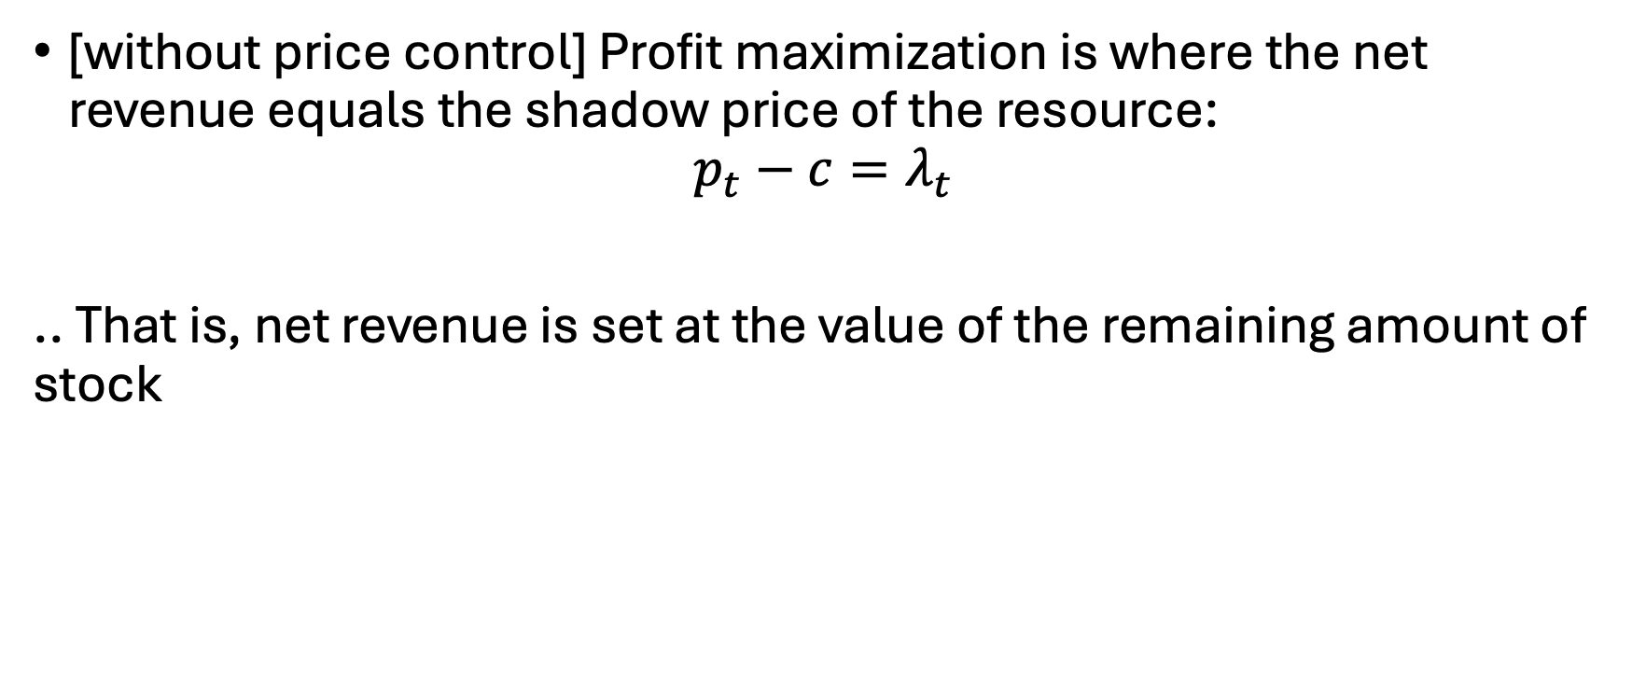
Another important rule
[without price control] Profit maximization is where the net revenue equals the shadow price of the resource:
$$p_{t}−c=λ_{t}$$
.. That is, net revenue is set at the value of the remaining amount of stock

Slide 23
New Prompt
If you were the only one that owned an exhaustible resource (oil field, or coal mine, or lithium mine, or natural gas well, …), how would you choose when to extract and how much?

Slide 24
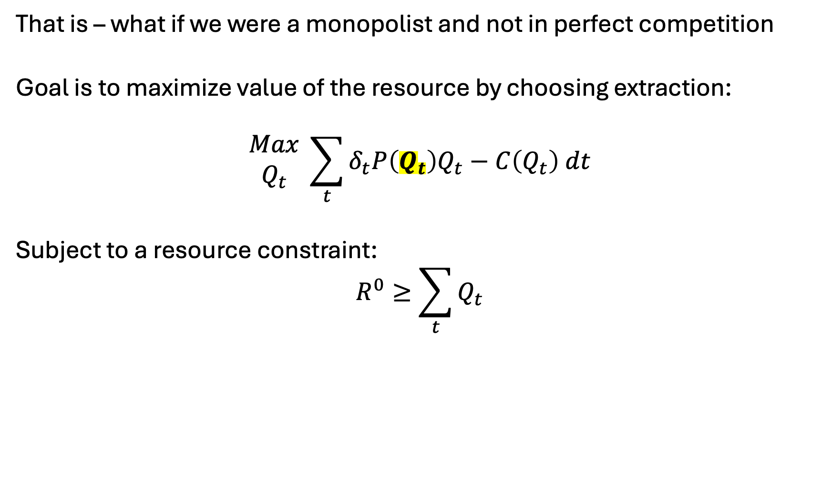
Now – what if we had price control?
That is – what if we were a monopolist and not in perfect competition
Goal is to maximize value of the resource by choosing extraction:
$$\begin{matrix}Max \\ Q_{t}\end{matrix} \sum_{t}{δ_{t}P\left(Q_{t}\right)Q_{t}−C\left(Q_{t}\right) dt}$$
Subject to a resource constraint:
$$R^{0}≥\sum_{t}{Q_{t}}$$

Slide 25
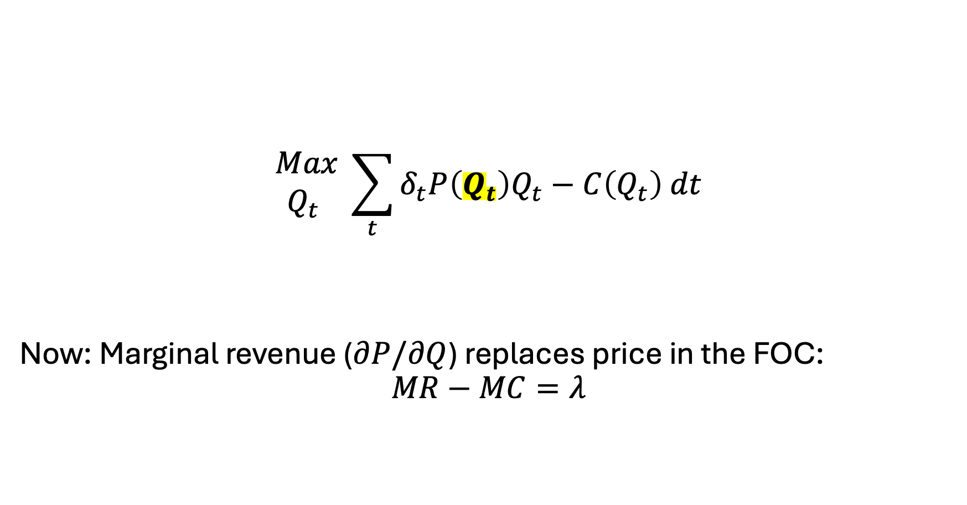
Monopolistic Resource Extraction
$$\begin{matrix}Max \\ Q_{t} \end{matrix} \sum_{t}{δ_{t}P\left(Q_{t}\right)Q_{t}−C\left(Q_{t}\right) dt}$$
Now: Marginal revenue ($∂P/∂Q$) replaces price in the FOC:
$$MR−MC=λ$$

Slide 26
Bigger picture of Hotelling and non-renewable resource extraction
Aspect | PC | Monopoly
Price Path | Rises at r | Rises slower than r
Extraction | Faster | Slower
Initial Price | Lower | Higher
Resource lifetime | Shorter | Longer
Extraction | Complete | May not fully exhaust resource

Slide 27

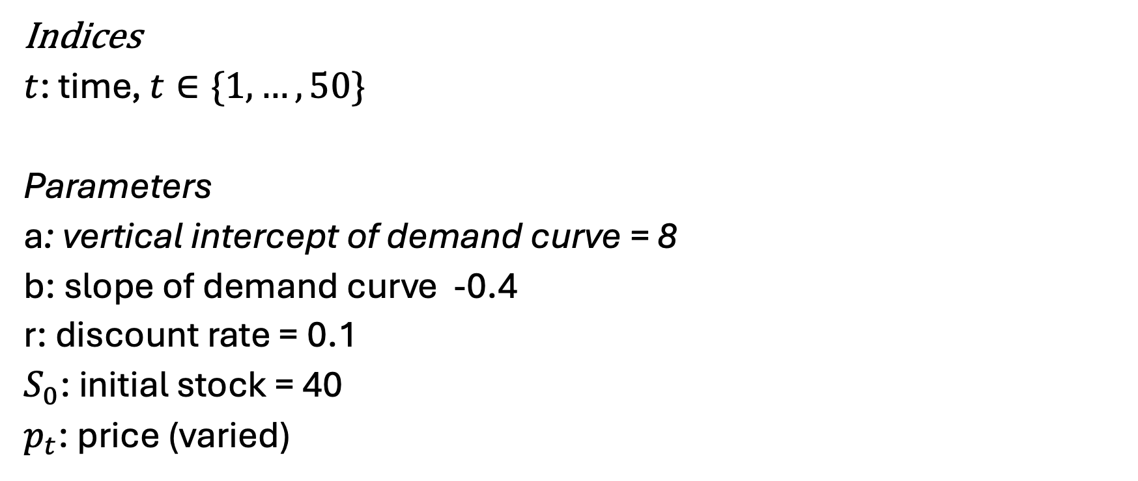
Let’s code up the models in GAMS
Variables
$q_{t}$: quantity extracted at time t
$p_{t}$: price at time t
$λ$: marginal cost
$π$: profit
Indices
$t$: time, $t∈\{1,…,50\}$
Parameters
a: vertical intercept of demand curve = 8
b: slope of demand curve -0.4
r: discount rate = 0.1
$S_{0}$: initial stock = 40
$p_{t}$: price (varied)

Slide 28
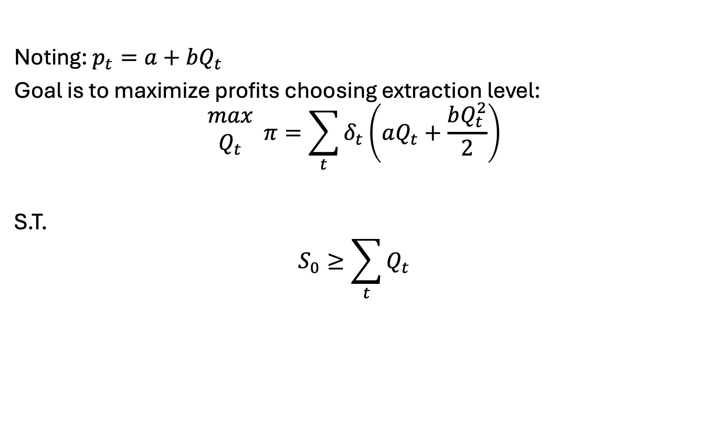
GAMS model, continued
Noting: $p_{t}=a+bQ_{t}$
Goal is to maximize profits choosing extraction level:
$$\begin{matrix}max \\ Q_{t}\end{matrix} π=\sum_{t}{δ_{t}\left(aQ_{t}+\frac{bQ_{t}^{2}}{2}\right)}$$
S.T.
$$S_{0}≥\sum_{t}{Q_{t}}$$

