Slide 1
Capstone Challenge Week Presentation
Shane Steer

Slide 2
Background Reading
During the summer I did background reading about different Hypertext Game Tool that already exist out there. I also received some material from my supervisor Prof. Richard Bartle. I will be listing out some of the information that I used to carry out my capstone project challenge week in the next few slides.

Slide 3
Since I am making a hypertext game tool, I did some research about hypertext game tools that already exist out there. Some of which were Twine, Quest, Adrift, Inform, Squiffy and Inklewriter. The website I visited had a lot of videos on how to use these tools and I got some ideas from them when trying to create the user interface for my project. For example, the user interface I created for my project was inspired by Quest where the user can just enter the name of the node, the story and the choices in the space provided then saving it instead of having to learn a new language when trying to create nodes.
MUO. 2021. How to Make Your Own Text Adventure Games: 7 Tools. [online] Available at: <https://www.makeuseof.com/tag/3-tools-to-create-your-own-text-adventure-games/> [Accessed 14 October 2021].
Fernandez, V., 2021. Tools to make narrative games. [online] Vagrant Cursor. Available at: <https://clarafv.com/2018/01/02/tools-to-make-narrative-games/> [Accessed 14 October 2021].
Paul, J., n.d. 5 Open Source Tools to Create Interactive Fiction - It's FOSS. [online] It's FOSS. Available at: <https://itsfoss.com/create-interactive-fiction/> [Accessed 14 October 2021].

Slide 4
I also read a design document sent to me by my supervisor about a hypertext game tool which he had created before and it was very informative. It gave me ideas like adding in sounds and images to make the hypertext game look better when it is being played.
Bartle, R., 2011. eHyperTool Design Specification. p.32.
Another piece of material that I received from my supervisor was a document about the treaty of Babel tool. It was also informative and complicated but I understood how the tool worked and may implement some of the things I read in the future. They use ID’s for nodes so that it is easier to locate them.
Babel.ifarchive.org. 2021. The Treaty of Babel. [online] Available at: <https://babel.ifarchive.org/babel_rev10.html#the-babel-tool> [Accessed 14 October 2021].

Slide 5
I also read a book online about the fundamentals of game design. I read about the storytelling aspect of the book as I will have to create a hypertext game using the tool I am creating. It says that players like story endings that reflect the dramatic choices that they have made while playing a game. The book says that we should create multiple endings to show the consequences of these players actions throughout the duration of the game.
Adams, E., 2021. Fundamentals of Game Design. [online] Google Books. Available at: <https://books.google.com.my/books?id=Lm1jAgAAQBAJ&pg=PA242&lpg=PA242&dq=building+a+hypertext+game+tool&source=bl&ots=7gGHKrq30d&sig=ACfU3U1i2IV7EwHA_rUYrY7jBiaoUbzowg&hl=en&sa=X&ved=2ahUKEwiU3L6zo7zyAhVfwjgGHXmeCaAQ6AF6BAgREAM#v=onepage&q=building%20a%20hypertext%20game%20tool&f=false> [Accessed 14 October 2021].

Slide 6
Project objectives
I have created main user interfaces for the project. I will have to then work on the back end stuff for the project like reading in and loading files so that they can be displayed on the UI. I will also have to figure out how to connect the nodes to each other once they have been created.
I did create a small hypertext game during the summer holidays that I may use to try and figure these out although it was not created using a hypertext game tool.
Hopefully when these are done, I will be able to create a short game in time for the oral interview.

Slide 7
Technical Achievements
While carrying out this challenge week, I did achieve most of what I wanted to which was creating the necessary UI for this project. I did face a few problem which I will list out below.

Slide 8
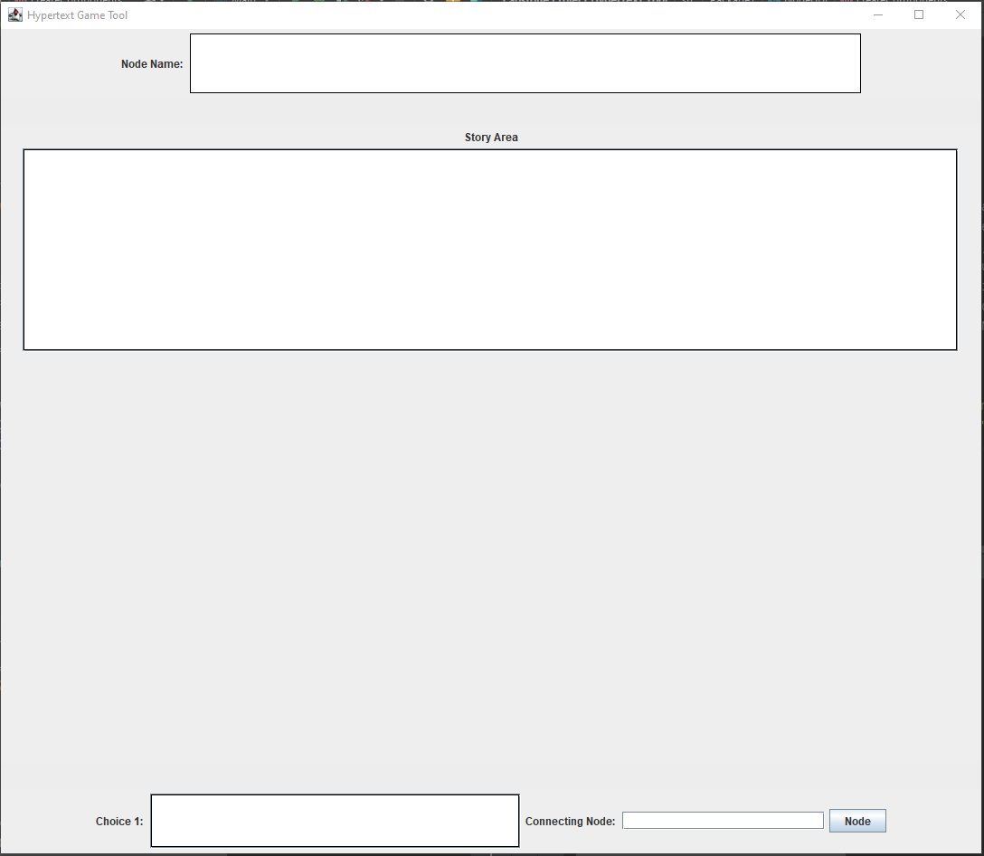
Story Area Editor GUI
While creating the graphical GUI for the main story area editor, I had encountered a few problems. The main problem was positioning the different components where I wanted them to be. I had to try out different layout managers such as Border Layout, Grid Layout and finally Box Layout.
Before experimenting with these different layout managers, I just tried to add in components using individual Jpanels and setting their bounds on the screen. It worked but then I found out that I could not add the scroll function to a text area if I did it this way and decided to look for other options.
While using Border Layout, I managed to get some of the components in the positions I wanted but slowly came to realise that since it only had 4 borders which are North, South, East and West, I could not add all my components in. Only one choice could be added in as shown in the image below.

Slide 9
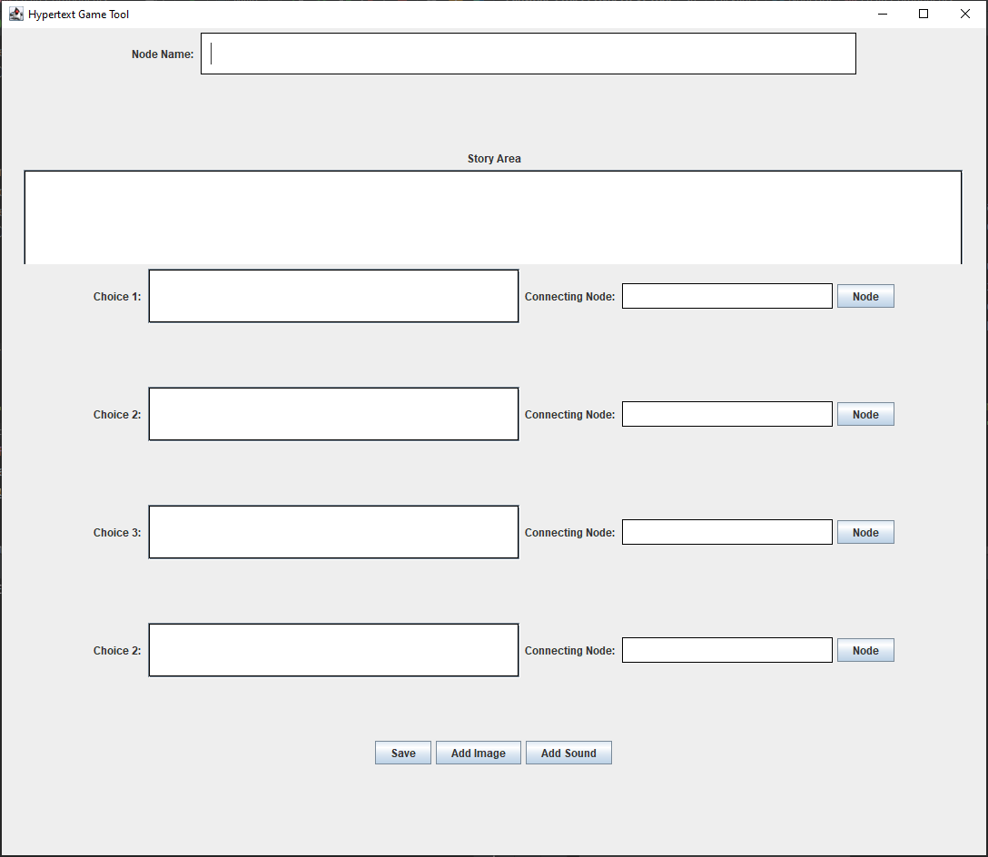
While using Grid Layout, I managed to get all the components in the positions I wanted them to be but the problem with Grid Layout is that each grid has a set size and cannot be adjusted according to your preference. This made it had as the text area for the story editing section was cut in half and did not display fully as shown below.

Slide 10
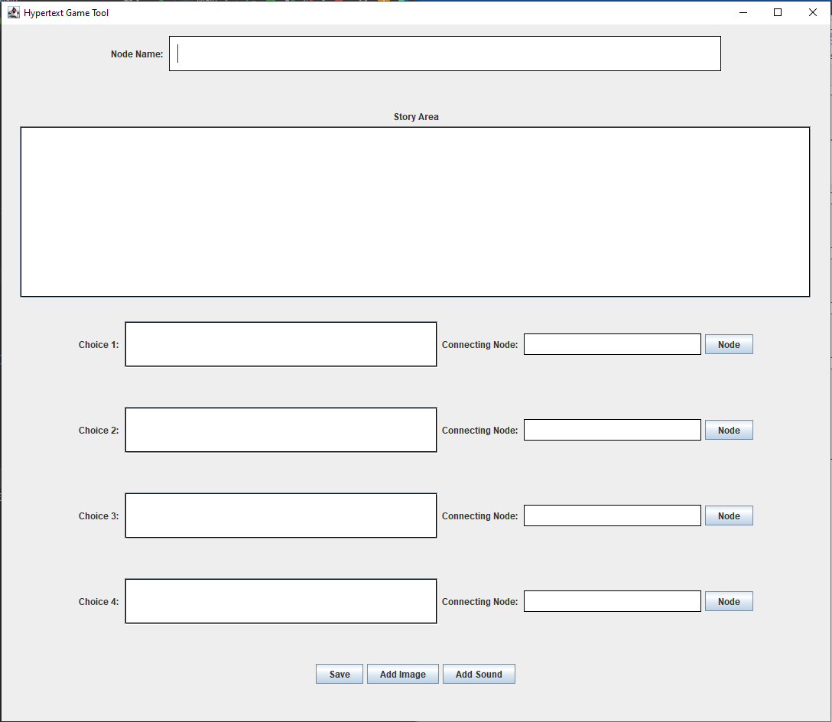
While using Box Layout, I managed to get all the components in the positions I wanted them to be with proper spacing in between them. The thing with Box Layout is that it allows you to just keep adding components in vertically down the GUI window using BoxLayout.PAGE_AXIS. I then used a Flow Layout to add the choice components in horizontally which the resulted in the GUI window shown below.

Slide 11
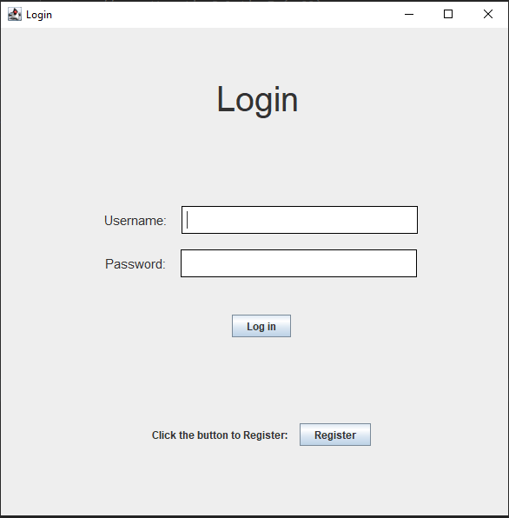
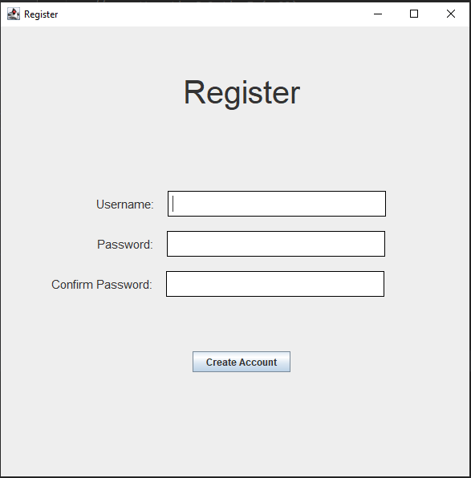
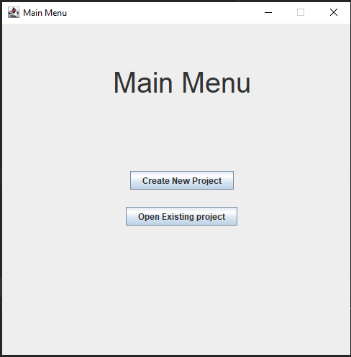
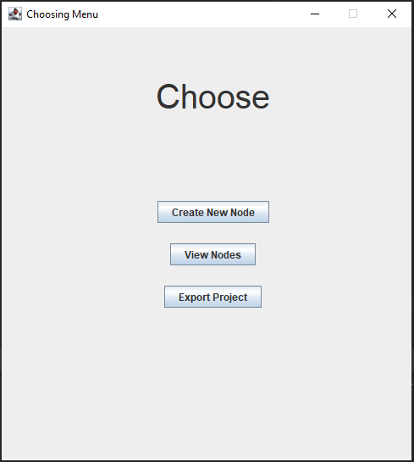
These are the rest of the GUI’s that I created during this week

Slide 12
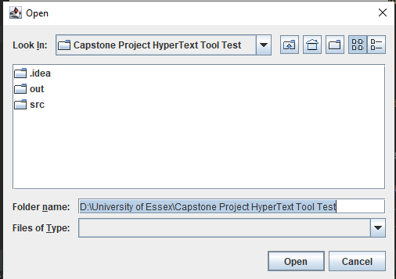
Other technical achievements that I achieved this week were just simple writing to file and file saving and also experimenting with jFilechooser.

Slide 13
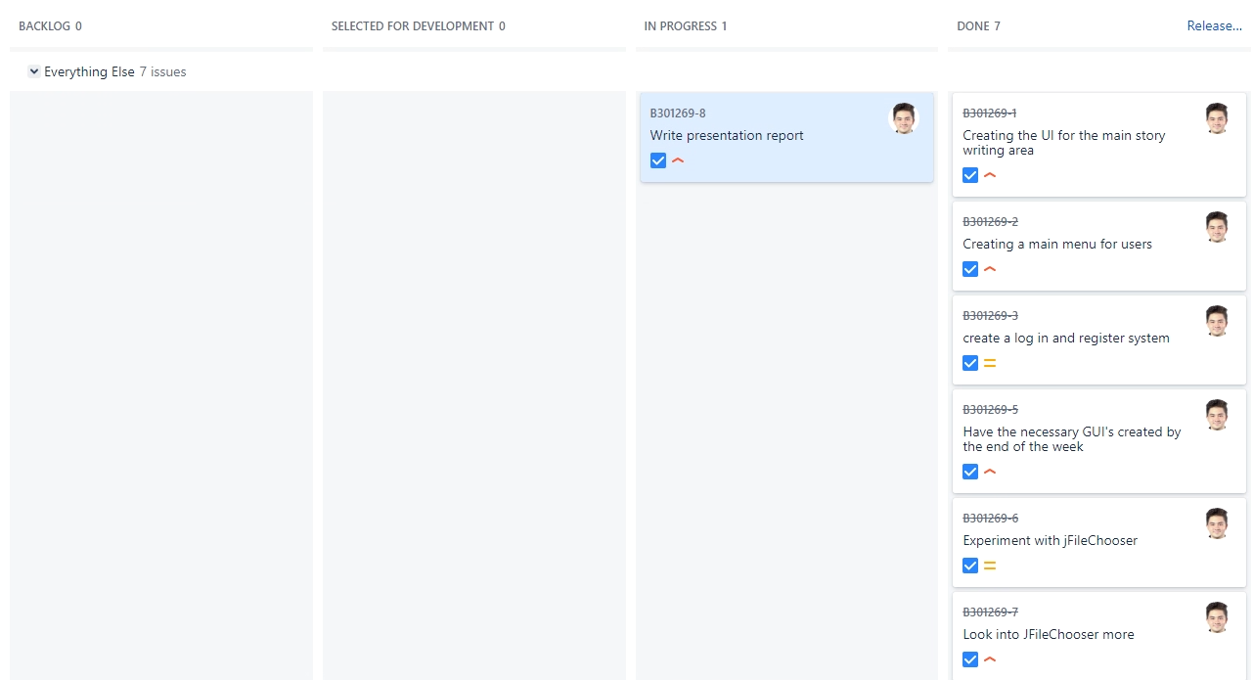
Project management

Slide 14
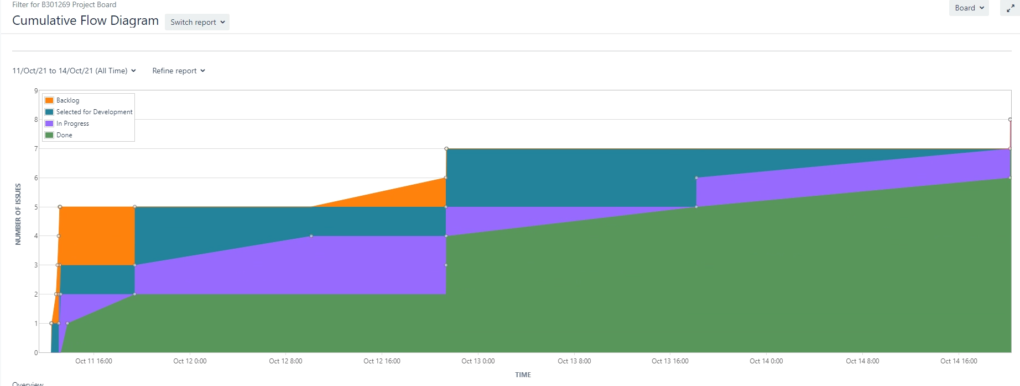

Slide 15
