Slide 1

Sorting and Searching Strings
by Shang-Lin Chen
CS20c Project

Slide 2
Based on “Fast Algorithms for Sorting and Searching Strings” by Jon Bentley and Robert Sedgewick
Binary search trees
Digital search tries (NOT “trees”)
Ternary search trees

Slide 3
Binary Search Trees
key, data
left
right
key, data
key, data
left
right
left
right

Slide 4
Sorting Strings in a Binary Tree
If keyword-1 > keyword-2, store as:
keyword-1
If keyword-1 < keyword-2, store as:
keyword-1
keyword-2
keyword-2
If keyword-1 = keyword-2, keyword-2 overrides keyword-1

Slide 5
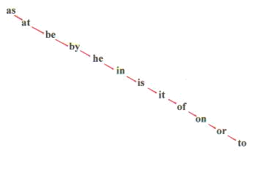
BINARY SEARCH TREES (2)
Example 1 keywords (as at be by he in is it of on or to)

Slide 6
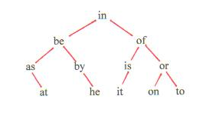
Binary Search Tree (3)
Example 2 keywords (in be of as by is or at he it on to)

Slide 7
Time Complexity
Time complexity of searching a string in a binary tree is proportional to its height, h
In worst case, input is pre-sorted (Ex. 1)
h=n,
where n is number of nodes
Balanced tree (Ex. 2), h=log n

Slide 8
By randomizing the input, can create a mostly balanced tree and achieve time complexity of O(n logn)
Construction of a binary search tree is isomorphic to Quicksort
Quicksort can be shown to have a time complexity of 1.140*nlogn

Slide 9
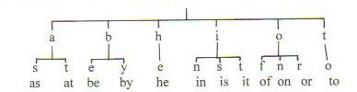
Digital Search Tries
Keyword of each node is one character long
Order of input data does not matter
Example: (as at be by he in is it of on or to)

Slide 10
Ternary Search Tree
A node: keyword is 1 character long middle-tree pointer, left-tree pointer, right-tree pointer
Compare a character x from the input string with the keyword y of a node: If x greater (less) than y, go to the right (left) tree. If x = y, go to the middle tree.
Still need randomization of input order to generate a balanced tree, but much faster than binary search tree.

Slide 11
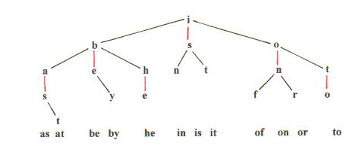
Example of Ternary Search Tree
Input: (is be by as he in it on of or to)

Slide 12
Time Complexity
In a balanced ternary search tree with n nodes where all the keywords of the nodes are k characters long, we want to search a k character long input string. The total number of character-to-character comparisons is at most lg n + k.
For a balanced binary search tree of n-nodes and k character long keywords, the total number of character-to-character comparisons is at most k * lg n which is substantially larger than lg n + k for large n.

Slide 13
Explicit Implementation
In C ++ and JAVA, create a Node class
Class Node keyword, data pointers to (middle) left right trees
LISP is a natural language to generate trees since LIST is substantially similar to trees.
Binary tree: a node = ((keyword data) (left-tree) (right-tree))
Ternary tree:a node = ((1-char- keyword data) (middle-tree) (left-tree) (right-tree))

Slide 14
Run Time in LISP Implementation
Construct binary and ternary search trees from randomly generated 5 character keywords . The times required are listed below
-----------------------------------------------------------------------
(run on a PC) n = 10 n = 100 n = 1000
---------------------------------------------------------------------- binary-tree 0.0052sec 0.11sec 2.32sec
----------------------------------------------------------------------- ternary-tree 0.0075sec 0.079sec 1.08sec

