Slide 1
Animating Human Locomotion
Shang-Lin Chen
Notes:
Final presentation for CS 174 project. May 2003.
Difficulties – Realistic turning (person does not walk in straight line). Determining where to cut off a state. Finding appropriate values of θ_{max} and coeffs for State 2.
Use forward dynamics because it simplifies states 2 and 5.
Don’t use all dynamics because it’s much more complex and difficult.

Slide 2
Introduction
Animate human figure on flat solid surface.
Has legs, knees, torso, arms, head, hips.
Mainly use inverse kinematics with some forward dynamics.
Essential element of walking: leg motion
Notes:
Project simulates human walking. Focuses on leg motion, essential element of walking. Simulation animates a human-like figure - Head, torso, arms, legs, and knees. Hands, feet, elbows, and face are not drawn. Person assumed to be walking of flat solid surface. Other factors (emotion, different walking surfaces) not taken into account.

Slide 3
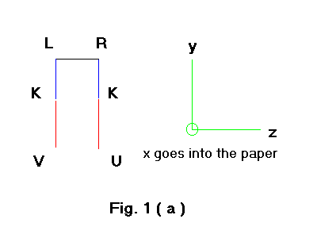
Front View
Notes:
Legs constructed as sticks – segment for lower leg, segment for upper leg. Two legs connected by bar to represent hips.

Slide 4
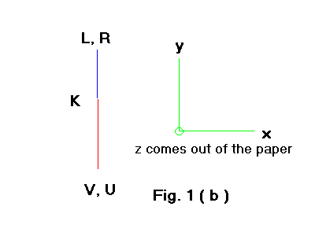
Side View

Slide 5
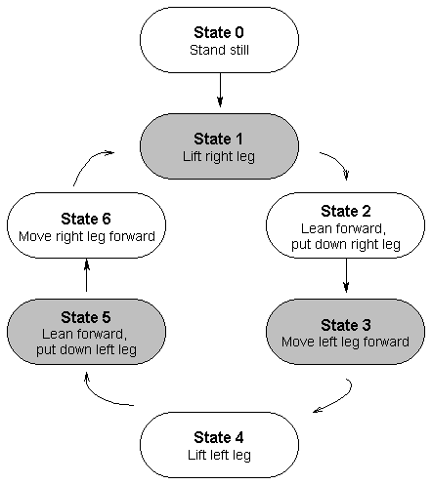
States
Notes:
Walking motion can be divided into states. State 0, initial state, person stands still. State 1 – Right leg is lifted. State 2 – Left leg leans forward, right leg is replaced on the ground. State 3 – Right leg straightens, left leg moves forward. State 4 – Analogous to State 1. Left leg is lifted. State 5 and 6 – Analogous to 2 and 3 with legs reversed. After State 6 – Return to State 1 and start over.

Slide 6
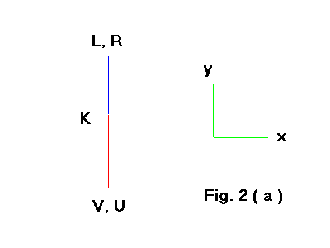
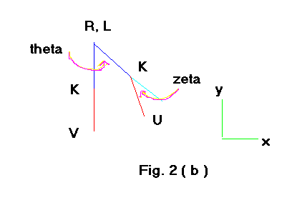
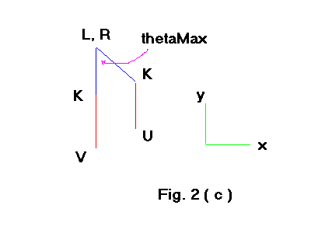
State 1 – Lift Right Leg
Notes:
State 1 – Initial position is standing still. Right leg is lifted so that lower leg hangs down. Left leg remains straight and stationary. Θ is angle between upper right leg and vertical, ζ is angle between lower right leg and upper right leg.

Slide 7
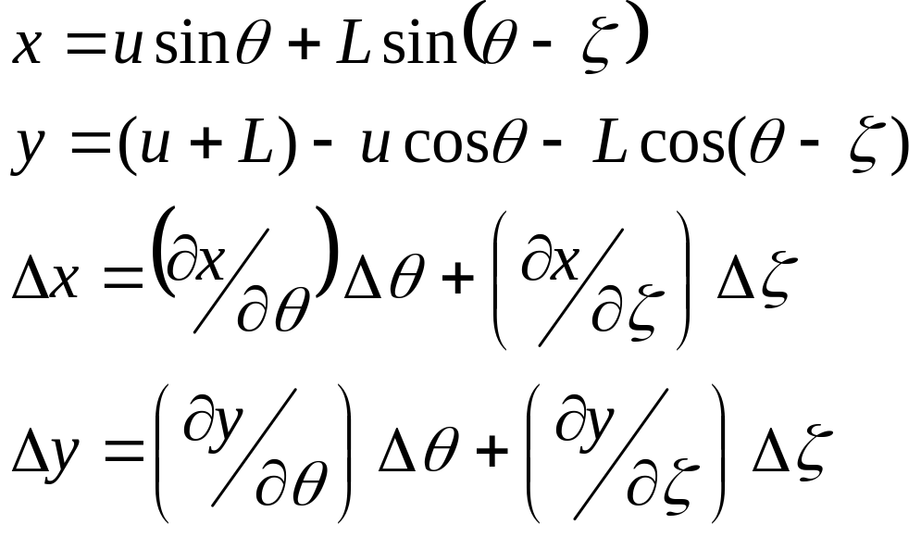
State 1
Notes:
X and y coords of tip of right leg determined trigonometrically. Increments in coords can be written in terms of partial derivatives. Need to calculate increments in angles to draw the complete leg.

Slide 8
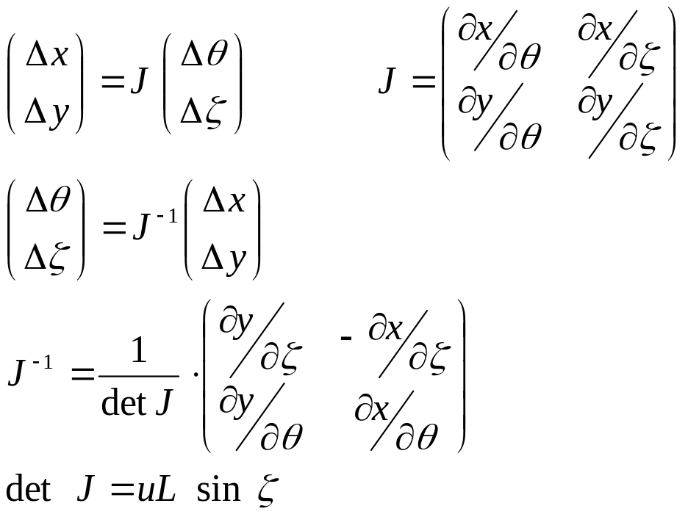
State 1
Notes:
System of equations represented as matrices in terms of Jacobian J. Finding increments in theta and zeta requires calculating det J and using to find J inverse. By substitution for the partial derivs det J is proportional to sin zeta.

Slide 9
State 1
When sin ζ = 0, J⁻¹ becomes singular.
Avoid singularity by assigning predetermined values to Δθ and Δζ.
No singularity – Use regular inverse kinematics.
Get frame-by-frame angle increments.
Notes:
Singularity occurs when sin ζ close to 0, when ζ close to 0 and right leg straight. (Δx and Δy pre-set using initial and final positions. Constant because movement is linear.)

Slide 10
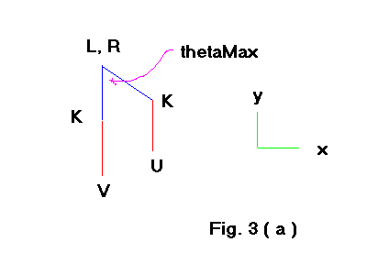
State 2
Left leg leans forward, right leg steps forward.
Initial position same as final position of State 1.

Slide 11
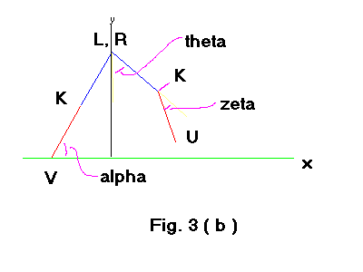
State 2 – Intermediate Position
Notes:
Intermediate steps of this state – Left leg forms angle alpha with ground. Still straight but leans forward. Right leg steps forward. Forms angle theta with vertical, lower right leg forms angle zeta with upper leg.

Slide 12
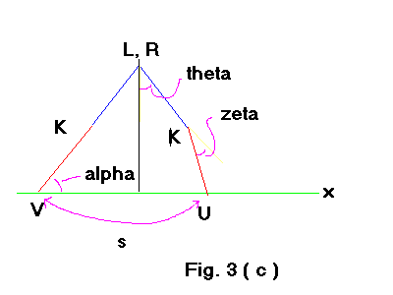
State 2 – Final Position
Notes:
Final position – tip of right leg (U) finished stepping forward on the ground. Left leg has leaned forward, forms angle alpha with ground. Tip of right leg is distance s from left leg tip.

Slide 13
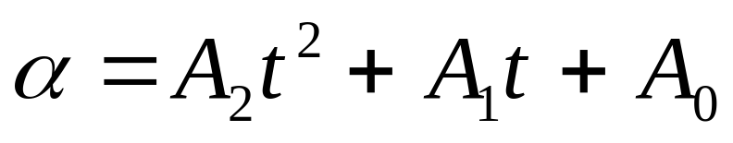
State 2 - Math
Tip of left leg serves as pivot.
Coefficients determined from forward dynamics – moment of inertia.
Notes:
Leaning forward of left leg determined by forward dynamics. Tip of left leg serves as pivot, rest of body rotates around it. Value of angle alpha determined by quadratic function of time t. Coefficients determined by moment of inertia and torque. In this implementation coeffs are input params. (A2 and A1 are negative.)
Quadratic from Newton’s equations.

Slide 14
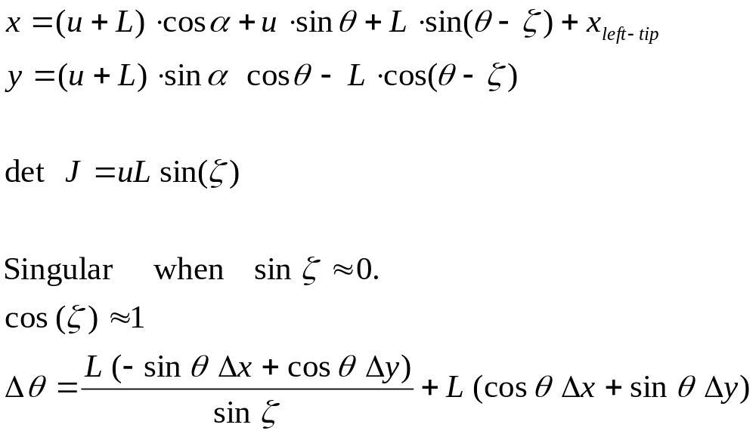
State 2 - Math
Notes:
X and y coords of tip of right leg determined trigonometrically. Increments in x, y solved in terms of Jacobian as in State 1. det J is again proportional to sin ζ . Singularity when sin ζ close to 0. Avoid singularities: Approximate cos ζ as 1. Substitute into calculations Δθ and choose ∆x and ∆y so that numerator of fraction in final equation equals 0. (Right tip is not moving linearly, so cannot set constant ∆x and ∆y for entire state.)
(More complicated than State 1 and not linear, so can’t use State 1’s method.)

Slide 15
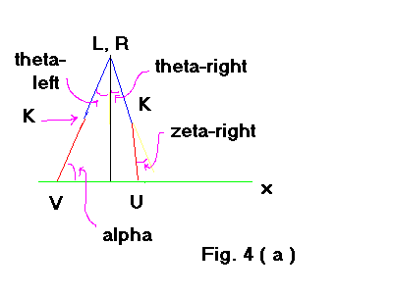
State 3
Straighten right leg.
Pull left leg forward.
Notes:
State 3 – right leg is straightened while left leg is pulled forward. Initial position is final position of previous state. Left leg forms angle θ_{left} with vertical. Upper right leg forms angle θ_{right} with vertical, lower right leg forms angle ζ_{right} with upper leg.

Slide 16
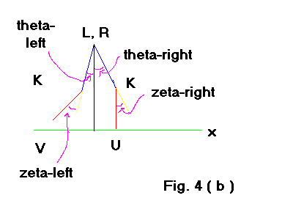
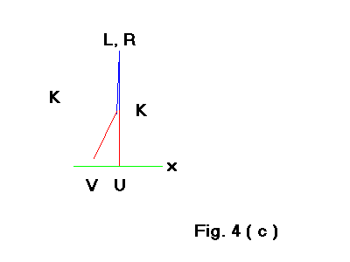
State 3
Notes:
Final position – State ends when right leg is straight. Left leg is pulled forward until right leg stops.

Slide 17
State 3 - Math
Inverse kinematics similar to State 2.
Method of avoiding singularities also similar to State 2.

Slide 18
States 4-6 are mirror images of States 1-3.
Once leg motion done, add on torso, head, and arms.
Change posture for aesthetics.

Slide 19
Implementation
C++, OpenGL, GLUT
Start in State 0, loop continuously through other states.
Code math equations for each state.
Inputs: θ_{max}, step size, leg length.
Notes:
Written in C++, uses OpenGL for rendering and GLUT for user interface. Algorithmic structure fairly straight-forward. Renders State 0, loop through other states. Increments in angles and coords are calculated within each state using equations mentioned earlier. User-defined inputs are theta_max and step size and leg lengths. Some values cause person to fall down or fall apart.

Slide 20
Other Methods
Forward and inverse dynamics
  Needs physics and biomechanics.
  More realistic but much more complex.
Motion capture
  Subject wears sensors to capture motion data.
  Or build physical model.
Notes:
Other methods for animating locomotion. Methods primarily based on forward and inverse dynamics methods use physics. More realistic but more computationally complex. Needs biomech knowledge. (mass dist, muscle structure)
Motion capture – Use physical models. Person or animal wearing sensors. Can also build physical model. Can combine with other methods. Used for making movies.

Slide 21
AVI movie
AVI movie (backup)

