Slide 1
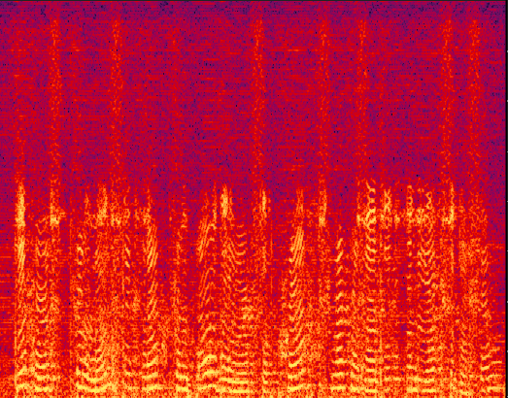
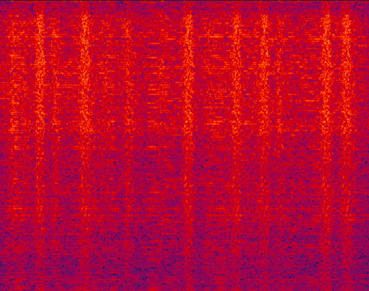
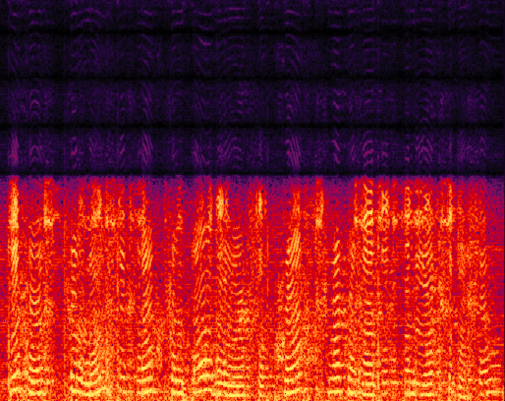
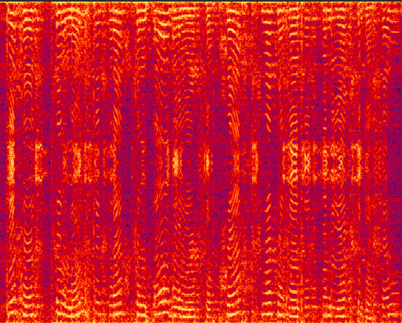







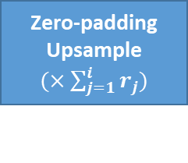


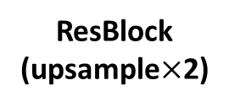




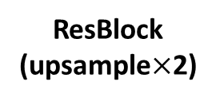


Raw Waveform
$$x_{i}$$
Output Conv
MRF
$$x_{5}$$
ResBlock
(upsample$×$2)
Leaky ReLU
$$x_{4}$$
Vanilla Conv
ResBlock
(upsample$×$2)
$$x_{3}$$
ResBlock
(upsample$×$8)
$${(n}_{i})$$
$${(x}_{i−1}^{LPF})$$
$$x_{2}$$
ResBlock
(upsample$×$8)
Vanilla Conv
Lowpass filter
$$x_{1}$$
$${(x}_{i−1}^{UP})$$
Zero-padding Upsample
$(×\sum_{j=1}^{i}{r_{j}})$
Input Conv
$$x_{0}$$
$$x_{0}$$
Zero-padding
Upsample $(×r_{j})$
Deterministic feature or
Sampling from distribution
$$x_{i−1}$$

