Slide 1
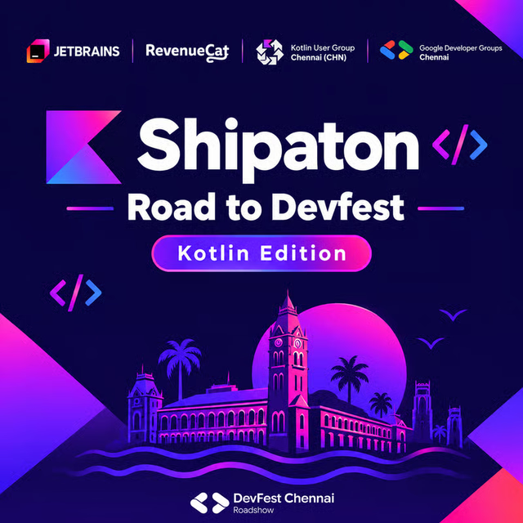
Notes:
Tanglish: Indha poster-ah vechi vidunga. Title over-ah padikkaathinga.
Leave the poster up. Do not read a second title over it. The art already names Shipaton, Road to DevFest, Kotlin Edition, and the partners on the card.
https://luma.com/mprx0ocg

Slide 2
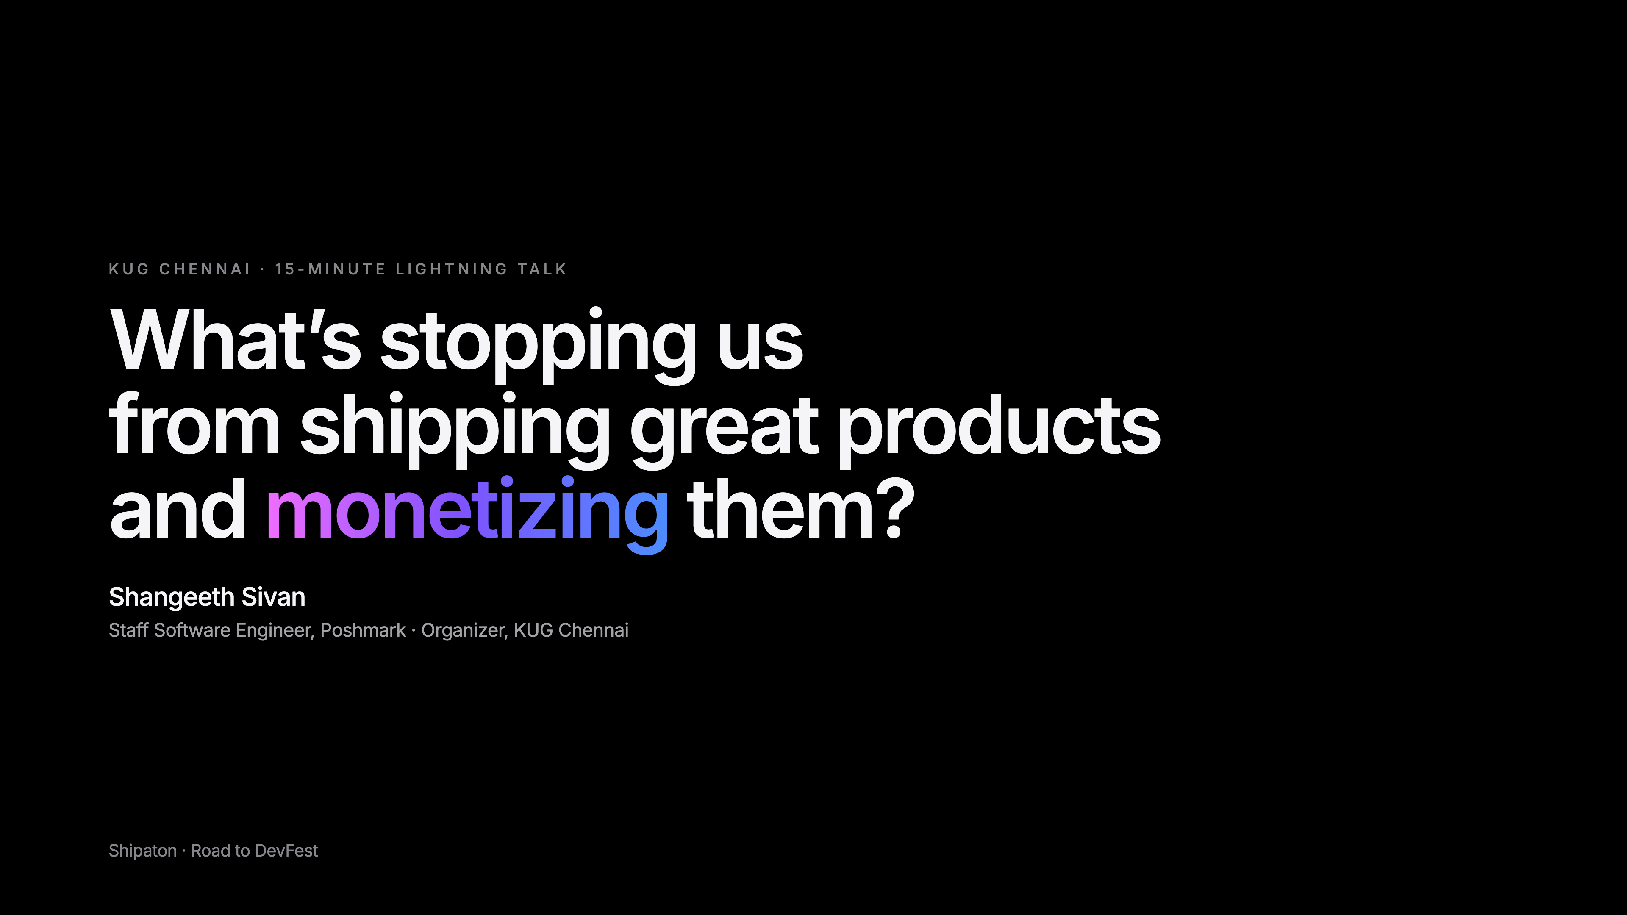
Notes:
Tanglish: Vanakkam. Indha card-ah vechi vidunga.
Leave the card up. The art already names the talk, Shangeeth Sivan, and KUG Chennai. Do not read a second title over it.
https://luma.com/mprx0ocg

Slide 3
What's stopping us from getting paid?
We know how to build.
Getting paid takes resilience
Notes:
Tanglish: Build panna theriyum. Pay vaangardhu dhaan kashtam. Adhukku resilience venum.
Vibe coding is easy. Getting someone to pay takes resilience.
https://www.youtube.com/watch?v=BUE-icVYRFU
https://www.youtube.com/watch?v=BJjsfNO5JTo

Slide 4
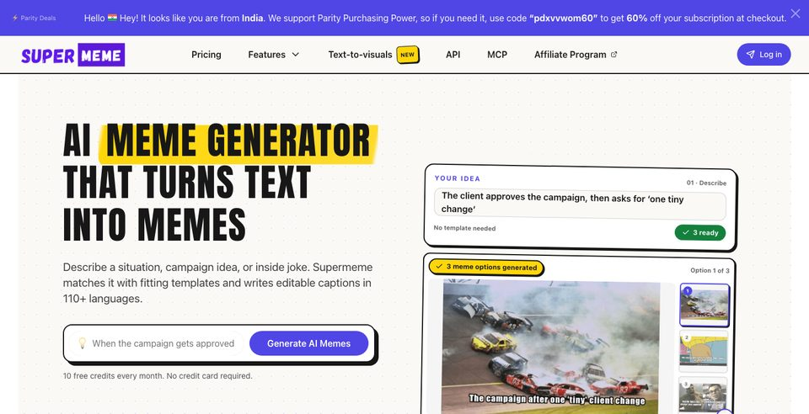
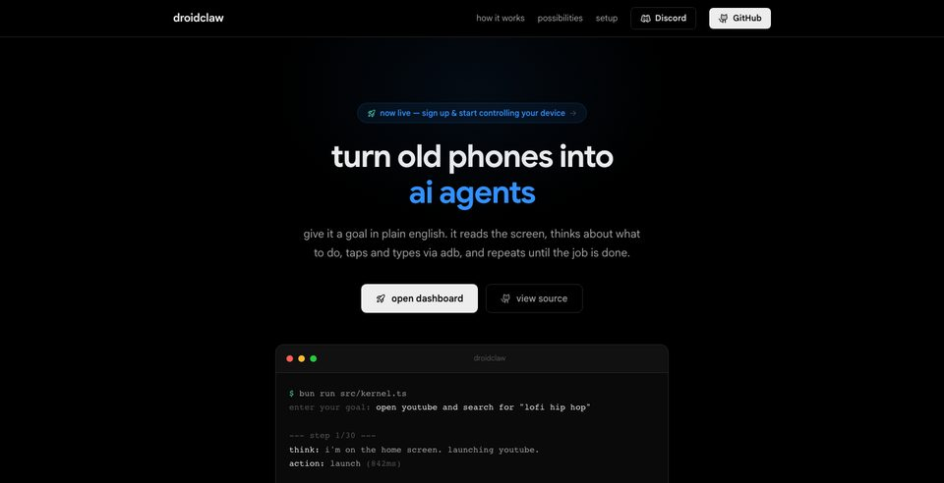
You don't need a big team.
Or months. Or an ad budget.
Super Meme
DroidClaw
Notes:
Tanglish: Periya team venam. Months venam. Ad budget-um venam.
Credit Sanjeev NC, DevFest 2024 for the tiny-team, no-ad-budget, ship-before-polish point. Super Meme is the spoken example — inspiration only. No revenue, ARR, or size claims. Same for DroidClaw.
https://supermeme.ai/
https://droidclaw.ai/
Do not invent a YouTube id for Sanjeev's talk.

Slide 5
You don't need the next Instagram.
One problem. A few people.
Puzzle game
Resume formatter
Invoice reminders
CI dashboard
Notes:
Tanglish: Instagram venam. Oru problem. Konjam per. Adhu pothum.
These are small products. Also: word game, quiz, browser game, PDF utilities, expense widget, social scheduling, inventory, booking reminders, productivity dashboards, Android performance report, API testing, log analysis.
Illustrative monetization: paid levels, one-time, credits, subscription, hosted plan, license.
https://luma.com/mprx0ocg

Slide 6
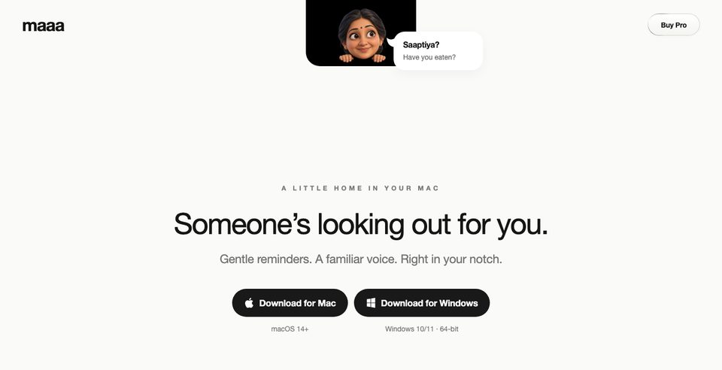

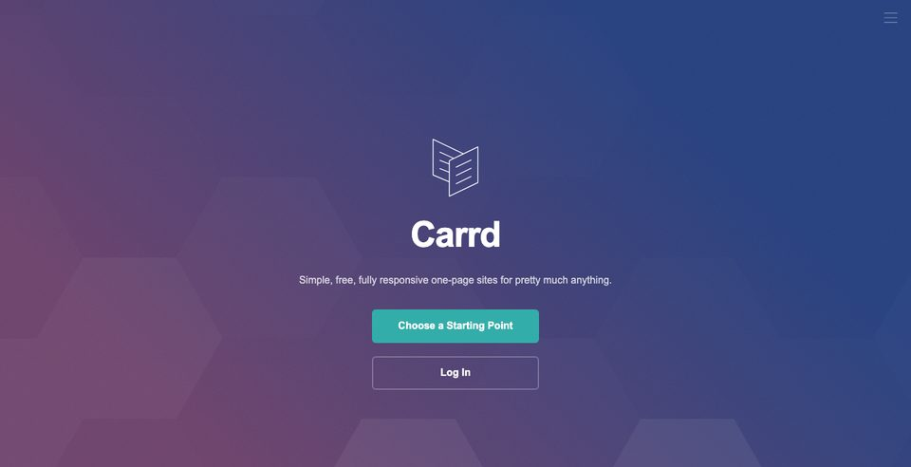
These already exist.
One job. A real price.
Maaa
Lucky Charm
Carrd
Notes:
Tanglish: Puthiya invention venam. Oru job. Oru price. Adhu pothum.
Maaa is a Mac notch reminder. Pro is $2.99 once for two computers. https://www.maaa.app/
Lucky Charm hangs a charm on the desktop. Phone shot: Nimbu-Mirchi, Floating Charm Overlay on. https://luckycharm.kraftostech.com/
Carrd is one-page sites. https://carrd.co/
No revenue or popularity counts.

Slide 7
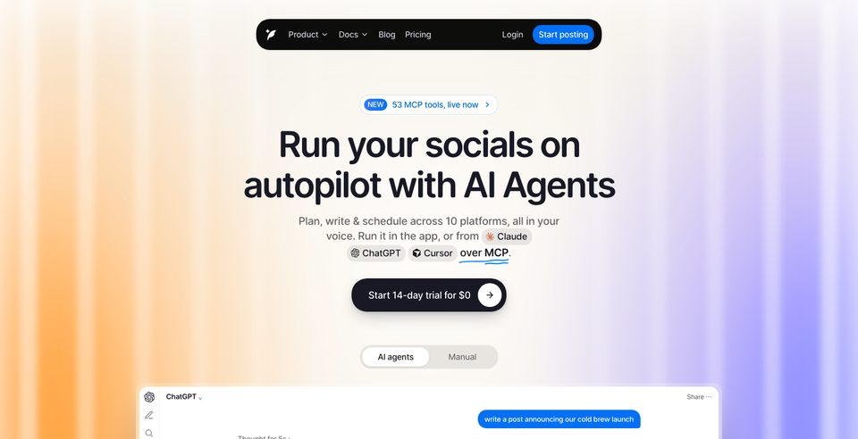
You don't have to invent it.
A better version is enough.
Notes:
Tanglish: Copycat-nu ninaikadheenga. Better version pothum. Market already irukku.
DunSocial is one more scheduler in a market that already has them. Public list price is $20/month — not a success claim. https://www.dunsocial.com/
The owner talked to the founder, who did not want an interview. What he did say: people trust you when you solve a problem, and he studies competitors.
The easiest test of a market is to ship a better version of something that already exists. Do not put a like count on this slide.

Slide 8
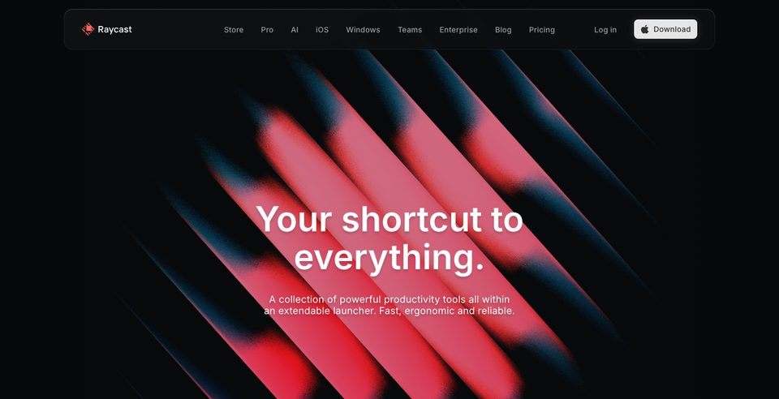
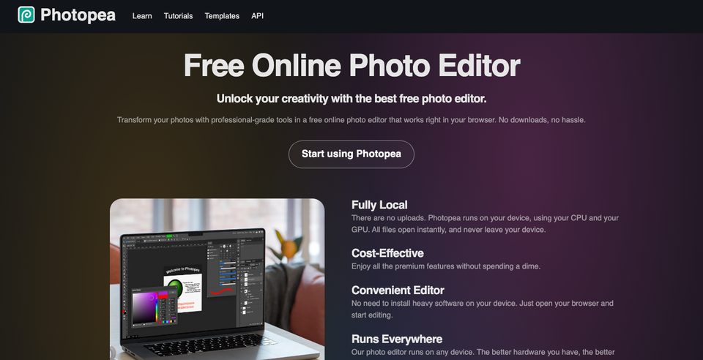
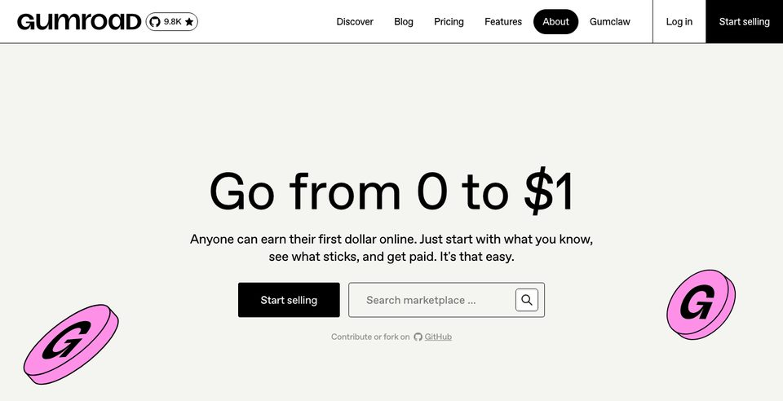
One job. People know these.
A launcher. An editor. A store.
Notes:
Tanglish: Oru job. Ivanga already therinjavanga. Inspiration dhaan.
Raycast is a launcher. https://www.raycast.com/
Photopea is a browser photo editor. https://www.photopea.com/
Gumroad is a store for files and memberships. https://gumroad.com/
Screenshots are from the live sites. Inspiration only — no revenue, user-count, or success claims.

Slide 9
You don't need Shark Tank.
We have Startup Singam.
Creedom
GrooveBook
Scholly
AI for creators. ₹1.9 crore deployed.
Photo app. Acquired for $14.5M.
Scholarship app. Shark Tank, later acquired.
Notes:
Tanglish: Shark Tank venam. Namma kitta Startup Singam irukku.
Spelling is Startup Singam. No Shark Tank logo. Do not use Sworkit.
Creedom: AI for creators. ₹1.9 crore deployed. https://www.linkedin.com/posts/startupsingam_a-commitment-on-stage-is-only-the-beginning-activity-7491060796655812608-QJl5
GrooveBook: photo app, acquired for $14.5M. https://shutterflyinc.com/shutterfly-inc-acquires-groovebook/
https://techcrunch.com/2014/11/17/shark-tank-backed-groovebook-acquired-by-shutterfly-for-14-5-million/
Scholly: scholarship app. Shark Tank deal, later acquired. Do not invent the check size. https://www.businesswire.com/news/home/20230726114303/en/Sallie-Mae-Acquires-Key-Assets-of-Top-Scholarship-Search-App-Scholly

Slide 10
Start with the product.
A game, a charm, or a tiny app.
Notes:
Tanglish: First product. Game, charm, oru chinna app. Oruthan finish panna mudiyumnu irukanum.
The first part of the recipe is something one person can finish. Examples stay the ones already named.
https://www.maaa.app/

Slide 11
Pick one.
Any of these is fine.
Razorpay
Stripe, where available
RevenueCat — mobile subscriptions
Google Pay — wallet, including UPI
Apple Pay — wallet, where available
Notes:
Tanglish: Oruthan pick pannunga. Anju-um venam. Next slide-la oru price, andha checkout.
Pick one of these. You do not need all five. Another allowed checkout is fine. The next slide is one price and that checkout.
Razorpay: https://razorpay.com/docs/
Stripe where available: https://docs.stripe.com/
RevenueCat is mobile subscriptions and stays optional. https://www.revenuecat.com/
Google Pay: wallet checkout, including UPI in India. https://developers.google.com/pay
Apple Pay: wallet checkout where Apple Pay is available. https://developer.apple.com/apple-pay/
Notes only: a store app bills through Google Play Billing and the App Store. RevenueCat can sit on those.
https://developer.android.com/google/play/billing
https://developer.apple.com/in-app-purchase/
Luma collaborator: https://luma.com/mprx0ocg

Slide 12
Then take payment.
One price. One checkout.
₹99–₹499
₹199/month
Notes:
Tanglish: Oru price. Oru checkout. Adhu dhaan payment.
Prices are examples. Razorpay: https://razorpay.com/docs/
Stripe where available. Crowdfunding is not guaranteed funding.

Slide 13
Then watch what they do.
One analytics tool is enough.
PostHog
Google Analytics
Plausible
Firebase Analytics
Crashlytics
Performance Monitoring
Most of these Firebase products are free.
Notes:
Tanglish: Analytics-ku oru tool pothum. Ella logo-um venam. Firebase-la Analytics, Crashlytics, Performance — most of these free.
PostHog: https://posthog.com/
Google Analytics: https://developers.google.com/analytics
Plausible: https://plausible.io/
Firebase Analytics: https://firebase.google.com/docs/analytics
Crashlytics: https://firebase.google.com/docs/crashlytics
Performance Monitoring: https://firebase.google.com/docs/perf-mon
Pick one. Track visitors, activation, retention, paid conversion, churn.
Most of these Firebase products are free. Official pricing lists Analytics, Crashlytics, Performance Monitoring, A/B Testing, Cloud Messaging, and Remote Config as no-cost, including production apps. Do not say all of Firebase is free. Firestore, Hosting, Storage, and Functions have quotas, then a bill. Firebase Analytics is Google Analytics for Firebase apps — both names stay.
https://firebase.google.com/pricing/

Slide 14
Growth is a system you can learn.
Ads, experiments, and the event stream.
Grow the product first. Then revenue, like ads.
Run ads to sell the product. Don't put ads inside it.
Ads
Experiments
The stream
Google Ads. Meta ads. Apple Search Ads.
PostHog experiments. GrowthBook. Firebase A/B Testing.
Events you already track. A flag ships a variant. Keep the winner.
Notes:
Tanglish: Growth team-oda velai-nu theriyum. AI era-la neenga pick up panna mudiyum. First product-ah valarunga. Use pannanavanga irukanum. Appuram ads. Product sell panna ads. Product-ukkulley ads potta, puthiya user-ku bloatware-ah theriyum.
These used to look like a growth team's job. In the AI era you can pick them up.
Grow the product first. Then revenue, like ads. Run ads to sell the product. Don't put ads inside it.
When the topic is making money from the product, people have to be using it before ads. Do not skip the earlier payment slides. Customer checkout and ad revenue are different.
Google Ads, Meta ads, and Apple Search Ads are for reaching buyers. Ads inside the product feel like bloatware to someone who just arrived. Ads cost money.
https://ads.google.com/
https://www.facebook.com/business/ads
https://ads.apple.com/
Experiments: PostHog experiments, GrowthBook, Firebase A/B Testing. A handful of users cannot prove a winner. AI can help write the test and read the result. It does not invent significance.
https://posthog.com/docs/experiments
https://www.growthbook.io/
https://firebase.google.com/docs/ab-testing
The stream: events you already track. A feature flag ships a variant. Keep the winner.
Do not name Google Optimize. Do not name Kafka.

Slide 15
Then give them a place to talk.
Discord is enough.
Discord
email
GitHub Discussions
Notes:
Tanglish: Support-ku Discord pothum. Periya team venam.
Discord, email, or GitHub Discussions. Nobody needs a support org.
https://discord.com/

Slide 16
They stay when you solve the next problem.
Likes are not customers.
Notes:
Tanglish: Like count customer illa. Problem solve panna, people trust pannuvaanga.
The owner's DunSocial observation, spoken lightly: posts he saw had about 5 or 10 likes. The projected line is the lesson, not the number.
https://www.dunsocial.com/

Slide 17
Your first paying customer beats another feature.
Too simple is why it stays in GitHub.
Notes:
Tanglish: Innoru feature kedayadhu. First paying customer dhaan matter. Simple-nu ninaichu GitHub-la vechutaanga.
Talk to customers. Show pricing early. Preorders. Paid pilot. Clear refund and delivery policy.
Validate demand. Smallest version someone will pay for. Turn the product into a business. Organic growth. An exit is possible later on https://acquire.com/
Prices are examples. Razorpay: https://razorpay.com/docs/
Stripe where available. Crowdfunding is not guaranteed funding.

Slide 18
Five people × ₹199.
Your first ₹1,000.
₹199 extension
₹299 app
₹499/month
Level pack
Notes:
Tanglish: Anju per ₹199 kudutha, almost thousand. Gross idhu — tax, fees illa. PMF illa, willingness to pay.
7-step path: painful problem → smallest useful solution → landing + pricing → payment method → share → measure → improve from behavior.
Loop: Launch → Analytics → Feedback → Improvements → Retention → Revenue.
Payment is evidence someone will pay. It is not product-market fit.
https://razorpay.com/docs/

Slide 19
Build anything. Ship something.
Solo or team.
Game
App
Site
Tool
Notes:
Tanglish: Team venum-na team. Solo-va irundha, solo. Build anything. Ship something.
Individuals and teams. New ideas and existing products. Any stack. Any policy-compliant payment provider.
RevenueCat is a Luma collaborator, not a requirement. A workable way to charge counts. Big revenue during the event is not required.
https://luma.com/mprx0ocg

Slide 20
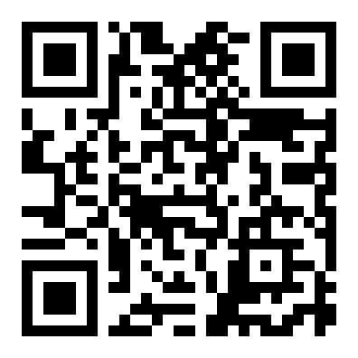
Take Startup School.
Free. Online. From YC.
Notes:
Tanglish: Startup School free. Online. YC. Early lessons-ah use pannunga. Lesson number invent pannaathinga.
The QR lives only here. Take Y Combinator Startup School. Free. Online. Say early lessons. Do not invent a lesson number.
https://www.startupschool.org/

Slide 21
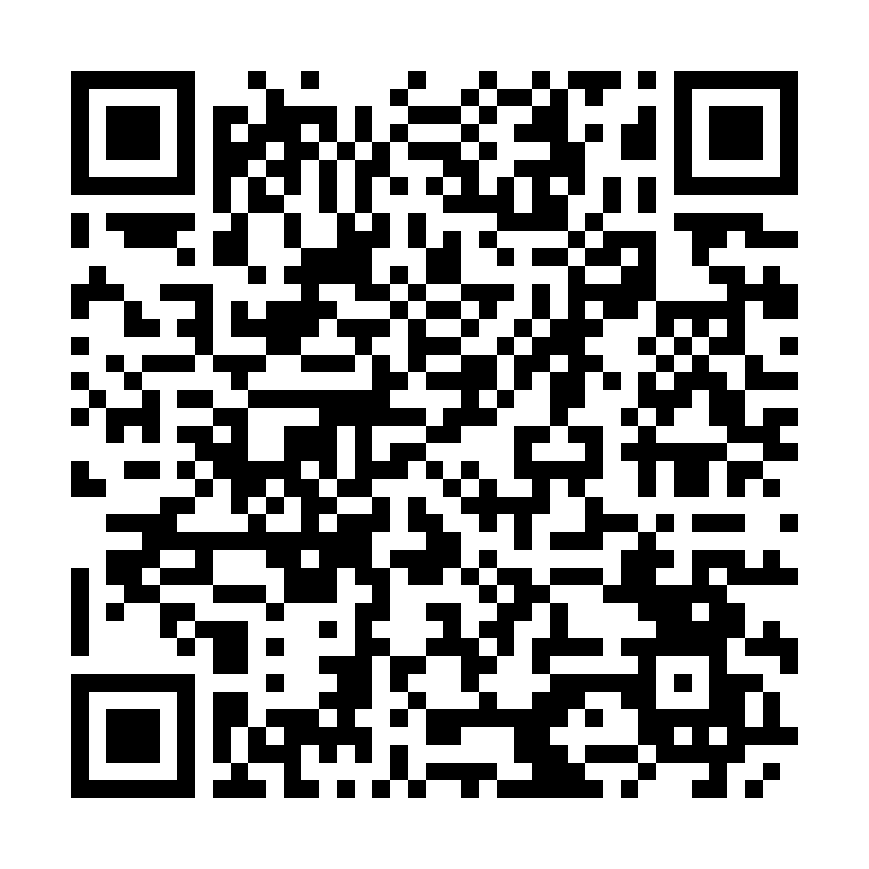
One sheet. Set Review Ready.
Notes:
Tanglish: Sheet-la fill pannunga. Review Ready-ku maathunga. Organizers dhaan paathu review pannuvaanga.
Sheet: https://docs.google.com/spreadsheets/d/1DZ7OSphlY8llxWisVc_FcLGeu9Psj_fvfxR2F7ohxcM/edit?usp=sharing
Columns: Product Name, Creator / Team, Product Category, Demo / Product URL, Repository URL, Monetization Model, Payment Integration, Deployment Status, Review Status, Production Ready by Thursday, Notes.
Workflow: fill the sheet, update URLs, the participant sets Review Status to Review Ready, organizers review. Review Ready is not approval.

Slide 22
Thursday. Make it live.
Deployed
Usable
Payments work
Notes:
Tanglish: Thursday-kku live aaganum. Review Ready-na ‘paathu videoonga.’ Production Ready-na users use panna ready.
Say Thursday. Do not print a calendar date.
Production Ready by Thursday = deployed and usable. Review Ready = please review.
Checklist: production URL; core flow works; usable onboarding; no critical blockers; a clear way to charge; payment flow works when they charge; basic analytics or feedback; enough for organizers to test.
Extra DevFest prize eligibility, not an automatic win.
https://luma.com/mprx0ocg
https://devfest.gdgchennai.in/

Slide 23
Ship it. Get reviewed.
We're going to see 10 person billion-dollar companies pretty soon.
Sam Altman
DevFest tickets
Notes:
Tanglish: Ship pannunga. Review aaganum. Ticket-na bonus — guarantee illa.
On the slide, attributed to Sam Altman: We're going to see 10 person billion-dollar companies pretty soon.
Fuller reported line: We're going to see 10-person companies with billion-dollar valuations pretty soon.
https://www.forbes.com/sites/michaelashley/2025/02/17/the-future-is-solo-ai-is-creating-billion-dollar-one-person-companies/
Organizers review. Selected winners get DevFest Chennai tickets. Prizes also at DevFest, Sat 17 Oct 2026, IITM Research Park. Thursday production-ready teams are considered for an additional prize — not a guarantee.
Judging themes only: usefulness, execution, UX, monetization potential, real deployment, learning. Do not invent amounts, winner counts, or weights.
https://devfest.gdgchennai.in/

Slide 24
Just follow these for now.
Don't get overwhelmed.
X
Product Hunt
Startup School
Notes:
Tanglish: Ippo ivathai follow pannunga. Overwhelm aagadheenga.
Three names only. X is build in public. https://x.com/
Product Hunt is where new products show up. https://www.producthunt.com/
Startup School is the free YC course shown earlier. https://www.startupschool.org/
No second QR here. No extra networks.

Slide 25
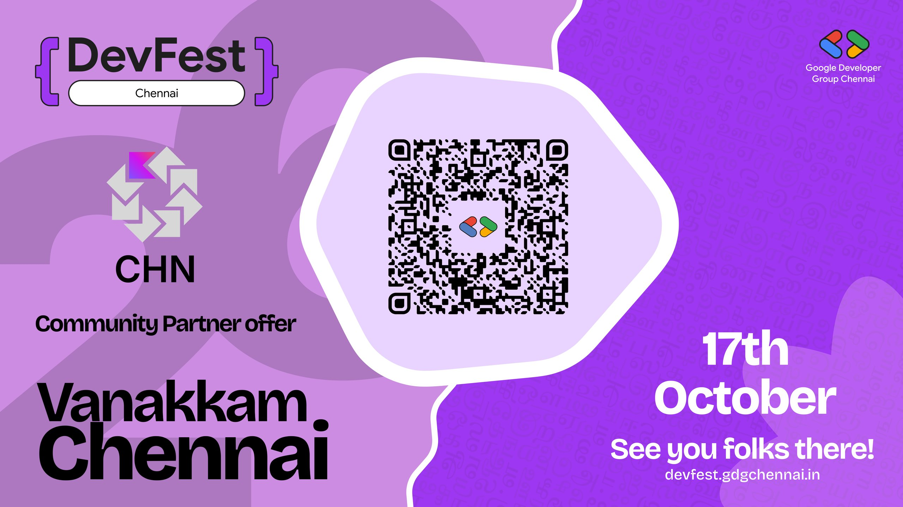
Notes:
Tanglish: Indha banner-ah vechi vidunga. Scan panna mudiyala-na DevFest site-ku point pannunga.
KUG community-partner art. Full image, no crop, no overlay, no second QR drawn on top.
The on-art QR did not decode in our check. Use https://devfest.gdgchennai.in/ — do not invent another.

Slide 26

Notes:
Tanglish: Indha card-ah vechi vidunga. Title overlay pannaathinga.
Whole image. No crop. No title on the slide. The date stays inside the art. 20% off, code KUGCHENNAI, 20 Nov 2026, Bengaluru — that is on the card, not a second headline.
https://india.droidcon.com/
https://ibb.co/3mpLSXFq

Slide 27
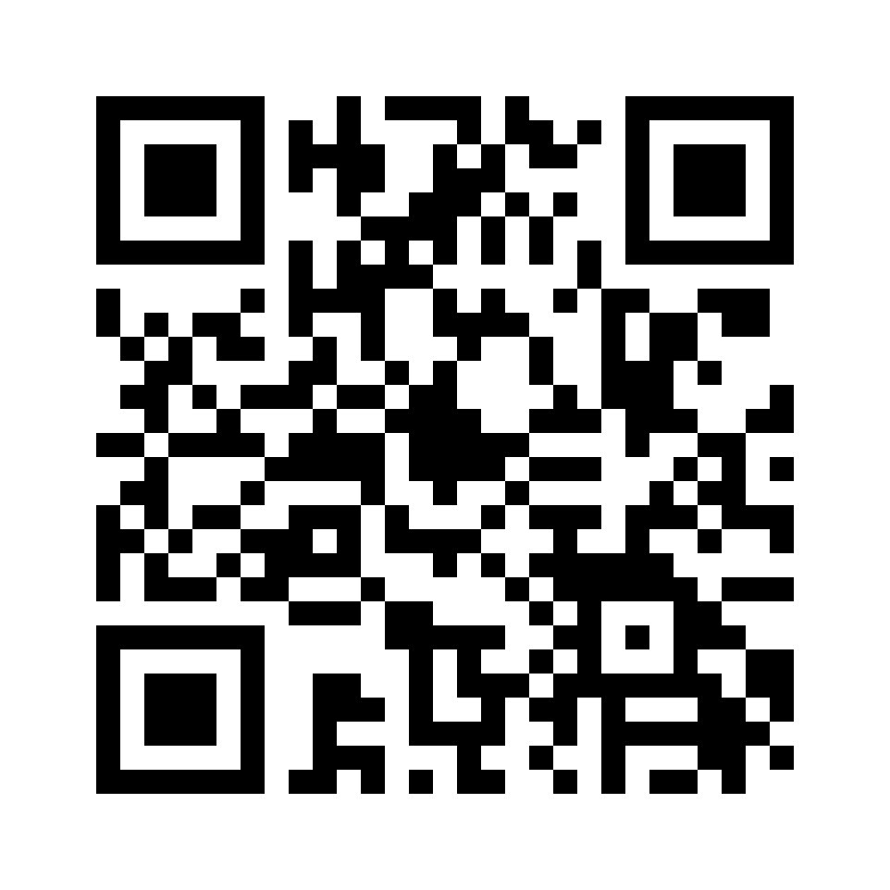
KUG Chennai Volunteer Interest Form
Notes:
Tanglish: Volunteer aaganum-na scan pannunga. Form fill pannunga.
This is the last slide before Jobs. Large QR. It decodes to https://forms.gle/bpL3rYXffdDWCMK89
Leave the form title up. Do not invent extra volunteer perks.

Slide 28
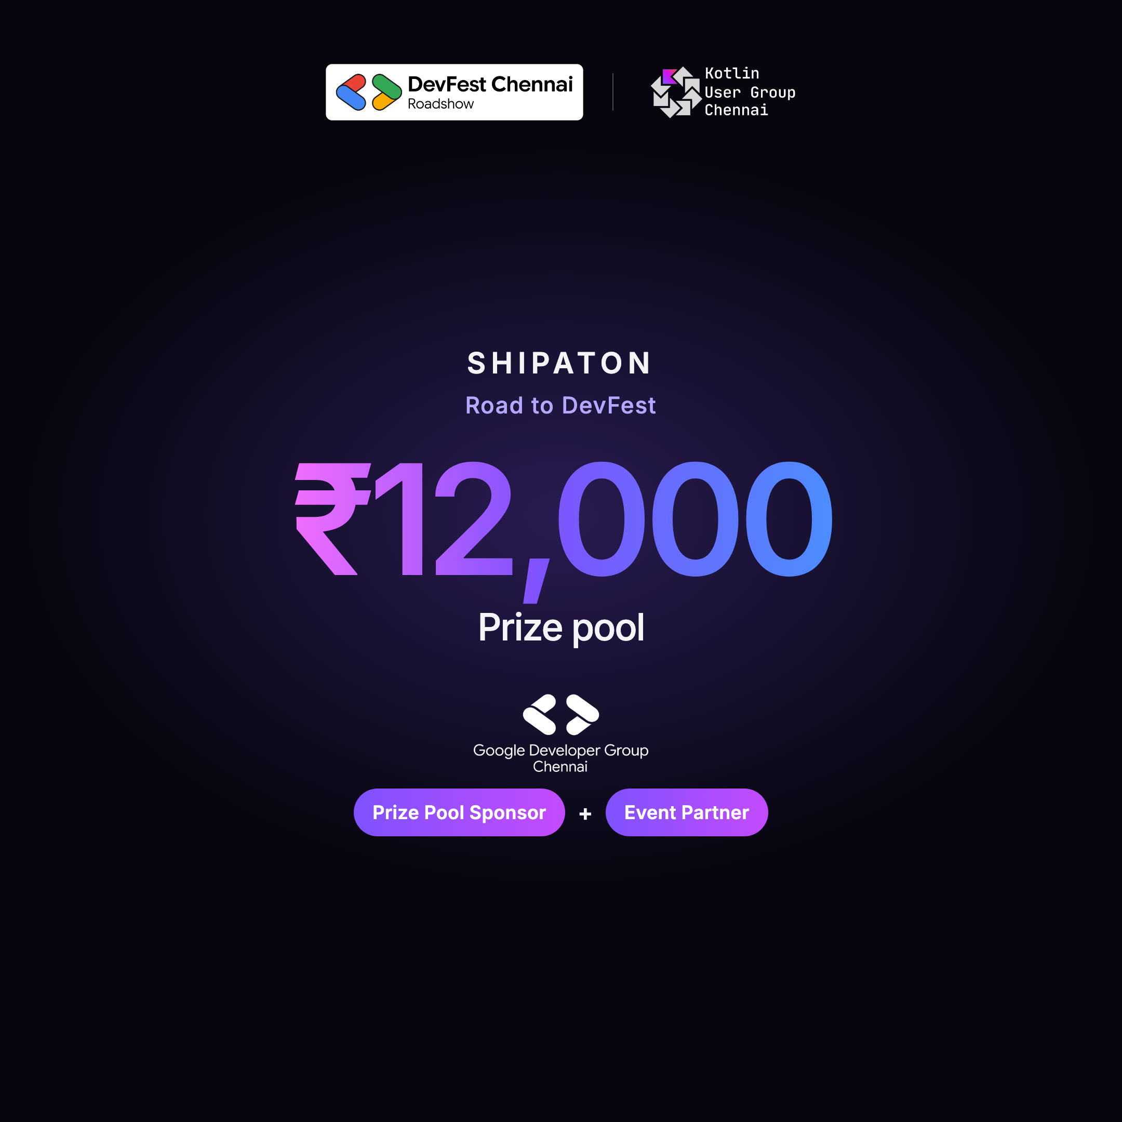
The people who are crazy enough to think they can change the world are the ones who do.
Steve Jobs
Today's prize pool is this. Nothing else is stopping you from a $1 billion company very soon. Think of the next $1 billion as your next hackathon-winning prize.
Notes:
Tanglish: Crazy-nu ninaichavanga dhaan world-ah maathuvaanga. Indha prize pool innaiku. Next billion-ah next hackathon prize-nu nenaikunga.
Leave the poster up. It already prints today's prize pool. ₹12,000 is today's prize pool, as printed. Do not retype that number as a second headline. Do not split it, name winners, or promise the billion.
Keep the Steve Jobs line: The people who are crazy enough to think they can change the world are the ones who do.
The billion line is the push to keep shipping: Today's prize pool is this. Nothing else is stopping you from a $1 billion company very soon. Think of the next $1 billion as your next hackathon-winning prize.
Don't just build another side project. Build something people can use, ship it to the world, and see if someone is willing to pay for it.
https://luma.com/mprx0ocg

Slide 29
Thank you.
Solaris Technologies and Tidel Park, for sponsoring the venue.
Notes:
Tanglish: Venue-ku thank you. Solaris Technologies. Tidel Park.
Thank Solaris Technologies and Tidel Park for sponsoring the venue only. Do not invent logos, amounts, or extra sponsors.
https://luma.com/mprx0ocg

