Slide 1

SOFTWARE ENGINEERING
FELIX JÄGER Shangeri Sivalingam Cédric Bollag

Slide 2
Research Question
Is there a correlation between the amount of tweets and the trading volume of the Tesla stock?

Slide 3
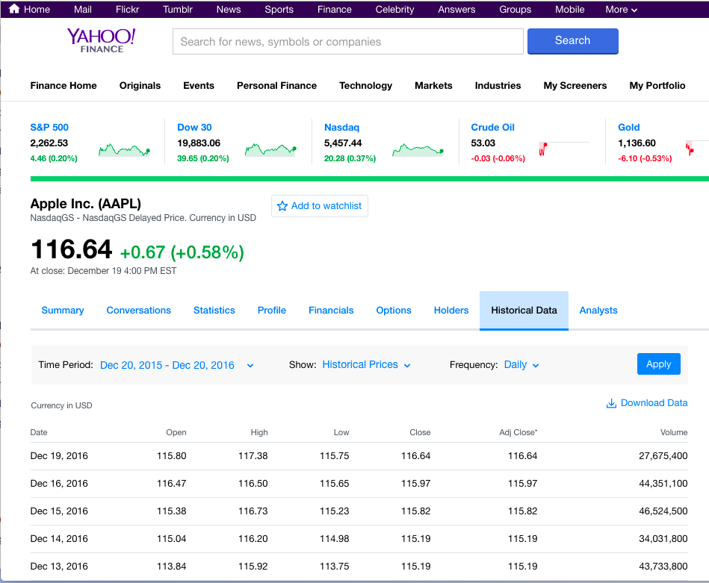
Research Question

Slide 4
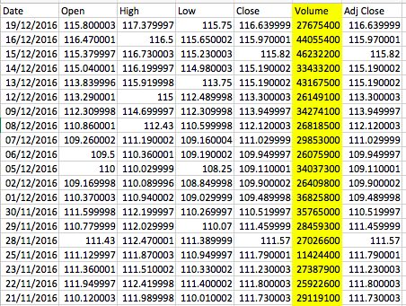
Research Question

Slide 5
Data collection
Running the IFTTT app and collect all the Tweets that consist of one of the following stocks: $TSLA, $MSFT $AAPL in separate ”Google Sheets”
Started: 13th of December 2016 13:45 (CET)
Amount of Tweets collected so far (estimates, 19th December 2016, 19:25):
Tesla: ca. 6000
Apple: ca. 10’000
Microsoft: ca. 8000

Slide 6
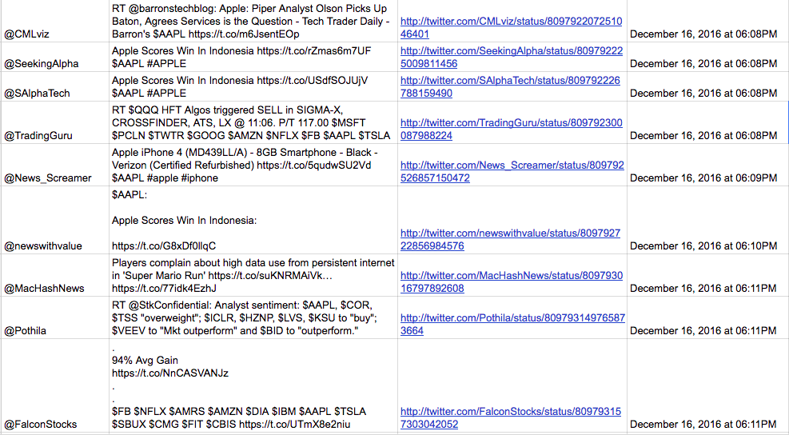
A Sample

Slide 7
A Sample: $AAPL

Slide 8
The challenges of the data
Duplicates

Slide 9
The challenges of the data
Duplicates
A tweet is counted more than once.
The only difference is the link (because of Twitter Analytics, different string within tweet)
Multiple accounts – which account should be counted?

Slide 10
The challenges of the data
Retweets

Slide 11
The challenges of the data
Retweets
A tweet is counted more than once.
Multiple accounts – which account should be counted?
Not Timely

Slide 12
What’s now?
Continue Data collection
Remove Duplicates and Retweets
Reformat date and time for analysis
Fetch data from Google or Bloomberg regarding the stock
Plan coding phase

Slide 13
questions
What programming language(s) should we use?
What should be the outcome? Graphical display of the data?
Run a simple linear regression?
What’s the “Final Product” of the project?

