Slide 1
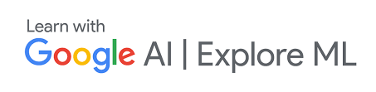
Deep Learning Beginner Track
BITS Pilani Goa Campus
Lecture - 1
Learning Problem and Data
Instructor : Shangeth Rajaa

Slide 2
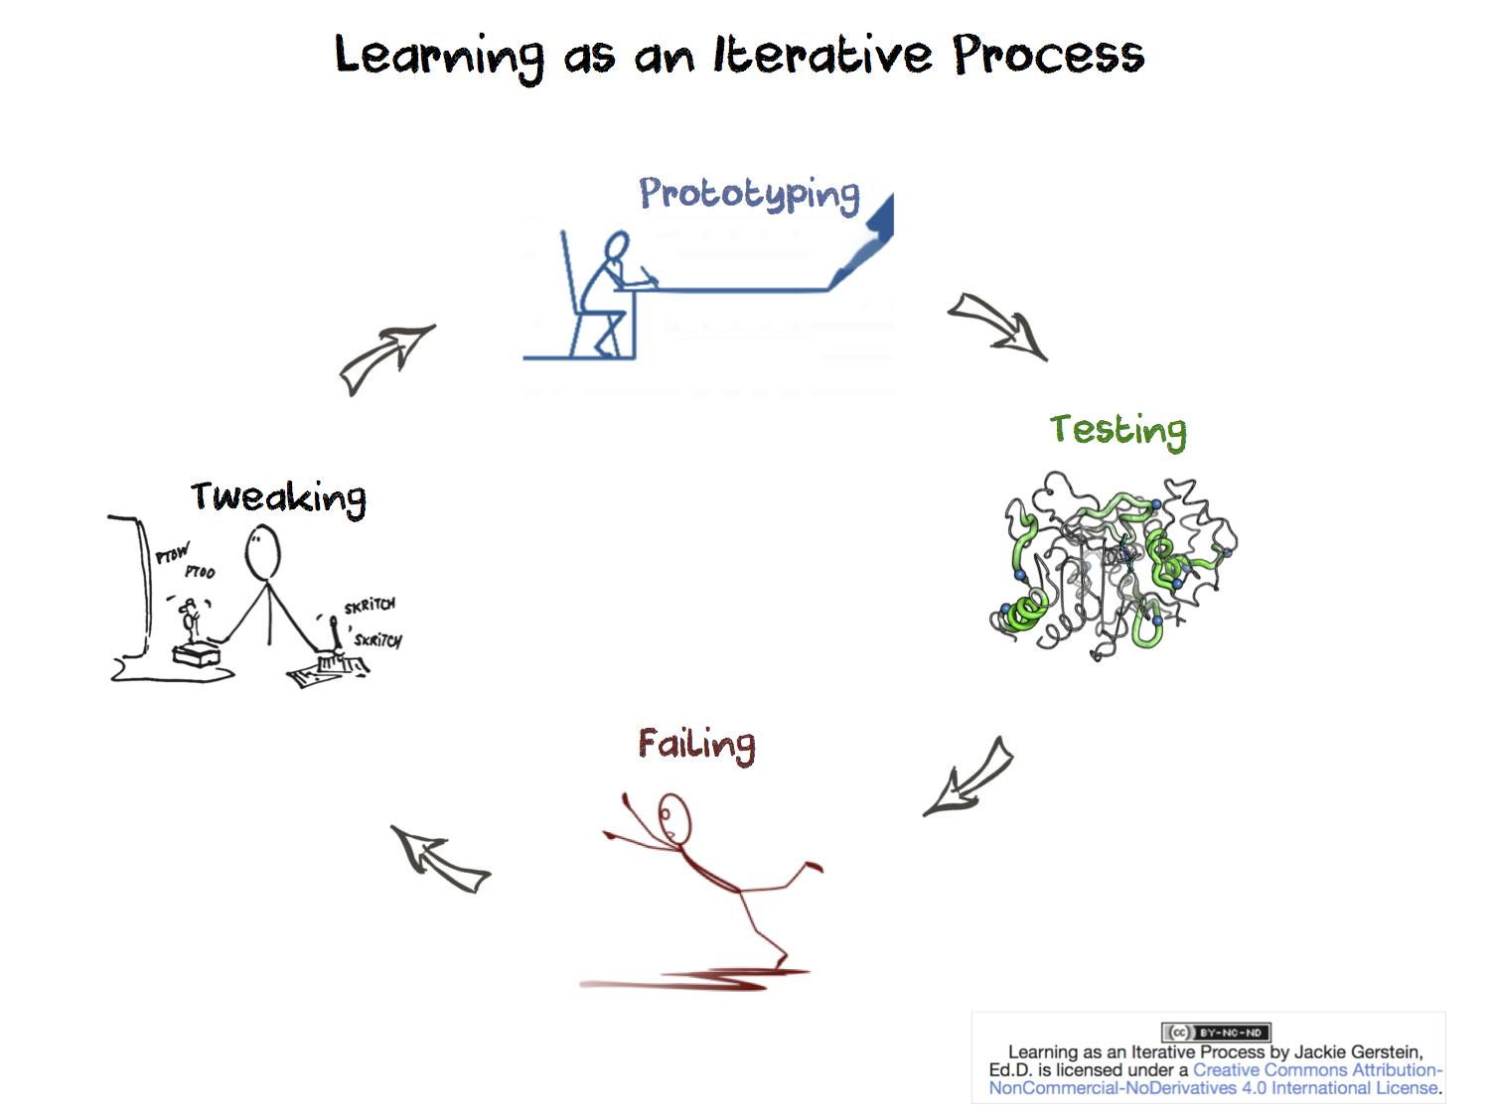
What is Learning?
Learning is any process by which a system improves performance from experience.

Slide 3
What is Machine Learning?
Machine Learning is the study of algorithms that improves their performance P, at task T, with experience E.
Example:
T : Differentiate/classify images of cars and dogs.
E : Many images with labels.
P : Metric of classification(percentage of correctly classified images)

Slide 4
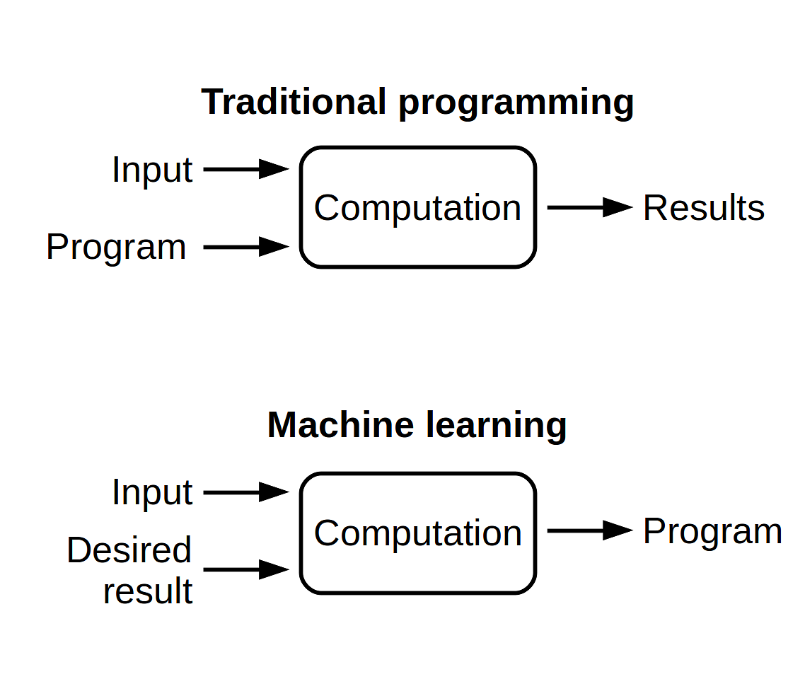
How is ML different from Programming?
def f(x):
y = 2*x+1
return y
y = f(x=2)
Source

Slide 5
Machine Learning
def ML(x, y):
# do something
# and find y = f(x)
return f
f = ML(x,y)

Slide 6
Where is Machine Learning used?
Almost everywhere!
Applications are endless, slides won’t be enough to talk about every applications.

Slide 7
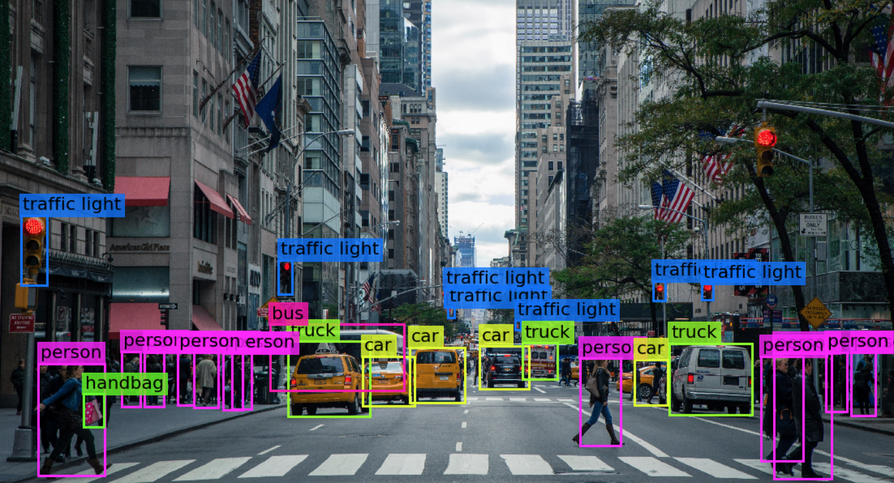
Autonomous Vehicles (Cars, Underwater, Air)

Slide 8
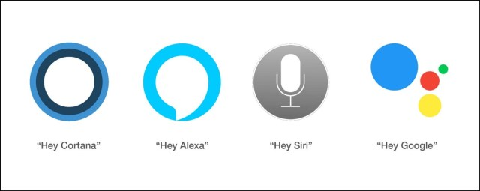
Speech Recognition, Conversational Agents
Source

Slide 9
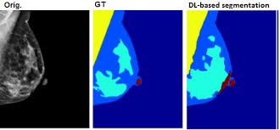
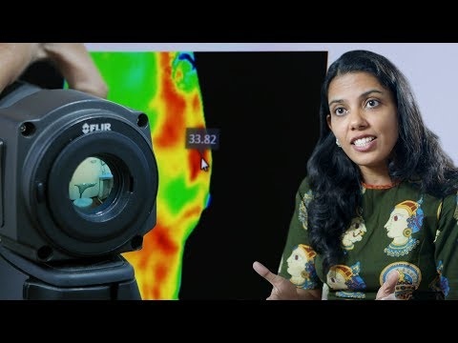
Medical Diagnosis
Machine learning makes the diagnosis of many diseases cheaper, faster and more accurate than it used to be.
Source

Slide 10
So can we use machine learning everywhere?
Some simple tasks doesn’t need Machine learning like addition, counting, ..., etc.
No Machine learning without Experience E. (X, y) are needed to get f: X-> y. So if you can’t get the data, then ML cannot help you.

Slide 11
Framing the Learning Task - 1
You have an email in your inbox, frame a learning task for a ML model to classify your email as spam or not.
T : Classify email as Spam or Not Spam.
P : Percentage of emails correctly classified.
E : Lots of emails with labels(Spam or Not Spam)

Slide 12
Framing the Learning Task - 2
Frame a ML task for Stock Prediction. Given past 20 days stock values, predict the next day stock price.
T : Predict Stock Price at T+1 time
P : How close if the predicted price to True price.
E : Sets of stock prices with past 20 days price and the next day price.

Slide 13
Types of Learning:
Supervised Learning
Unsupervised Learning
Semi-supervised Learning
Reinforcement Learning
Some new type of learning may be added soon, at this rate of research in AI.

Slide 14
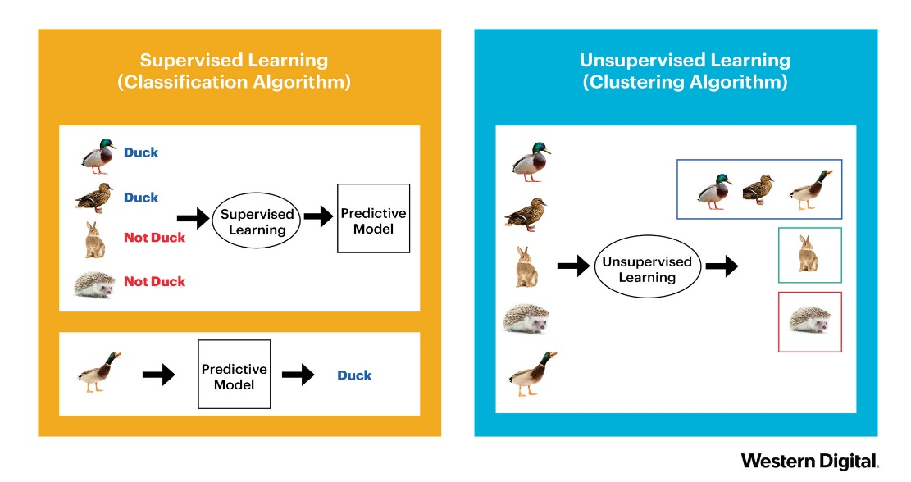
Supervised Learning
Given Data X and Target y
Find relation y = f(X)
Source

Slide 15
Unsupervised Learning
Training Data X without the Target y.

Slide 16
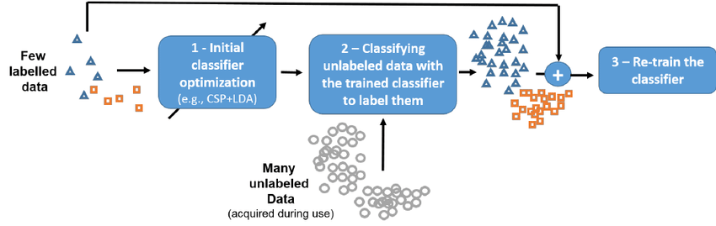
Semi-supervised Learning
Training Data X with few target y.
Source

Slide 17
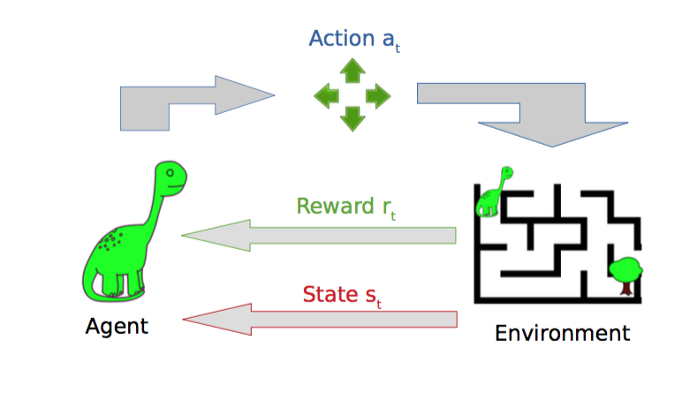
Reinforcement Learning
Agent gets rewards from sequence of best actions.
Source

Slide 18
Learning System
Choose a training experience or training data.
Choose the target to learn.
Representation of training data and target.
Learning algorithm to infer/predict the target from data.

Slide 19

Learning System Example - Handwritten Digits Recognition
Training data (X) = Images of handwritten digits of all 10 classes.
Target (y) = {0, 1, 2, 3, 4, 5, 6, 7, 8, 9} respectively.
Representation of X(each example) = array or tensor of shape (28, 28, 1).
Representation of y(each example) = array of shape (1,1) from one of {0, 1, 2, 3, 4, 5, 6, 7, 8, 9}.

Slide 20
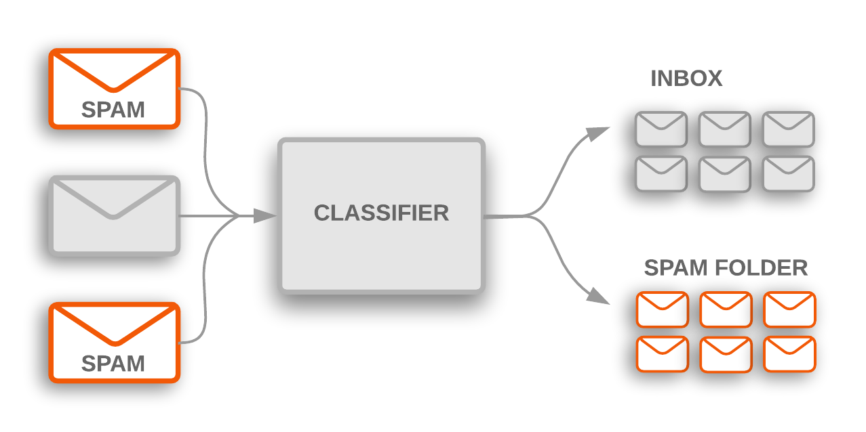
Learning System Example - Email Spam Classification
Training data (X) = Text Emails of both spam and not spam
Target (y) = {0,1} respectively.
Representation of X(each example) = array or tensor of shape (28, 28, 1).
Representation of y(each example) = array of shape (1,1) from one of {0, 1, 2, 3, 4, 5, 6, 7, 8, 9}.
Source

Slide 21
Thank You!

