Slide 1
AlgoMango
Asset Trading Resource
by
Shang and Elias

Slide 2
Trading Algorithm
Design & Implementation
Company

Slide 3
Case of:
EME16 and EME26

Slide 4
Intro ( Scope)
In this project we will create a company that will help individual traders:
Implementing their trading strategy on an Auto trader
They can use one of our own strategy
Clients
With Strategy
Needs Strategy
Fill Ledger
Receives Documents that could help make a choice

Slide 5
This project leverages python version 3.8.5 with the following packages and modules:
Streamlit; Streamlit turns data scripts into shareable web apps in minutes
Datetime The datetime module supplies classes for manipulating dates and times
Dataclasses This module provides a decorator and functions for automatically adding generated
Typing This module provides runtime support for type hints
Pandas pandas is a fast, powerful, flexible and easy to use open source data analysis and manipulation tool, built on top of the Python programming language.
Hashlib This module implements a common interface to many different secure hash and message digest algorithms

Slide 6
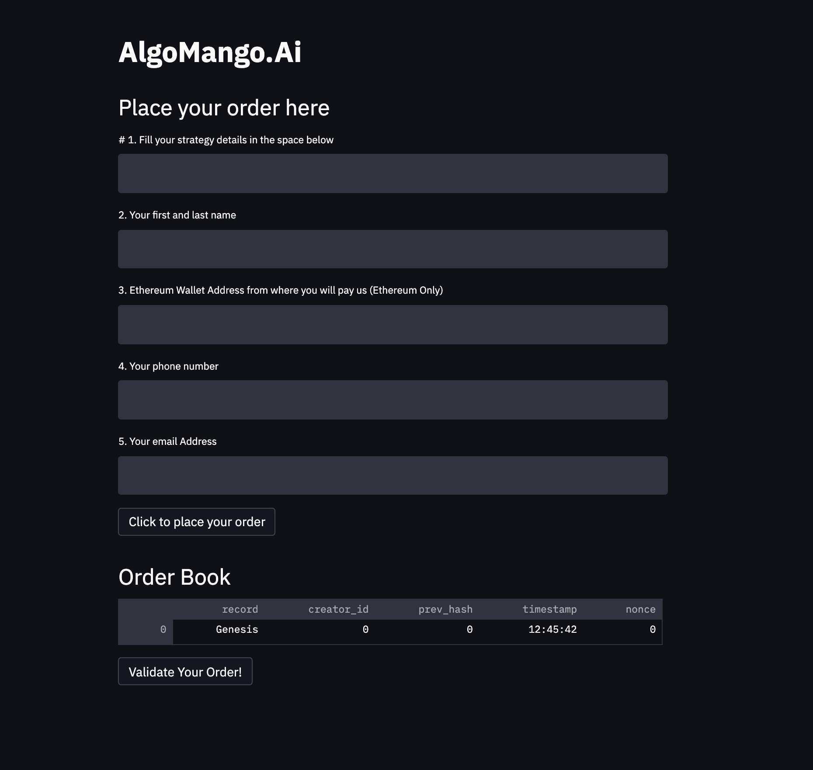

Slide 7
Technologies
python: This project makes great use of python version 3.8.5 with the following packages and modules:
pandas - version 1.3.2 - To manipulate and create dataframes.
hashlib- A common interface to many different secure hash and message digest algorithms. In our case; SHA256 to return a hexdigest
web3.py - A Python library for connecting and performing operations on Ethereum-based blockchain.
B. Solidity - A programing language to create smart contracts and implement the joints saving application to work with ether.
c. Remix IDE (not a python module)- For writing and editing of solidity formatted code, and launched the our application.

Slide 8
Smart Contract
Each time we have a customer, we will launch an ERC-20 smart contract that can only accept payment from the client’s account provided at the time of inquiry.
The contract will collect the Ethereum from the customer and send to our company’s account.

Slide 9
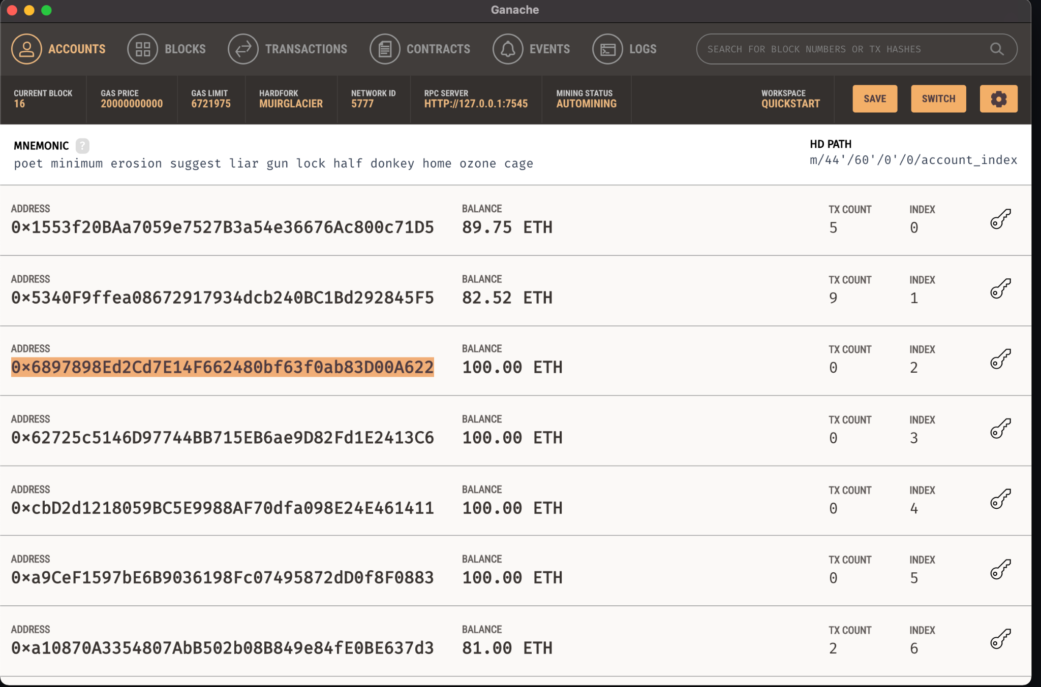
Sample Address from Ganache

Slide 10
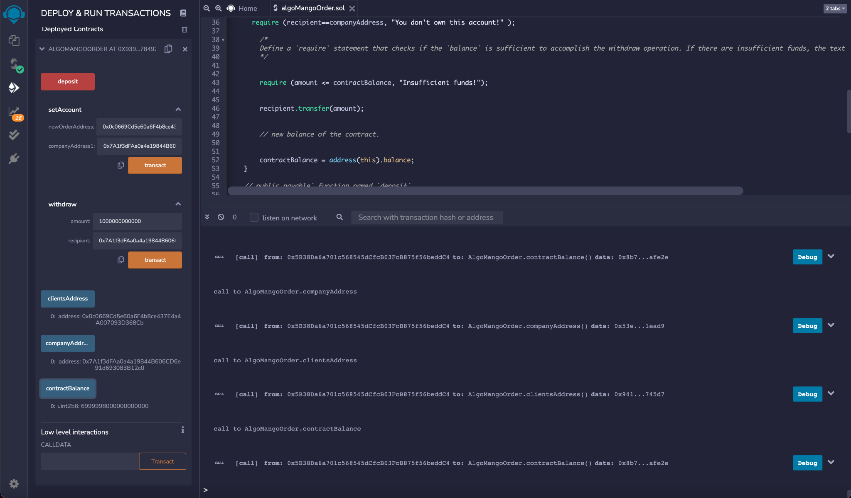

Slide 11
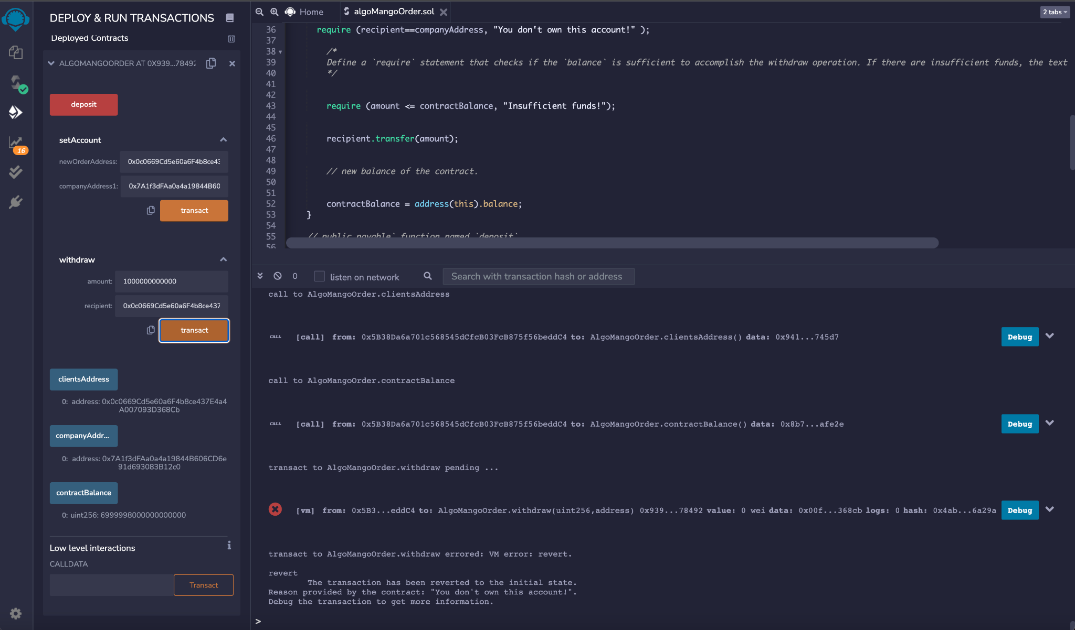

Slide 12
To further help our customers
We have created a google colab simulator for people to go there and use Machine Learning with facebook prophet to see the future of their coin/stock based on the available data. This should help the customer know if they should stay long term or short now and when they could turn the algorithm off.
Client can use heroku to host ( free and run)
All these resources are hosted on our server for people to auto interact with
AlgoMango.ai

Slide 13
Technologies
This project leverages python version 3.8.5 with the following packages and modules:
pandas - This was used to be able to easily manipulate dataframes.
Jupyter Lab - This was used to be able to create and share documents that contain live code, equations, visualizations and narrative text.
PyVizlot - Python visualization package that provides a single platform for accessing multiple visualization libraries. Two of the libraries are:
hvPlot - version 0.7.2 - This was used to be able to have an interactive plotting tool such as a line/bar graph and scatter plot.
Holoviews - verion 1.14.4 - This was used to design and make data analysis and visualization seamless and simple.
FBProphet - This was used to create our forecasting time series model to be able as a way to predict our future dataframe.
Pystan - This is a Python interface to Stan, a package for Bayesian inference.

Slide 14
Google Colab (Case of ADA)
5 years Daily Data

Slide 15
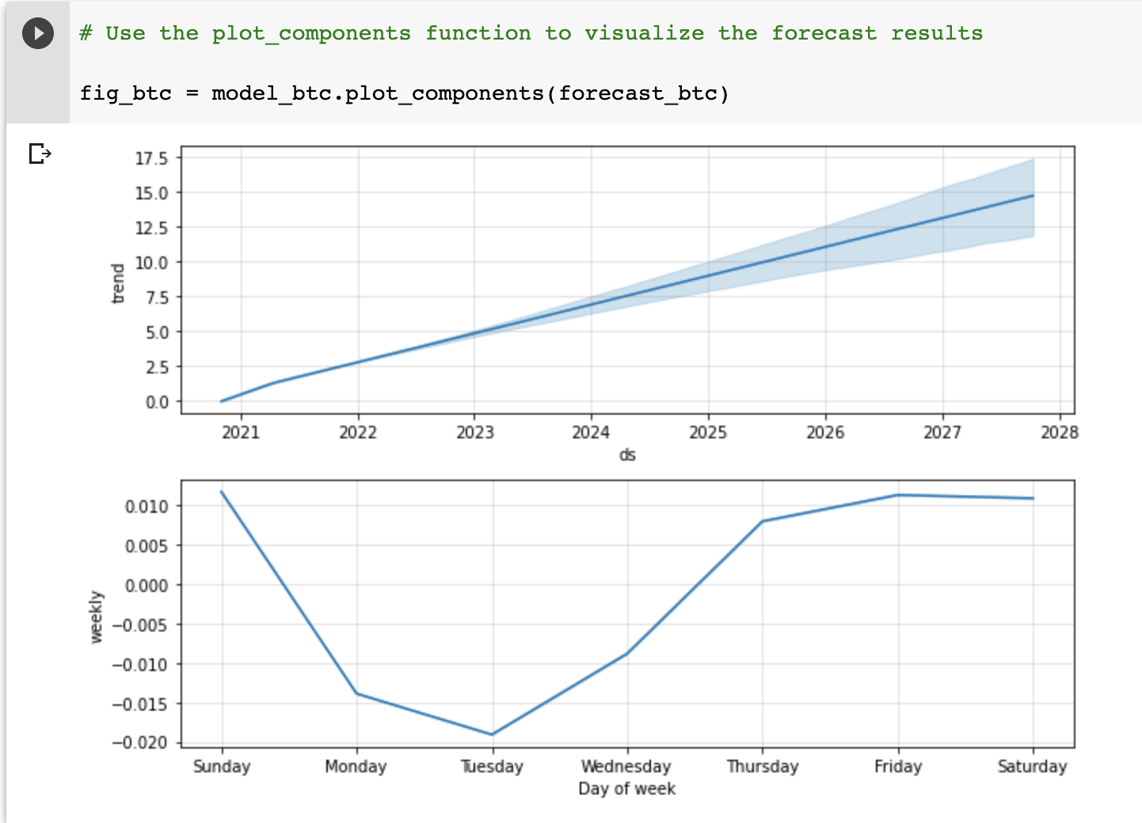

Slide 16
Case Study
Trading use the Method (EMA12 and EMA26 with binance API)
EMA12 and EMA26 with RSI

Slide 17
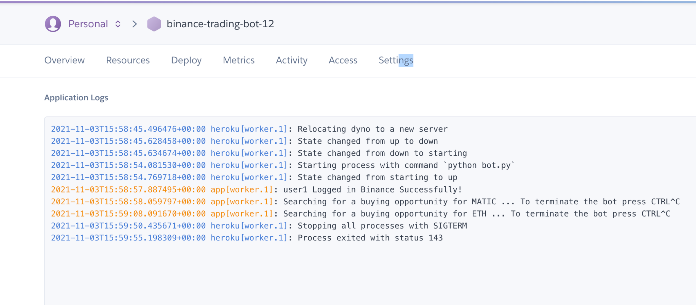

Slide 18
Thing to show the Class
Landing page design (To collect orders on Streamlit)
Working Streamlined form ( where people can place orders)
Working Smart contract to be use with clients , code and deployed)
Trading form on google colab ( with how to use)
Jupiter lab hosted ( link from landing page)
Code (Streamlit, smart contract, trading algo strategy)
Markup of website connected to domain name
Show transactions on testnet.

Slide 19
Presentation
Shang Celsius: Presentation of Streamlite, Smart contract, Hosted solution (links), trading results from Algo, Heroku, landing page with links to hosted solution
Elaise: Show how the trading Algo code designed, show google colab simulations with ADA
Presentation Strategy: Half time should take Questions from the students in class.
3 Minutes ( Shang)
2 Minutes ( Elaise)
5 Minutes ( The Class)

Slide 20
Working Streamlined form ( where people can place orders)
Contact info: first name, last name, Phone number, Strategy to implement , ( NA if not),

Slide 21
Thank you!
Q & A

