Slide 1
PCI –
a software engineer perspective
Notes:
1. Replace “Project Name” with your own project name
2. “Accomplishment” : Major task completed since last meeting
3. “Key issues” : important issue&risks, add solution or mitigation plan if possible
4. “Milestone” : Major milestone in this year;
Color legend
Grey rows: the milestone that has been achieved;
Green row : on going and on schedule;
Red rows :ongoing but delay two weeks;
Yellow rows: ongoing buy delay one week;
5. “Major Work Areas” : what the team is working on

Slide 2
Agenda
How to talk to a PCI device?
Ready to make your hands dirty?

Slide 3
Agenda
How to talk to a PCI device?
  BDF(bus,device,function)
  PCI configuration space
  BAR(Base Address Register)
Ready to make your hands dirty?

Slide 4
How to talk to a PCI device?
Imagine what we need when we send a mail?
  Address/Who
  PCI address – BDF(Bus/Device/Function)

Slide 5
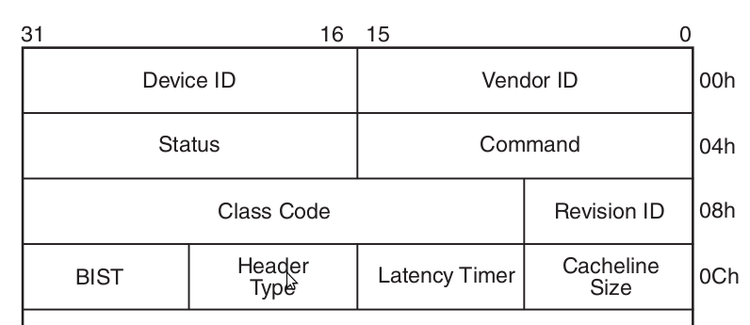
Hi, Bonjour, こんにちは
After we get the address, what's next?
  English? Chinese?
  Standard language for PCI – PCI configuration space

Slide 6
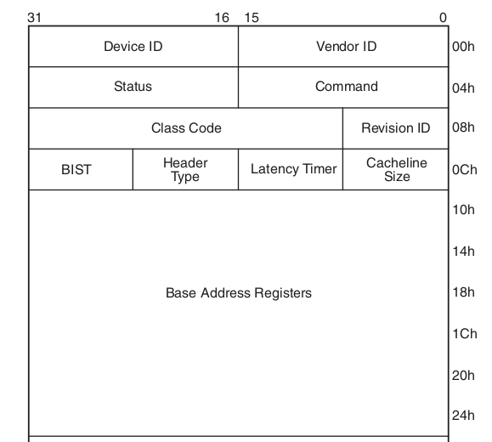
I am Yangtze River, are you Huanghe?
Well, now how we control the device? This is more device specific
6 BARs for device driver
This is a secrete between
device and driver

Slide 7
Agenda
How to talk to a PCI device?
Ready to make your hands dirty?
  lspci
  sysfs

Slide 8
lspci
lspci
lspci -n
lspci -s
lspci -k
lspci -vvv
lspci -t

Slide 9
$ lspci
00:00.0 Host bridge: Intel Corporation 2nd Generation Core Processor Family DRAM Controller (rev 09)
00:02.0 VGA compatible controller: Intel Corporation 2nd Generation Core Processor Family Integrated Graphics Controller (rev 09)
00:16.0 Communication controller: Intel Corporation 6 Series/C200 Series Chipset Family MEI Controller #1 (rev 04)
00:16.3 Serial controller: Intel Corporation 6 Series/C200 Series Chipset Family KT Controller (rev 04)
00:19.0 Ethernet controller: Intel Corporation 82579LM Gigabit Network Connection (rev 04)

Slide 10
$ lspci -n
00:00.0 0600: 8086:0104 (rev 09)
00:02.0 0300: 8086:0126 (rev 09)
00:16.0 0780: 8086:1c3a (rev 04)
00:16.3 0700: 8086:1c3d (rev 04)
00:19.0 0200: 8086:1502 (rev 04)

Slide 11
$ lspci -s 00:19.0
00:19.0 Ethernet controller: Intel Corporation 82579LM Gigabit Network Connection (rev 04)
$ lspci -s 00:19.0 -k
00:19.0 Ethernet controller: Intel Corporation 82579LM Gigabit Network Connection (rev 04)
Subsystem: Lenovo Device 21ce
Kernel driver in use: e1000e
Kernel modules: e1000e

Slide 12
$ sudo lspci -s 00:19.0 -v
00:19.0 Ethernet controller: Intel Corporation 82579LM Gigabit Network Connection (rev 04)
Subsystem: Lenovo Device 21ce
Flags: bus master, fast devsel, latency 0, IRQ 40
Memory at d2500000 (32-bit, non-prefetchable) [size=128K]
Memory at d252a000 (32-bit, non-prefetchable) [size=4K]
I/O ports at 5060 [size=32]
Capabilities: [c8] Power Management version 2
Capabilities: [d0] MSI: Enable+ Count=1/1 Maskable- 64bit+
Capabilities: [e0] PCI Advanced Features
Kernel driver in use: e1000e
Kernel modules: e1000e
lspci -vvv will print more informatin.

Slide 13
lspci -t
-[0000:00]-+-00.0
+-02.0 Normal device
+-16.0
+-16.3
+-19.0
+-1a.0
+-1b.0
+-1c.0-[02]--
+-1c.1-[03]----00.0
+-1c.3-[05-0c]-- A bridge contains sub-bus 05-0c
+-1c.4-[0d]----00.0
+-1d.0
+-1f.0
+-1f.2
+-1f.3
\-1f.5

Slide 14
$ pwd
/sys/bus/pci/devices
$ ls
0000:00:00.0 0000:00:16.3 0000:00:1b.0 0000:00:1c.3 0000:00:1f.0 0000:00:1f.5
0000:00:02.0 0000:00:19.0 0000:00:1c.0 0000:00:1c.4 0000:00:1f.2 0000:03:00.0
0000:00:16.0 0000:00:1a.0 0000:00:1c.1 0000:00:1d.0 0000:00:1f.3 0000:0d:00.0

Slide 15
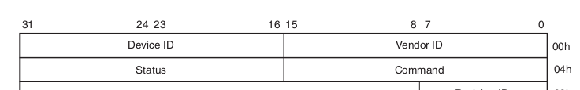
$ pwd
/sys/bus/pci/devices/0000:00:19.0
$ od -Ax -tx2 -w4 -N4 config
000000 8086 1502
000004
$ lspci -s 0000:00:19.0 -n
00:19.0 0200: 8086:1502 (rev 04)

Slide 16
$ pwd
/sys/devices/pci0000:00
$ tree -L 2 -d -P "0000:*" | grep 000
├── 0000:00:00.0
├── 0000:00:02.0
├── 0000:00:16.0
├── 0000:00:16.3
├── 0000:00:19.0
├── 0000:00:1a.0
├── 0000:00:1b.0
├── 0000:00:1c.0
├── 0000:00:1c.1
│ ├── 0000:03:00.0
├── 0000:00:1c.3
├── 0000:00:1c.4
│ ├── 0000:0d:00.0
├── 0000:00:1d.0
├── 0000:00:1f.0
├── 0000:00:1f.2
├── 0000:00:1f.3
├── 0000:00:1f.5

Slide 17
/proc/ioport
5060-507f : 0000:00:19.0
5060-507f : e1000e_test
$ lspci -s 00:19.0 -v
00:19.0 Ethernet controller: Intel Corporation 82579LM Gigabit Network Connection (rev 04)
Subsystem: Lenovo Device 21ce
Flags: fast devsel, IRQ 20
Memory at d2500000 (32-bit, non-prefetchable) [size=128K]
Memory at d252a000 (32-bit, non-prefetchable) [size=4K]
I/O ports at 5060 [size=32]
Capabilities: <access denied>
Kernel driver in use: e1000e_test
Kernel modules: e1000e

Slide 18
/proc/iomem
d2500000-d251ffff : 0000:00:19.0
d2500000-d251ffff : e1000e_test
d252a000-d252afff : 0000:00:19.0
d252a000-d252afff : e1000e_test
$ lspci -s 00:19.0 -v
00:19.0 Ethernet controller: Intel Corporation 82579LM Gigabit Network Connection (rev 04)
Subsystem: Lenovo Device 21ce
Flags: fast devsel, IRQ 20
Memory at d2500000 (32-bit, non-prefetchable) [size=128K]
Memory at d252a000 (32-bit, non-prefetchable) [size=4K]
I/O ports at 5060 [size=32]
Capabilities: <access denied>
Kernel driver in use: e1000e_test
Kernel modules: e1000e

Slide 19
Reference
PCI SPEC
driver/net/ethernet/intel/e1000e/netdev.c
Man Page of lspci

