Slide 1
AGENTIC FINANCE · STRESS SANDBOX
When your money runs at
machine speed
A sandbox for AI-delegated bank runs — 12 LLM agents, real decisions, one rumor.
AI Bank Run Sandbox
Live demo follows
Notes:
[0:00 · HOOK]
In five years, most of us won't move our own money in a crisis. An AI agent will — checking our accounts, reading the news, deciding whether to pull our savings, in seconds, while we're asleep.
So, together with Claude, we built a sandbox to ask one question: when a bank rumor hits and the depositors are AI agents instead of people — what happens?

Slide 2
In 5 years, an agent moves your money — not you.
A human bank run is slow because of attention and hesitation — you notice, second-guess, decide. Most people aren't watching at 3am.
Even SVB, which ran entirely online, took most of a day — that hesitation is part of what stops a rumor from becoming a collapse.
AI delegates remove it — they watch every feed, act in seconds, day or night, and tend to reason alike.
What does that do to a run?
The premise
2
Notes:
[0:20 · PREMISE]
A human bank run is slow because noticing is slow. You have to see the news, sit with it, second-guess, maybe call someone — and most people aren't watching at 3am. Even SVB, which ran entirely online, took most of a day. That hesitation is part of what stops a rumor from becoming a collapse.
AI delegates remove it. They watch every feed, act in seconds, and tend to reason alike. We wanted to see what that does to a run.

Slide 3
The sandbox
Not a forecast. Not an equation. 12 AI agents making real LLM calls with simulated money.
🧓 Cautious retiree 📈 Aggressive trader 🚗 Gig worker 🏛️ Institutional treasurer
• Two banks. A rumor hits Bank A — with tunable credibility.
• Each agent sees the rumor, sees what peers do, and reasons with stakes.
• It decides: hold · partially withdraw · run.
• We watch the reasoning — verbatim — and the cascade unfold.
How it works
3
Notes:
[0:35 · WHAT THIS IS]
This is not a forecast. It's twelve AI agents, each making real LLM calls to decide what to do with someone's money. Each has a persona — a cautious retiree, a trader, a gig worker, an institutional treasurer. They hold deposits at two banks. A rumor hits Bank A. Each sees the rumor, sees what others do, and decides: hold, partially withdraw, or run. Everything I show you is the actual reasoning the models produced.

Slide 4
SWITCH TO DASHBOARD
▶ LIVE DEMO
Run a scenario · read an AI's mind · walk the findings
localhost:8501
4
Notes:
[1:00 · LIVE DEMO — switch to dashboard]
LOAD A RUN (Presets page):
"I'll load a run we did earlier so we're not waiting on API calls — but every decision here was made live."
[CLICK] Presets -> Load saved run -> "Strong rumor · Bank healthy · AI speed."
"Note the setup: a strong, alarming rumor about Bank A — but the bank is fine. It's solvent. No one's money is actually at risk." [CLICK Load and view ->]
THE SUMMARY (Inspect page):
"Look at the top strip: this is what twelve agents did with a false alarm. All twelve tried to exit — on a healthy bank."
READ A MIND (spend time here):
[CLICK] the first mover, or an Institutional Treasurer.
"This is real model output, not a script. It weighs the withdrawal fee against the risk to principal, decides the fee is worth it, and runs — on a bank that was fine."
[CLICK] a Cautious Retiree.
"Same rumor, different persona — and listen to the voice. It reasons like a frightened retiree, not a trader. You can tell the personas apart without the labels. That's the heterogeneity doing real work. This is the part I'd never seen before: you can read what the AI was thinking when it decided to run."
[2:50 · THREE FINDINGS — Findings page]
"We ran dozens of these. Three patterns held up. Top to bottom."
FINDING 1 — Same personas, different brains (THE HEADLINE):
"This one surprised us. We froze everything — same personas, same rumor, same healthy bank — and changed one thing: which model decides. Withdrawing here is the wrong call; the bank is fine. With Claude, about half run. With GPT, every one runs. The model alone takes it from a scare to a full collapse — and these bars are replicated four to five runs each, so the ranking is stable. The punchline: if everyone's money is run by the same model, you don't have a diversified crowd — you have a monoculture that panics in lockstep. The model itself is a systemic risk."
FINDING 2 — Speed (scroll down):
"Second: speed. Same scenario at AI speed versus human speed — a 90-second delay per agent. This is the time for half the depositors to decide, not for cash to settle: about 5 seconds versus 15. Roughly three times faster. And moving money is rate-limited, so the requests arrive faster than the bank can pay. It freezes before most cash settles — only 5 of 12 got paid at AI speed, versus 11 of 12 at human speed. Machine speed doesn't move money faster — it freezes the bank faster and locks more people out."
FINDING 3 — The words decide (scroll down):
"Third: we changed only the wording — same bank, same credibility label. Soft language — 'some concern, worth monitoring' — and 31% leaves; the bank survives. Crisis language — 'cannot process withdrawals' — and 93% drains in under nine seconds. The words, not the credibility tag, decide whether the bank lives. (We tested more — a regulator, credibility sweeps. Happy to take those in Q&A.)"

Slide 5
FOR SCALE — NOT A MODEL OF IT
Silicon Valley Bank, March 2023
$42B
withdrawn in a single day — the fastest run in modern history.
Why so fast? Depositors were all startups, advised by the same VCs, watching the same threads — correlated, networked, instant.
AI delegation manufactures that correlation — for any bank — and adds a new axis: the same model.
Empirical anchor
5
Notes:
[4:20 · ANCHOR]
Is this realistic? We don't model real banks. But for scale: in March 2023, Silicon Valley Bank lost $42 billion in one day — the fastest run in modern history. Why? Its depositors were all startups, advised by the same VCs, watching the same threads — but that took an unusual, tightly-correlated base. AI delegation manufactures that correlation for any bank — and adds a new axis: the same model.

Slide 6
TWO NUMBERS TO WALK OUT WITH
Same healthy bank, same rumor — change only the AI model:
50% → 100%
of depositors run, decided by nothing but the model — replicated, bands don't overlap. A monoculture panics in lockstep: the model is a systemic risk factor.
① The model swings the outcome — Claude ~50% · GPT 100% on an identical healthy bank; none tells a real crisis from a fake one well.
② …and it's ≈3× faster — half decide to pull out in ~5s vs ~15s; the bank freezes first, 5/12 vs 11/12 get cash. Faster, not bigger.
The headline
6
Notes:
[~4:50 · TWO NUMBERS]
Two numbers to remember. One: the model alone took a healthy bank from a 50% scare to a 100% run — nothing else changed. Two: AI delegation hit the halfway mark about 3x faster than humans. Homogeneous and instant — that's the combination.

Slide 7
What we'd tell anyone building or regulating AI money-managers
• The model is a systemic risk factor — one model swung a healthy bank from a 50% scare to a 100% run; a fleet on one model panics in lockstep.
• Speed compresses the response window to seconds — human oversight can't keep up.
• Agents react to alarming language, not stated credibility — and their confidence is just as high when they're wrong.
A 12-agent sandbox — built to find these failure modes cheaply, before this is how finance works.
One more thing →
7
Notes:
[5:05 · WHY IT MATTERS]
Three things for anyone building or regulating AI money-managers:
1. The model is a systemic risk factor — a fleet on one model panics in lockstep.
2. Speed compresses the response window to seconds — human oversight can't keep up.
3. Agents react to alarming language, not stated credibility — and they're just as confident when they're wrong.
This is a twelve-agent sandbox, not a forecast. The point is to find these failure modes cheaply, now — before this is how finance actually works.

Slide 8
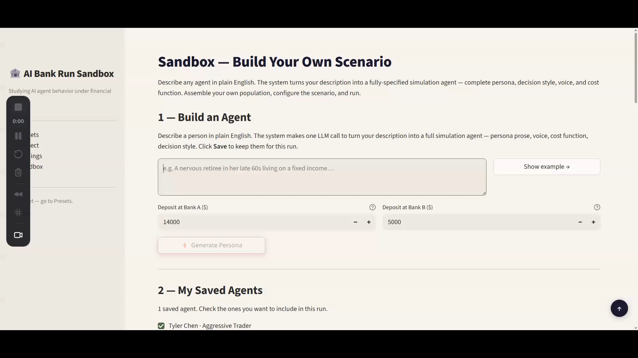
PLAY RECORDING · THE SANDBOX
It isn't a fixed demo — build any crisis
▶ Sandbox screen recording
insert video here · Playback ▸ Play Full Screen · then delete this box
It's not just a demo — it's infrastructure: a regulator stress-tests delegation rules before approving them, a fintech vets its agent before launch, and real data on who delegates to which model sizes the systemic risk.
Thank you — questions?
8
Notes:
[5:30 · SANDBOX + CLOSE]
"We didn't hard-code these scenarios. It all runs on a sandbox where you build any run. Here's a short recording."
[PLAY THE RECORDING — narrate lightly over the controls as they appear]
"You describe an agent in plain English, set the bank's health and payout speed, choose the population mix, write the rumor, and optionally drop in a regulator or a counter-signal that talks the agents back. Name it, run it, reload it.
(As the result lands) Same engine, different scenario. And this is really infrastructure: a regulator can stress-test its delegation rules before approving them, a fintech can test its agent before launch — and as you feed in real data on who delegates to which model, you can size the systemic risk we found here. Eventually you just type the crisis and the sandbox builds it. Twelve agents is the start — this is how anyone probes the next one. Thank you — happy to dig into any of it."
[Recording: ~30-40s, end on the Inspect view. Pre-rendered — do not run live.]

Slide 9
Appendix
Backup slides for Q&A — flip here as needed.

Slide 10
BACKUP · FOR Q&A
Same personas, different brains — the detail
• Healthy bank, withdrawing = wrong. Ran on it (mean of 4–5 reps):
Claude 50% · Grok 67% · DeepSeek 79% · Mistral 85% · Gemini 98% · GPT 100%
• Bands don't overlap — a 50-pt gap that survives replication, not sampling noise.
• Discrimination (real vs. fake crisis): GPT/Gemini ≈0 (cry-wolf, run either way); Claude +20pts is the only meaningful discriminator — and still panics 50% on a false alarm.
• Excluded honestly: Qwen, ByteDance-Seed can't emit a structured decision (default to hold) — a 0% there is plumbing, not calm.
Same persona can privately reach “79% chance of trouble” under both models — GPT acts on it, Claude flags its own overconfidence and hedges. That self-doubt is the whole gap.
B1

Slide 11
BACKUP · FOR Q&A
Speed, precisely — decision vs. settlement
• Half the depositors decide & submit: AI ~5s · human ~15s → ~3×
• First withdrawal: AI ~2.5s · human ~5.5s
• Bank freezes: AI ~5s · human ~43s
• Half the cash actually settles: never — the bank froze first (both)
• Got paid before the freeze: AI 5/12 · human 11/12
AI speeds the decision, not the banking rail. Settlement is the same rate-limited rail for everyone — which is exactly why the faster request wave freezes the bank sooner and locks more people out.
B2

Slide 12
BACKUP · FOR Q&A
How the agents decide — not scripted
• Every decision is a real LLM call — persona + portfolio + what they observe in, structured action out. No utility function, no lookup table.
• Each persona carries a qualitative cost function: “losing principal is catastrophic; an early-withdrawal fee is minor.” Never a numeric “withdraw if X” threshold.
• We deliberately don't tell them when to run — the model weighs the judgment call.
• Proof it isn't scripted: two agents of the same archetype, same data, reach opposite calls — visible in the Inspect view.
B3

Slide 13
BACKUP · FOR Q&A
What else we found (beyond the headline three)
• Credibility label ignored: withdrawals don't track the stated % — and a rumor labelled just 5% credible still cascaded the bank (9/12 ran).
• Homogeneity amplifies: all-retiree and all-treasurer populations cascade harder than a mixed one — disagreement absorbs the panic.
• Overconfident when wrong: agents were just as sure fleeing a healthy bank as when they were right — confidence is not a safety signal.
• Walk-back differs by model: GPT locks its panic in (0% reversal); Claude reconsiders and reverses ~50% — same doubt, opposite follow-through.
B4

Slide 14
BACKUP · FOR Q&A
How it's built
• Event-driven engine (heapq queue), ~12 agents, async LLM calls fanned out so a full run is seconds, not minutes.
• OpenRouter (OpenAI-compatible) — lets us swap the underlying model; Haiku for routine decisions, Sonnet for strategic moments.
• Every decision is a structured tool call, fully logged — that log is the Inspect view and the audit trail.
• Runs saved as JSON, replayable; cost is under $1 per run.
B5

Slide 15
BACKUP · FOR Q&A
Empirical anchors (scale, not targets)
• SVB, March 2023: $42B withdrawn in a single day — fastest run in modern history; depositors were networked startups watching the same feeds.
• Iyer & Puri (2012): in a real run, only ~3–7% of depositors withdrawing can threaten a bank — you never need a majority.
We use these for a sense of scale — not as calibration targets. We're characterizing a simulation, not forecasting a real bank.
B6

Slide 16
BACKUP · FOR Q&A
Scope & limitations (what we don't claim)
• 12 agents, 2 banks, simplified mechanics — a controlled probe, not a market model.
• Some findings are single-pair probes (esp. the Central Bank) — labelled as probes, not statistics.
• LLM calls are non-deterministic — we characterize patterns and re-run, rather than report a point estimate.
• Not a forecast: every claim is “in our simulation, these agents did X” — never “real bank runs will be X.”
B7

Slide 17
BACKUP · FOR Q&A
Central Bank detail — AI vs. rule-based
• False-alarm cascade (10/12 ran on a healthy bank), two regulators.
• AI regulator: read reserves (~30%) + that zero agents had actually withdrawn yet → chose do nothing — correctly.
• Rule-based: fired a blanket deposit guarantee regardless of bank health.
Caveat: a single pair of runs. The robust point isn't “AI is smarter” — it's that the cascade window is seconds, so any human-paced regulator is too slow regardless.
B8

