Slide 1
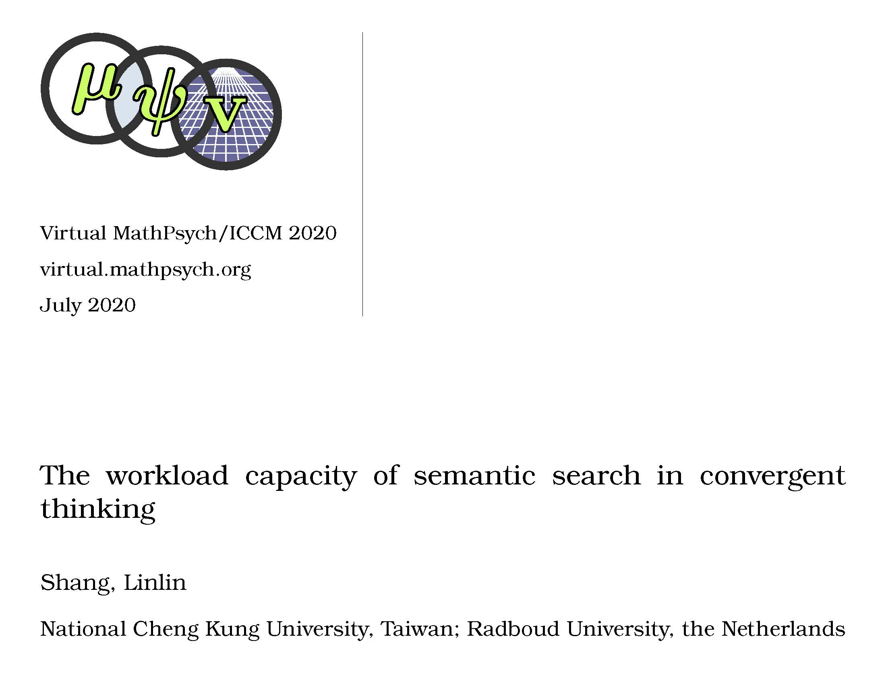
; Little, Daniel R.; Webb, Margaret E.; Eidels, Ami & Yang, Cheng-Ta*

Slide 2
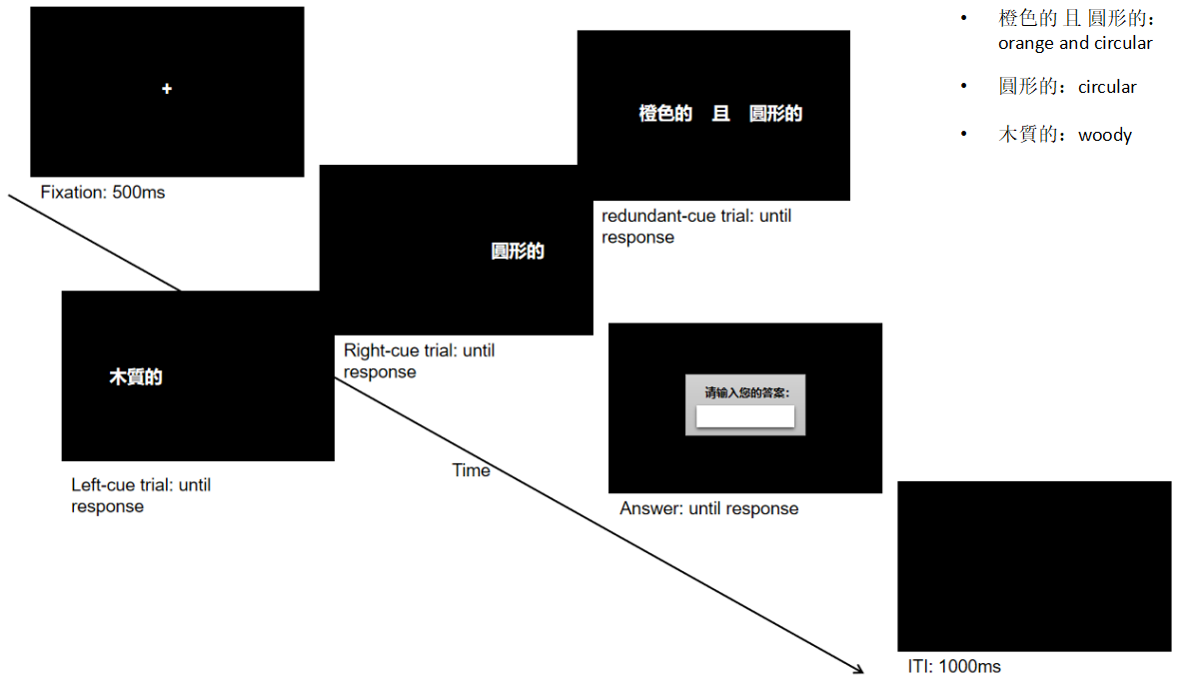
Aims
how cues interact during the process of semantic search
whether workload capacity is related to the final search result
Systems Factorial Technology
supercapacity: facilitation
limited capacity: inhibition
unlimited capacity: no change
Capacity | N = 44
unlimited | 21
limited | 12
super | 11

Slide 3
A possible cause
available resources
used resources
high convegent thinker
low convegent thinker

Slide 4
Thank You
l.shang@psych.ru.nl

