Slide 1
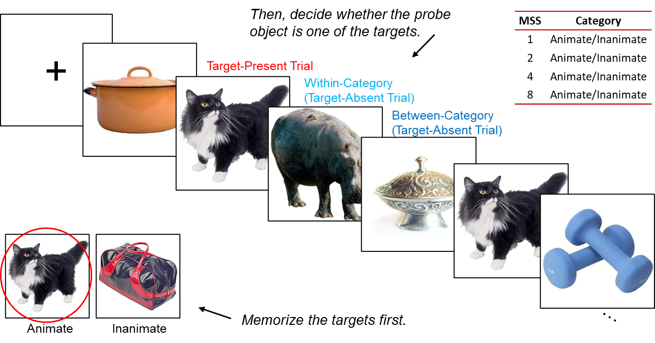
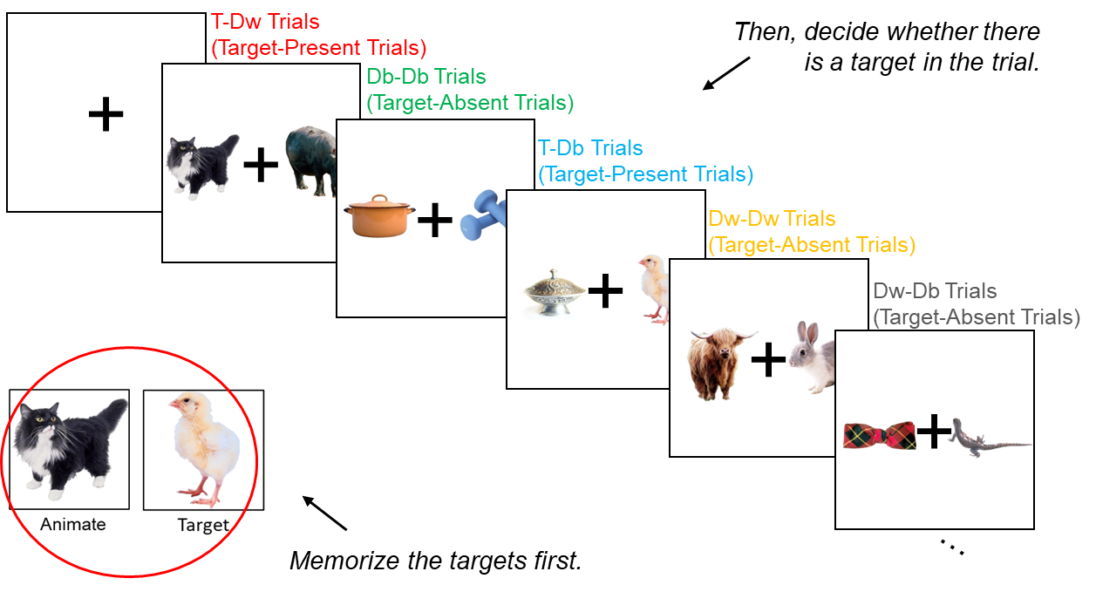
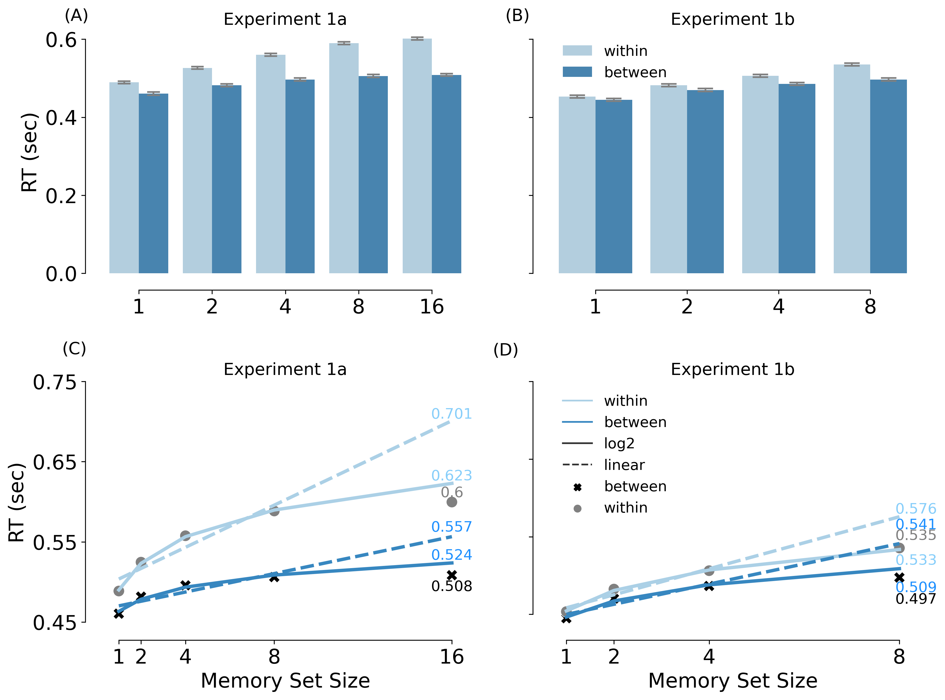
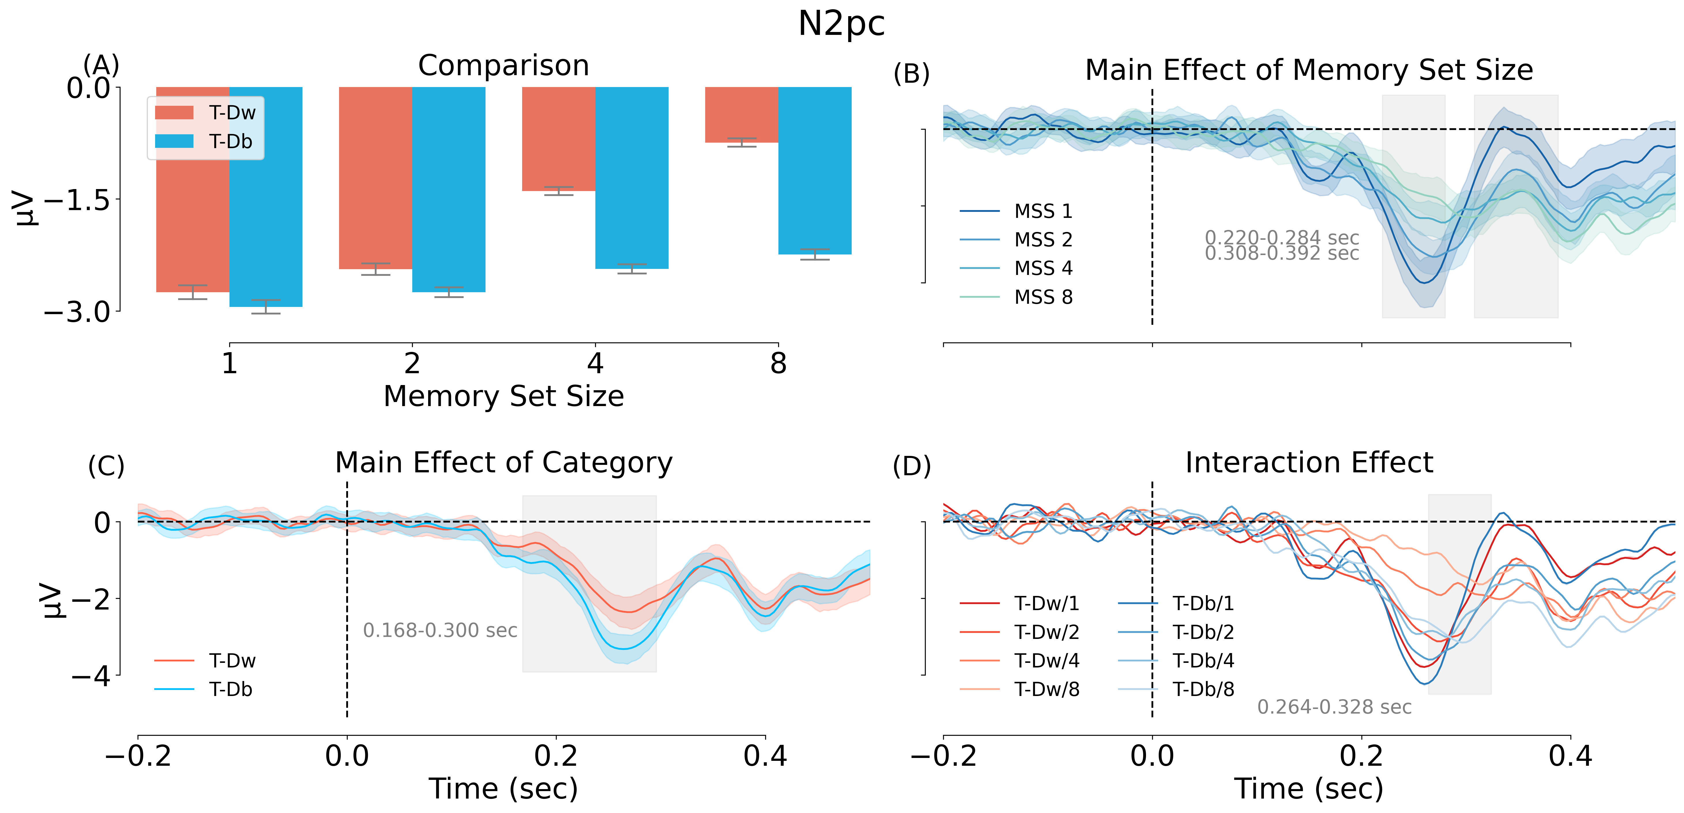
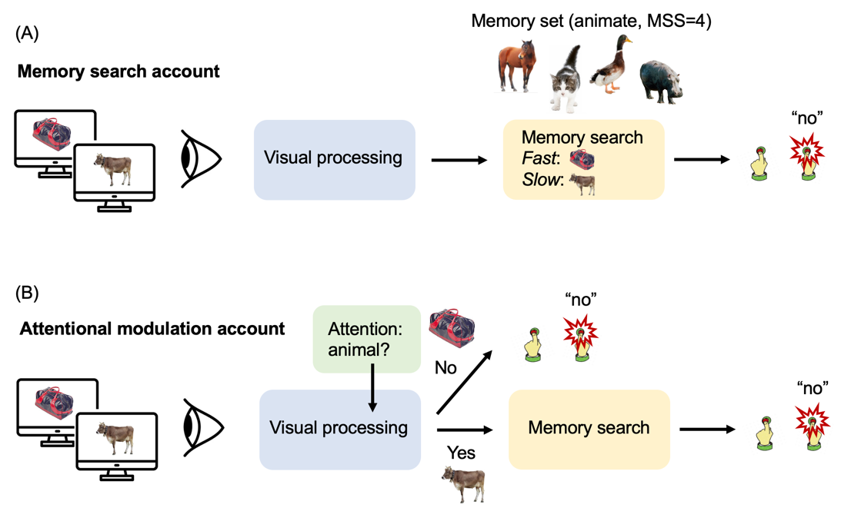
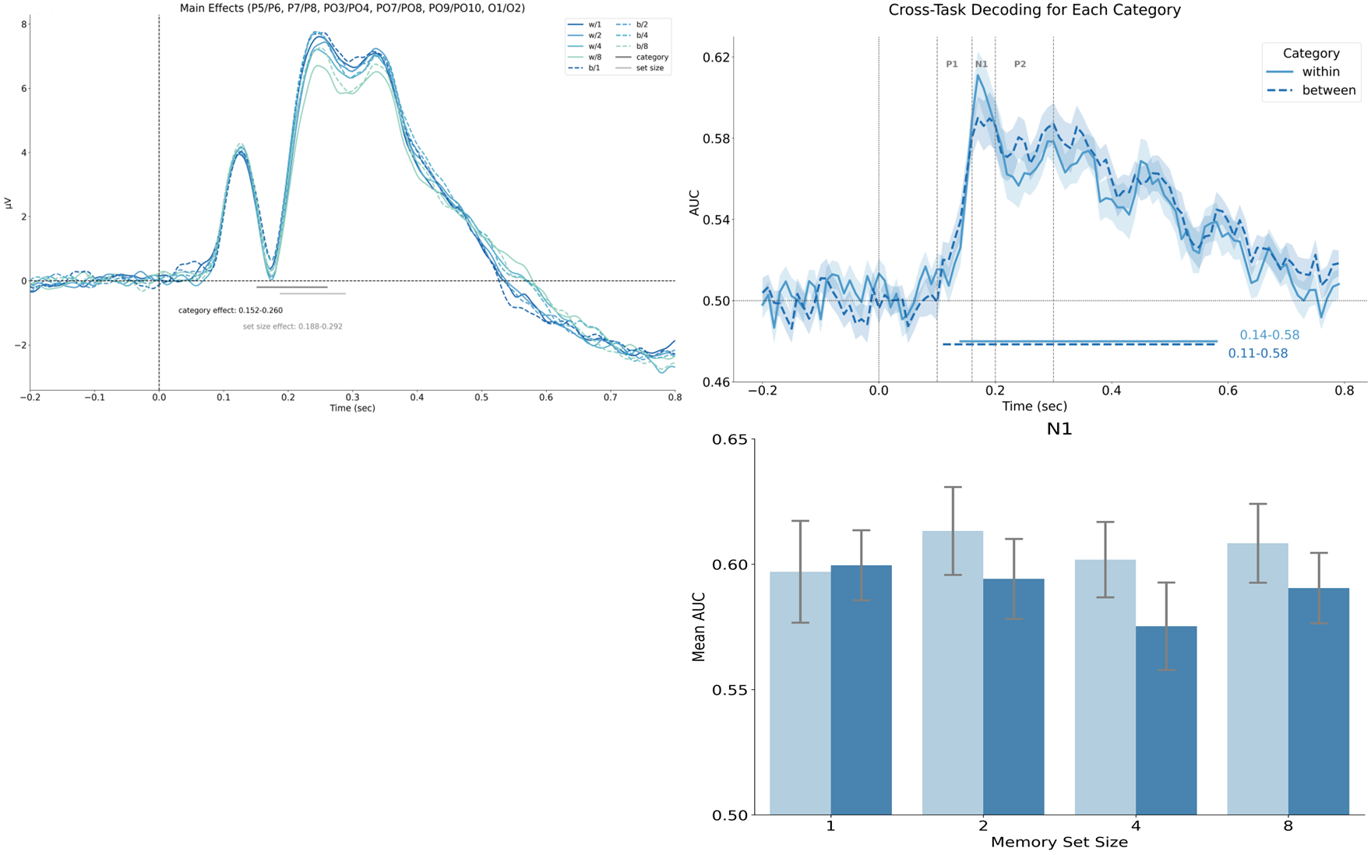
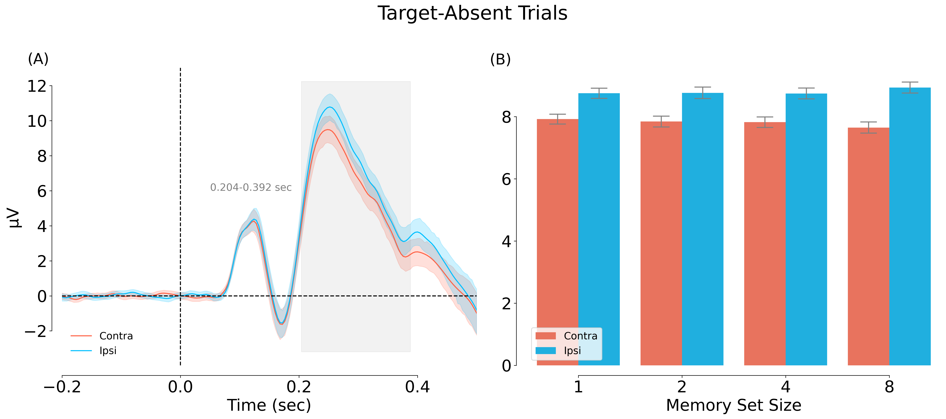


Memory search is facilitated by attentional modulation of visual object processing
Shang, Linlin*¹; Yeh, Lu-Chun²; Zhao, Yuanfang³; Peelen, Marius¹
¹Donders Institute, Radboud University, Nijmegen, The Netherlands; ²Mathematical Institute, Department of Mathematics and Computer Science, Physics, Geography, Justus-Liebig-University, Gießen, Germany; ³Department of Cognitive Science, Johns Hopkins University, Baltimore, MD, USA
INTRODUCTION
EXPERIMENTS
Memory search efficiency depends on the categorical relationship between the objects in the memory set and the probe (Cunningham & Wolfe, 2012, 2014; Drew & Wolfe, 2014).
A question then arises: Why memory search is much more efficient for distractors that are categorically dissimilar to the items in the memory set (between-category) than for distractors that are of the same category as the items in the memory set (within-category).
1.Old/New Recognition Task
2. Target Detection Task
HYPOTHESES
Results
Results
Behavioural Results: Memory search was much more efficient for between-category distractors than within-category distractors.
Categorical information seized attention at relatively early stage.
The interaction of the MSS and category effects was significant.
CONCLUSIONS
Multiple object templates can be activated at the same time in the manner of one categorically single-chunk template.
Categorical information can seize attention at early stage of visual object recognition which even could occur before memory search stage.
The more similar the target and distractor are, the more easily the attention is seized.
Category effect: ~150 msec after stimulus onset (early responses) expressed both as an evoked response modulation and as an increase in decoding accuracy of within-category distractors.
N2pc was induced by within-category distractors.
The N2pc did not differ significantly across MSS.
Correspondence / linlin.shang@donders.ru.nl
@shangll
https://github.com/shangll

