Slide 1
Understanding Factors Influencing the Citation Count for Conference Papers
Utkarsh Goel
Sandhya Thangavel

Slide 2

Motivation

Slide 3



Null Hypothesis

Slide 4

Null Hypothesis

Slide 5

Null Hypothesis

Slide 6

Alternate Hypothesis

Slide 7
Response Variable and Factors
Response variable
Citation count
Factors
Choice of keywords in the paper title
Cloud, Distributed, Security, Mobile, Performance
Conference Rank
A, B, C
Publication year
2008 until 2012 (5 years)

Slide 8
Research Questions
How to classify conferences in different ranks?
Is there an accurate database for conference rankings?
Does the rankings change over time?

Slide 9
Data Collection Technique
Google Survey for determining conference ranking
Insight of Community opinion (47 responses)
Online Conference Ranking Databases
Core Conference Portal, ERA Ranking Portal
Prof. Kevin Almeroth’s blog on Conference Statistics
Acceptance rate, #Papers submitted, #Papers accepted
Google Scholar
Paper Title, Citation Count, Conference Name, Publication Year

Slide 10
Data Collected
63 networking conferences
22 rank A conferences (Acceptance Rate: 11% to 20.9%)
22 rank B conferences (Acceptance Rate: 21% to 30.9%)
19 rank C conferences (Acceptance Rate: 31% to 40.9%)
Total papers = 38895
#Papers in Rank A Conferences = 8224
#Papers in Rank B Conferences = 7134
#Papers in Rank C Conferences = 23537

Slide 11
Research Questions
How to classify conferences in different ranks?
Is there an accurate database for conference rankings?
Does the rankings change over time?
What

Slide 12
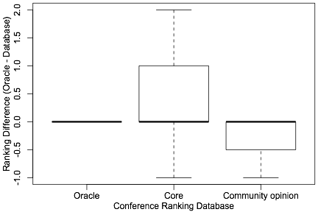
Variation in Conference Ranking

Slide 13
Research Questions
How to classify conferences in different ranks?
Is there an accurate database for conference rankings?
Does conference rankings change over time?

Slide 14
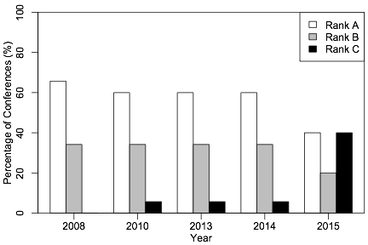
Conference Rankings over Time

Slide 15

How do people cite papers?
Search papers from high quality conferences?
Ask Google?
Search papers from an year?

Slide 16
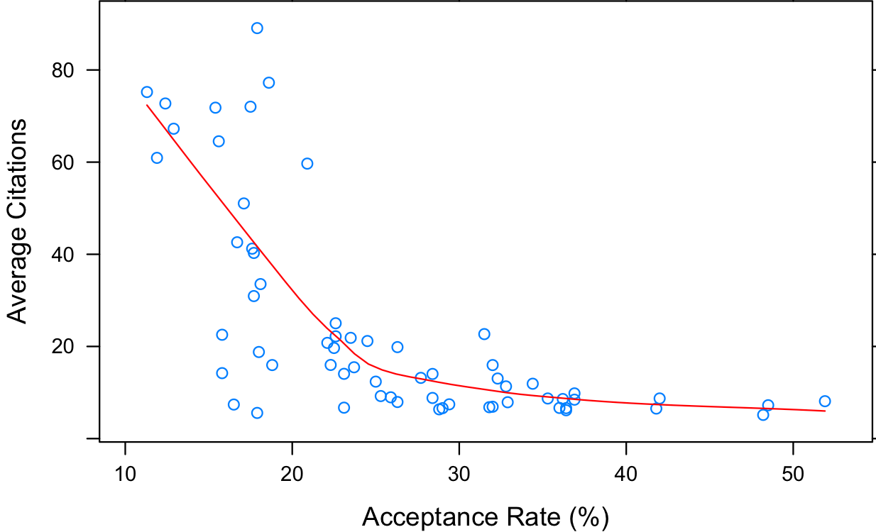
Does Conference affect Citation Count?

Slide 17
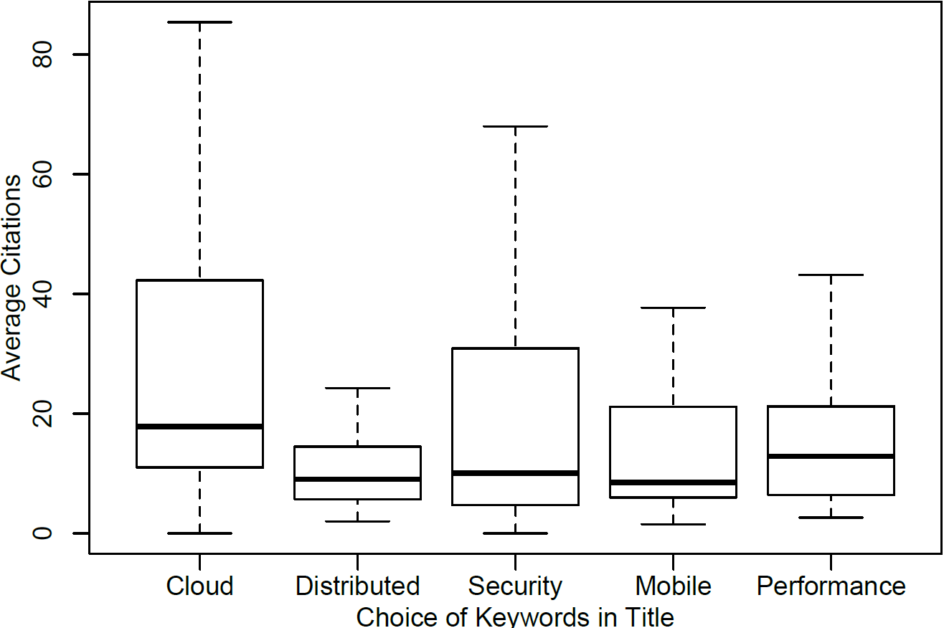
Does Paper Title affect Citation Count?

Slide 18
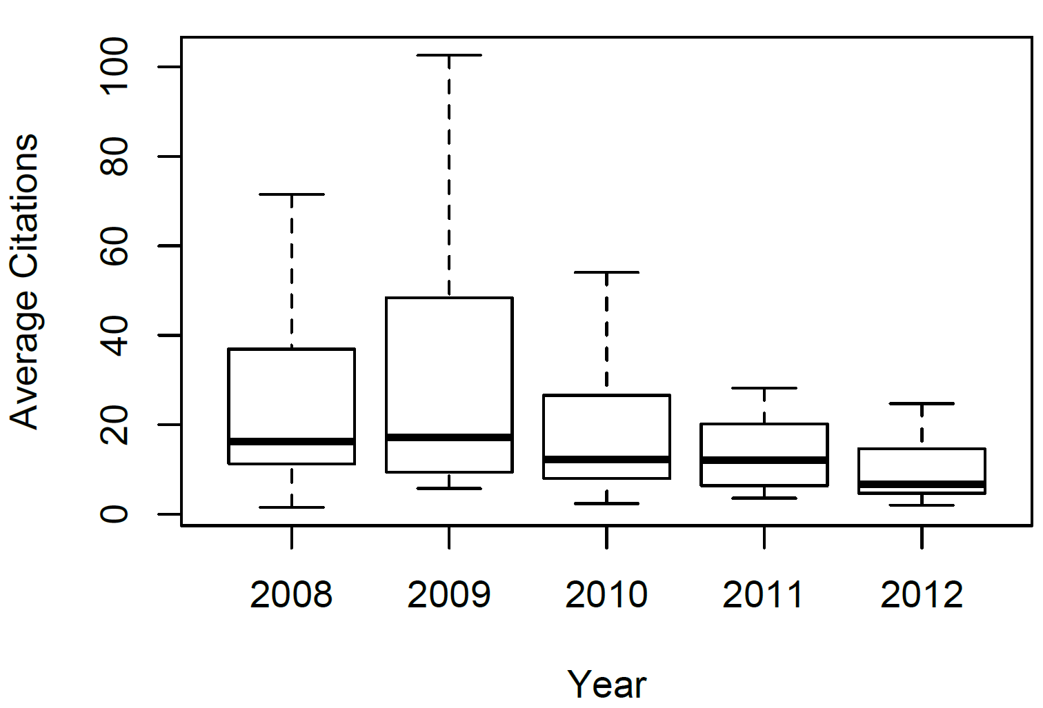
Does Publication Year affect Citation Count?

Slide 19
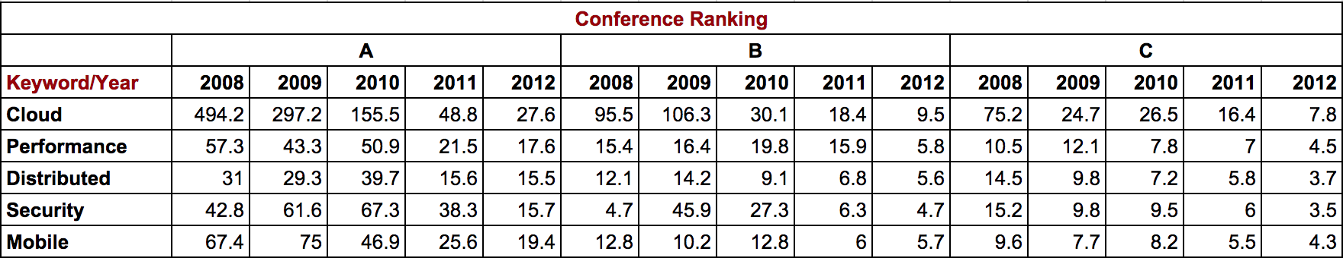
3-Way Nested ANOVA

Slide 20
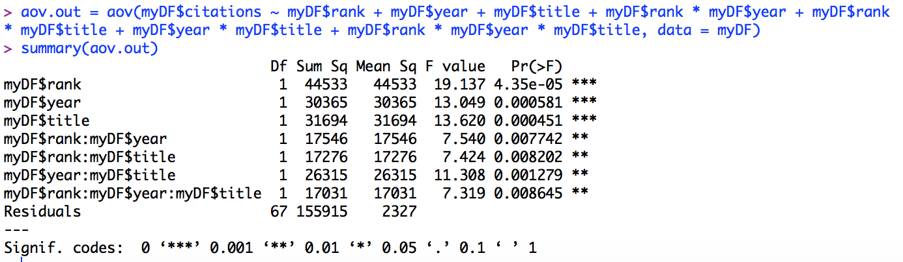
3-Way Nested ANOVA Contd…

Slide 21
Conclusion
Conference Ranking affects citation count by 13%.
Paper title affects citation count by 9.3%.
Publication year affects citation count by 9%.
Interactions affect citation count by 23%.
Unknown factors affect citation count by 45.7%.

Slide 22
Conclusion Contd…
What else could affect citations?

Slide 23

Conclusion Contd…
What else could affect citations?
Author popularity.

Slide 24

Conclusion Contd…
What else could affect citations?
Author popularity.
Paper relevance.

Slide 25

Conclusion Contd…
What else could affect citations?
Author popularity.
Paper relevance.
Timeliness of paper.

Slide 26

Conclusion Contd…
What else could affect citations?
Author popularity.
Paper relevance.
Timeliness of paper.
Citation source.

Slide 27

Conclusion Contd…
What else could affect citations?
Author popularity.
Paper relevance.
Timeliness of paper.
Citation source.
Access to papers.

Slide 28

Conclusion Contd…

Slide 29

Thank You
Data and Code Available at:
https://github.com/ugoel/ESOF522

