Slide 1
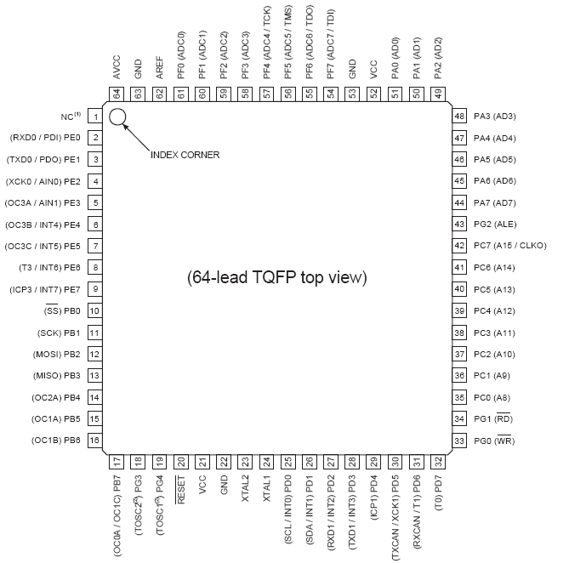
ADC 0-7
Std I/O
UART
Std I/O
External
Mem.
PWM
INT4-7
Clock out
SPI
Std I/O
PWM
UART
External
Mem.
PWM
Reset
Clock
INT 0-3
CAN
Timer clock out

