Slide 1
PHP Programming
Basic Skills (3)
Wen-Hsiang Lu (盧文祥)
Department of Computer Science and Information Engineering,
National Cheng Kung University
2014/12/4

Slide 2
Outline
SQL Language
PHP+MySQL
Notes:
*
07/16/96
*
##

Slide 3
Introduction
PHP (Hypertext Preprocessor)
- Open source, server-side, scripting language.
- Supports databases such as MySQL and Oracle.
- http://www.w3schools.com/php/default.asp
MySQL (Structured Query Language)
- Open source, speedy, scalable, reliable database technology.
- http://dev.mysql.com/doc/mysql/en/Tutorial.html

Slide 4
Basic SQL Syntax
SHOW DATABASES;
USE database_name;
SHOW TABLES;
DROP TABLE table_name;

Slide 5
Create/Delete SQL Table
CREATE TABLE user (name varchar(9) NOT NULL,
id int(6) NOT NULL,
PRIMARY KEY (id),
UNIQUE (id)
);
DROP TABLE user;

Slide 6
Add/Delete/Update Table
INSERT INTO user (name, id) VALUES (‘tim’,‘001’);
DELETE FROM user WHERE id=‘001’;
UPDATE user SET name=‘Tim’ WHERE id=‘001’;

Slide 7
Query Database
SELECT * FROM user;
SELECT * FROM user WHERE name=‘BOND’;
SELECT DISTINCT name FROM user;
SELECT name, id FROM user ORDER BY name;
SELECT pid, SUM(price*num) as total FROM order GROUP BY pid HAVING total>1000;

Slide 8
MySQL
Open Source database server
  Runs on many platforms (Unix & Windows)
Networked server – no fancy GUI like MS Access.
  You can find clients that provide a GUI.
Great for small to medium-sized applications

Slide 9
phpMyAdmin
A MySQL client written in PHP
Via the web you can :
  Manage Databases
  Manage MySQL users
  Submit queries (SQL)
A great way to learn SQL!

Slide 10
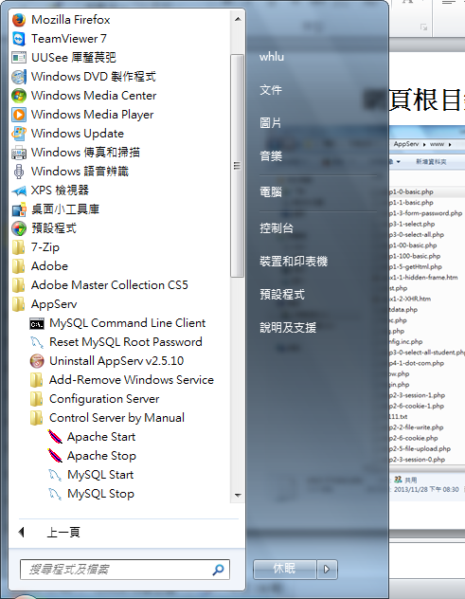
Start Apache web server

Slide 11
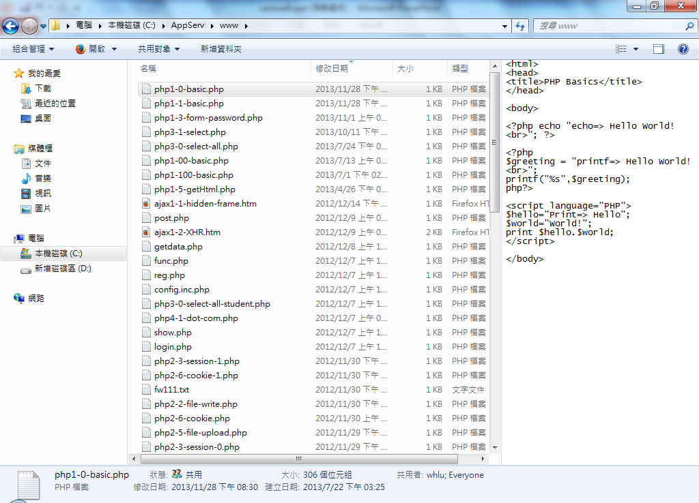
Web pages stored in the web server directory：C:/AppServ/www/

Slide 12
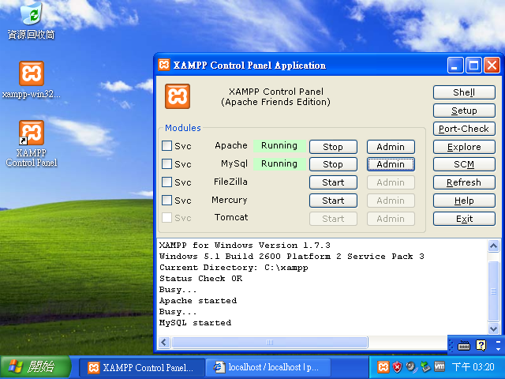

Slide 13
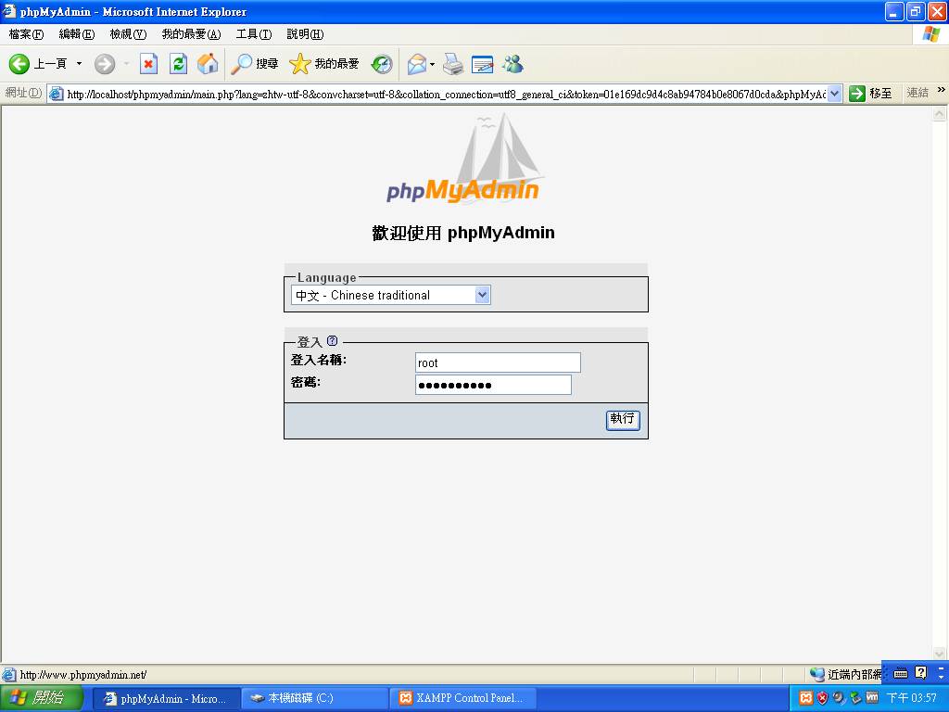

Slide 14
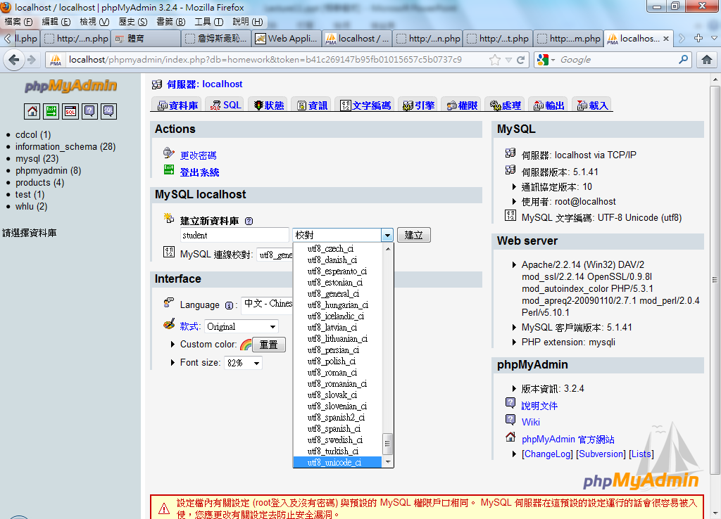

Slide 15
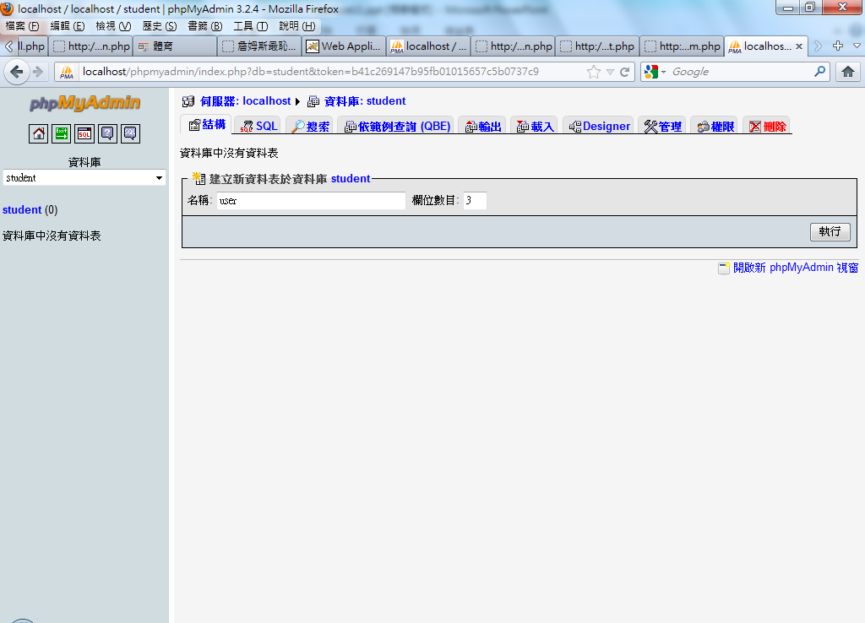

Slide 16
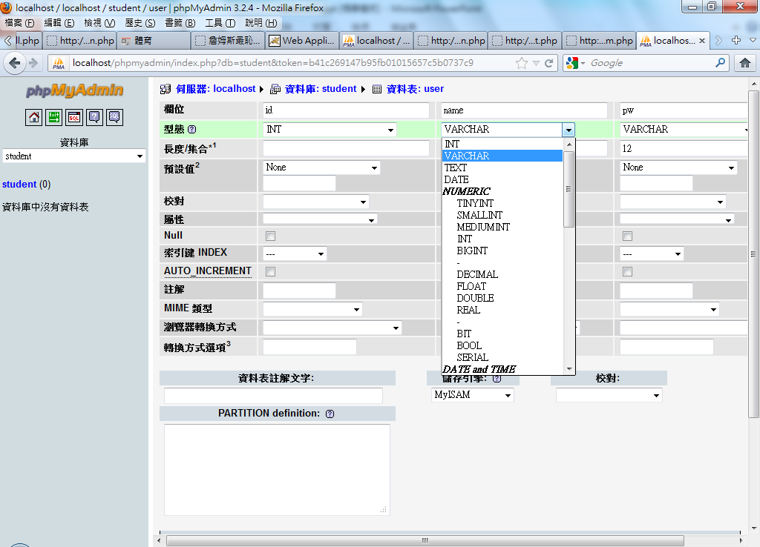

Slide 17
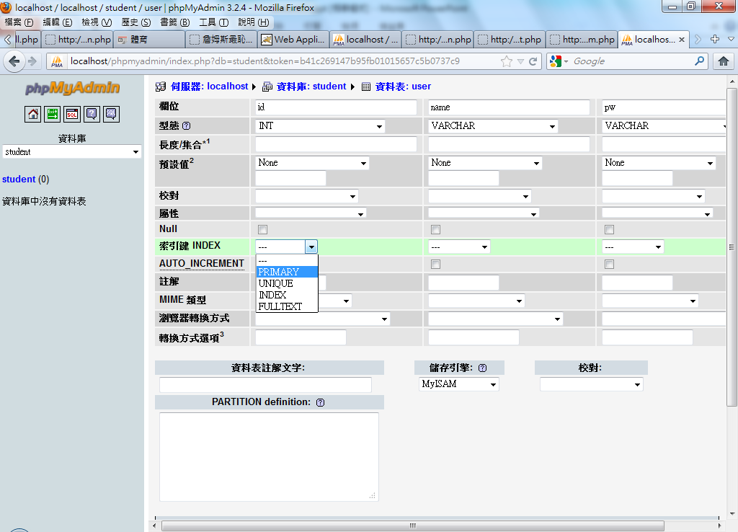

Slide 18
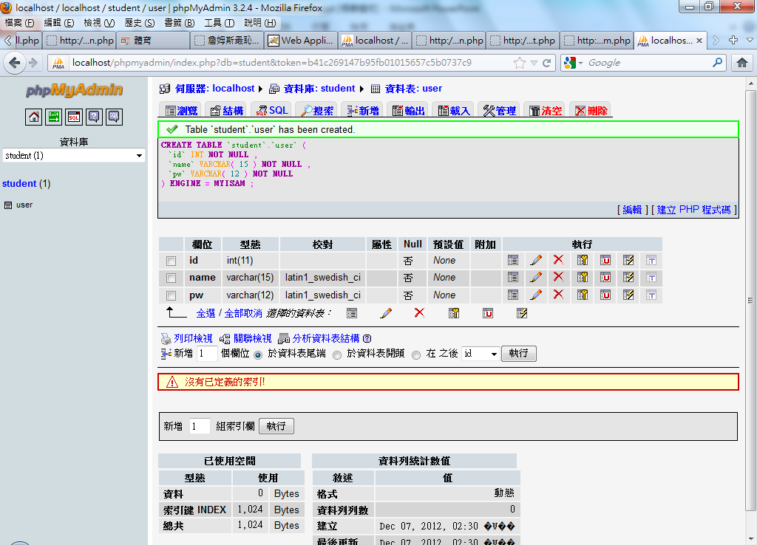

Slide 19
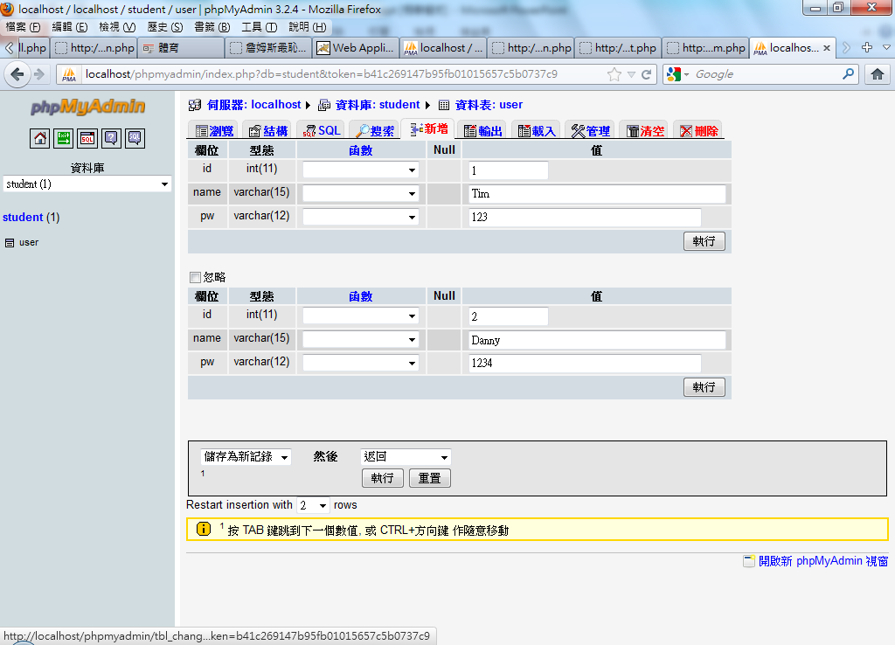

Slide 20
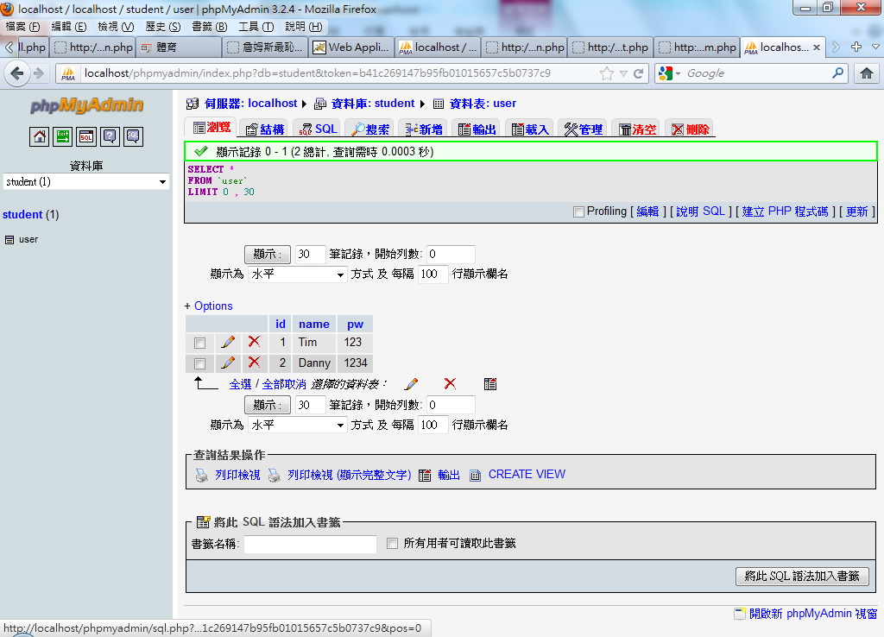

Slide 21
Basic Manipulication Steps
Create MySQL database(s) with tables as required.
Create PHP powered webpage for adding, deleting, updating and viewing database information.

Slide 22
Opening a MySQL database
Assumes that the machine running the server is “localhost”
You can easily use a MySQL server that is running on a remote machine.
$host="localhost";
$username=“whlu”;
$password=“123”;
$database=“student”;
mysql_connect($host,$username,$password);
mysql_select_db($database)or die( "Unable to select database");

Slide 23
Fetching Functions
the fetching functions (mysql_fetch)are as follows:
  mysql_fetch_row: Returns row as an enumerated array
  mysql_fetch_object: Returns row as an object
  mysql_fetch_array: Returns row as an associative array
$query = “SELECT ID, Name, Password FROM user WHERE id = 1”;
$result = mysql_query($query);
while ($row = mysql_fetch_row($result)) {
print(“ $row[0], $row[1], $row[2] <BR>\n”);
}
while ($row = mysql_fetch_object($result)) {
echo “ $row->ID, $row->LastName, $row->FirstName <BR>\n”;
}
while ($row = mysql_fetch_array($result)) {
echo “ $row[ID], $row[LastName], $row[FirstName] <BR>\n”;
}

Slide 24
Session: php3-0-select-all.php
(localhost: php3-0-select-all.php)
<?php
$host="localhost";
$user="whlu";
$upwd=“whlu";
$db="whlu";
$link=mysql_connect($host,$user,$upwd) or die ("Unable to connect!");
mysql_select_db($db, $link) or die ("Unable to select database!");
$query="SELECT * FROM `user` ";
$result= mysql_query($query,$link) or
die ("Error in query: $query.". mysql_error());;
while ($rows=mysql_fetch_array($result)){
echo "$rows[0] $rows[1] $rows[2] <br>";
}
?>

Slide 25
Session: php3-1-select.php
(localhost: php3-1-select.php)
<?php
$host="localhost";
$user="whlu";
$upwd=“123";
$db=“student";
$link=mysql_connect($host,$user,$upwd) or die ("Unable to connect!");
mysql_select_db($db, $link) or die ("Unable to select database!");
$query="SELECT * FROM `user` where user=‘Danny’ ";
$result= mysql_query($query,$link) or
die ("Error in query: $query. " . mysql_error());;
if($rows= mysql_fetch_array($result)){
echo "$rows[0] $rows[1] $rows[2]";
}
else{ print "fetch error"; }
?>

Slide 26
PHP Configuration File
Use a securely positioned ‘config’ file to store variables.
Other PHP pages can link to it and use the variables as their own.
config.inc.php
<?
// database configuration parameters
$host="localhost";
$user="whlu";
$upwd=“123";
$db="whlu";
//database connection
$link=mysql_connect($host,$user,$upwd) or die ("Unable to connect!");
mysql_select_db($db, $link) or die ("Unable to select database!");
?>

Slide 27
reg.php
<?php
if($_REQUEST[user]){
include "./config.inc.php";
$result= mysql_query("SELECT * FROM `user` WHERE user='$_REQUEST[user]'", $link);
if($rows= mysql_fetch_array($result,MYSQL_ASSOC)){
print "此帳號有人使用";
}else{
print "此帳號註冊成功";
$r=md5($_POST[pw]);
$result=mysql_query("INSERT INTO `user` (`id` ,`user` ,`pw`) VALUES ( NULL , '$_REQUEST[user]', '$r');", $link);
print "<script>location.href=('show.php');</script>";
}
}else{
print '<form action="reg.php" method="post">
Username: <input type="text" name="user" /><br/>
password: <input type="password" name="pw" />
<input type="submit" value="註冊" /> </form>';
}
?>

Slide 28
show.php
<?php
include_once "./config.inc.php";
include_once "./func.php";
if(vaild($_COOKIE["user"],$_COOKIE["pw"])){
print " you are ".$_COOKIE["user"]."&nbsp;&nbsp;
<a href=\"login.php?action=logout\">logout</a><br/>";
}else{ login("show.php"); }
$result= mysql_query("SELECT * FROM `score` WHERE id=(SELECT id FROM user WHERE user='".$_COOKIE["user"]."')",$link);
?>
<table border="1">
<tr><td>id</td> <td>english</td> <td>chinese</td> <td>math</td>
</tr>
<?php
while($rows= mysql_fetch_array($result,MYSQL_ASSOC)){
print '<tr><td>'.$rows[id]."</td><td>".$rows[eng]."</td><td>".$rows[ch].
"</td><td>".$rows[math]."</td></tr>";
}
?>

Slide 29
func.php
<?php
function vaild($users,$pws){
if($users and $pws){
include "./config.inc.php";
$result= mysql_query("SELECT * FROM `user` WHERE user='$users'", $link);
if($rows= mysql_fetch_array($result,MYSQL_ASSOC)){
if($rows[pw] == $pws){ return 1; }
}
}
return 0;
}
function login($url){
print '<form action="login.php" method="post">
Username: <input type="text" name="user" /><br/>
password: <input type="password" name="pw" />
<input type="hidden" name="url" value="'.$url.'"/>
<input type="submit" value="登入" />
</form>';
exit;
}
?>

Slide 30
login.php
<?php
include_once "./func.php";
if($_REQUEST[action]=="logout"){
setcookie("user","");
setcookie("pw","");
print "登出OK";
exit;
}
if($_REQUEST[user]){
$r=md5($_POST[pw]);
// echo "$_REQUEST[user],$r<br/>";
if(vaild($_REQUEST[user],$r)){
setcookie("user",$_REQUEST[user]);
setcookie("pw",$r);
print "登入OK";
print "<script>location.href='show.php';</script>";
exit;
}else{ print "登入失敗"; }
}
login($_REQUEST[url]);
?>

Slide 31
PHP Delete
Include "./config.inc.php";
// form not yet submitted, display initial form with values pre-filled
$id=$_GET['id'];
{
// open database connection
$connection = mysql_connect($host, $user, $pass) or die ("Unable to connect!");
// select database
mysql_select_db($db) or die ("Unable to select database!");
// generate and execute query
$query = "DELETE FROM score WHERE id = '$id'";
$result = mysql_query($query) or die ("Error in query: $query. " . mysql_error());
// close database connection
mysql_close($connection);
// print result
echo "<font size=-1>Deletion successful. <br><br><a href=papers.php>Go back to the main page </a> </font>";
}

Slide 32
PHP Update
<?php
Include "./config.inc.php";
// form submitted so start processing it
$title = $_POST["title"];
$authors = $_POST["authors"];
$id = $_POST["id"];
$count = 0;
// validate text input fields
if (!$contact) { $contact = $def_contact; }
// check for errors, if none found...
$connection = mysql_connect($host, $user, $pass) or die ("Unable to connect!");
mysql_select_db($db) or die ("Unable to select database!");
$query = "UPDATE papers SET title = '$title', authors = '$authors',
url = '$url' WHERE id = '$id'";
$result = mysql_query($query) or die ("Error in query: $query. " . mysql_error());
mysql_close($connection);
?>

Slide 33
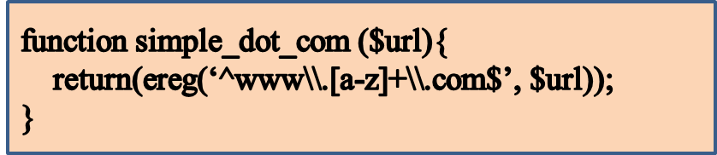
Regular Expression
function ereg(): Regular expression match
  Searches a string for matches to the regular expression given in pattern in a case-sensitive way.
  int ereg (string $pattern , string $string)
  [Ex]
Confusingly, we have to put two backslashes in the pattern string, because PHP treats the first slash as an escape character for the second backslash. (You can get away with just one backslash, but that behavior is not guaranteed to continue in future versions of PHP.) The second backslash (escaped by the first), in turn, is a regex escape character for the following character.
{Ex]: php4-1-dot-com.php

Slide 34
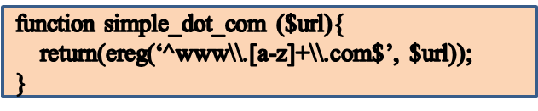
Regular Expression
^www\.[a-z]+\.com$
  ^www : In this expression we have the ‘^’ symbol, which says that the three letters www portion must start at the beginning of the string.
  \. : Then comes a dot (.), preceded by a backslash that says we really want a dot, not the special . wildcard character.
  [a-z] :Then we have a bracket-enclosed range of all the lowercase alphabetic letters.
  + : The following + indicates that we want to match any number of these lowercase letters in a row, as long as we have at least one of them.
  \.com$ : Then another literal ., the three letters com, and the special symbol ‘$’ that says that com is the end of it.

Slide 35
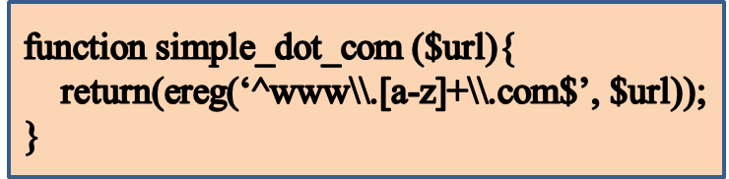
Regular Expression
The special character
  ^ matches the beginning of a string
  $ matches the end of a string
  . matches any character
  ? matches exactly once character
  * matches zero or more instances of the previous regular expression
  + matches one or more instances of the previous expression.
A set of characters enclosed in square brackets matches any of those characters
  the pattern [ab] matches either a or b
  the pattern [a-c] matches a, b, or c
Special characters that are escaped with a backslash (\) lose their special meaning and are matched literally, e.g., \d, \s.

Slide 36
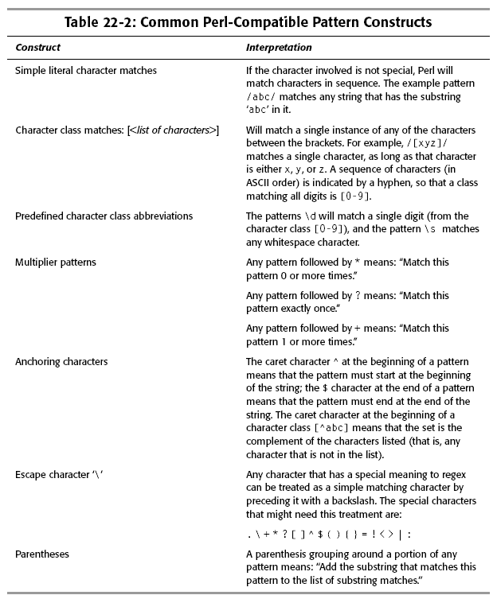

Slide 37
Regular Expression
<?php
function print_links ($url){
$fp = fopen($url, “r”)
or die(“Could not contact $url”);
$page_contents = “”;
while ($new_text = fread($fp, 100)) {
$page_contents .= $new_text;
}
$match_result = preg_match_all(‘ /<\s*A\s*HREF=”([^\”]+)”\s*>([^>]*)<\/A>/I ’,$page_contents,$match_array,
PREG_SET_ORDER);
foreach ($match_array as $entry) {
$href = $entry[1];
$anchortext = $entry[2];
print(“<B>HREF</B>: $href;<B>ANCHORTEXT</B>: $anchortext<BR>”);
}
}
?>

Slide 38
