Slide 1
AJAX Programming Skills (1)
Wen-Hsiang Lu (盧文祥)
Department of Computer Science and Information Engineering,
National Cheng Kung University
2015/12/11

Slide 2
Outline
AJAX Introduction
Hidden Frame
XHR (XMLHttp Requests )
Notes:
*
07/16/96
*
##

Slide 3
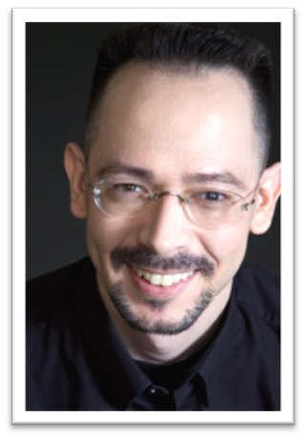
Jesse James Garrett
An information architect
Founder of Adaptive Path
Co-founder of
Information Architecture Institute(IAI)
Author of
The Elements of User Experience
Coined the term AJAX in February, 2005
Jesse James Garrett
NEXT
JJG

Slide 4
What is AJaX?
A name given to an existing approach to building dynamic web applications
Web pages use JavaScript to make asynchronous calls to web-based services that typically return XML
  allows user to continue interacting with web page while waiting for data to be returned
  page can be updated without refreshing browser
  results in a better user experience
  there are AJaX libraries that reduce the amount of JavaScript code that must be written
Uses a JavaScript class called XMLHttpRequest

Slide 5
A Good Acronym?
A is for “asynchronous”
  requests can be made asynchronously or synchronously
  both techniques allow a web page to be updated without refreshing it
  anything useful the user can do while processing request?
    if yes then use asynchronous, otherwise use synchronous
J is for “JavaScript”
  typically JavaScript is used on the client-side (in the browser)
  can use any language on server-side that can accept HTTP requests and return HTTP responses
    Java servlets, Ruby servlets, CGI scripts, …
X is for “XML”
  request and response messages can contain XML
  can really contain any text (single text value, delimited text, …)

Slide 6
Why Ajax?
HTML and HTTP are weak
  Non-interactive
  Coarse-grained updates
Everyone wants to use a browser
  Not a custom application
"Real" browser-based active content
  Failed: Java Applets
    Not universally supported; can't interact with the HTML
  Serious alternative: Flash (and Flex)
    Not yet universally supported; limited power
  New and unproven
    Microsoft Silverlight
    JavaFX
    Adobe Apollo
Notes:
*
07/16/96
*
##

Slide 7
Uses For AJaX
Asynchronous
  examples
    Google Maps – http://maps.google.com
      asynchronously loads graphic tiles to support map scrolling
    Google Suggest – http://www.google.com/suggest
      asynchronously updates list of possible topic matches based on what has been typed so far
Synchronous
  even when there is nothing useful for the user to do after a request is submitted to a server, AJaX can be used to retrieve data and update selected parts of the page without refreshing the entire page
    better user experience

Slide 8
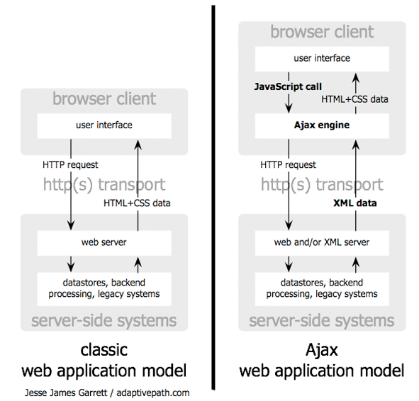
AJAX vs. Traditional Web
JJG

Slide 9


AJaX Process via Hidden Frame
[Ex]: ajax1-1-hidden-frame.htm
2
Onload=function(){
var str =document.getElementById(‘g’)
top.frames[‘A’].display(str);
}
1
Onclick=function(){
top.frames[‘B’].location=“getdata.php”
}
getdata.php
display.php
Button
3
g
display(str)
function display(str){
docment.getElementById(“d”).innerHTML=str
}
d
data
data
<frameset rows="100%,0" style="border: 0px>
<frame src="display.php" name=“A" noresize>
<frame src="about:blank" name=“B" noresize>
</frameset>
Server

Slide 10
XMLHttp Requests (XHR)
[Ex]: ajax1-2-XHR.htm
JavaScript
  Define an object for sending HTTP requests
  Initiate request
    Get request object
    Designate a response handler function
      Supply as onreadystatechange attribute of request
    Initiate a GET or POST request
    Send data
  Handle response
    Wait for readyState of 4 and HTTP status of 200
    Extract return text with responseText or responseXML
    Do something with result
HTML
  Loads JavaScript
  Designates control that initiates request
  Gives ids to input elements that will be read by script
readyState
  0: not open
  1: not request
  2: request (send)
  3: receive data
  4: complete

Slide 11
GET Requests (XHR)
[Ex]: ajax1-2-XHR.htm
var oXHR=new XMLHttpRequest();
para= "key1=value1&key2=value2";
oXHR.open("GET","get.php?"+para, true);
oXHR.onreadystatechange= function(){
if(oXHR. readyState==4 &&(oXHR.status==200||oXHR.status==304)){
var r=document.getElementById("re");
r.innerHTML=oXHR.responseText;
}
}
oXHR.send();

Slide 12
POST Requests (XHR)
var oXHR=new XMLHttpRequest(); //IE5相容性問題未解決
para= "key1=value1&key2=value2"; // encodeURIComponent(para); URL編碼
oXHR.open("POST","post.php",true);
oXHR.setRequestHeader("Content-type", "application/x-www-form-urlencoded");
oXHR.onreadystatechange= function() {
if (oXHR. readyState==4 &&(oXHR.status==200||oXHR.status==304)) {
var r=document.getElementById("re");
r.innerHTML=oXHR.responseText;
}
}
oXHR.send(para);

Slide 13
XHR vs. Hidden Frame
XHR’s advantage: simple
XHR’s disadvantage: lack historical records in browsers
Notes:
*
07/16/96
*
##

Slide 14
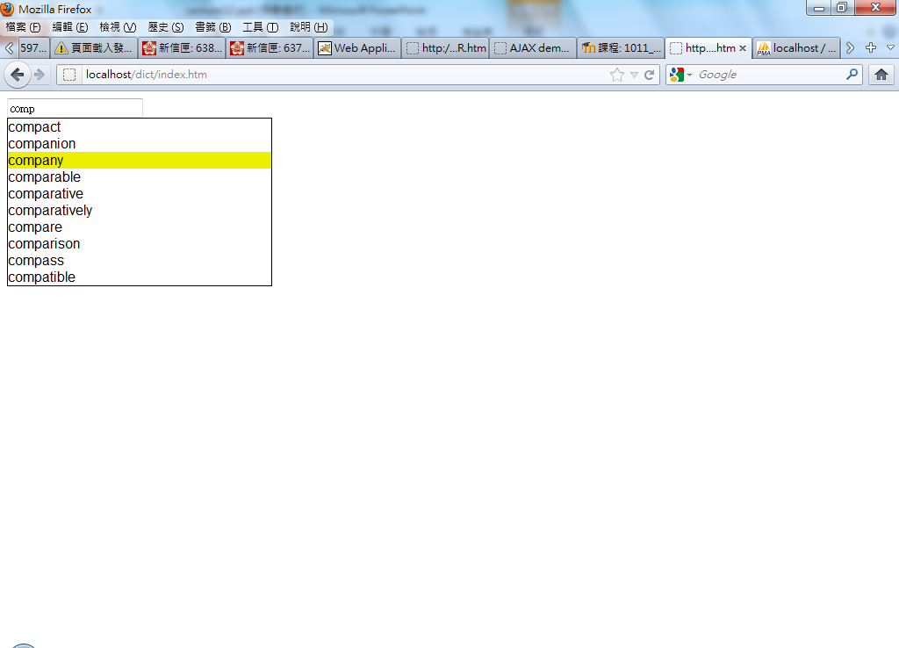
XHR Application: Google suggestion (1)
[Ex: remotehost]: Google suggestion
[Ex: localhost]: Google suggestion
<INPUT type="text" id="search" onblur="dis();Focus=0;" onfocus="Focus=1;" onkeydown="bb(event)"><br/>
<div id="list"></div>
<div id="main"></div>
Notes:
*
07/16/96
*
##

Slide 15
function bb(event){
var listN=document.getElementById("list").children.length;
switch( event.keyCode){
case 40:
var current=(selectI+listN)%listN;
var next=(selectI+listN+1)%listN;
document.getElementById("SG"+current).className="";
document.getElementById("SG"+next).className="hlight";
selectI=next;
break;
case 38:
if(selectI==-1) selectI=0;
var current=(selectI+listN)%listN;
var next=(selectI+listN-1)%listN;
document.getElementById("SG"+current).className="";
document.getElementById("SG"+next).className="hlight";
selectI=next;
break;
case 13:
clearTimeout(ti);
at(13);
break;
default:
clearTimeout(ti);
ti=setTimeout(aa,500);
}
}
function aa(){
var current_input =document.getElementById("search").value;
if (pre!= current_input){
pre=current_input;
changeSet(current_input);
}
}
Notes:
*
07/16/96
*
##

Slide 16
function changeSet (current_input){
……..
var par=document.getElementById("list");
for(var i=par.children.length;i>0;i--)
par.removeChild(par.children[i-1]);
var oXHR=new XMLHttpRequest();//相容性問題未解決
para= "q="+current_input;
oXHR.open("GET","q.php?"+para,true);
oXHR.onreadystatechange= function(){
if (oXHR.readyState==4 &&(oXHR.status==200||oXHR.status==304)){
var similarE=oXHR.responseText.split("|");
var par=document.getElementById("list");
for (var i=0;i<similarE.length;i++){
if (current_input == similarE[i]) { return; }
var newobj= document.createElement("div");
// 建一新物件，這個物件是放一個單字，整個物件視為一項
newobj.id= "SG"+i; //設定ID，以方便在滑鼠移動與鍵盤操作時運算
newobj.onmouseover= mouseO; //設定新物件移過去呼叫之函式
newobj.onmousedown= at; //設定新物件點下去呼叫之函式
newobj.innerHTML= similarE[i]; //新物件的內容設為英文單字
par.appendChild(newobj); //把新物件加到列表中
}
……….
}
}
oXHR.send();
}
Notes:
*
07/16/96
*
##

Slide 17
function at(enter_key){
if (enter_key == 13) {current_input= document.getElementById("search").value;}
else {
var current_input=document.getElementById("SG"+selectI).innerHTML;
document.getElementById("search").value=current_input;
}
var oXHR=new XMLHttpRequest();//相容性問題未解決
para= "q="+current_input;
oXHR.open("GET","main.php?"+para,true);
oXHR.onreadystatechange= function(){
if (oXHR.readyState==4 &&(oXHR.status==200||oXHR.status==304)){
dis();
document.getElementById("main").innerHTML=oXHR.responseText;
}
}
oXHR.send();
}
</script>
Notes:
*
07/16/96
*
##

Slide 18
<?php include_once "./config.inc.php";
$result=mysql_query("SELECT * FROM `dict` WHERE eng LIKE '$_GET[q]%' LIMIT 1",$link); while($rows=mysql_fetch_array($result,MYSQL_ASSOC)){ print "Chinese translation: <br/>".$rows[ch];
// print "english: ".$rows[eng]."<br/>".$rows[ch];
}
?>
Main.php

