Slide 1
HTML5 Programming
Basic Skills (1)
Wen-Hsiang Lu (盧文祥)
Department of Computer Science and Information Engineering,
National Cheng Kung University
2015/12/25

Slide 2
Outline
HTML5 New Functions
Canvas

Slide 3
HTML5
New Functions
  Canvas
  Video/Audio
  Drag & Drop
  RichText
  Web Storage
  Web Workers
  Data Push
  File API

Slide 4
Semantic Tag
Example
<html>
<body>
<div class=“header”>
Page head …
</div>
…
<div class=“content”>
Page content …
</div>
…
<div class=“footer”>
Page end …
</div>
</body>
</html>
<html>
<body>
<header>
Page head …
</header>
…
<section class=“content”>
Page content …
</section>
…
<footer>
Page end
</footer>
</body>
</html>

Slide 5
HTML5 Development
Working Draft (W3C): January, 22, 2008
Last Call (WHATWG): October, 2009

Slide 6
HTML5 Language Syntax
Perhaps follow XHTML
<?xml version=“1.0” encoding=“UTF-8”?>
<html xmlns=“http://www.w3.org/1999/xhtml”>
<head>
<title>XHTML sample</title>
</head>
<body>
<h1>Page head …</h1>
<p> Page content …</p>
<input type=“text” value=“Enter name” />
</body>
</html>

Slide 7
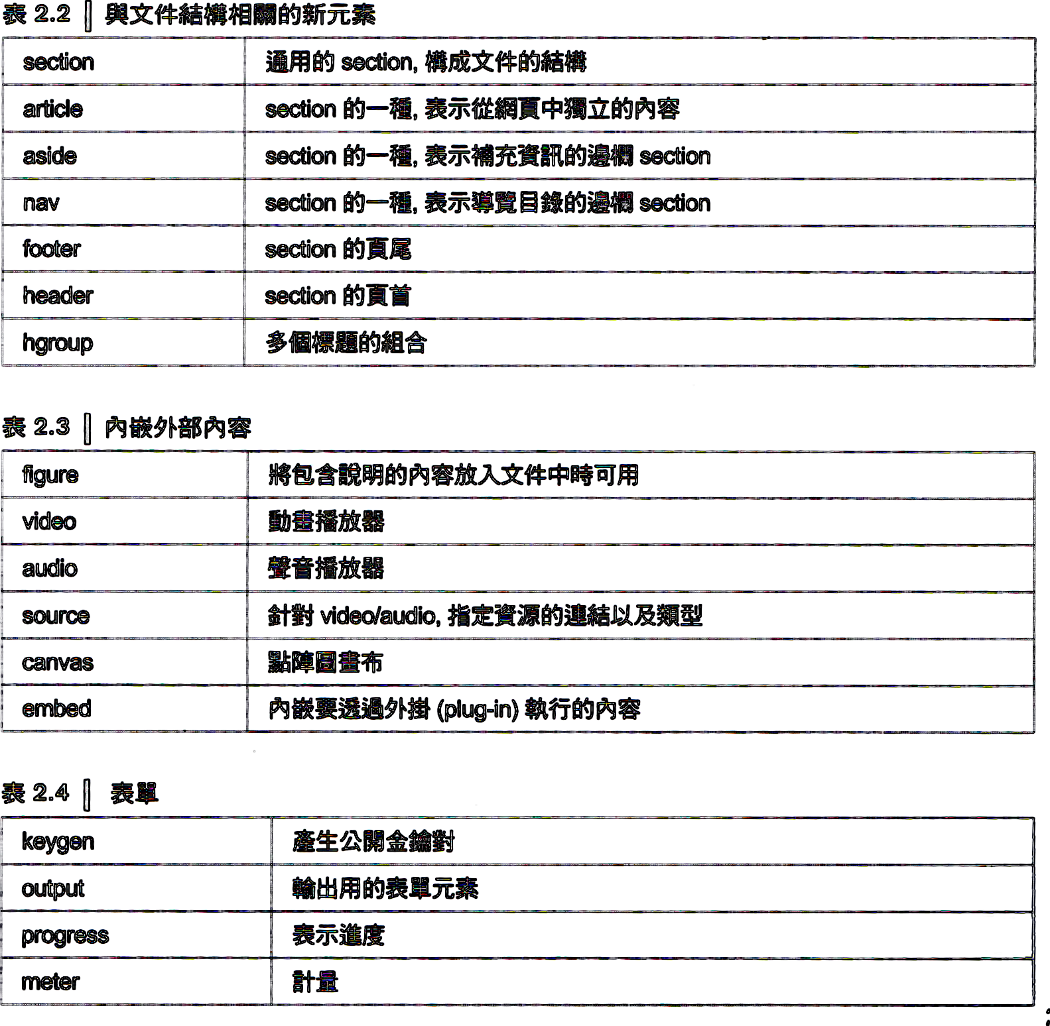

New Tags in HTML5

Slide 8
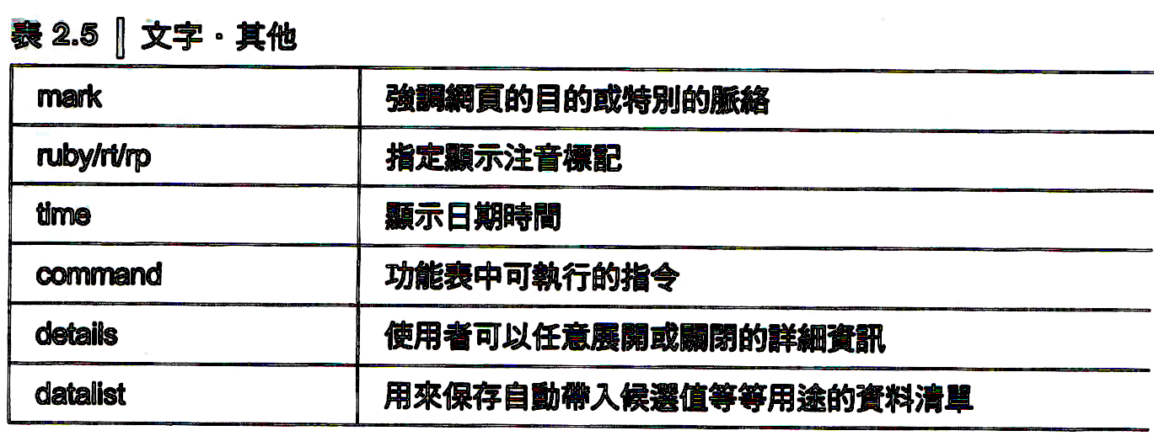
New Tags in HTML5

Slide 9
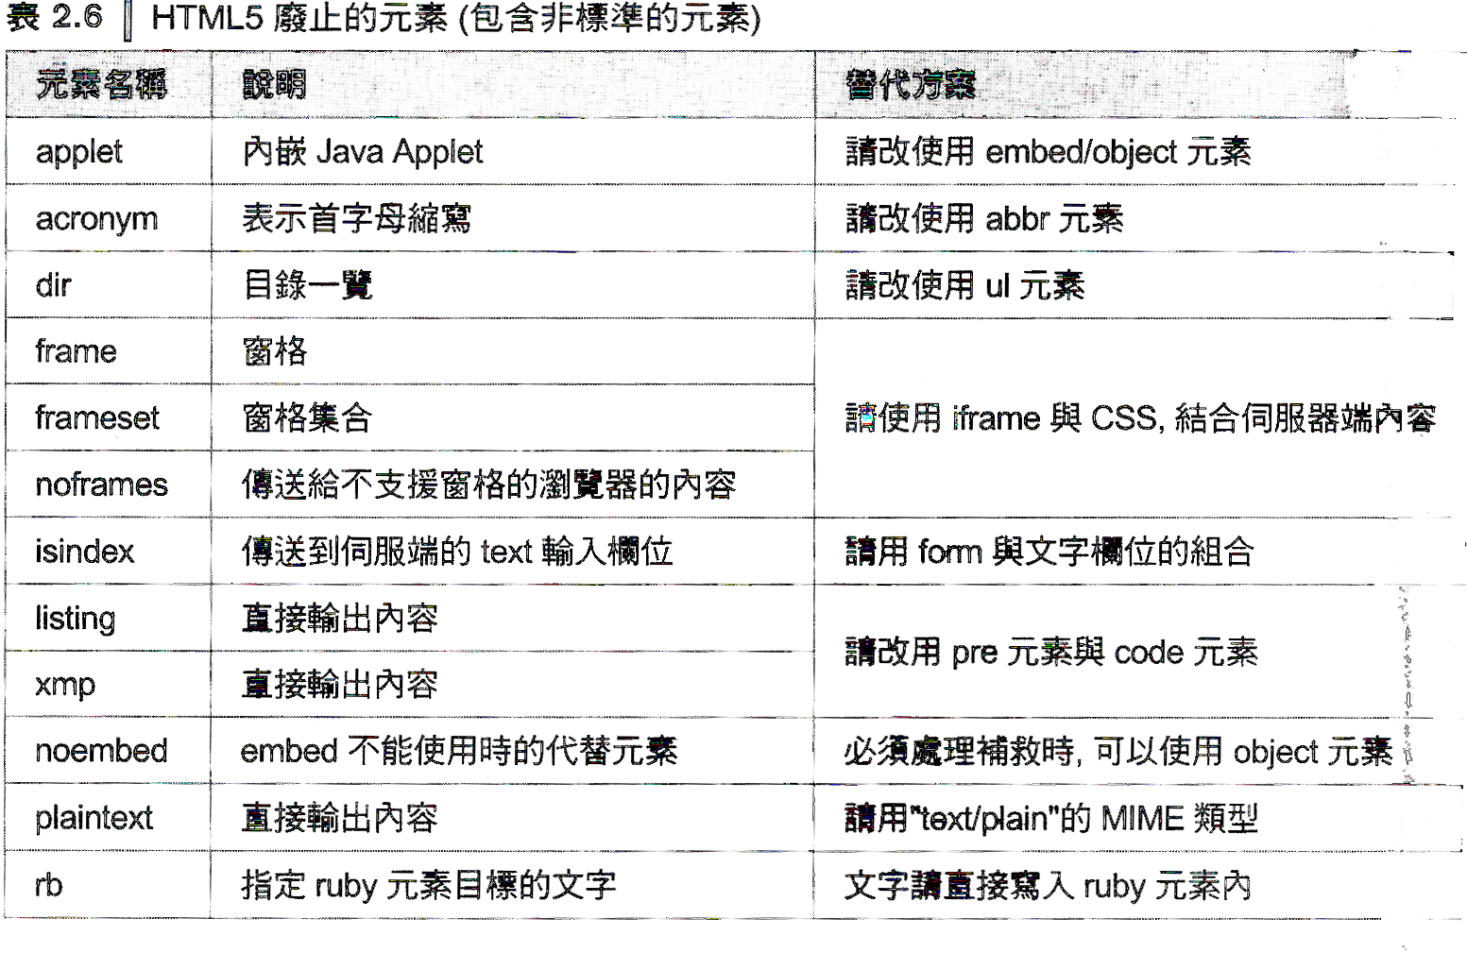
Cancelled Tags in HTML5

Slide 10
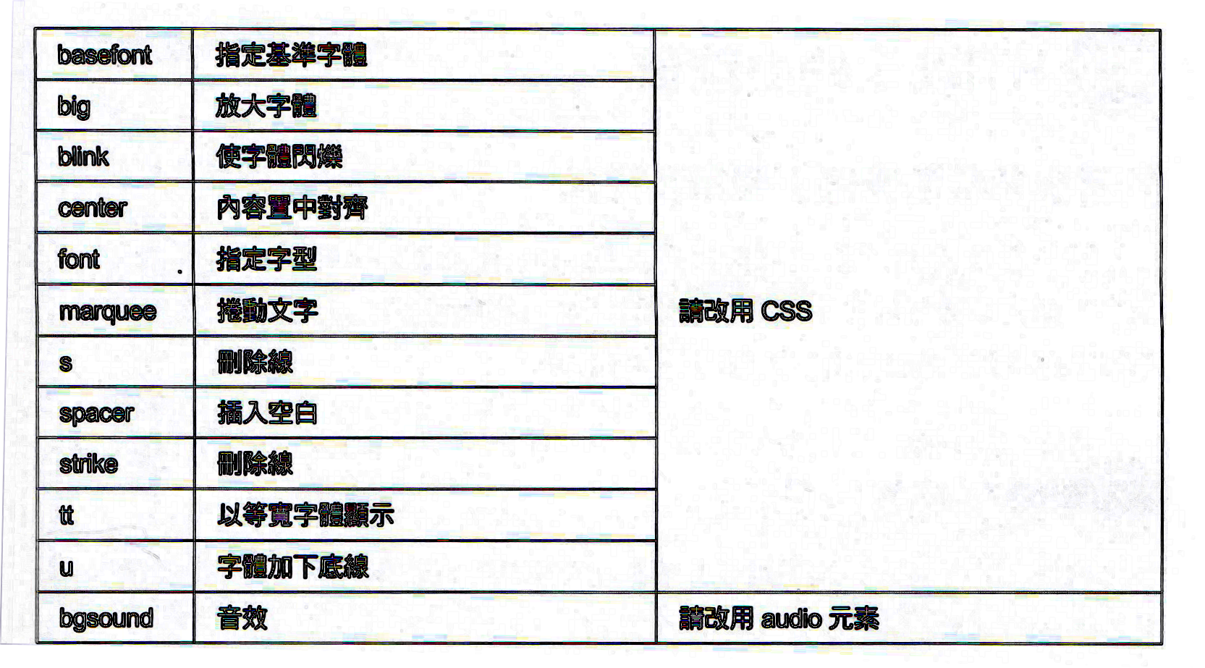
Cancelled Tags in HTML5

Slide 11
<canvas> Tag
Use JavaScript to draw graphics on a web page.
A rectangular area
<canvas id="darea1" width="300" height="200"></canvas>
var canvas= document.getElementById("darea1");
var cx= canvas.getContext("2d");
cx.strokeRect(0, 0, 90, 100);
cx.fillRect(50, 50, 70, 100);
cx.clearRect(70, 70, 30, 50);
cx.fillText("Canvas is powerful in HTML 5!", 120, 20);
cx.rect(0, 0, 300, 200);
  [Ex] html5-1-canvas.htm
cx.strokeRect (x, y, width, height);
cx.fillRect (x, y, width, height);
cx.clearRect (x, y, width, height);

Slide 12
drawImage() method
Draw image
  drawImage(image, sx, sy, sw, sh, dx, dy, dw, dh);
    sx, sy, sw, sh: spliting area
    dx, dy, dw, dh: displaying area
  [Ex] html5-2-canvas-drawimage.htm

Slide 13
Draw Complex Path
Steps for drawing complex path
  beginPath(): initiate the path drawing
  moveTo(), lineTo(), arcTo(), arc(), … : use Canvas API to draw path
    arcTo(x1, y1, x2, y2, radius)
    arc(x, y, radius, startAngle, endAngle, anticloclwise)
  stroke(), fill(), … : display path
  closePath(): connect the lines together to form a shape
  [Ex] html5-3-canvas-stroke.htm

Slide 14
Display Path: stroke(), fill() & clip() methods
Display complex path
  stroke(): display the path with lines
  fill(): fill in with some color or a pattern inside the assigned path
  clip(): clip the assigned path
  [Ex] html5-4-canvas-clip.htm

Slide 15
Drawing with Color: Gradient
Color or Pattern Style
  fillStyle property: set color or pattern style when drawing a diagram
  strokeStyle property: set color or pattern style when drawing a line
CSS color: [Ex] fillStyle= “green”;
Gradient (漸層)
  Gradient color setting
  [Ex] html5-5-canvas-gradient.htm
g1= cx.createLinearGradient (x0, y0, x1, y1);
g1= cx.createRadialGradient (x0, y0, r0, x1, y1, r1);
g1.addColorStop(offset, color);
// offset= 0 => the start point of gradient
// offset= 1 => the end point of gradient
cx.fillStyle= g1;

Slide 16
Drawing with Pattern
Pattern (圖樣)
  Pattern setting
    repeat: four styles
      Repeat, repeat-x, repeat-y, no-repeat
  Transparency
    globalAlpha property
      0: completely transparent
      1: completely not transparent
  [Ex] html5-6-canvas-pattern.htm
g1= cx.createPattern(image, repeat);
cx.fillStyle= g1;

Slide 17
Shadow
Shadow effect for lines or diagrams
  [Ex] html5-7-canvas-shadow.htm
cx.shadowOffsetX = 5;
cx.shadowOffsetY = 5;
cx.shadowColor = "gray";
cx.shadowBlur = 2; //模糊度

Slide 18
Overlap: globalCompositeOperation
Diagram overlapping
  globalCompositeOperation property
  [Ex] html5-8-canvas-composite.htm
globalCompositeOperation=
"source-atop";
"source-in";
"source-out"; //ok
"source-over"; //ok
"destination-atop";
"destination-in";
"destination-out";
"destination-over";
"lighter";
"copy";
"xor"; //ok

Slide 19
Draw Text: fillText() & strokeText()
Draw text
  fillText(text, x, y, maxWidth);
  strokeText(text, x, y, maxWidth);
  font
  textBaseline: top, middle, bottom
  textAlign: left, right, center
  measureText(text): measure information of drawing text
[Ex] html5-9-canvas-text.htm

Slide 20
<canvas> Transform (1)
translate (x, y);
scale (x, y);
rotate (angle);
Transform
var canvas= document.getElementById("darea1");
var cx= canvas.getContext("2d");
cx.translate(50,20);
cx.fillText("translate=>"+text1,30,30); //(2)
cx.scale(3,2);
cx.fillText("scale=>"+text1,50, 50); //(3)
cx.rotate(45*Math.PI/180);
cx.fillText("rotate=>"+text1,150, 60); //(4)
  [Ex] html5-12-canvas-translate.htm

Slide 21

<canvas> Transform (2)
Transform
cx.globalAlpha= 0.5;
cx.translate(100,100);
cx.drawImage(img, 0, 0); //(2)
cx.globalAlpha= 0.2;
cx.rotate(30*Math.PI/180);
cx.drawImage(img, 0, 0); //(3)
cx.transform( 1,0,0,-0.5, 20,img.height*1.5);
cx.drawImage(img, 0, 0); //(4)
[Ex] html5-13-canvas-transform.htm
transform (m₁₁, m₁₂, m₂₁, m₂₂, dx, dy);
m₁₁, m₁₂ x dx
m₂₁, m₂₂ y dy
+

Slide 22
save() & restore() methods
Save/Restore states of drawing environment
  cx.save();
  cx.translate(50,20);
  cx.fillText("translate=>"+text1,30,30); //(2)
  cx.restore();
  cx.rotate(45*Math.PI/180);
  cx.fillText("rotate=>"+text1,150, 0); //(4)
  [Ex] html5-14-canvas-save.htm

Slide 23
<canvas> Bitmap Drawing
Red (0-255) | Blue (0-255) | Green (0-255) | Transparency (透明度) (0-255)
Bitmap array operation
var imageData= cx1.getImageData(x, y, w, h);
for (i=0; i<imageData.data.length; i++){
if (i % 4 == 3){
imageData.data[i]= 255*alpha;
}
}
cx1.putImageData(imageData, x, y);
[Ex] html5-15-canvas-imagedata.htm
ImageData.data[0]

Slide 24
<canvas>Animation Example
Animation process
  setInterval(), setTimeout()
  clearRect()
  save(), restore()
[Ex] html5-16-canvas-clock.htm

