Slide 1
HTML Programming
Basic Skills (1)
Wen-Hsiang Lu (盧文祥)
Department of Computer Science and Information Engineering,
National Cheng Kung University
2015/09/25

Slide 2
What is HTML?
HTML is a language for describing web pages.
HTML stands for Hyper Text Markup Language
HTML is not a programming language, it is a markup language
A markup language is a set of markup tags
HTML uses markup tags to describe web pages

Slide 3
HTML Structure
A HTML document
  consists of HTML’s (markup) tags and plain text contents
  HTML tags are keywords surrounded by angle brackets
    Tag example: <head>、<p>、<br>、<img>
  The plain text is described between “<html>” and </html> tags
    A HTML document is divided into two sections
      Heading section：represented by tag “<head>”
      Body section：represented by tag “<body>”
  http://www.w3schools.com/html/default.asp

Slide 4
HTML Document Example
<!DOCTYPE HTML>
<html>
<head>
<title>The title of this webpage</title>
</head>
<body>
<h1>My First Homepage</h1>
<p>I am Tim.</p>
I like reading.
</body>
</html>

Slide 5
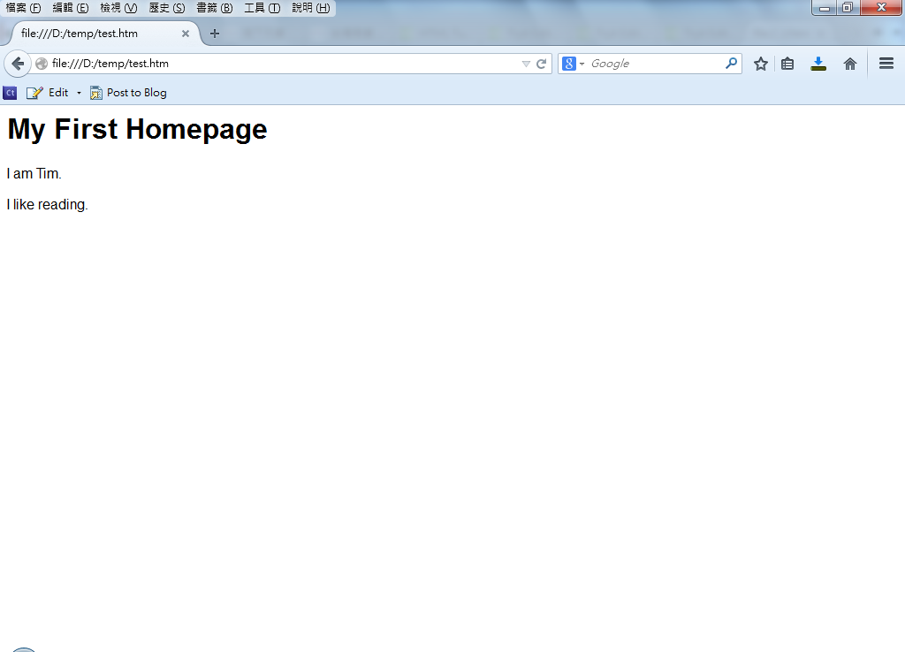
HTML Document Displayed

Slide 6
Heading Section
HTML head elements
Tag | Description
<head> | Defines information about the document
<title> | Defines the title of a document
<base> | Defines a default address or a default target for all links on a page
<link> | Defines the relationship between a document and an external resource
<meta> | Defines metadata about an HTML document | part1-1.htm
<script> | Defines a client-side script, e.g., JavaScript and VBScrip | part1-2.htm

Slide 7
<meta> Tag (1)
Metadata is information about data.
The <meta> tag provides metadata about the HTML document. Metadata will not be displayed on the page, but will be machine parsable.
The <meta> tag always goes inside the head element.
The metadata can be used by browsers (how to display content or reload page), search engines (keywords), or other web services.

Slide 8
<meta> Tag (2)
Meta elements are typically used to specify
  page description
  keywords
  author of the document
  last modified
  other metadata.
<head> <meta name="description" content="Free Web tutorials" /> <meta name="keywords" content="HTML, CSS, XML, JavaScript" /> <meta name="author" content=“Tim Lee" /> <meta http-equiv="content-type" content="text/html; charset=UTF-8" /> </head>

Slide 9
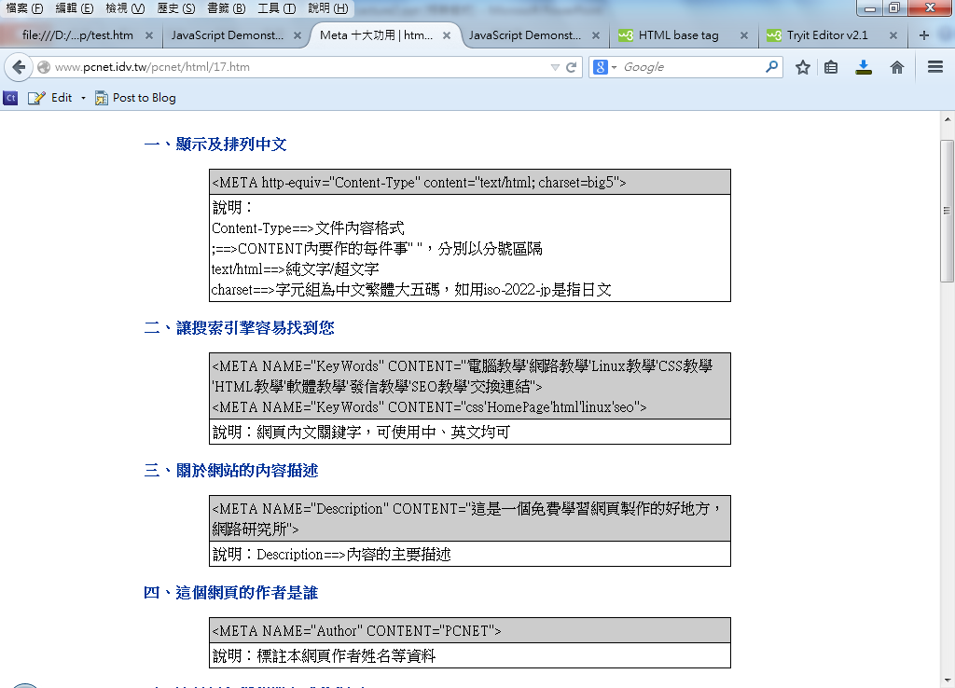
<meta> Tag (3)

Slide 10
<!DOCTYPE>
The <!DOCTYPE> declaration is not an HTML tag; it is an instruction to the web browser about what version of HTML the page is written in.
  <!DOCTYPE html>
  <!DOCTYPE HTML PUBLIC "-//W3C//DTD HTML 4.01//EN" "http://www.w3.org/TR/html4/strict.dtd">
  <!DOCTYPE HTML PUBLIC "-//W3C//DTD HTML 4.01 Transitional//EN" "http://www.w3.org/TR/html4/loose.dtd">
  <!DOCTYPE HTML PUBLIC "-//W3C//DTD HTML 4.01 Frameset//EN" "http://www.w3.org/TR/html4/frameset.dtd">
  <!DOCTYPE html PUBLIC "-//W3C//DTD XHTML 1.1//EN" "http://www.w3.org/TR/xhtml11/DTD/xhtml11.dtd">

Slide 11
Notes of HTML
<!-- ******** -->
<!-- Example -->
<!-- ******** -->
<!-- Content of this paragraph is demonstrated by JavaScript code -->
Notes can cross columns
Notes do not display on web page
  [Example] part1-2.htm

Slide 12
Tags
Tag types
  paired tag：<html>…</html>，<a>…</a>
  single tag：<br>，<p>
Tag’s name has no difference with uppercase and lowercase
It is not allowed to define tag’s name by yourself
Tags can contain attributes
  <img src=Photo.gif>
  <a href=http://www.ncku.edu.tw/>Cheng Kung University</a>
  Three formats of tag attributes
    <body bgcolor= green>
    <body bgcolor= ‘green’ >
    <body bgcolor= “green” >

Slide 13
Paragraph Layout (1)
<br> : Change to a new line (line break)
<pre>…</pre> : Maintain the original text layout
<p> : Paragraph tags
<div> : a block level element used for grouping HTML elements.
Special characters ：<、>、”、&
  &nbsp; => Whitespace
  &lt; => <
  &gt; => >
  &quot; => ”
  &amp; => &
    [Example] part2-1.htm

Slide 14
Paragraph Layout (2)
<blockquote>: Indent (縮排) tag
<address>: Special post/mail format
<center>: text position alignment
[Example] part2-1.htm

Slide 15
Paragraph Layout (3)
<hr>: line tag
      size attribute (line thickness)
      width attribute (line width)
      align attribute (line position alignment)
      noshade attribute (shadow lines)
    [Example] part2-1.htm

Slide 16
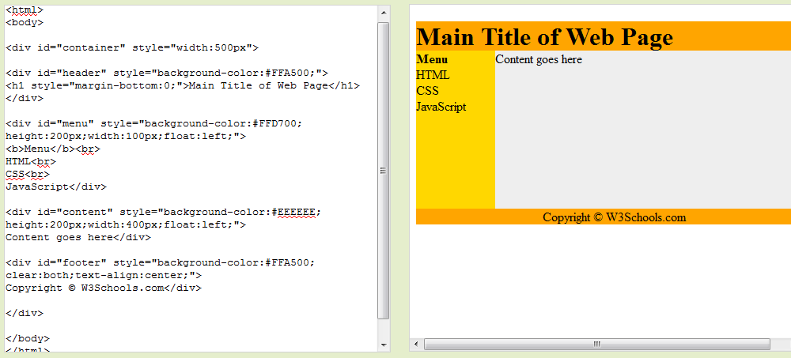
Paragraph Layout (4)
    Example: use five div elements to create a multiple column layout.

Slide 17
Page Background: <body> Tag
The attributes of tag <body>
  bgcolor attribute (background color)
        [Example] part3-1.htm
  background attribute (background image)
  text attribute (text color)
  leftmargin, topmargin attribute (page’s left & top border)
    [Example] part3-2.htm

Slide 18
Text Formatting (1)
Effect | Tag | Effect | Tag
title | <h1>, <h2>,…, <h6> | Delete Line | <s> <strike> <del>
Bold | <b> <strong>
 |  | Small font | <tt>
Italic | <i> <em> <var> <cite> | Increase font | <big>
 |  | Reduce Font | <small>
 |  | Superscript font | <sup>
 |  | Subscript font | <sub>
Underline | <u> <ins>

Slide 19
Text Formatting (2)
<h?>: Text heading tag(? is the value between 1 to 6)
      align attributes：left、center、right
<b>、<strong>: Bold tag
<i>、<em>、<var>、<cite>: Italic tag
<u>、<ins> : Underline tag
<s>、<strike>、<del> : Strike tag
[Example] part4-1.htm

Slide 20
Text Formatting (3)
<tt>: Small font tag
<big>、<small>: Increase and reduce font size tag
<sub>、<sup>: Subscript and Superscript tag
<blink>: Blinking text tag
    [Example] part4-2.htm

Slide 21
Multifunction Text Formatting
<font>: Multifunction text layout tag
  size attribute (font size)
  color attribute (font color)
  face attribute (font type)
    [Example] part4-2.htm

Slide 22
List Tags
<li>: Item tag
<ol>: Ordered list
<ul>: Unordered list (Standard list with indent (縮排))
<lh>: Unordered list (Standard list without indent)
Nested list
[Example] part5-1.htm

Slide 23
Table Tag (1)
Table declaration：<table>…</table>
  row：<tr>…</tr>
  cell：<td>…</td>
  cell header ：<th>…</th>
[Example] part6-1.htm

Slide 24
Table Tag (2)
Table attributes
  border width: <table border=“3”>…</table>
  width of the internal borders:
  <table border=“3” cellspacing=“5”>
  width: <table border=“3” width=“600”>
  height: <table border=“3” height=“30%”>
  position: <table align=“left”> [center, right]
  background color: <table bgcolor=“FFFF00”>
  border color : <table bordercolor=“FF0000”>
  background image: <table background=“bg1.gif”>
[Example] part6-1.htm

Slide 25
Table Tag (3)
<tr> row’s attributes
  row’s background color ：<tr bgcolor=“FFFF00”>
  Align content in a table row ：<tr align=“left”> [center, right]
  Vertically align content in a table row ：
  <tr valign=“top”> [middle, bottom]
[Example] part6-2.htm

Slide 26
Table Tag (4)
<th><td> cells’ attributes
  cell width ：<td width=“100”>
  cell height ：<td height=“50”>
  Align content in a cell ：<td align=“left”> [center, right]
  Vertically align content in a cell ：
  <td valign=“top”> [middle, bottom]
  cell background color ：<td bgcolor=“FFFF00”>
[Example] part6-3.htm

Slide 27
Table Tag (5)
<th><td>cells’ attributes
  Specify the number of columns the current cell spans across ：<td colspan=“2”>
  Specify the number of rows the current cell spans across ：<th rowspan=“2”>
Table caption ：<caption>…</caption>
  Align the caption ：<caption align=“left”> [center, right]
Nested Table
[Example] part6-4.htm

