Slide 1
PHP Programming
Basic Skills (1)
Wen-Hsiang Lu (盧文祥)
Department of Computer Science and Information Engineering,
National Cheng Kung University
2015/11/20

Slide 2
Outline
Introduction
Resources
PHP Language Basics
Built-in Functions
Notes:
*
07/16/96
*
##

Slide 3
Introduction
What is PHP?
  PHP stands for "PHP Hypertext Preprocessor”
  The product was originally named Personal Home Page Tools
  PHP is the Web development language written by and for Web developers.
  An embedded scripting language for HTML like ASP or JSP
  PHP is a server-side scripting language
  A language that combines elements of Perl, C, and Java

Slide 4
Introduction
History of PHP
  Created by Rasmus Lerdorf in 1995 for tracking access to his resume
  Originally a set of Perl scripts known as the “Personal Home Page” tools
  Rewritten in C with database functionality
  Added a forms interpreter and released as PHP/FI: includes Perl-like variables, and HTML embedded syntax

Slide 5
Introduction
History of PHP (cont.)
  Version 5.0 includes version 2.0 of the Zend Engine
    New object model is more powerful and intuitive
    Objects will no longer be passed by value; they now will be passed by reference
    Increases performance and makes OOP more attractive

Slide 6
Resources
    PHP Downloads and Online Documentation
      www.php.net
    Community
      www.phpbuilder.com: articles on PHP, discussion forums
      www.phpresourceindex.com: over 1,000 PHP scripts
      www.phpvolcano.com: PHP 5 information
    Newsgroups
      comp.lang.php

Slide 7
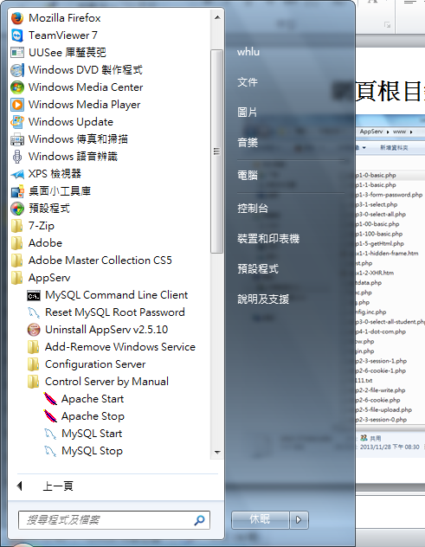
(1) Start Apache web server via AppServe

Slide 8
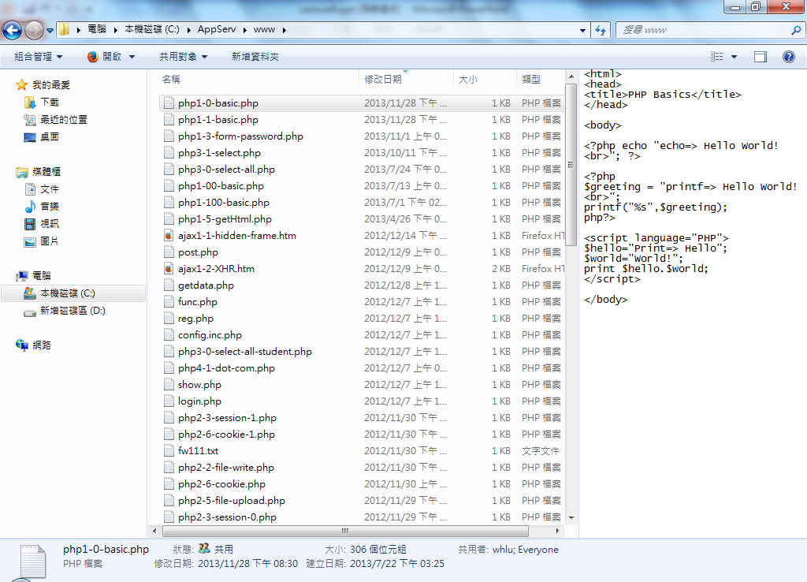
Web pages stored in the web server directory：C:/AppServ/www/

Slide 9
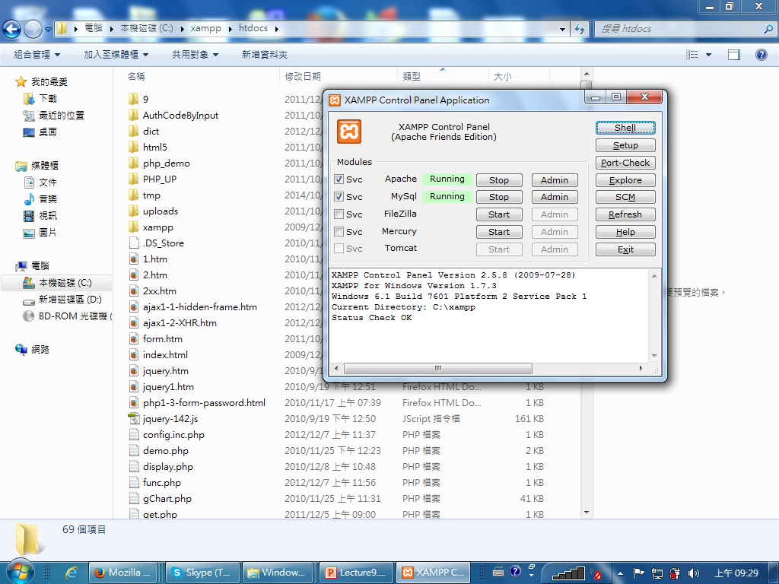
(2) Start Apache web server via Xampp
* Web pages stored in the web server directory：C:/xampp/htdocs/

Slide 10
PHP Language Basics
The Script Tags
  All PHP code is contained in one of several script tags:
    <?
    // Some code
    ?>
    <?php
    // Some code here
    ?>
    <script language=“PHP">
    // Some code here
    </script>

Slide 11
Print Strings
Like Perl, there is more than one way to do it
  <?php echo “Hello World!”; ?>
  <?php
  $greeting = “Hello World!”
  printf(“%s”, $greeting);
  ?>
  <script language=“PHP”>
  $hello = “Hello”;
  $world = “World!”;
  print $hello . $world
  </script>
  [Ex]php1-0-basic.php, php1-1-basic.php

Slide 12
Constants
Constants define a string or numeric value
Constants do not begin with a dollar sign
Examples:
  define(“COMPANY”, “Acme Enterprises”);
  define(“YELLOW”, “#FFFF00”);
  define(“PI”, 3.14);
  define(“NL”, “<br>\n”);
Using a constant
  print(“Company name: “ . COMPANY . NL);

Slide 13
Data Types
Integers, doubles and strings
  isValid = true; // Boolean
  25 // Integer
  3.14 // Double
  ‘Four’ // String
  “Total value” // Another string

Slide 14
Data Types
Strings and type conversion
  $street = 123;
  $street = $street . “ Main Street”;
  $city = ‘Naperville’;
  $state = ‘IL’;
  $address = $street;
  $address = $address . NL . “$city, $state”;
  $number = $address + 1; // $number equals 124

Slide 15
Data Types
Arrays
  Perl-like syntax
    $arr = array("foo" => "bar", 12 => true);
  same as
    $arr[“foo”] = “bar”;
    $arr[12] = true;

Slide 16
Data Types
Arrays (cont.)
  <?php
  $arr = array("somearray" => array(6 => 5, 13 => 9,
  "a" => 42) );
  echo $arr["somearray"][6]; // 5
  echo $arr["somearray"][13]; // 9
  echo $arr["somearray"]["a"]; // 42
  ?>

Slide 17
Data Types
Objects
  Currently not much more advanced than associative arrays
  Before version 5.0, objects are passed by value
    Slow
    Functions can not easily change object variables

Slide 18
Operator & Statement
Operators
  Contains all of the operators like in C and Perl (even the ternary)
Statements
  if, if/elseif
  Switch/case
  for, while, and do/while loops
  Include and require statements for code reuse

Slide 19
Built-in Functions
Array Manipulator Functions
  sort, merge, push, pop, slice, splice, keys, count
Date and Time Functions
  getdate, mkdate, date, gettimeofday, localtime, strtotime, time
String Functions
  strcmp
  similar_text
  md5 => (encoding)
  [Ex]php1-2-string.php

Slide 20
Form Handling
In PHP, form handler is used to deal with HTML form via
  _GET and _POST arrays
  [Ex]php1-3-form-password.html
php1-3-form-password.html | php1-3-form-password.php
<form action="http://localhost/php1-3-form-password.php" method=get> ….. <input type=text name="uname"> <input type=password name="upwd"> <input type=submit value="OK"> …… </form> | <body> <?php echo "Hello $_GET[uname]!"; ?> …… <?php echo $_GET['upwd']; ?> </body>

Slide 21
Class & Object
[Ex]php1-4-class.php
Define class | Generate object
<?php class cart{ var $owner; var $product; function get_owner(){ return $this->owner; } function buy_product($item, $number){ $this->product[$item]= $number; } } //cart ?> | <?php $ucart= new cart; $ucart->owner= $_POST['uname']; $pitem= $_POST['pname']; $pnumber= $_POST['number']; $ucart->buy_product($pitem,$pnumber); echo $ucart->get_owner(); echo $ucart->product[$pitem]." ".$pitem."s!"; ?>

Slide 22
Built-in Functions
Directory Functions
  Platform independent
Error Handling Functions
  Recover from warnings and errors
File system Functions
  Access flat files
  Check directory, link, and file status information
  Copy, delete, and rename files

Slide 23
Built-in Functions
IMAP (Internet Message Access Protocol) Functions
  Manipulate mail boxes via the IMAP protocol
LDAP (Lightweight Directory Access Protocol ) Functions
  Works with most LDAP servers
Mail Functions
  mail($recipient, $subject, $message)

Slide 24
Built-in Functions
Database Functions
  dba: dbm-style abstraction layer
  dBase
  Frontbase
  Informix
  Ingres II
  Interbase
  mSQL

Slide 25
Built-in Functions
Database Functions (cont.)
  MySQL
  Oracle
  PostgreSQL
  SQL Server
MING
  Macromedia Flash
PDF
  Create/manipulate PDF files dynamically

Slide 26
Built-in Functions
POSIX Functions
  Manipulate process information
Regular Expression Functions
  Uses POSIX regex
Semaphore and Socket Functions
  Available only on Unix
Session Management Functions

Slide 27
Built-in Functions
Date & Time Functions
  time(): return time stamp in seconds
    1290610056
  microtime(); return the current time in seconds and microseconds
    0.65625300 1290610056
  date(format, timestamp):format a timestamp
    date(‘Y-M-d’) => 2010-Nov-24
  getdate(timestamp): return date information
    $date1=getdate(time());
    echo $date1['year'].$date1['month'].$date1['mday'];
  [Ex]php1-5-date.php

Slide 28
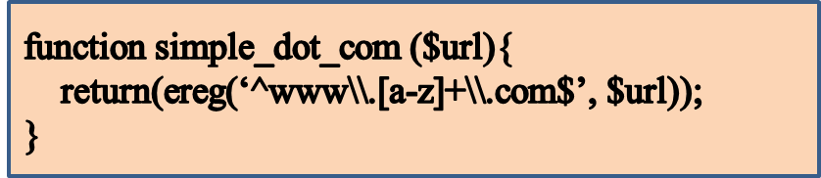
Regular Expression
function ereg(): Regular expression match
  Searches a string for matches to the regular expression given in pattern in a case-sensitive way.
  int ereg (string $pattern , string $string)
  [Ex]
Confusingly, we have to put two backslashes in the pattern string, because PHP treats the first slash as an escape character for the second backslash. (You can get away with just one backslash, but that behavior is not guaranteed to continue in future versions of PHP.) The second backslash (escaped by the first), in turn, is a regex escape character for the following character.
{Ex]: php4-1-dot-com.php

Slide 29
Regular Expression
^www\.[a-z]+\.com$
  ^www : In this expression we have the ‘^’ symbol, which says that the three letters www portion must start at the beginning of the string.
  \. : Then comes a dot (.), preceded by a backslash that says we really want a dot, not the special wildcard character.
  [a-z] :Then we have a bracket-enclosed range of all the lowercase alphabetic letters.
  + : The following + indicates that we want to match any number of these lowercase letters in a row, as long as we have at least one of them.
  \.com$ : Then another literal ., the three letters com, and the special symbol ‘$’ that says that com is the end of it.

Slide 30
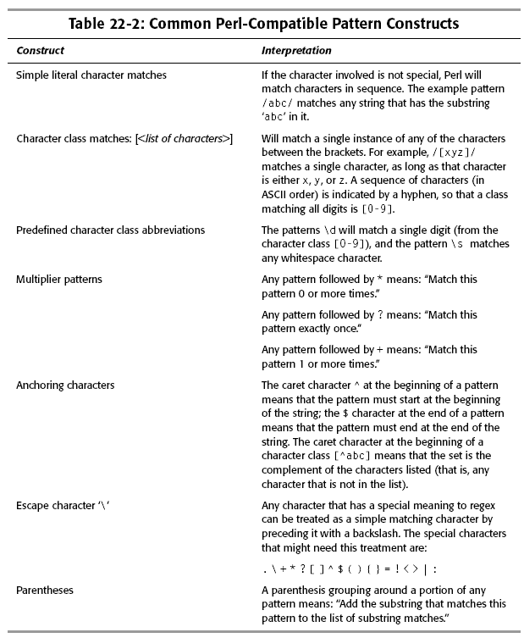

Slide 31
Regular Expression
The special character
  ^ matches the beginning of a string
  $ matches the end of a string
  . matches any character
  ? matches exactly once character
  * matches zero or more instances of the previous regular expression
  + matches one or more instances of the previous expression.
A set of characters enclosed in square brackets matches any of those characters
  the pattern [ab] matches either a or b
  the pattern [a-c] matches a, b, or c
Special characters that are escaped with a backslash (\) lose their special meaning and are matched literally, e.g., \d, \s.

Slide 32
Regular Expression
<?php
function print_links ($url){
$fp = fopen($url, “r”)
or die(“Could not contact $url”);
$page_contents = “”;
while ($new_text = fread($fp, 100)) {
$page_contents .= $new_text;
}
$match_result = preg_match_all(‘ /<\s*A\s*HREF=”([^\”]+)”\s*>([^>]*)<\/A>/I ’,$page_contents,$match_array,
PREG_SET_ORDER);
foreach ($match_array as $entry) {
$href = $entry[1];
$anchortext = $entry[2];
print(“<B>HREF</B>: $href;<B>ANCHORTEXT</B>: $anchortext<BR>”);
}
}
?>

Slide 33
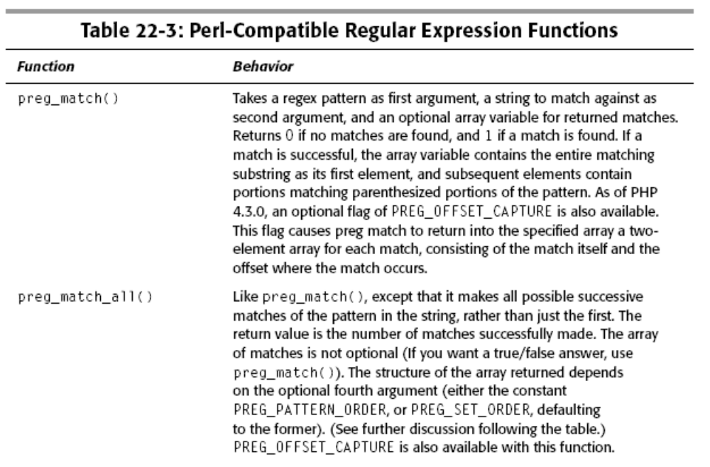

Slide 34
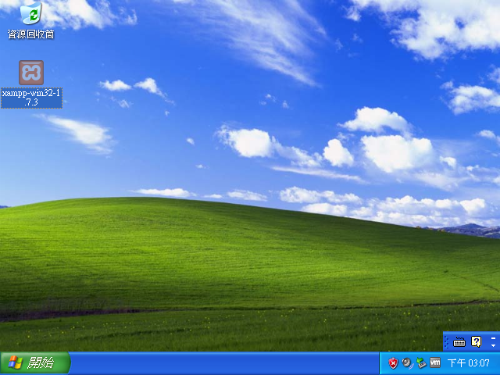
Install XAMPP PhpMyAdmin

Slide 35
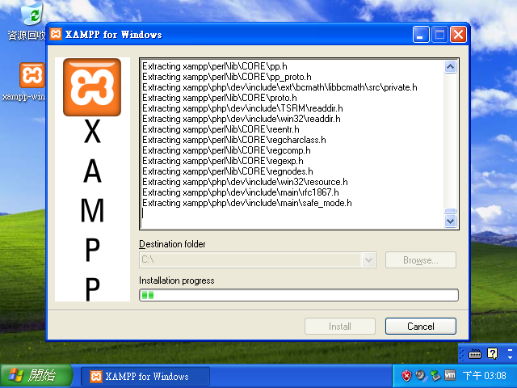

Slide 36
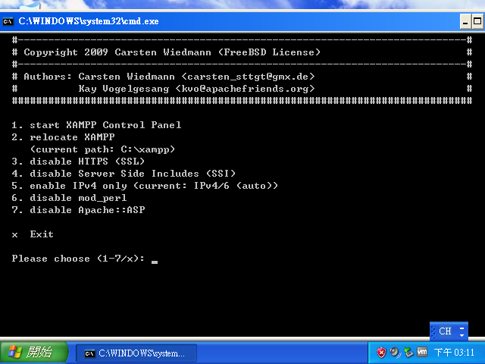
數個類似以下畫面，請依預設值
最後來至以下畫面，請按x

Slide 37
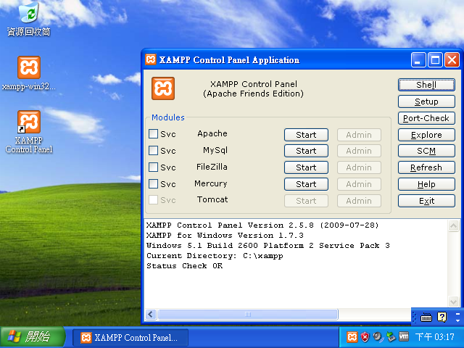

Slide 38
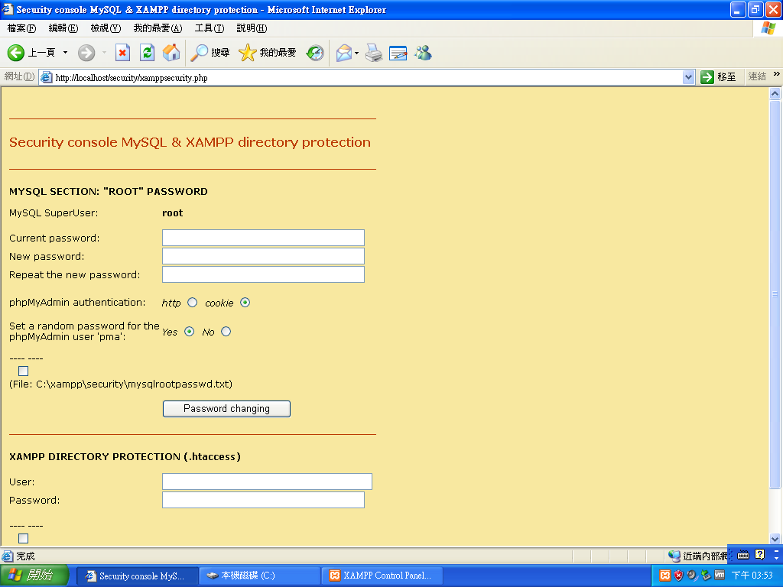
http://localhost/security/xamppsecurity.php
只需填紅框中的資料

Slide 39
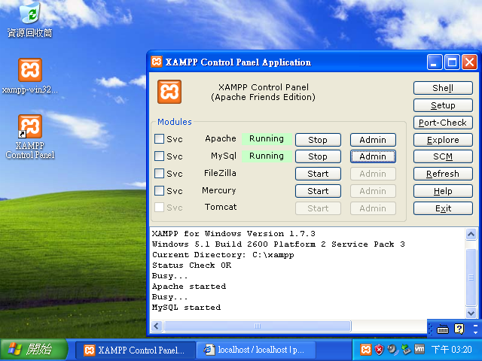

Slide 40
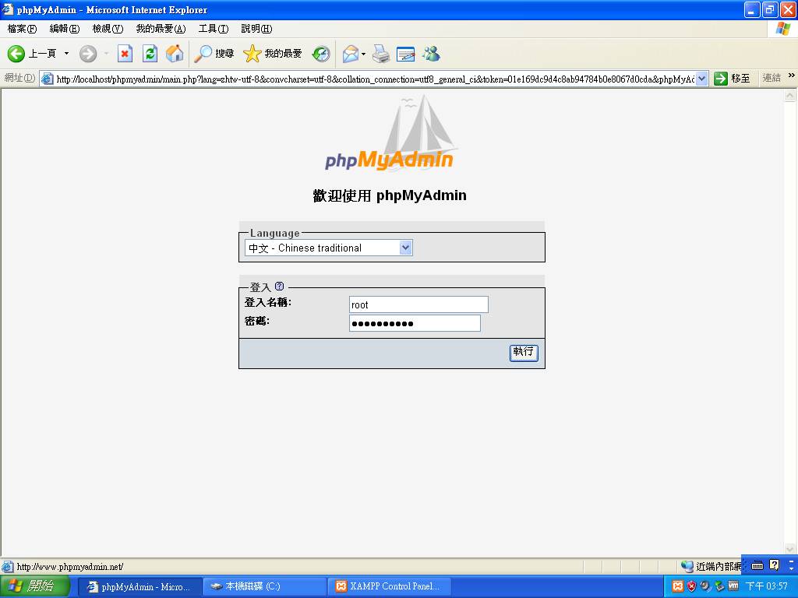

Slide 41
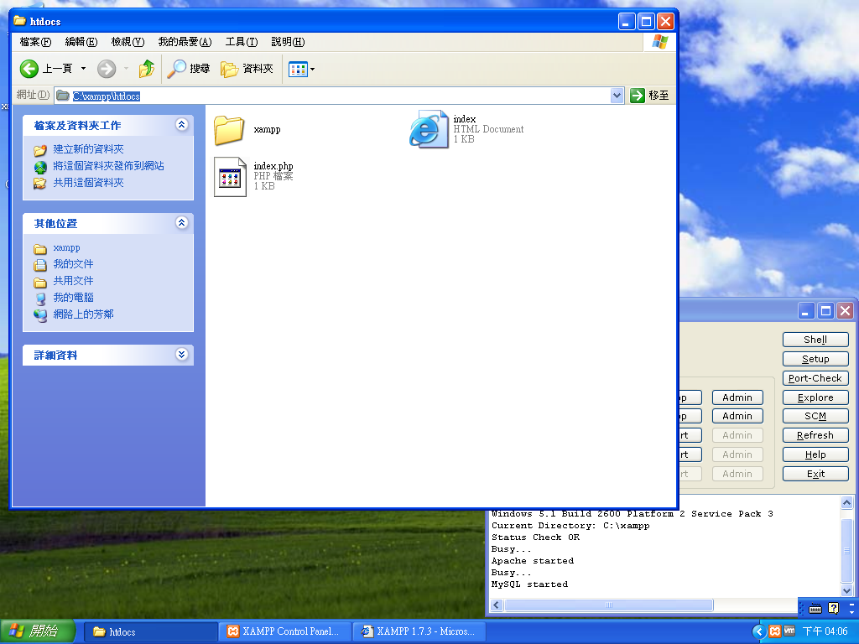
網頁根目錄：C:\xampp\htdocs

Slide 42
