Slide 1
GC-stall and Page Scan Attacks by Linux
Cuong Tran
LinkedIn Performance Group

Slide 2
Agenda
GC attacks by Linux
Page scan attacks by Linux
Recommendations

Slide 3
Examples of GC attacks by Linux
2013-10-05T05:01:04.179+0000:…. : 216982K->9328K(256000K), 0.0666320 secs] 377835K->170188K(768000K), 0.0675850 secs] [Times: user=0.17 sys=0.00, real=3.18 secs]
2013-09-19T06:14:03.632+0000: 44372.834: [GC [1 CMS-initial-mark: 703914K(921600K)] 718372K(1433600K), 126.1196340 secs] [Times: user=0.00 sys=127.31, real=126.10 secs]
GC stopped the world for minutes but:
Did no real work (CPU time in user mode = 0)
Burned cycles in Linux kernel

Slide 4
GC attacks by Linux
IO starvation
Symptom: GC log shows “low user time, low system time, long GC pause”.
Cause: GC threads stuck in kernel waiting for IO, usually due to journal commits or FS flush of changes by gzip of log rolling
Memory starvation.
Symptom: GC log shows “Low user time, high system time, long GC pause”
Cause: Memory pressure triggers swapping or scanning for free memory

Slide 5
Solutions for GC-attacks
IO Starvation
Strategy: Even out workload to disk drives (flush every 5 s rather than 30 s)
sysctl –w vm.dirty_writeback_centisecs = 500
sysctl –w vm.dirty_expire_centisecs = 500
In progress: Direct IO with gzip or gzip as-you-go
Memory Starvation
Strategy: Pre-allocate memory to JVM heap and protect it against swapping or scanning
Turn on –XX:+AlwaysPreTouch option in JVM
Sysctl –w vm.swappiness=0 to protect heap and anonymous memory
JVM start up has 2 second delay to allocate all memory (17GB)

Slide 6
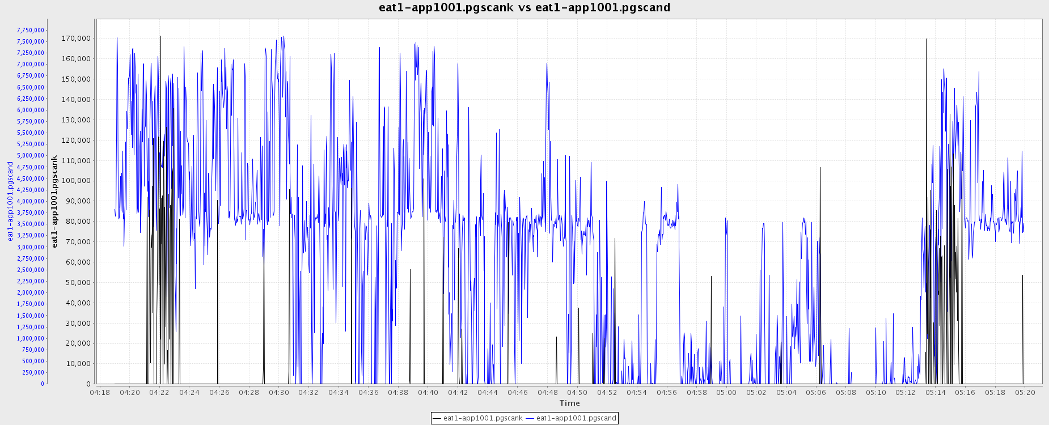
Page scan attacks by Linux
Measured: 7,000,000 scans/sec
Stall: 2+ minutes
Goal: 0 scans/sec

Slide 7
Transparent Huge Page (THP)
Cause : Page Scan Attacks
A Redhat enhancement for performance
2MB huge pages vs. 4KB regular pages
Less TLB miss and page table walk
Only work for anonymous memory (malloc)
Improve 10% performance for SPECjbb, app server workload
But THP can degrade performance severely
Collapsing, Compacting, Splitting, Migration
Very high pgscand/s
Very busy khugepaged
Very high system time when process compacts memory or khugepaged runs
THP optimization can increase GC stall time by minutes

Slide 8
NUMA Optimization
Cause : Page Scan Attacks
A Linux optimization for NUMA
2 CPU sockets, each having 12 cores and local memory.
Memory accessible by all 24 cores but local memory is faster
Linux tries to allocate local memory to application threads, i.e., from local zone
Best suited for applications that can fit in one local zone
NUMA optimization can degrade performance severely
Very high pgscand/s
Linux zone-reclaim insists on finding memory on local zone although memory is plentiful on the other zone
Linux migrates memory including THP, creating a viscous cycle of breaking up 2 MB pages, scanning for 4 KB free pages, and re-assembling 4KB into 2 MB pages

Slide 9
Solutions
Cause : Page Scan Attacks
Turn off THP optimization and thus khugepaged
echo never > /sys/kernel/mm/redhat_transparent_hugepage/enabled
Will not affect file-IO or memory mapped files
Redhat, Oracle, Hadoop recommends no THP
Turn off zone-reclaim optimization
sysctl –w vm.zone_reclaim_mode=0
Twitter recommends NUMA interleaving

Slide 10
Recommendations
Gate keepers: SRE and SysOps
Safe to roll-out fixes for GC attacks now
Linux: Flush changes more frequently and protect heap
sysctl –w vm.dirty_writeback_centisecs = 500
sysctl –w vm.dirty_expire_centisecs = 500
sysctl –w vm.swappiness=0
JVM: Give JVM heap all memory it needs when started
–XX:+AlwaysPreTouch
Heap size per AutoTune
Gradual roll-out fixes of page scan attacks.
Best for back-end servers
Linux: Turn off THP and NUMA optimization
echo never > /sys/kernel/mm/redhat_transparent_hugepage/enabled
sysctl –w vm.zone_reclaim_mode = 0
Work with product groups to test on small group of servers before applying changes to the rest

