Slide 1
Machion Learning 00 ML Introduction
姓名 王選仲
興創知能 AI工程師
2020.05.02
jeremy4555@yahoo.com.tw
https://www.linkedin.com/in/hsuanchungwang/

Slide 2
Table of Content
Prerequisite
Git
Python3.6
Jupyter
Project Env
Clone the Project
Virtualenv Installation & Building
Packages Installation
Add virtualenv to Jupyter kernel
Start the project

Slide 3
Prerequisite - Git
Installation
go to official site: https://git-scm.com/download/win
download executable
open executabled: Always "Next“
Check Install: open Command line (命令提示字元)
>>> git
usage: git [--version] [--help] [-C <path>] [-c <name>=<value>]
[--exec-path[=<path>]] [--html-path] [--man-path] [--info-path]
[-p | --paginate | -P | --no-pager] [--no-replace-objects] [--bare]
[--git-dir=<path>] [--work-tree=<path>] [--namespace=<name>]
<command> [<args>] .........

Slide 4
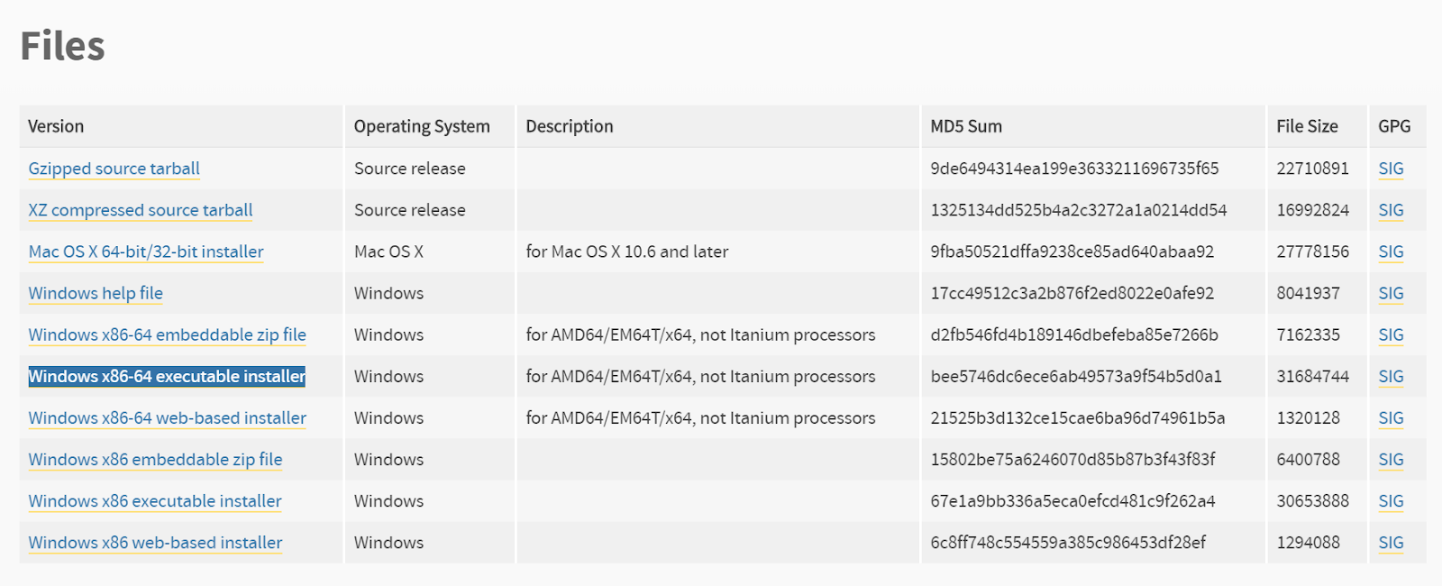
Prerequisite - Python3.6
Installation: Intallation: go to python 3.6.4 download page (https://www.python.org/downloads/release/python-364/)
Download "Windows x86-64 executable installer"

Slide 5
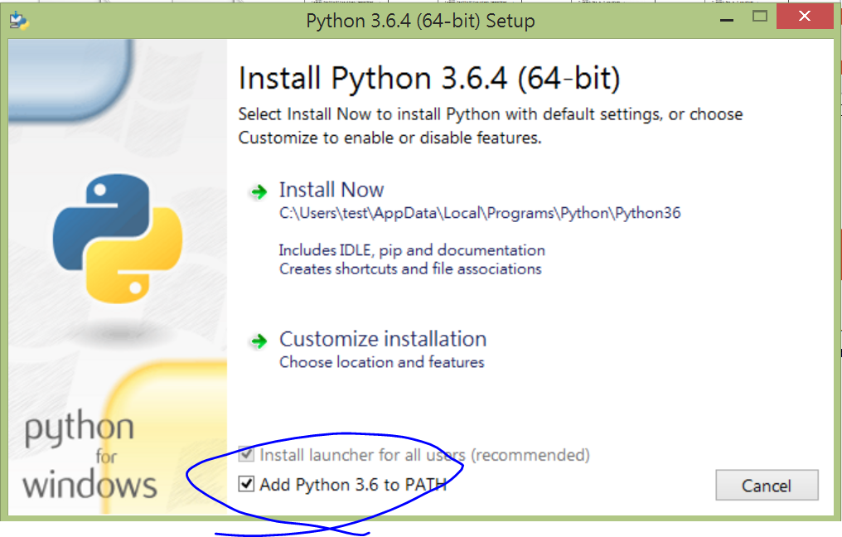
Prerequisite - Python3.6
Open installer
2. Click Install now
1. (very important!!) check "Add Python 3.6 to PATH" at bottom

Slide 6
Prerequisite - Python3.6
Check Install: open Command line (命令提示字元)
>>>python -V
Python 3.6.4
>>>pip -V
pip 9.0.1 from C:\.......\pip (python 3.6)

Slide 7
Prerequisite - Jupyter
install: open Command line (命令提示字元) with admin auth (以管理員權限開啟)
Check Install: open Command line (命令提示字元)
>>> pip install --upgrade pip
>>> pip install jupyter
>>> jupyter notebook
[I 15:59:53.257 NotebookApp] Serving notebooks from local directory: C:\Users\........\IIIMaterial
[I 15:59:53.258 NotebookApp] The Jupyter Notebook is running at:
[I 15:59:53.259 NotebookApp] http://localhost:8888/?token=.............

Slide 8
Table of Content
Prerequisite
Git
Python3.6
Jupyter
Project Environment
Clone the Project
Virtualenv Installation & Building
Packages Installation
Add Virtualenv to Jupyter kernel
Start the project

Slide 9
Project Environment
pip install -r requirements.txt
Clone the Project
Virtualenv Installation & Building
Packages Installation
>>> git clone https://github.com/GoatWang/IIIMaterial
>>> cd IIIMaterial # go into the directory
>>> pip install virtualenv
>>> virtualenv venv
>>> venv\Scripts\activate
(venv) >>> pip install -r requirements.txt # install packages listed in the txt (venv) >>> pip list # check installation successfully

Slide 10
Project Environment
pip install -r requirements.txt
Add Virtualenv to Jupyter kernel
See: https://ipython.readthedocs.io/en/stable/install/kernel_install.html
Start the project
(venv) >>> pip install ipykernel
(venv) >>> python -m ipykernel install --user --name IIIMaterial
(venv) >>> deactivate
>>> jupyter notebook

Slide 11
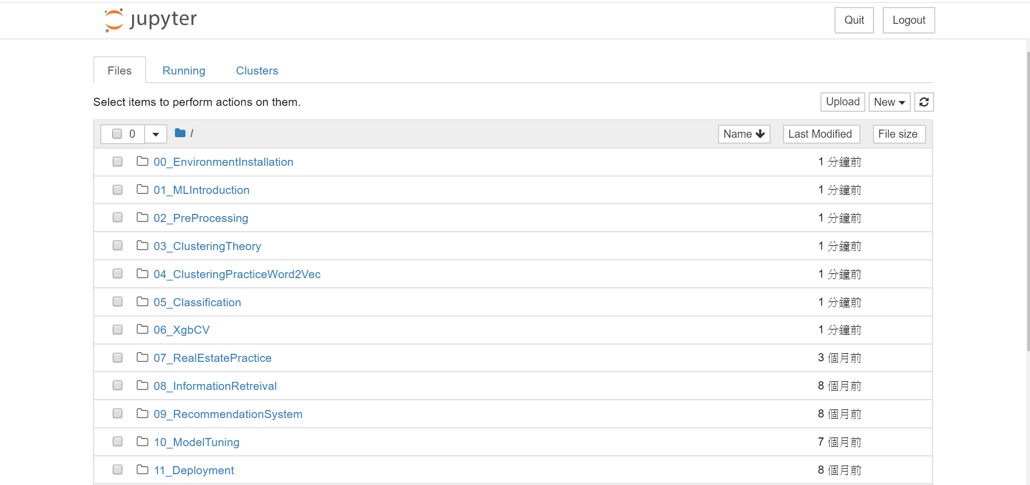
Project Environment
pip install -r requirements.txt
Project Page

Slide 12
Thank you

