Slide 1
Machion Learning 04 Clustering Practice Word2Vec
姓名 王選仲
興創知能 AI工程師
2020.05.03
jeremy4555@yahoo.com.tw
https://www.linkedin.com/in/hsuanchungwang/

Slide 2
Word2Vec
簡介
Word2Vec其實是Word to Vector的簡稱，意在將每一個字轉換成一條向量，並讓這字的語意透過這條向量描繪出來。早期做自然語言處理時，很難對讓電腦對詞背後的意思有更深一層的理解，因此詞與詞之間的關係很難被挖掘出來，像是相似詞、相反詞、對應詞等，因此Word2Vec在這樣的背景下產生就顯得極其珍貴。
作用&賣點
它可以找到相似的字。
它可以加減，像是Taiwan-Taipei=Germany-Berlin。
已經訓練好的model:
Google Pretrained Models (https://code.google.com/archive/p/word2vec/)
本課程使用之GloVe Word2Vec (時間考量已經壓縮過，只留下這個文件中會用到的字)。
專案: 將e-commerce商品標籤分群

Slide 3
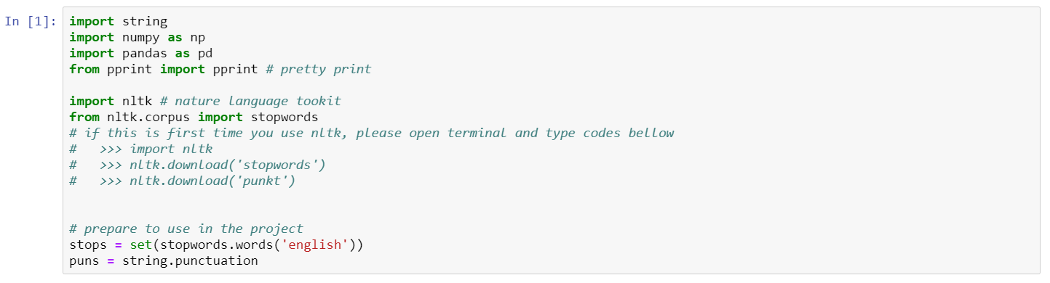
Algorithm & Package Used

Slide 4
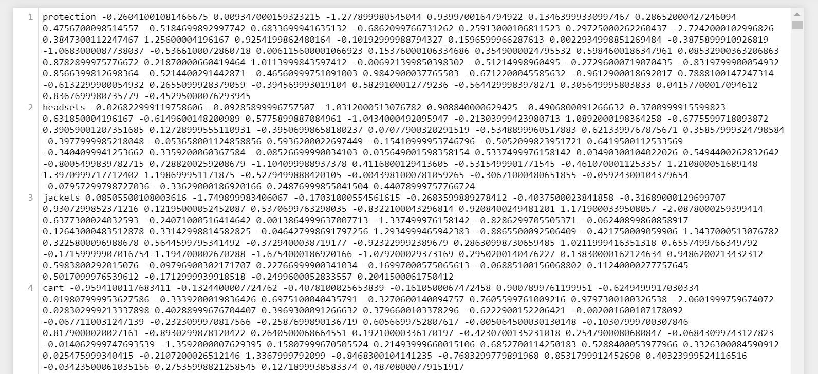
Data – Pretrained Work2Vec

Slide 5
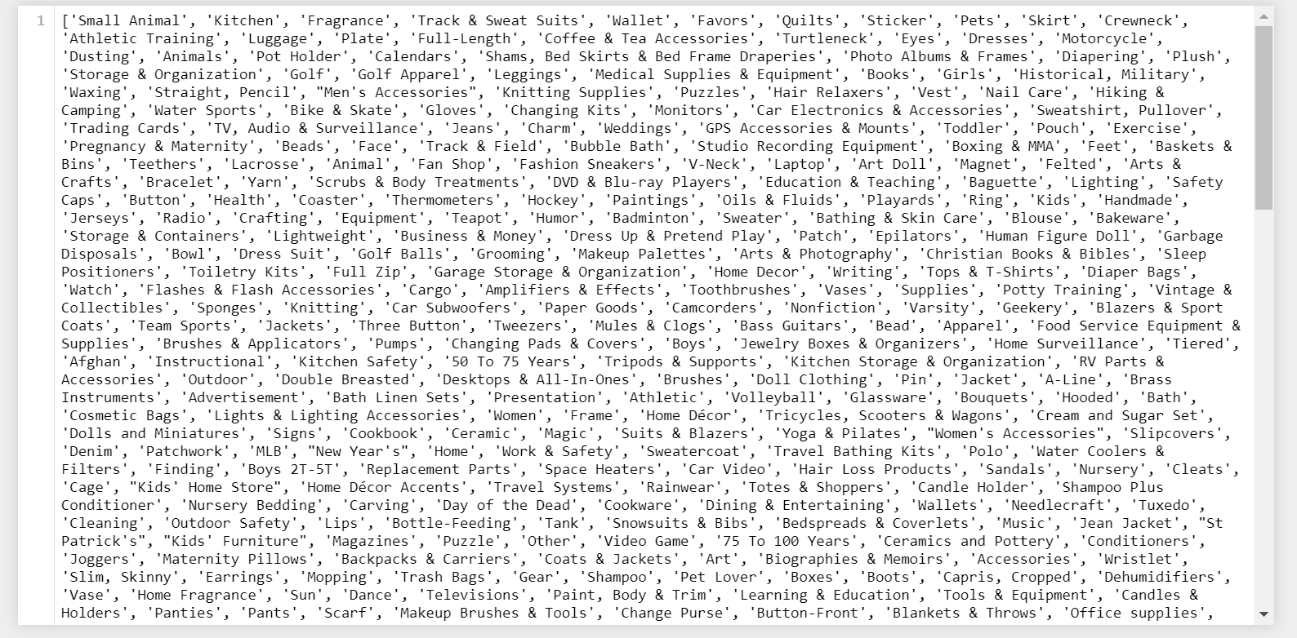
Data – Goods Category

Slide 6
Steps
Tokenize: Split category label into tokens
'Small Animal'=> ['small', 'animal’]
Convert tokens to vector:
small: [0.3, 0.5, 0.7]
animal: [0.7, 0.5, 0.3]
Doc2Vec: Average vectors of all tokens together elementwisely.
small + animal: [1/2, 1/2, 1/2]
Clustering
Kmeans
Hireachical
DBSCAN

Slide 7
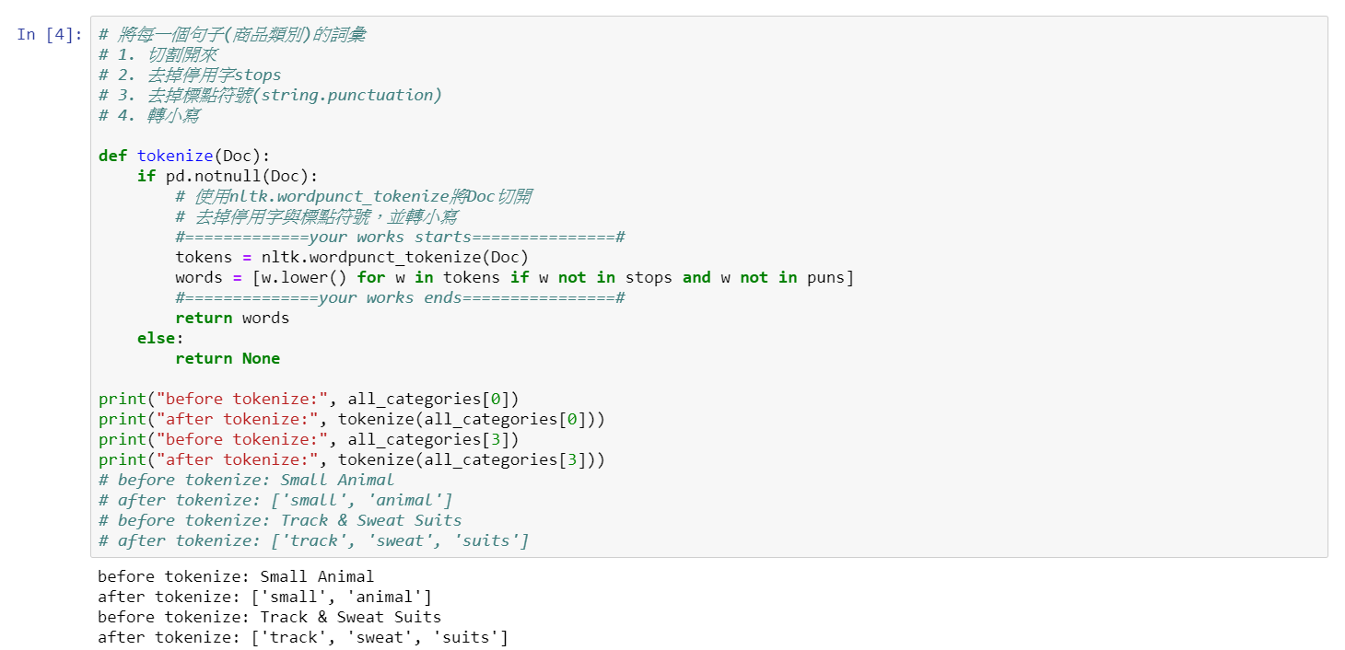
Tokenize

Slide 8
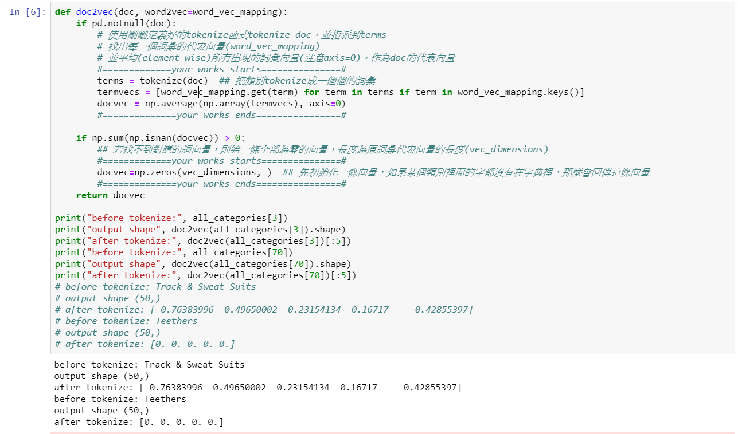
Doc2Vec

Slide 9
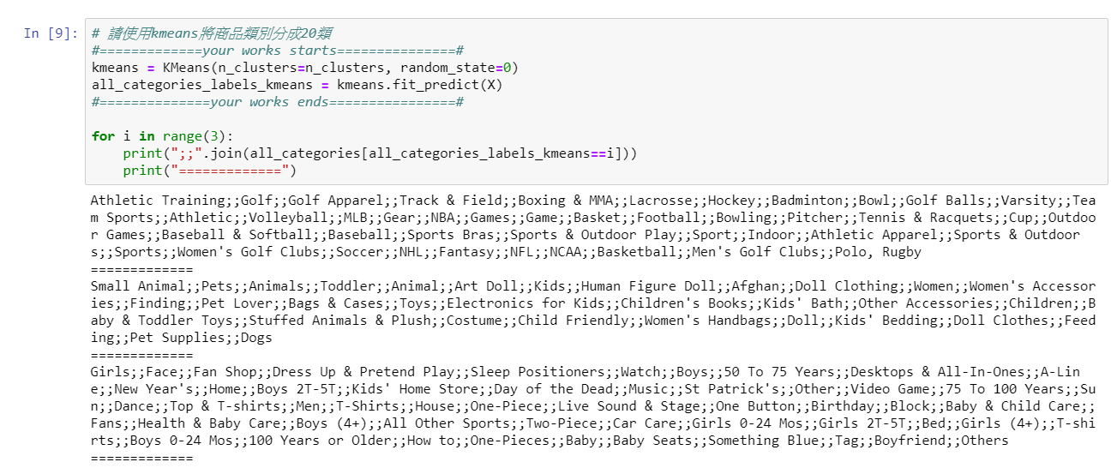
Clustering - Kmeans

Slide 10
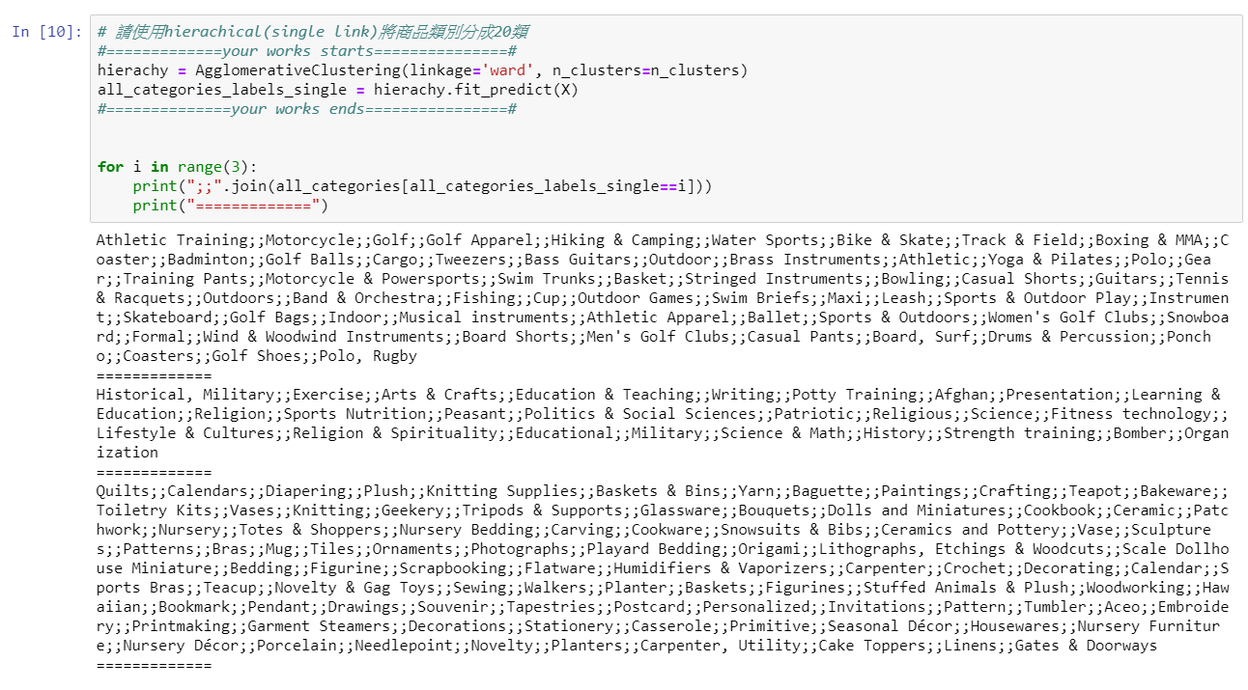
Clustering - Hireachical

Slide 11
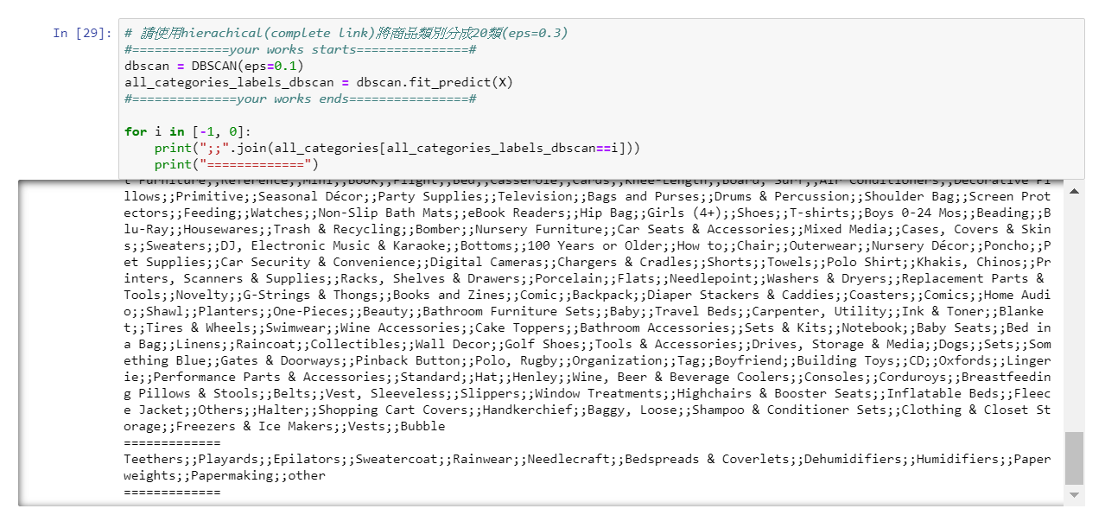
Clustering -DBSCAN

Slide 12
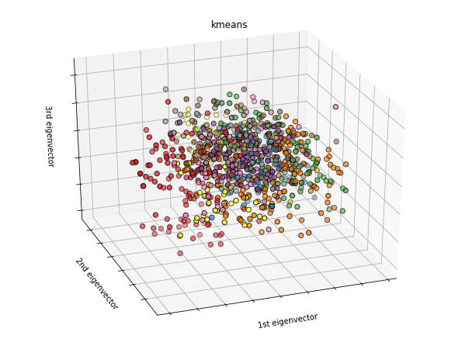
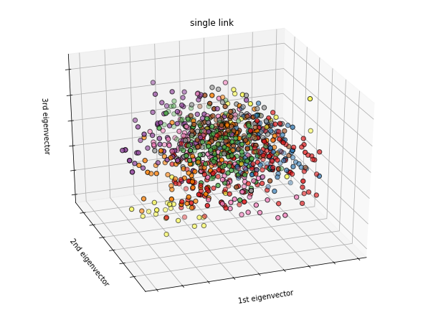
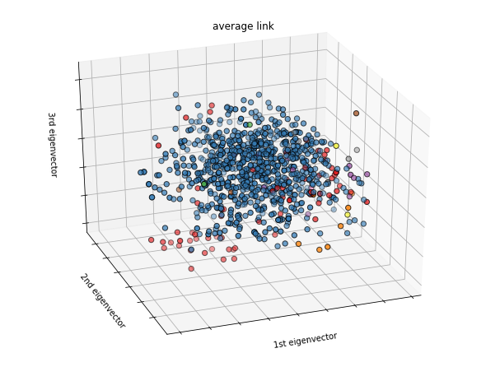
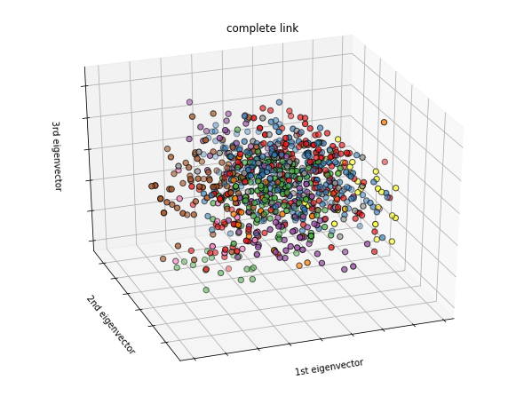
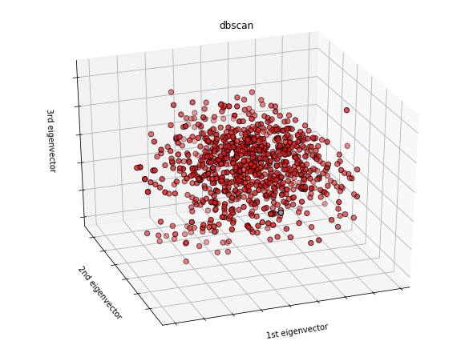
Result - PCA

Slide 13
Result - Evaluation
Athletic Training, Golf, Golf Apparel, Track & Field, Boxing & MMA, Lacrosse, Hockey, Badminton, Bowl, Golf Balls, Varsity, Team Sports, Athletic, Volleyball, MLB, Gear, NBA, Games, Game, Basket, Football, Bowling, Pitcher, Tennis & Racquets, Cup, Outdoor Games, Baseball & Softball, Baseball, Sports Bras, Sports & Outdoor Play, Sport, Indoor, Athletic Apparel, Sports & Outdoors, Sports, Women's Golf Clubs, Soccer, NHL, Fantasy, NFL, NCAA, Basketball, Men's Golf Clubs, Polo, Rugby
Small Animal, Pets, Animals, Toddler, Animal, Art Doll, Kids, Human Figure Doll, Afghan, Doll Clothing, Women, Women's Accessories, Finding, Pet Lover, Bags & Cases, Toys, Electronics for Kids, Children's Books, Kids' Bath, Other Accessories, Children, Baby & Toddler Toys, Stuffed Animals & Plush, Costume, Child Friendly, Women's Handbags, Doll, Kids' Bedding, Doll Clothes, Feeding, Pet Supplies, Dogs
cluster 0
cluster 1

Slide 14
Result - Evaluation
Girls, Face, Fan Shop, Dress Up & Pretend Play, Sleep Positioners, Watch, Boys, 50 To 75 Years, Desktops & All-In-Ones, A-Line, New Year's, Home, Boys 2T-5T, Kids' Home Store, Day of the Dead, Music, St Patrick's, Other, Video Game, 75 To 100 Years, Sun, Dance, Top & T-shirts, Men, T-Shirts, House, One-Piece, Live Sound & Stage, One Button, Birthday, Block, Baby & Child Care, Fans, Health & Baby Care, Boys (4+), All Other Sports, Two-Piece, Car Care, Girls 0-24 Mos, Girls 2T-5T, Bed, Girls (4+), T-shirts, Boys 0-24 Mos, 100 Years or Older, How to, One-Pieces, Baby, Baby Seats, Something Blue, Tag, Boyfriend, Others
Crewneck, Turtleneck, Vest, Gloves, Sweatshirt, Pullover, Blazers & Sport Coats, Jackets, Apparel, Pumps, Hooded, Suits & Blazers, Cleats, Tuxedo, Joggers, Coats & Jackets, Capris, Cropped, Trench, Swim Trunks, Overalls, Collared, Puffer, Cardigan, Peacoat, Wool, Tracksuits & Sweats, Swim Briefs, Thermal Underwear, Footwear, Leash, Parka, Turtleneck, Mock, Skirts, Skorts & Dresses, Scarves & Wraps, Hawaiian, Snowboard, Windbreaker, Capri, Cropped, Tops & Blouses, Sunglasses, Bomber, Outerwear, Khakis, Chinos, Flats, Swimwear, Raincoat, Oxfords, Corduroys, Belts, Vest, Sleeveless, Fleece Jacket, Vests
cluster 2
cluster 5

Slide 15
Thank you

