Slide 1
Machion Learning 06 XgbCV
姓名 王選仲
興創知能 AI工程師
2020.05.07
jeremy4555@yahoo.com.tw
https://www.linkedin.com/in/hsuanchungwang/

Slide 2
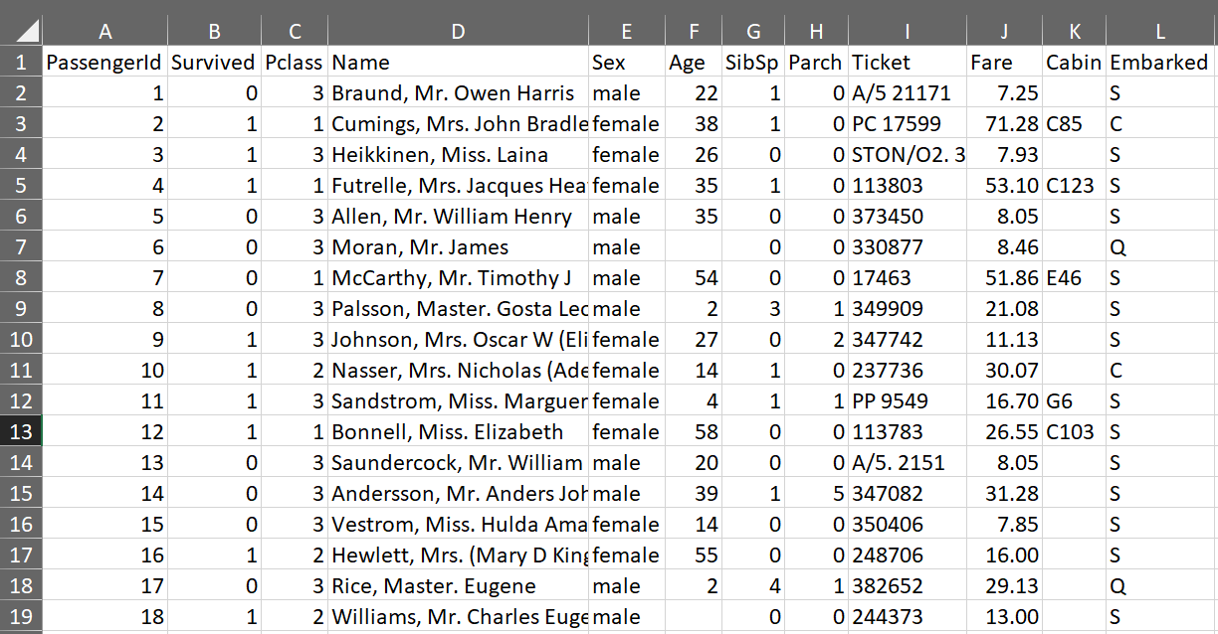
Data - Titanic

Slide 3
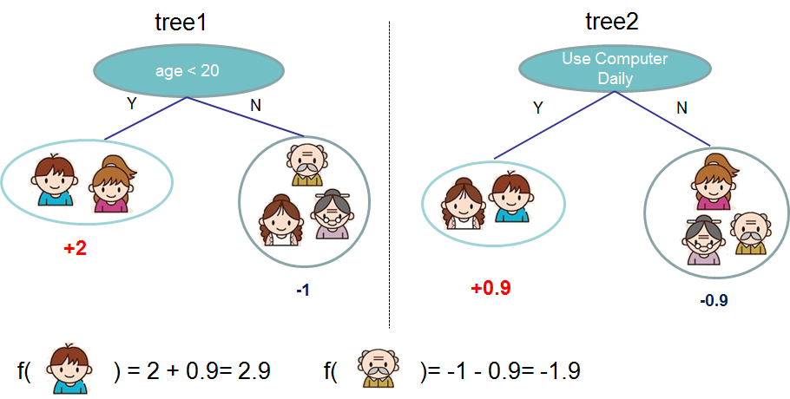
XGBoost
Theory
https://xgboost.readthedocs.io/en/latest/tutorials/model.html

Slide 4
XGBoost
Parameter
objective
Intro: Assign according to task type
Choice: reg:squarederror, reg:squaredlogerror, reg:logistic, binary:logistic, binary:logitraw, binary:hinge, count:poisson, survival:cox, survival:aft, multi:softmax, multi:softprob, rank:pairwise, rank:ndcg, rank:map, reg:gamma, reg:tweedie
eval_metric
Intro: Evaluation metrics for validation data.
Choice: rmse, rmsle, mae, logloss, error, error@t, merror, mlogloss, auc, aucpr, ndcg, map, ndcg@n, map@n, ndcg-, map-, ndcg@n-, map@n-, poisson-nloglik, gamma-nloglik, cox-nloglik, gamma-deviance, tweedie-nloglik, aft-nloglik
Eta:
Intro: Step size shrinkage used in update to prevents overfitting.
Range: [0,1]

Slide 5
XGBoost
Parameter
max_depth
Intro: Maximum depth of a tree.
Range: [0,∞]

Slide 6
XGBoost
Parameter Tuning
control overfitting
Control model complexity: max_depth, min_child_weight and gamma.
Add randomness to make training robust to noise: subsample and colsample_bytree, eta and num_round.
Imbalanced Dataset
Overall performance metric (AUC): adjust scale_pos_weight and Use AUC for evaluation.
Predicting the right probability: Set parameter max_delta_step to a finite number (say 1)

Slide 7
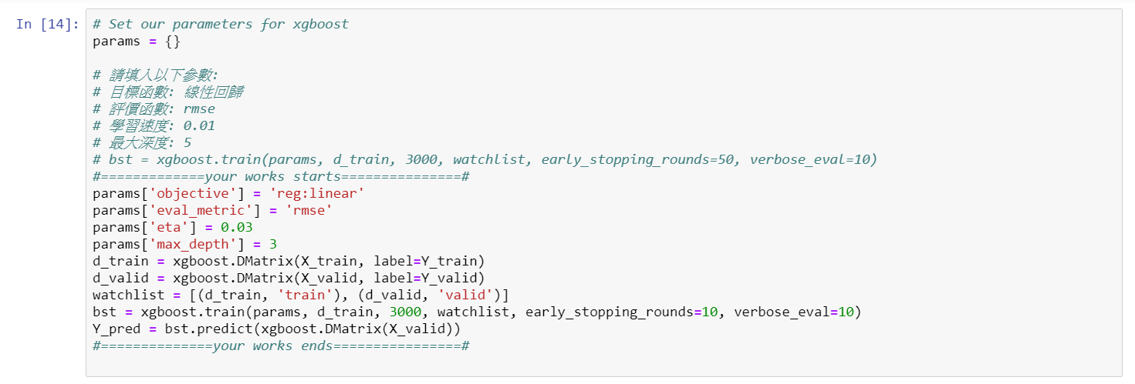
XGBoost
Implementation

Slide 8
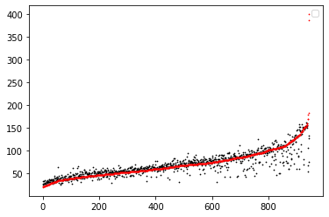
XGBoost
Result

Slide 9
Thank you

