Slide 1
Correlation between bugs and leaks
Shangxuan Han

Slide 2
How to detect bugs?
Analyze each revision log and decide if this revision is a bug fixed revision. If yes, then we think there exist a bug in the corresponding changed classes.
By keywords:
issue, fix, bug, error.
By patterns: (4 pattern now)
\\bfix(s|es|ing|ed|up)?\\b
\\b(error|bug|issue)(s)?\\b
\\b(bug|issue|fix)(s)?\\b\\s*(#)?\\s*[0-9]+
\\b(bug|issue|fix)\\b\\s*id(s)?\\s*(=)?\\s*[0-9]+

Slide 3
Cited Paper
Mockus, Audris, and Lawrence G. Votta. "Identifying reasons for software changes using historic databases." Software Maintenance, 2000. Proceedings. International Conference on. IEEE, 2000.
Śliwerski, Jacek, Thomas Zimmermann, and Andreas Zeller. "When do changes induce fixes?." ACM sigsoft software engineering notes. Vol. 30. No. 4. ACM, 2005.

Slide 4
How to find leaks?
Ben's query can find leaks for each class.

Slide 5
Hypothesis statement
H1: There is a relationship between number of leaks and number of bugs in the same class.
H2: There is a relationship between existence of leaks and bugs in the same class.
H3: More leaks a class has is more possible to have more bugs.

Slide 6
Method I used to test the hypothesis
For Different hypothesis, I will use different methods to test.
H1: Correlation coefficient(test linear relation) and regression model.
H2: Chi-Square independent test(test relation between two variables).
H3: ANOVA one-way analysis(test difference among group means)

Slide 7
Cited Paper
Nagappan, Nachiappan, and Thomas Ball. "Static analysis tools as early indicators of pre-release defect density." Proceedings of the 27th international conference on Software engineering. ACM, 2005.
Kembhavi, Sampada, Ravindra Gupta, and Gajendra Singh. "An Efficient Algorithm for Auto Upload and Chi-Square Test on Application Software." International Journal of Advanced Computer Research 3.2 (2013): 121.
Ahmed, Iftekhar, et al. "Can Testedness be Effectively Measured?." (2016).

Slide 8
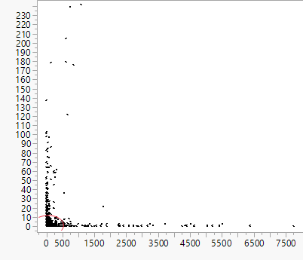
Hypothesis 1: correlation coefficient
We should combine leaks query and bugs query together and output number of leaks and number of bugs for each class(26,018).
Now we have a paired data set, then do correlation analysis on JMP pro, we get the correlation coefficient:
r = 0.05
r is too small to prove a linear relationship
bugs #
leaks #

Slide 9
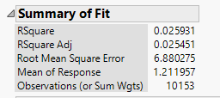
Hypothesis 1: Regression model
Assume the regression:
Y= a+b * X+ c * lnX + d * √ X + e * X^-1 + f * X^-2
We got:
a= -6.29 b=0.00025 c= -0.156
d= 2.474 e= 17.158 f= -10.25
However, For the Summary of Fit:
R-square = 0.0259
R-square is range from 0 to 1. It represents how well the regression fit the data. 1 is the best. 0.0259 is too small, which means this regression cannot explain our data very well.

Slide 10
Conclusion of Hypothesis 1
We cannot find a good regression to fit the data of bugs and leaks. So there is no apparent relationship between number of bugs and number of leaks.

Slide 11
Extension of Hypothesis 1
To improve the usage of regression model, we divide our data into different groups by using some criteria:
criteria1: number of class the project has:
6 groups: number of class is less than 6, 12, 25, 50, 100 and bigger than 100
criteria 2: number of revisions the project has:
6 groups: number of revision is less than 6, 12, 25, 50, 100 and bigger than 100
criteria 3: maturity definition:
3 groups: mature/non-mature/all projects.
(maturity definition: projects have more than 10 classes, more than 1000 statements and more than 50 commits)

Slide 12
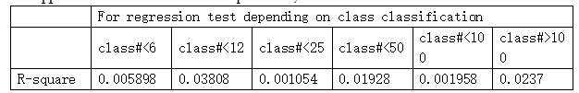



Slide 13
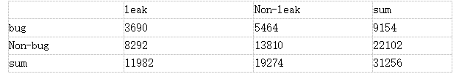
Hypothesis 2: Chi-Square independent test
Data we should have (4 number):
number of class that has leaks and bugs
number of class that has leaks but doesn't has bugs
number of class that doesn't has leaks but has bugs
number of class that doesn't has leaks and bugs

Slide 14

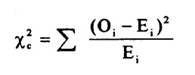
Hypothesis 2: Chi-Square independent test
Null Hypothesis: There is no correlation between existence of bugs and existence of leaks
By the formula: We get X^2 = 21.365
Depending on the Chi-square table, 95% confidence p-value is 3.841
Because 21.365>3.841
Then we have 95% confidence to say that our Null hypothesis is wrong.
Conclusion: There is such a relationship between existence of leaks and bugs. a class without
leaks has more possibility of without bugs.

Slide 15



Extension
The same as we did in regression model. We use the same criteria to classify our data and do Chi-square test for each classification:

Slide 16
Hypothesis 3: ANOVA one-way analysis
Explanation: ANOVA is used to test the difference of group means, We divide our data into 5 different groups based on the number of leaks.
Group 1: leaks#<5 Group 2: leaks#<10 Group 3: leaks#<15
Group 4: leaks#<20 Group 5:leaks#>20
We do ANOVA analysis:
Null Hypothesis: There is no difference among bug number means of these 5 groups
P-value <0.001
Conclusion: There exist differences among each group means.

Slide 17
Hypothesis 3: Conclusion
We have already proved there exist difference between each group means. And the way we divide groups is depending on the number of leaks. So ANOVA test result tells that different number of leaks may cause different number of bugs.
 | leaks#<5 | leaks#<10 | leaks#<15 | leaks#<20 | leaks#>20
mean of bugs number | 0.6 | 1.09 | 1.37 | 3.26 | 7.73
We can see that group with more leaks has larger means.
So we can conclude that More leaks a class has is more
possible to have more bugs.

Slide 18
Future Plan
Looking for other new hypothesis
Changing the classification criteria

Slide 19
Future Plan
categorize leaks or bugs. Maybe there will be more relations.
Do the same analysis on project based data.

