Slide 1

American Express-Default Prediction

Slide 2
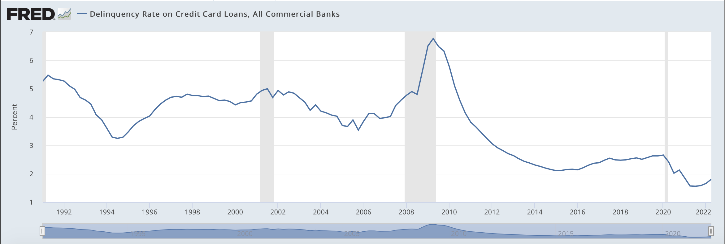
Problem Statement
Machine learning models to predict credit card default
Federal Reserve Economic Data
Notes:
Why we need to predict the credit card default.
Even though banks are trying hard to minimize their loss, it’s better than 1990s, it’s still can be improved
The banks and financial institutions uses a traditional and manually approach to find the customers who can not make the payments for the credit card by the due day.
The traditional way is the account will become delinquent if missing a payment for 30 days and the default happens after 6 months if not make the minimum payment due. Then the bank managers will contact you and lock your account. But at this point, it’s already late, the bank already lose money. So this project is to create machine learning models to predict whether a customer will default in the future or not. this problem will be a classification problem

Slide 3
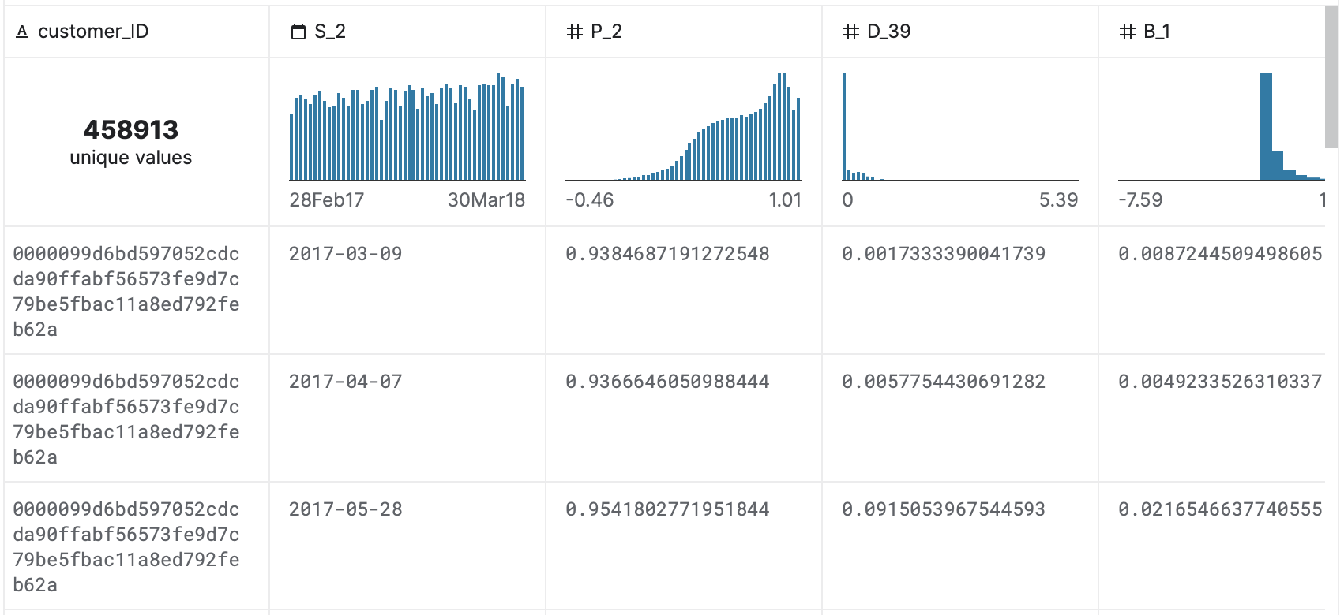
Dataset
190 anonymized and normalized features
5 categories: delinquency variables, spend variables, payment variables, balance variables, and risk variables
Target variables: 0/1
Notes:
The dataset is released by the American Express. To protect customers privacy and accounts’ security, all features are anonymized and normalized and also separated into 5 categories including delinquency variables, spend variables, payment variables, balance variables, and risk variables.

Slide 4
Related Work
Comparison of Several Data Mining Methods in Credit Card Default Prediction
Logistic Regression, Neural Network, Support Vector Machine, Xgboost and LightGBM
LightGBM win by comparing AUC, Correct rate, and F1-Score
Credit Card Default Prediction using Machine Learning Techniques
Logistic Regression, Rpart Decision Tree, and Random Forest
Random Forest win by comparing accuracy and AUC
Notes:
Dataset on the UCI website is from April to September 2005 in Taiwan on the UCI website and each feature is known and specific

Slide 5
Approach
Data Cleaning
Missing value
Handle class imbalance
Feature Selection
Check feature correlation
SelectkBest
Model Training
Logistic Regression, Neural Network, Support Vector Machine, random Forest, Xgboost, LightGBM
Model Test

