Slide 1

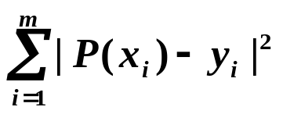
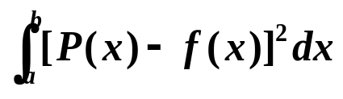

§2 正交多项式与最小二乘拟合
/* Orthogonal Polynomials & Least-Squares Approximation */
已知 x₁ … x_{m} ; y₁ … y_{m}, 求一个简单易算的近似函数 P(x) ≈ f(x) 使得 最小。
已知 [a, b]上定义的 f(x)，求一个简单易算的近似函数 P(x) 使得 最小。
定义
线性无关/* linearly independent */函数族{ ϕ₀(x), ϕ₁(x), … , ϕ_{n}(x), … } 满足条件：其中任意函数的线性组合
a₀ϕ₀(x)+a₁ϕ₁(x)+… +a_{n}ϕ_{n}(x)=0 对任意 x∈[a, b]成立
当且仅当 a₀= a₁=… =a_{n}=0。

Slide 2
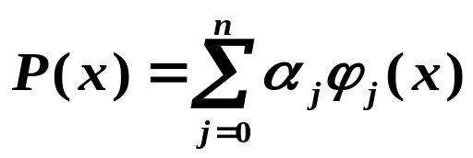

§2 Orthogonal Polynomials & L-S Approximation
定义
考虑一般的线性无关函数族Φ={ ϕ₀(x), ϕ₁(x), … , ϕ_{n}(x), … }，其有限项的线性组合 称为广义多项式 /* generalized polynomial */.
常见多项式：
➢ { ϕ_{j}(x) = x ^{j} } 对应代数多项式 /* algebraic polynomial */
➢ { ϕ_{j}(x) = cos jx }、{ ψ_{j}(x) = sin jx } ⇒ { ϕ_{j}(x), ψ_{j}(x) }对应三角多项式 /* trigonometric polynomial */
➢ { ϕ_{j}(x) = e ^{kj x} , k_{i} ≠ k_{j} } 对应指数多项式 /* exponential polynomial */

Slide 3

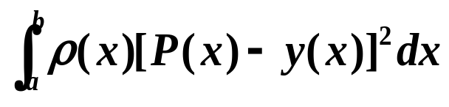
§2 Orthogonal Polynomials & L-S Approximation
定义
权函数：
^{①} 离散型 /*discrete type */
根据一系列离散点 拟合时，在每一误差前乘一正数w_{i} ，即 误差函数φ ，这个w_{i} 就称作权/* weight*/，反映该点的重要程度。
n
=
Σ
w
[
P
(
x
)
−
y
]
2
i
i
i
i
=
1
^{②} 连续型 /*continuous type */
在[a, b]上用广义多项式 P(x) 拟合连续函数 f(x) 时，定义权函数 ρ(x) ∈C[a, b]，即误差函数φ = 。权函数必须ρ(x)满足：非负、可积，且在[a, b]的任何子区间上ρ(x) ≡ 0。

Slide 4

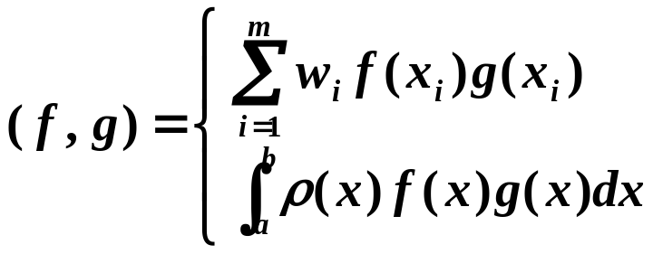



§2 Orthogonal Polynomials & L-S Approximation
定义
广义 L-S 拟合：
^{①} 离散型 /*discrete type */
在点集{ x₁ … x_{m} } 上测得{ y₁ … y_{m} }，在一组权系数{ w₁ … w_{m} }下求广义多项式 P(x) 使得误差函数 φ
最小。
n
=
Σ
w
[
P
(
x
)
−
y
]
2
i
i
i
( f, g )=0 表示 f 与 g 带权正交。
i
=
1
^{②} 连续型 /*continuous type */
已知 y(x) ∈C[a, b] 以及权函数 ρ(x)，求广义多项式 P(x) 使得误差函数φ = 最小。
∫
b
ρ
(
x
)
[
P
(
x
)
−
y
(
x
)]
2
dx
a
内积与范数
离散型
则易证( f, g ) 是内积，而 是范数。
连续型
广义 L-S 问题可叙述为：求广义多项式P(x)使得
最小。

Slide 5
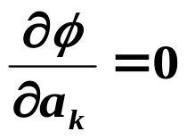

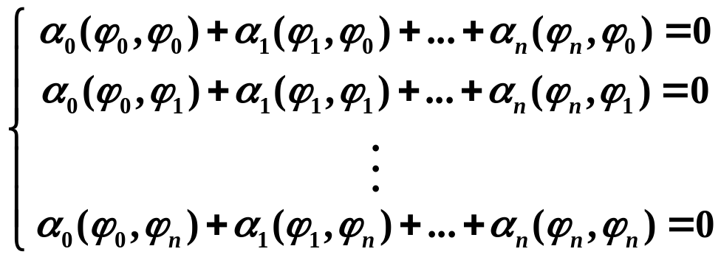
§2 Orthogonal Polynomials & L-S Approximation
设
则完全类似地有：
P
(
x
)
=
a
ϕ
(
x
)
+
a
ϕ
(
x
)
+
...
+
a
ϕ
(
x
)
0
0
1
1
n
n
n
Σ
(
ϕ
,
ϕ
)
=
ϕ
=
a
(
,
y
)
,
k
0
,
...
,
n
=
k
j
j
k
j
0
a
(
ϕ
,
y
)
法方程组
/*normal equations */
即：
0
0
= c
b
=
(
ϕ
,
ϕ
)
=
ij
i
j
a
(
ϕ
,
y
)
n
n
定理
Ba = c 存在唯一解 ⇔ ϕ₀(x), ϕ₁(x), … , ϕ_{n}(x) 线性无关。
α
ϕ
+
α
ϕ
+
+
α
ϕ
=
证明：若存在一组系数 {α_{i} } 使得
...
0
0
0
1
1
n
n
则等式两边分别与ϕ₀, ϕ₁, … , ϕ_{n}作内积，得到：
即：B α = 0
… …

Slide 6
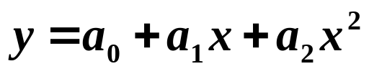
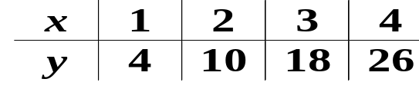
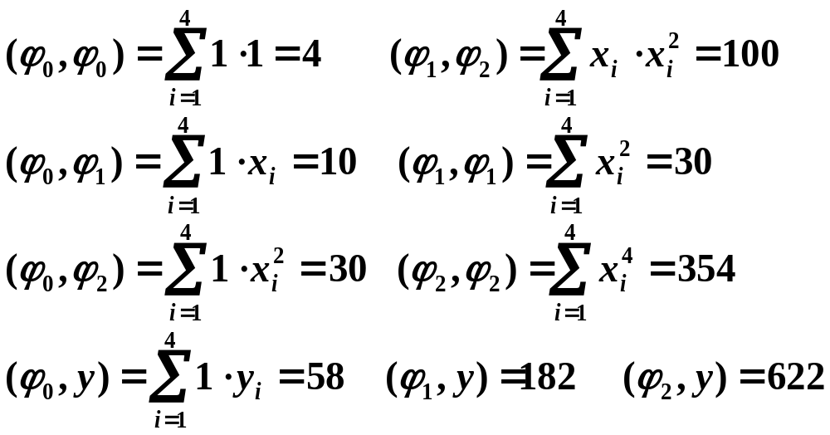
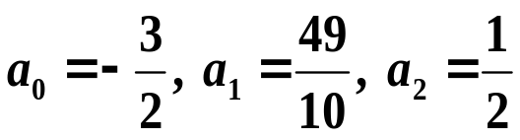
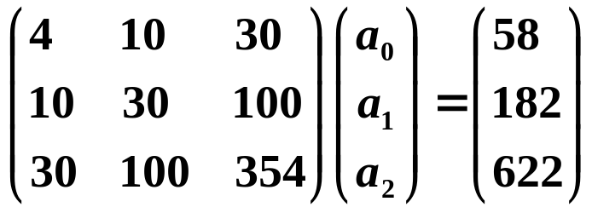
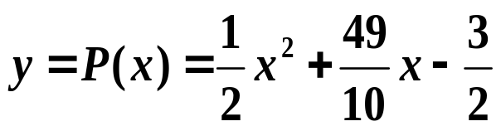
§2 Orthogonal Polynomials & L-S Approximation
例：用 来拟合 ，w ≡ 1
解： ϕ₀(x) = 1， ϕ₁(x) = x， ϕ₂(x) = x²
It is soooo simple! What can possibly go wrong?
63
||
B
||
=
484,
||
B
−
1
||
=
cond
(
B
)
=
7623
∞
∞
4


Slide 7
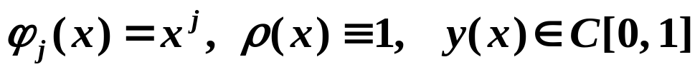
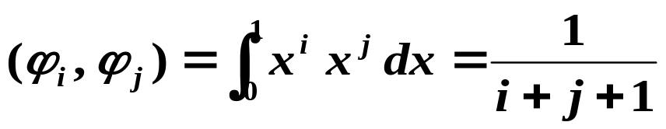
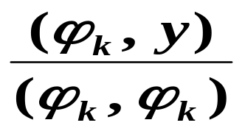

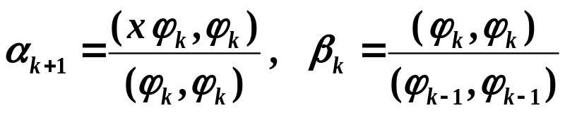
§2 Orthogonal Polynomials & L-S Approximation
例：连续型拟合中，取
Hilbert阵！
则
若能取函数族Φ={ ϕ₀(x), ϕ₁(x), … , ϕ_{n}(x), … }，使得任意一对ϕ_{i}(x)和ϕ_{j}(x)两两（带权）正交，则 B 就化为对角阵！
改进：
这时直接可算出a_{k} =
➢ 正交多项式的构造：
Well, no free lunch anyway…
将正交函数族中的ϕ_{k} 取为k 阶多项式，为简单起见，可取ϕ_{k} 的首项系数为 1 。
有递推
关系式：
证明略
p.148-149
其中

Slide 8
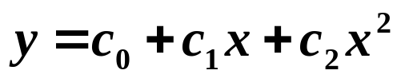
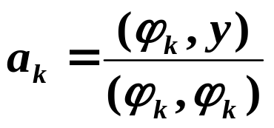
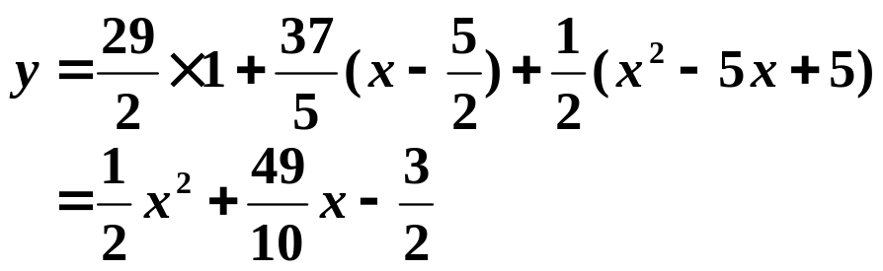
§2 Orthogonal Polynomials & L-S Approximation
例：用 来拟合 ，w ≡ 1
解：通过正交多项式 ϕ₀(x), ϕ₁(x), ϕ₂(x) 求解
设
y
=
a
ϕ
(
x
)
+
a
ϕ
(
x
)
+
a
ϕ
(
x
)
0
0
1
1
2
2
(
ϕ
,
y
)
29
ϕ
(
x
)
=
1
a
=
0
=
0
0
(
ϕ
,
ϕ
)
2
(
x
ϕ
,
ϕ
)
5
0
0
5
ϕ
α
=
0
0
=
ϕ
=
−
α
ϕ
=
−
(
,
y
)
37
(
x
)
(
x
)
(
x
)
x
a
=
1
=
1
(
ϕ
,
ϕ
)
2
1
1
0
2
1
(
ϕ
,
ϕ
)
5
0
0
1
1
(
x
ϕ
,
ϕ
)
5
(
ϕ
,
ϕ
)
5
α
=
1
1
=
β
=
1
1
=
2
(
ϕ
,
ϕ
)
2
1
(
ϕ
,
ϕ
)
4
1
1
0
0
5
5
(
ϕ
,
y
)
1
ϕ
(
x
)
=
(
x
−
)
ϕ
(
x
)
−
ϕ
(
x
)
=
x
2
−
5
x
+
5
a
=
2
=
2
2
1
4
0
2
(
ϕ
,
ϕ
)
2
2
2
注：手算时也可用待定系数法确定函数族。
与前例结果一致。

Slide 9
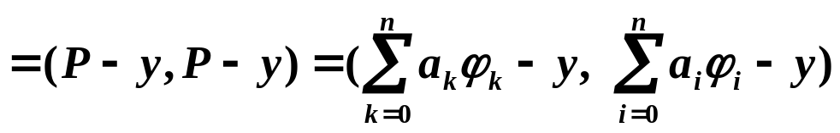

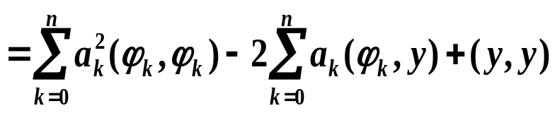
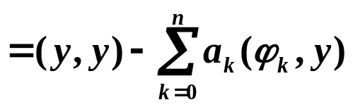
§2 Orthogonal Polynomials & L-S Approximation
Algorithm: Orthogonal Polynomials Approximation
To approximate a given function by a polynomial with error bounded
by a given tolerance.
Input: number of data m; x[m]; y[m]; weight w[m]; tolerance TOL;
maximum degree of polynomial Max_n.
Output: coefficients of the approximating polynomial.
Step 1 Set ϕ₀(x) ≡ 1; a₀ = (ϕ₀, y)/(ϕ₀, ϕ₀); P(x) = a₀ ϕ₀(x); err = (y, y) − a₀ (ϕ₀, y);
Step 2 Set α₁= (xϕ₀, ϕ₀)/(ϕ₀, ϕ₀); ϕ₁(x) = (x − α₁) ϕ₀(x);
a₁ = (ϕ₁, y)/(ϕ₁, ϕ₁); P(x) += a₁ ϕ₁(x); err −= a₁ (ϕ₁, y);
Step 3 Set k = 1;
Step 4 While (( k < Max_n)&&(|err|≥TOL)) do steps 5-7
Step 5 k ++;
Step 6 α_{k}= (xϕ₁, ϕ₁)/(ϕ₁, ϕ₁); β_{k−1} = (ϕ₁, ϕ₁)/(ϕ₀, ϕ₀);
ϕ₂(x) = (x − α_{k}) ϕ₁(x) − β_{k−1} ϕ₀(x); a_{k} = (ϕ₂, y)/(ϕ₂, ϕ₂);
P(x) += a_{k} ϕ₂(x); err −= a_{k} (ϕ₂, y);
Step 7 Set ϕ₀(x) = ϕ₁(x); ϕ₁(x) = ϕ₂(x);
Step 8 Output ( ); STOP.
注：

Slide 10

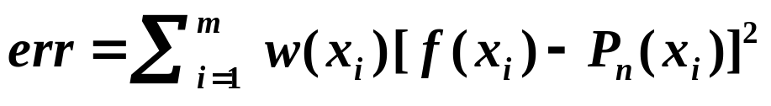
§2 Orthogonal Polynomials & L-S Approximation
Another von Neumann quote :
Young man, in mathematics you don't
understand things, you just get used to
them.
HW:
p.152 #1
Lab 12. Orthogonal Polynomials Approximation
Given a function f and a set of 200 ≥ m > 0 distinct points . You are supposed to write a function
void OPA ( double (*f)( ), double x[ ], double w[ ], int m, double tol, FILE *outfile )
to approximate the function f by an orthogonal polynomial using the exact function values at the given m points x[ ]. The array w[m] contains the values of a weight function at the given points x[ ]. The total error
must be no larger than tol.

Slide 11


§2 Orthogonal Polynomials & L-S Approximation
Input
There is no input file. Instead, you must hand in your function in a *.h file. The rule of naming the *.h file is the same as that of naming the *.c or *.cpp files.
Output ( represents a space)
For each test case, you are supposed to output the following information:
The 1st line contains the integer 6 ≥ n >0 which is the degree of the polynomial in the format: fprintf(outfile, "%d\n", n );
The 2nd line contains the n+1 coefficients of the approximation polynomial where . Each of the coefficient is to be printed as in C printf:
fprintf(outfile, "%8.4e", coefficient );
The 3rd line contains the total error in the format:
fprintf(outfile, "error=%12.8e\n", err );
Note: If the total error is still not small enough when n = 6, simply output the result obtained when n = 6.
The outputs of two test cases must be seperated by a blank line.

Slide 12
§2 Orthogonal Polynomials & L-S Approximation
Sample Judge Program
#include <stdio.h>
#include <math.h>
#define MAX_m 200
#define MAX_n 6
#include "98115001_12.h"
double f1 ( double x )
{ return sin(x); }
double f2 ( double x )
{ return exp(x); }
void main( )
{
FILE *outfile = fopen("out.txt", "w");
int m, i;
double x[MAX_m], w[MAX_m], tol;
m = 90;
for (i=0; i<m; i++) {
x[i] = 3.1415926535897932;
x[i] = x[i]* (double)(i+1)/180.0;
w[i] = 1.0;
}
tol = 0.001;
OPA(f1, x, w, m, tol, outfile);
m = 200;
for (i=0; i<m; i++) {
x[i] = 0.01*(double)i;
w[i] = 1.0;
}
tol = 0.001;
OPA(f2, x, w, m, tol, outfile);
fclose(outfile);
}

Slide 13
§2 Orthogonal Polynomials & L-S Approximation
Sample Output ( represents a space)
3
−2.5301e−0031.0287e+000−7.2279e−002−1.1287e−001
error=6.33097847e−005
4
1.0025e+0009.6180e−0016.2900e−0017.0907e−0031.1792e−001
error=1.61711536e−004

