Slide 1

第二章 非线性方程求根
/* Solutions of Nonlinear Equations */
求 f (x) = 0 的根
§1 多项式基础 /* Polynomials */ （自习）
§2 二分法 /* Bisection Method */
原理：若 f ∈C[a, b]，且 f (a) · f (b) < 0，则 f 在 (a, b) 上必有一根。

Slide 2
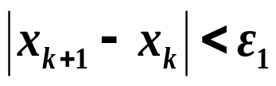
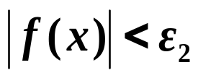
§2 Bisection Method
When to stop?
a
x₁
x*
a
x₂
b
b
或
不能保证 x 的精度
ε₂
x*
x

Slide 3

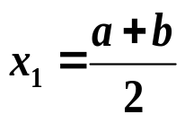
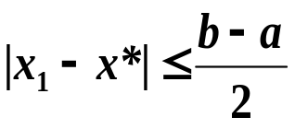
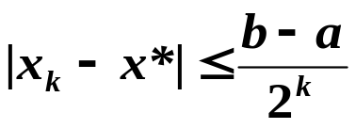
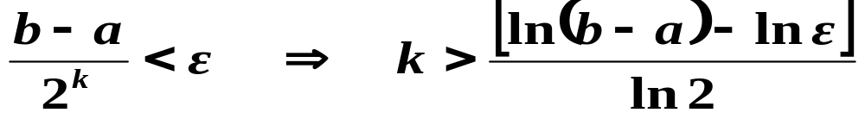

§2 Bisection Method
误差 分析：
第1步产生的
有误差
第 k 步产生的 x_{k} 有误差
对于给定的精度 ε ,可估计二分法所需的步数 k ：
①简单;
② 对f (x) 要求不高(只要连续即可) .
HW: p.16 #1
①无法求复根及偶重根
② 收敛慢
注：用二分法求根，最好先给出 f (x) 草图以确定根的大概位置。或用搜索程序，将[a, b]分为若干小区间，对每一个满足 f (a_{k})·f (b_{k}) < 0 的区间调用二分法程序，可找出区间[a, b]内的多个根，且不必要求 f (a)·f (b) < 0 。

Slide 4


§2 Bisection Method
Lab 02. Bisection Method
Use the Bisection method to find on m given intervals the m real roots of a given polynomial of degree 5 ≥ n ≥ m, .
Input
There are several sets of inputs. For each set:
The 1st line contains an integer n which is the degree of a polynomial. n = −1 signals the end of file.
The 2nd line contains n+1 real numbers which are the coefficients of the polynomial. The numbers are separated by spaces.
The 3rd line contains an integer Max and two real numbers eps1 and eps2, where Max is the maximum number of iterations, eps1 is the accuracy bound for x and eps2 is the accuracy bound for p(x).
The 4th line contains an integer m (n ≥ m ≥ 0), followed by m pairs of real numbers a₁ b₁ …a_{m} b_{m} which are the end points of the intervals
[ a₁ , b₁ ] …[ a_{m} , b_{m} ].

Slide 5
§2 Bisection Method
Output
Each root is to be printed as in the C fprintf:
fprintf(outfile, "%12.7f", root ); /* here  represents a space */
If there is no root found in an interval, simply print “noroot”.
The output of the next set must be printed in a new line.
Sample Input ( represents a space)
2
10−1
10000.000000010.00000001
2−2−0.50.52
3
100−1
10000.000000010.00000001
2−1002
−1
Sample Output ( represents a space)
−1.00000001.0000000
noroot1.0000000

Slide 6
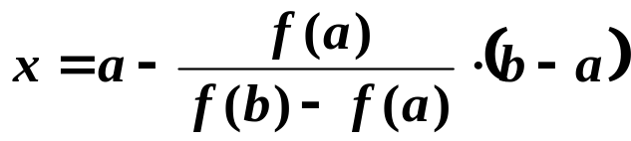
§2 Bisection Method
➢ 试位法 /* Regula Falsi Method */
Is it really better than
Bisection Method?
(b, f (b))
a
x*
b
(a+b)/2
(a, f (a))
注：试位法每次迭代比二分法多算一次乘法，而且不保证收敛。

Slide 7

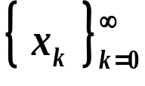
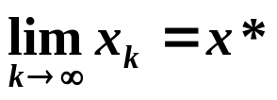
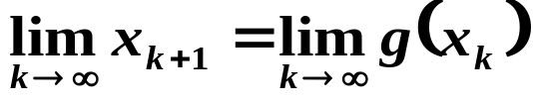
§3 迭代法 /* Fixed-Point Iteration */
等价变换
f (x) = 0
x = g (x)
f (x) 的根
g (x) 的不动点
从一个初值 x₀ 出发，计算 x₁ = g(x₀), x₂ = g(x₁), …, x_{k+1} = g(x_{k}), … 若 收敛，即存在 x* 使得
，且 g 连续，则由 可知 x* = g(x* )，即x* 是 g 的不动点，也就是f 的根。
思路
So basically we are done! I can’t believe it’s so simple!
What’s the problem?
Oh yeah? Who tells you that the method is convergent?

Slide 8
§3 Fixed-Point Iteration
y
y = x
y
y = x
p₁
p₀
y=g(x)
✓
p₀
✓
y=g(x)
p₁
x
x
x₀
x₁
x*
x₀
x*
x₁
y
y = x
y
y = x
y=g(x)
y=g(x)
p₀
❒
❒
p₀
p₁
p₁
x
x
x₁
x₀
x*
x₀
x*
x₁

Slide 9


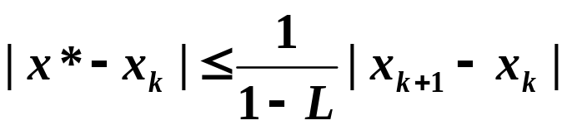
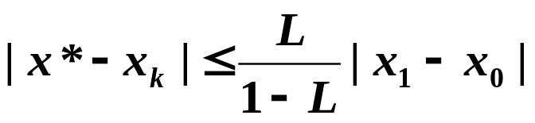
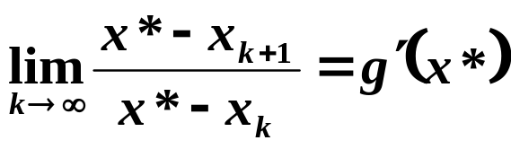
§3 Fixed-Point Iteration
定理
考虑方程 x = g(x), g(x)∈C[a, b], 若
( I ) 当 x∈[a, b] 时， g(x)∈[a, b]；
( II ) ∃ 0 ≤ L < 1 使得 | g’(x) | ≤ L < 1 对 ∀ x∈[a, b] 成立。
则任取 x₀∈[a, b]，由 x_{k+1} = g(x_{k}) 得到的序列 收敛于g(x) 在[a, b]上的唯一不动点。并且有误差估计式：
⬧
⬧
⬧
⬧
①
( k = 1, 2, … )
⬧
k
②
⬧
且存在极限

Slide 10















§3 Fixed-Point Iteration
证明：① g(x) 在[a, b]上存在不动点？
令
有根
✓
② 不动点唯一？
反证：若不然，设还有 ，则
在
和
之间。
✓
而
③ 当k → ∞ 时， x_{k} 收敛到 x* ？
✓

Slide 11
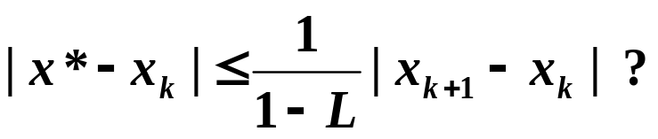
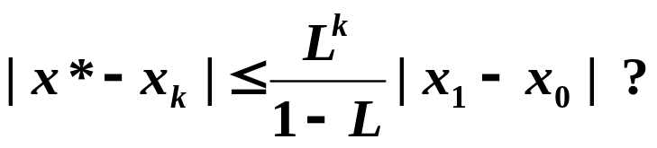

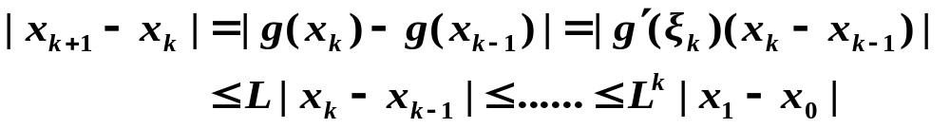
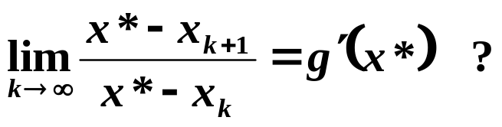
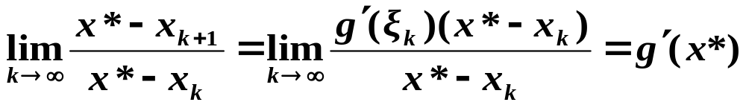
§3 Fixed-Point Iteration
④
✓
可用 来控制收敛精度
⑤
L 越 收敛越快
✓
小
⑥
✓
注：定理条件非必要条件，可将[a, b]缩小，定义局部收敛性：若在 x* 的某δ 领域 B_{δ} = { x | | x − x* | ≤ δ } 有 g∈C¹[a, b] 且 | g’(x*) | < 1，则由∀x₀∈B_{δ} 开始的迭代收敛。即调整初值可得到收敛的结果。

Slide 12
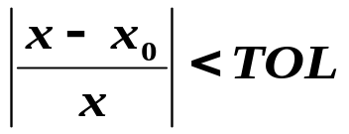
§3 Fixed-Point Iteration
Algorithm: Fixed-Point Iteration
Find a solution to x = g(x) given an initial approximation x₀.
Input: initial approximation x₀; tolerance TOL; maximum number of
iterations N_{max}.
Output: approximate solution x or message of failure.
Step 1 Set i = 1;
Step 2 While ( i ≤ N_{max}) do steps 3-6
Step 3 Set x = g(x₀); /* compute x_{i} */
Step 4 If | x − x₀ | < TOL then Output (x); /* successful */
STOP;
Step 5 Set i ++;
Step 6 Set x₀ = x ; /* update x₀ */
Step 7 Output (The method failed after N_{max} iterations); /* unsuccessful */
STOP.
当 x 很大时，此处可改为

Slide 13

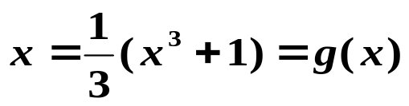

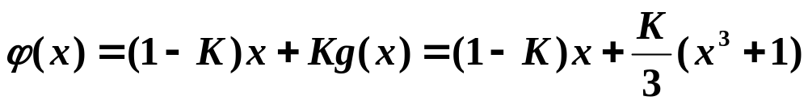

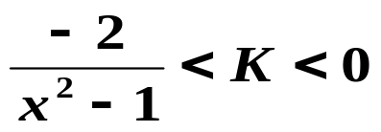
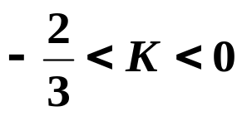
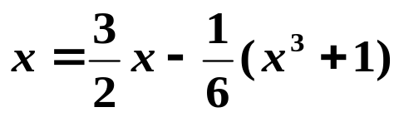
§3 Fixed-Point Iteration
改进、加速收敛 /* accelerating convergence */
➢ 待定参数法：
若 | g’(x) | ≥ 1，则将 x = g(x) 等价地改造为
求K，使得
例：求 在 (1, 2) 的实根。
如果用 进行迭代，则在(1, 2)中有
现令
希望
，即
在 (1, 2) 上可取任意 ，例如K = −0.5，则对应 即产生收敛序列。

Slide 14
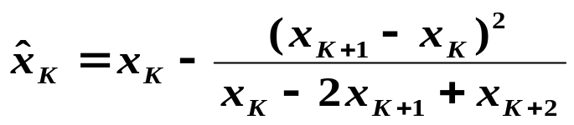
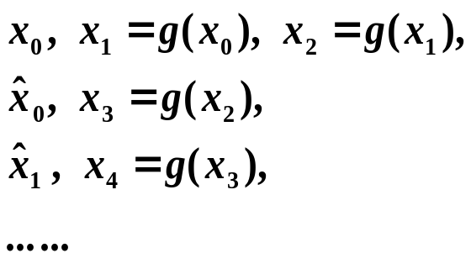


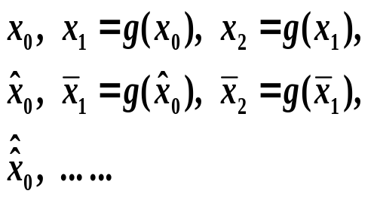
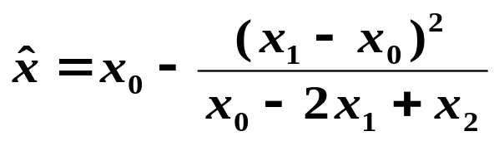

§3 Fixed-Point Iteration
➢ Aitken 加速：
一般地，有：
y
y = g(x)
y = x
P(x₁, x₂)
比 收敛得略快。
➢ Steffensen 加速：
P(x₀, x₁)
x
x₁
x*
x₂
x₀
HW: p.21-22
#1, #5

Slide 15
§3 Fixed-Point Iteration
Lab 03. Steffensen’s Method
Use Steffensen’s method to approximate the solutions of x=10.0*(sinx+cosx+1.0) near m given points to some given accuracy.
Input
The 1st line contains an integer m which is the number of solutions to be found, and an integer N_{max} which is the maximum number of iterations.
The 2nd line contains a real number eps which is the absolute accuracy bound for each solution.
The 3rd line contains m real numbers which are the initial guesses of the solutions. The numbers are separated by spaces.
Output
Each root is to be printed as in the C fprintf:
fprintf(outfile, "%10.5f\n", root );
If there is no root found near a given point simply print “noroot\n” (here  represents a space).

Slide 16
§3 Fixed-Point Iteration
Sample Input ( represents a space)
11000
0. 0000005
3.00
Sample Output ( represents a space)
2.88351

