Slide 1








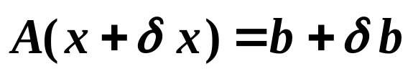


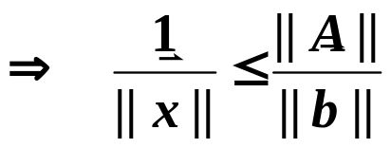

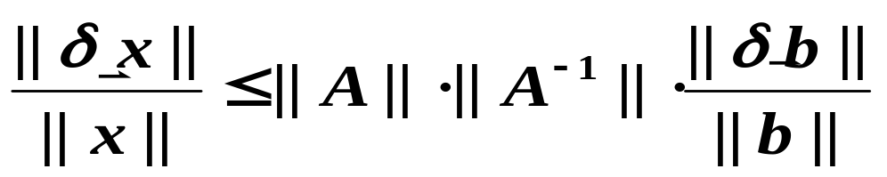
§2 线性方程组的误差分析
/* Error Analysis for Linear system of Equations */
求解 时，A 和 的误差对解 有何影响？
➢ 设 A 精确， 有误差 ，得到的解为 ，即
绝对误差放大因子
相对误差放大因子
又

Slide 2



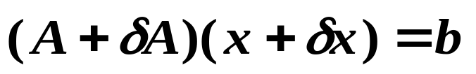





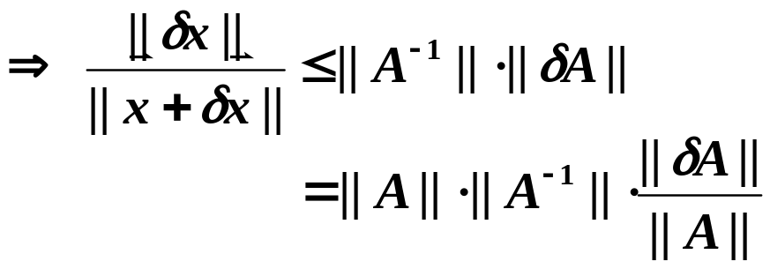


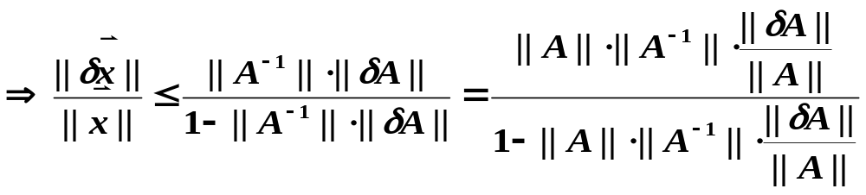
§2 Error Analysis for .
是关键
的误差放大因子，称为
A的条件数，记为cond (A) ,
越 则 A 越病态，
难得准确解。
➢ 设 精确，A有误差 ，得到的解为 ，即
大
Wait a minute …
Who said that ( I + A⁻¹δ A )
is invertible?
(只要δ A充分小，使得

Slide 3

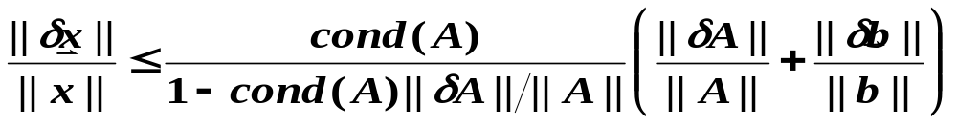


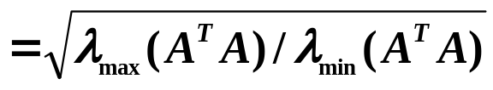
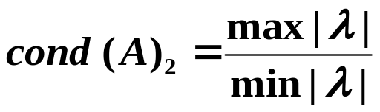

§2 Error Analysis for .
注:  cond (A) 的具体大小与 || · || 的取法有关，但相对大小一致。
☞ cond (A) 取决于A，与解题方法无关。
☞
常用条件数有：
cond (A)₁
cond (A)∞
cond (A)₂
特别地，若 A 对称，则
条件数的性质：
 A可逆，则 cond (A)_{p} ≥ 1；
 A可逆，α ∈ R 则 cond (α A) = cond (A) ；
 A正交，则 cond (A)₂=1；
 A可逆，R正交，则 cond (RA)₂ = cond (AR)₂ = cond (A)₂ 。

Slide 4
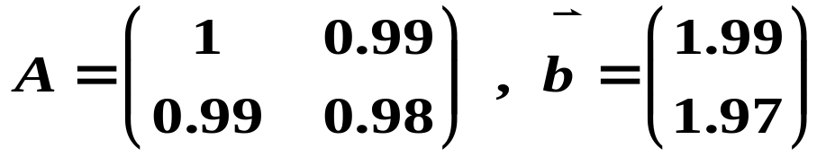
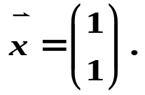
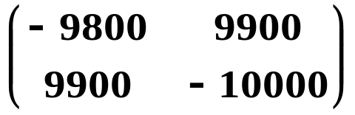
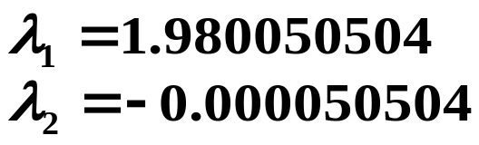

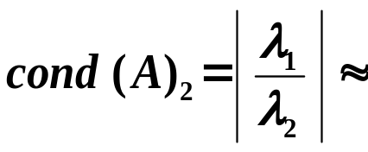
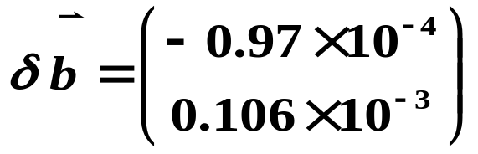

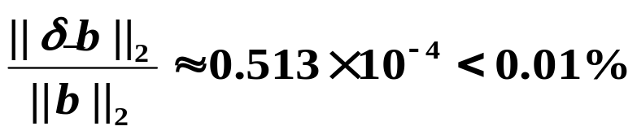
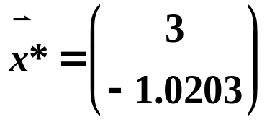
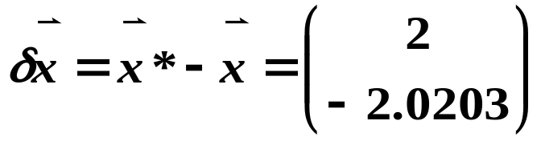
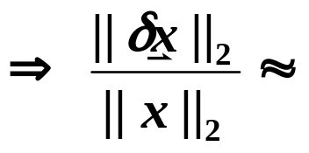
§2 Error Analysis for .
例：
精确解为
计算cond (A)₂ 。
A⁻¹ =
解：考察 A 的特征根
39206 >> 1
 测试病态程度：
给 一个扰动
，其相对误差为
此时精确解为
2.0102 > 200%

Slide 5
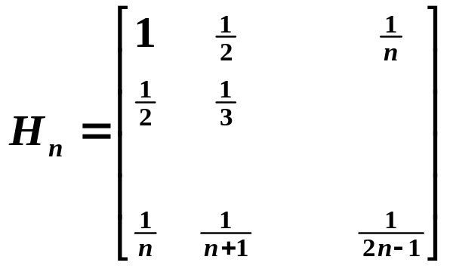
§2 Error Analysis for .
例：Hilbert 阵
cond (H₂)∞ =
27
cond (H₃)∞ ≈
748
2.9 × 10⁶
cond (H₆)∞ =
cond (H_{n})∞→ ∞ as n → ∞
注：一般判断矩阵是否病态，并不计算A⁻¹，而由经验得出。
☞ 行列式很大或很小（如某些行、列近似相关）；
☞ 元素间相差大数量级，且无规则；
☞ 主元消去过程中出现小主元；
☞ 特征值相差大数量级。

Slide 6



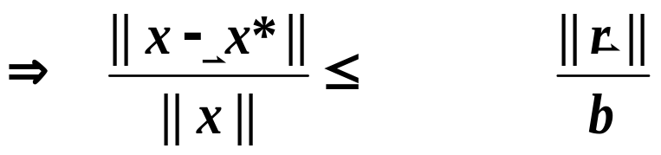









§2 Error Analysis for .
➢ 近似解的误差估计及改善：
设 的近似解为 ，则一般有
cond (A)
HW: p.66
#2, #4, #5
 改善方法：
Step 1: 近似解
误差上限
Step 2:
若 可被精确解出，则有
就是精确解了。
Step 3:
Step 4:
经验表明：若 A 不是非常病态（例如： ），则如此迭代可达到机器精度；但若 A 病态，则此算法也不能改进。

Slide 7
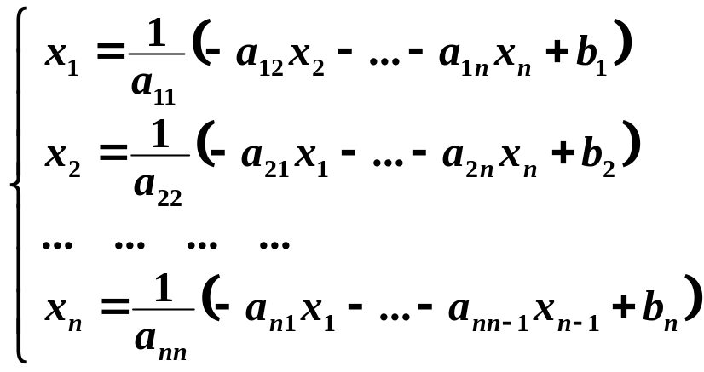
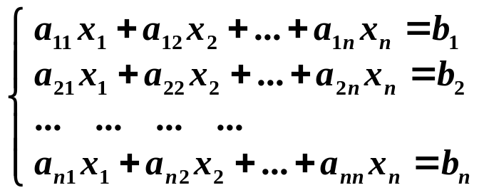

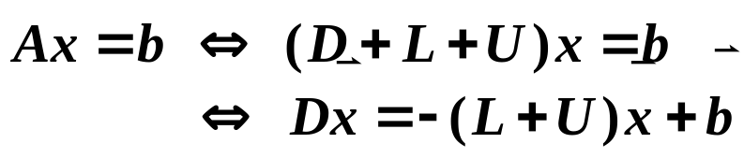



§3 Jacobi 法和 Gauss - Seidel 法
/* Jacobi & Gauss-Seidel Iterative Methods */
➢ Jacobi Iterative Method
写成矩阵形式：
U
L
A =
D
B
Jacobi 迭代阵

Slide 8


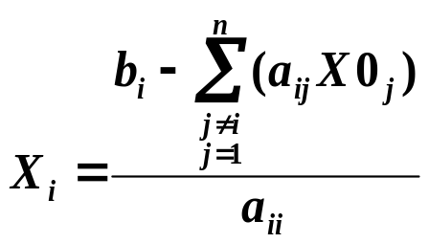

§3 Jacobi & Gauss-Seidel Iterative Methods
Algorithm: Jacobi Iterative Method
Solve given an initial approximation .
Input: the number of equations and unknowns n; the matrix entries a[ ][ ];
the entries b[ ]; the initial approximation X0[ ]; tolerance TOL;
maximum number of iterations N_{max}.
Output: approximate solution X[ ] or a message of failure.
Step 1 Set k = 1;
Step 2 While ( k ≤ N_{max}) do steps 3-6
Step 3 For i = 1, …, n
Set ; /* compute x_{k} */
Step 4 If then Output (X[ ]);
STOP; /* successful */
Step 5 For i = 1, …, n Set X 0[ ] = X [ ]; /* update X0 */
Step 6 Set k ++;
Step 7 Output (Maximum number of iterations exceeded);
STOP. /* unsuccessful */
迭代过程中，A 的元素
不改变，故可以事先调整好 A 使得
a_{ii} ≠ 0，否则 A不可逆。
A bit wasteful, isn’t it?
What if a_{ii} = 0?
必须等X^{(k)}完全计算
好了才能计算X^{(k+1)}，因此
需要两组向量存储。

Slide 9
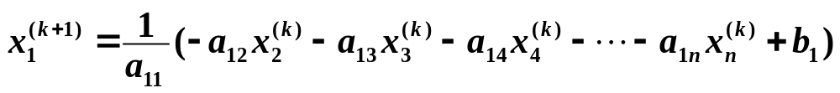
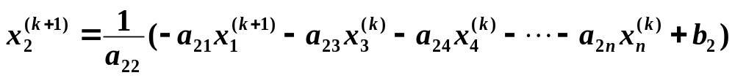
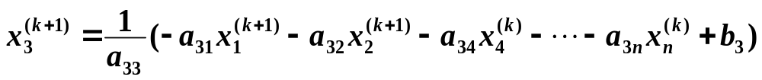

§3 Jacobi & Gauss-Seidel Iterative Methods
➢ Gauss - Seidel Iterative Method
只存一组向量即可。
… … … …
写成矩阵形式：
Gauss-Seidel
迭代阵
B

Slide 10
§3 Jacobi & Gauss-Seidel Iterative Methods
A mathematician about his colleague:
" He made a lot of mistakes, but he made them
in a good direction. I tried to copy this, but I found
out that it is very difficult to make good mistakes. "
注：二种方法都存在收敛性问题。
有例子表明：Gauss-Seidel法收敛时，Jacobi法可能不收敛；而Jacobi法收敛时， Gauss-Seidel法也可能不收敛。
p.76 #2 给出了例子。
收敛性分析将在下节课讨论。

Slide 11


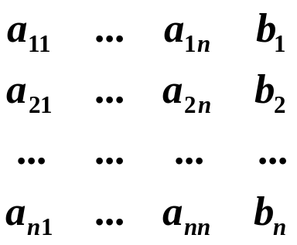
§3 Jacobi & Gauss-Seidel Iterative Methods
Lab 07. Gauss-Seidel Method
Use the Gauss-Seidel method to solve a given n×n linear system
with an initial approximation and a given tolerance TOL.
Input
There are several sets of inputs. For each set:
The 1st line contains an integer 100 ≥ n ≥ 0 which is the size of a matrix. n = −1 signals the end of file.
The following n lines contain the
augmented matrix in the following format:
The numbers are separated by spaces and new lines.
The last line of each test case contains a real number TOL, which is the tolerance for || · ||∞ norm, and an integer N ≥ 0 which is the maximum number of iteration.

Slide 12


§3 Jacobi & Gauss-Seidel Iterative Methods
Output /*  represents a space */
Each entry of the solution is to be printed as in the C fprintf:
fprintf(outfile, "%12.8f\n", x );
If the matrix has a zero column, print the message “Matrixhasazero column. No uniquesolutionexists.\n”.
If the method fails to give a solution after N iterations, print the message “Maximumnumberof iterationsexceeded.\n”.
If there is an entry of that is out of the range , print the message “No convergence.\n”.
The outputs of two test cases must be seperated by a blank line.
Sample Input
( represents a space)
3
10–109
–110–27
0–4106
0.0000000011000
3
3–101
3600
3304
0.0000000011000
–1
Sample Output
( represents a space)
1.00000000
1.00000000
1.00000000
Matrixhasazerocolumn.Nouniquesolutionexists.

