Slide 1

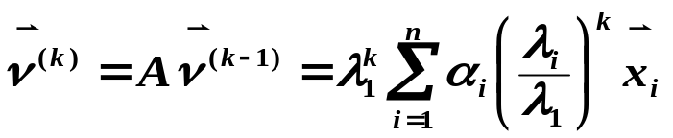


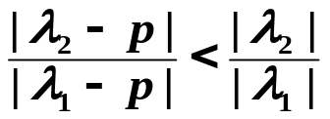
Ch.5 Power Method – Deflation Technique
➢ 原点平移法 /* deflation technique */
希望 | λ₂ / λ₁ | 越小越好。
不妨设 λ₁ > λ₂ ≥ … ≥ λ_{n} ，且 | λ₂ | > | λ_{n} |。
决定收敛的速度，特别
是 | λ₂ / λ₁ |
λ_{n}
λ₂
λ₁
O
p = ( λ₂ + λ_{n} ) / 2
令 B = A − pI ，则有 | λI−A | = | λI−(B+pI) | = | (λ−p)I−B |
⇒ λ_{A} − p = λ_{B} 。而 ，所以求B的特征根收敛快。
How are we supposed to know where p is?
思路
As far as the laws of mathematics refer to reality, they are not certain, and as far as they are certain, they do not refer to reality.
-- Albert Einstein (1879-1955)

Slide 2


Ch.5 Power Method –Inverse Power Method
➢ 反幂法 /* Inverse Power Method */
1
>
1
≥ …≥
1
若 A 有| λ₁ | ≥ | λ₂ | ≥ … > | λ_{n} |，则 A⁻¹ 有
对应同样一组特征向量。
λ
λ
λ
n
n
−
1
1
A⁻¹ 的主特征根 A的绝对值最小的特征根
Q: How must we compute in every step?
A: Solve a linear system with A factorized.
若知道某一特征根 λ_{i} 的大致位置 p ，即对任意 j ≠ i 有| λ_{i} − p | << | λ_{j} − p | ，并且如果 (A − pI)⁻¹存在，则可以用反幂法求(A − pI)⁻¹的主特征根 1/(λ_{i} − p ) ，收敛将非常快。
思路

Slide 3

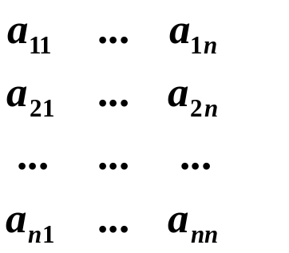
Ch.5 Power Method –Inverse Power Method
Lab 09. Approximating Eigenvalues
Approximate an eigenvalue and an associated eigenvector of a given n×n matrix A near a given value p and a nonzero vector .
Input
There are several sets of inputs. For each set:
The 1st line contains an integer 100 ≥ n ≥ 0 which
is the size of a matrix. n = −1 signals the end of file.
The following n lines contain the matrix entries in
the format shown:
The next line contains a real number TOL, which is the tolerance for eigenvalues, and an integer N ≥ 0 which is the maximum number of iterations.
The next line contains an integer n ≥ m > 0 which is the number of eigenvalues to be approximated.
Each of the following m lines contains a real number p which is an initial approximation of the eigenvalue, followed by n real number entries of the nonzero vector .
The numbers are separated by spaces and new lines. The inputs guarantee that the shifted matrix can be factorized by Doolittle method.

Slide 4
Ch.5 Power Method –Inverse Power Method
Output ( represents a space)
For each p, there must be a set of outputs in the following format:
The 1st line contains the approximation of an eigenvalue printed as in the C printf: fprintf(outfile, "%12.8f\n", lambda );
The 2nd line contains the n entries of the associated eigenvector. Each entry is printed as in the C fprintf: fprintf(outfile, "%12.8f", x );
If the method fails to give a solution after N iterations, print the message “Maximumnumberof iterationsexceeded.\n”.
If p is just the accurate eigenvalue, print the message
fprintf(outfile, “%12.8fisaneigenvalue.\n”, p );
The outputs of two test cases must be seperated by a blank line.
Sample Input
3
123
234
345
0.00000000011000
1
–0.6111
2
01
10
0.000000000110
1
1.011
–1
Sample Output
–0.62347538
1.000000000.17206558–0.65586885
1.00000000isaneigenvalue.

