Slide 1

第六章 插值 /* Interpolation */
当精确函数 y = f(x) 非常复杂或未知时，在一系列节点 x₀ … x_{n} 处测得函数值 y₀ = f(x₀), … y_{n} = f(x_{n})，由此构造一个简单易算的近似函数 g(x) ≈ f(x)，满足条件g(x_{i}) = f(x_{i}) (i = 0, … n)。这里的 g(x) 称为f(x) 的插值函数。最常用的插值函数是 …?
多项式
g(x) ≈ f(x)
x₀
x₁
x₂
x
x₃
x₄

Slide 2





§1 拉格朗日多项式 /* Lagrange Polynomial */
求 n 次多项式 使得
P
(
x
)
=
y
,
i
=
0
,
...
,
n
n
i
i
条件：无重合节点，即
n = 1
称为拉氏基函数 /* Lagrange Basis */，
满足条件 l_{i}(x_{j})=δ_{ij} /* Kronecker Delta */
已知 x₀ , x₁ ; y₀ , y₁ ，求
使得
P
(
x
)
=
y
,
P
(
x
)
=
y
1
0
0
1
1
1
可见 P₁(x) 是过 ( x₀ , y₀ ) 和 ( x₁, y₁ ) 两点的直线。
y
−
y
P
(
x
)
=
y
+
1
0
(
x
−
x
)
1
0
x
−
x
0
1
0
x
−
x
x
−
x
1
= y₀ + y₁
Σ
1
0
=
l
(
x
)
y
x
−
x
x
−
x
i
i
0
1
1
0
i
=
0
l₀(x)
l₁(x)

Slide 3
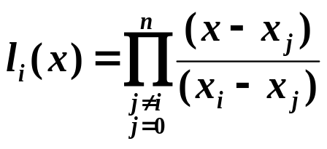
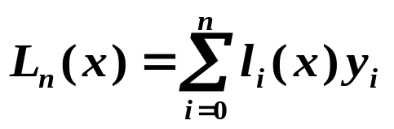
§1 Lagrange Polynomial
The mathematician S. had to move to a new place.
His wife didn't trust him very much, so when they stood
down on the street with all their things, she asked him to
watch their ten trunks, while she got a taxi. Some minutes
later she returned. Said the husband: "I thought you said
there were ten trunks, but I've only counted to nine!"
The wife said: "No, they're TEN!"
"But I have counted them: 0, 1, 2, ..."
n ≥ 1
希望找到l_{i}(x)，i = 0, …, n 使得 l_{i}(x_{j})=δ_{ij} ；然后令
n
P
(
x
)
=
Σ
l
(
x
)
y
，则显然有P_{n}(x_{i}) = y_{i} 。
n
i
i
i
=
0
l_{i}(x)
每个 l_{i} 有 n 个根 x₀ … x_{i} … x_{n}
与 有关，而与 无关
Lagrange Polynomial
节点
f
n
l
(
x
)
=
C
(
x
−
x
)...(
x
−
x
)...(
x
−
x
)
=
C
Π
(
x
−
x
)
i
i
0
i
n
i
j ≠ i
j
l
(
x
)
=
1
C
=
Π
1
j
=
0
i
i
i
j ≠ i
(
x
−
x
)
i
j

Slide 4



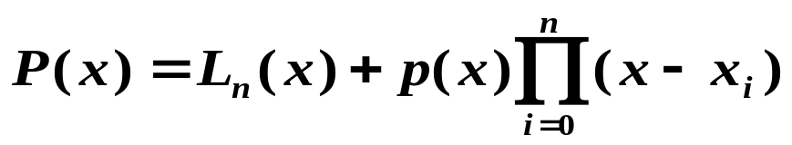

§1 Lagrange Polynomial
定理
(唯一性) 满足 的 n 阶插值多项式是唯一存在的。
证明： ( p.105-106 利用Vandermonde 行列式论证)
反证：若不唯一，则除了L_{n}(x) 外还有另一 n 阶多项式 P_{n}(x) 满足 P_{n}(x_{i}) = y_{i} 。
考察 则 Q_{n} 的阶数
≤ n
而 Q_{n} 有 个不同的根
n + 1
x₀ … x_{n}
注：若不将多项式次数限制为 n ，则插值多项式不唯一。
例如 也是一个插值多项式，其中 可以是任意多项式。

Slide 5



















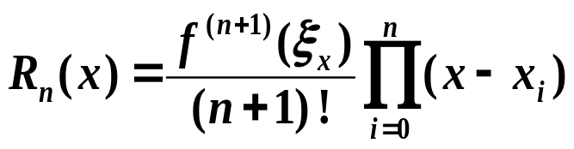
§1 Lagrange Polynomial
➢ 插值余项 /* Remainder */
设节点
，且 f 满足条件 ,
在[a , b]内存在, 考察截断误差
n
=
Π
−
Rolle’s Theorem: 若 充分光滑， ，则
存在 使得 。
R_{n}(x) 至少有 个根
n+1
R
(
x
)
K
(
x
)
(
x
x
)
n
i
i
=
0
注意这里是对 t 求导
n
任意固定 x ≠ x_{i} (i = 0, …, n), 考察
Π
ϕ
(
t
)
=
R_{n}
(
t
)
−
K
(
x
)
(
t
−
x
)
推广：若
i
i
=
0
ϕ(x)有 n+2 个不同的根 x₀ … x_{n} x
使得
使得
f
(
n
+
1
)
(
ξ
)
−
L
(
n
+
1
)
(
ξ
)
−
K
(
x
)(
n
+
1
)
!
=
R
(
n
+
1
)
(
ξ
)
−
K
(
x
)
(
n
+
1
)
!
x
n
x
n
x
存在
使得
f
(
n
+
1
)
(
ξ
)
K
(
x
)
=
x
(
n
+
1
)
!

Slide 6

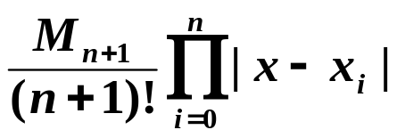


§1 Lagrange Polynomial
注： 通常不能确定 ξ_{x} , 而是估计 , ∀x∈(a,b)
将 作为误差估计上限。
当 f(x) 为任一个次数≤ n 的多项式时， , 可知 ，即插值多项式对于次数≤ n 的多项式是精确的。
Quiz: 给定 x_{i} = i +1, i = 0, 1, 2, 3, 4, 5. 下面哪个是 l₂(x)的图像？
y
A
y
B
y
C
1
-
1
-
1
-
0.5
-
0.5
-
0.5
-
0
1
2
3
4
5
6
x
0
1
2
3
4
5
6
x
0
1
2
3
4
5
6
x
-
0.5
-
-
0.5
-
-
0.5
-
✓

Slide 7
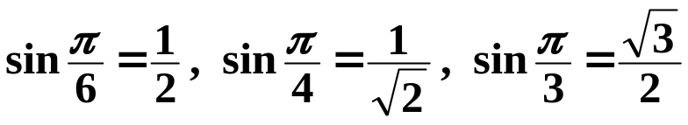
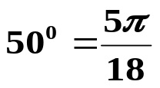



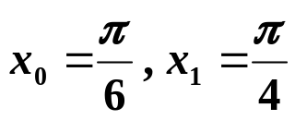
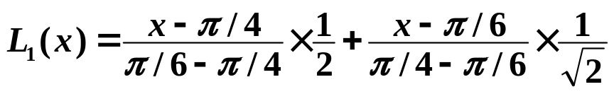
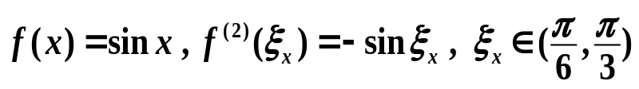
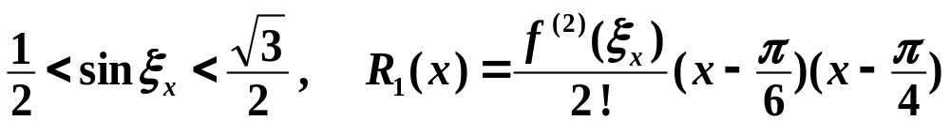
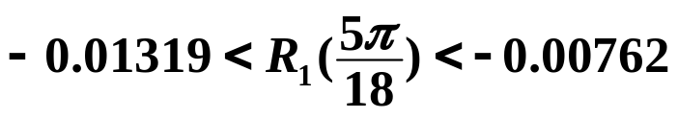
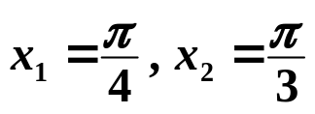
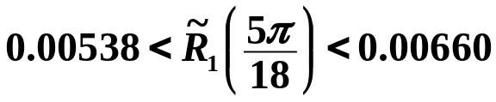
§1 Lagrange Polynomial
例：已知
分别利用 sin x 的1次、2次 Lagrange 插值计算 sin 50°
并估计误差。
解：
n = 1
分别利用x₀, x₁ 以及 x₁, x₂ 计算
利用
内插通常优于外推。选择要计算的 x 所在的区间的端点，插值效果较好。
sin
50
0
≈
L
(
5
π
)
≈
0.77614
这里
1
18
而
sin 50° = 0.7660444…
外推 /* extrapolation */ 的实际误差 ≈ −0.01001
利用
sin 50° ≈ 0.76008,
内插 /* interpolation */ 的实际误差 ≈ 0.00596

Slide 8
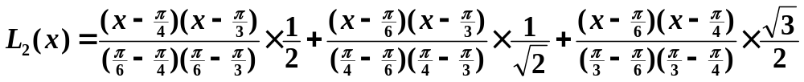
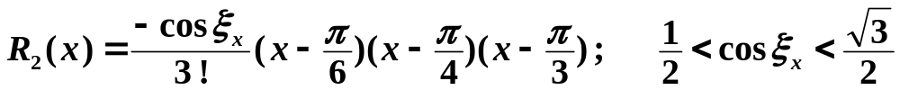
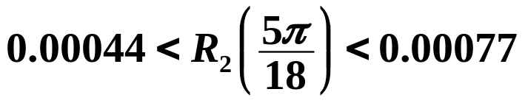

§1 Lagrange Polynomial
n = 2
sin
50
0
≈
L
(
5
π
)
≈
0.76543
2
18
sin 50° = 0.7660444…
2次插值的实际误差 ≈ 0.00061
HW: p.112-113
#5，#7
高次插值通常优于低次插值
但绝对不是次数越高就越好，嘿嘿……

Slide 9



§1 Lagrange Polynomial
Lab 10. Lagrange Polynomial
Given a set of sample points of a certain function f , use Lagrange polynomial to approximate function values at some given points .
Input
There are several sets of inputs. For each set:
The 1st line contains an integer 20 ≥ n ≥ 0 which is the degree of Lagrange polynomial. n = −1 signals the end of file.
The 2nd line contains n+1 distinct real numbers .
The 3rd line contains n+1 real numbers .
The last line of a test case consists of an integer m > 0 and m real numbers .
The numbers are separated by spaces and new lines.

Slide 10
§1 Lagrange Polynomial
Output ( represents a space)
For each a_{i} , you are supposed to print the function value at this point in the following format:
fprintf(outfile, "f(%6.3f)=%12.8e\n", a, f );
The outputs of two test cases must be seperated by a blank line.
Sample Input
7
0.50.70.91.11.31.51.71.9
0.480.640.780.890.961.000.990.95
50.741.60.551.21.85
1
0.01.0
0.01.0
10.5
–1
Sample Output
f(0.740) =6.68735821e–001
f(1.600) =1.00341309e+000
f(0.550) =5.26938820e–001
f(1.200) =9.29135742e–001
f(1.850) =9.52078056e–001
f(0.500) =5.00000000e–001

Slide 11
When you start writing the program,
you will find how easy it is to calculate
the Lagrange polynomial.
Oh yeah? What if I find the current interpolation not accurate enough?
Right. Then all
the Lagrange basis, l_{i}(x),
will have to be re-calculated.
Then you might want to take
more interpolating points into account.
Excellent point !
We will come to discuss this problem
next time.

