Slide 1
Retail Store Transaction
Dataset Analysis
Data Analysis and Visualization
Semester 4th
Name: Shanib
Roll No: CSC/24/42
Subject: Data Analysis & Visualization

Slide 2
1. Dataset Overview — Loading & Cleaning
import pandas as pd
import matplotlib.pyplot as plt
df = pd.read_excel("Retail-Store-Transactions.xlsx")
df.drop(columns=["Unnamed: 17"], inplace=True)
df = df.loc[:, ~df.columns.str.contains("^Unnamed")]
print(df.head(4))
Output:
time StoreID Location Product Qty PaymentType
0 15:29 S3 Store C Tablet 3 Gift Card
1 16:53 S1 Store B Printer 9 Online
2 21:22 S9 Store B Laptop 9 Debit Card
3 14:28 S9 Store C Monitor 7 Online
Columns
Rows
time, StoreID, Location,
Product, Quantity,
PaymentType, Cashier,
StoreManager, TotalPrice...
199 transactions
across 4 stores

Slide 3
2. Exploratory Analysis — Value Counts
print("Product counts:", df["Product"].value_counts())
print("Unique products:", df["Product"].unique())
print("Location counts:", df["Location"].value_counts())
print("Store Manager counts:", df["StoreManager"].value_counts())
print("Cashier counts:", df["Cashier"].value_counts())
Products (7)
Locations (4)
Phone: 38 | Desk: 31 | Monitor: 30
Printer: 29 | Laptop: 28
Chair: 25 | Tablet: 18
Store C: 64 | Store D: 54
Store B: 41 | Store A: 40
Store Managers (4)
Cashiers (5)
Noah: 53 | Olivia: 53
Mia: 47 | Liam: 46
C1: 45 | C5: 42 | C2: 39
C4: 38 | C3: 35

Slide 4
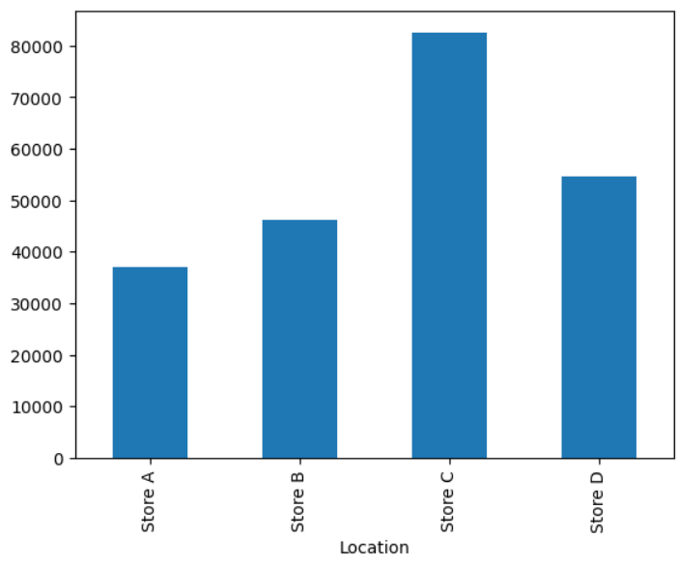
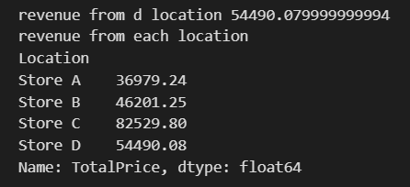
3. Revenue Analysis — By Location
r_from_d = df[df["Location"] == "Store D"]["TotalPrice"].sum()
print("Revenue from Store D:", r_from_d)
r_each_l = df.groupby("Location")["TotalPrice"].sum()
print("Revenue from each location:", r_each_l)
# Bar chart
r_each_l_graph = df.groupby("Location")["TotalPrice"].sum()
r_each_l_graph.plot(kind="bar")
Store A
Store B
₹36,979
₹46,201
Store C
Store D
₹82,530 🏆
₹54,490
Total Revenue: ₹2,20,200
Output:
Revenue from Store D: 54490.08
Location | Store A: 36979.24 |
Store B: 46201.25 |
Store C: 82529.80 |
Store D: 54490.08

Slide 5
4. Revenue Analysis — By Product
tablet_rev = df[df["Product"]=="Tablet"]["TotalPrice"].sum()
printer_rev = df[df["Product"]=="Printer"]["TotalPrice"].sum()
phone_rev = df[df["Product"]=="Phone"]["TotalPrice"].sum()
# ... (similar for all products)
r_each_p = df.groupby("Product")["TotalPrice"].sum()
print("Revenue per product:", r_each_p)
Chair
Desk
₹15,525
₹39,519
Laptop
Monitor
₹34,614
₹39,150
Phone
Printer
Output:
₹39,973 🏆
₹37,267
Product
Chair 15524.54
Desk 39519.04
Laptop 34613.89
Monitor 39149.59
Phone 39972.89
Printer 37266.78
Tablet 14153.64
Tablet
₹14,154

Slide 6
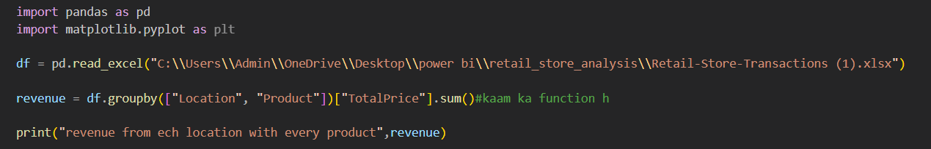
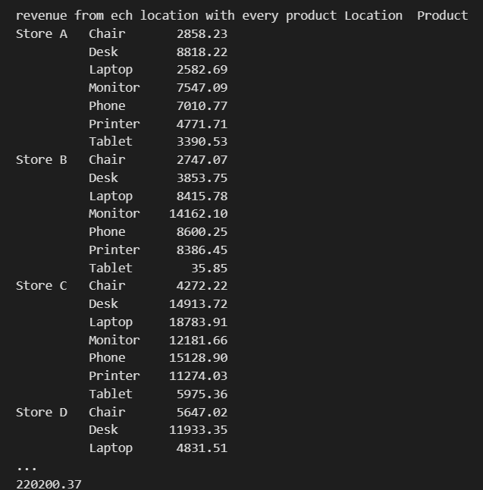
5. Revenue — Location × Product Breakdown
revenue = df.groupby(["Location", "Product"])["TotalPrice"].sum()
print("Revenue per location per product:", revenue)
Location / Product | Chair | Desk | Laptop | Monitor | Phone | Printer | Tablet
Store A | 2858 | 8818 | 2583 | 7547 | 7011 | 4772 | 3391
Store B | 2747 | 3854 | 8416 | 14162 | 8600 | 8386 | 36
Store C | 4272 | 14914 | 18784 | 12182 | 15129 | 11274 | 5975
Store D | 5647 | 11933 | 4832 | 5259 | 9233 | 12835 | 4752

Slide 7
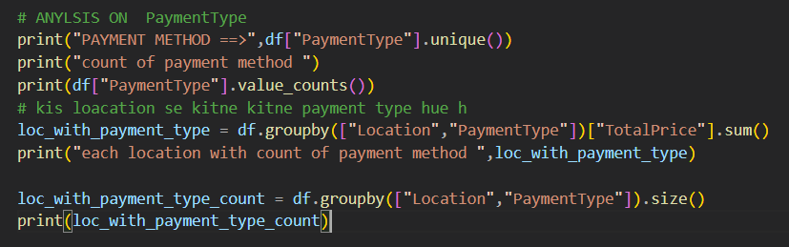
6. Payment Type Analysis
print("Payment types:", df["PaymentType"].unique())
print("Count per type:", df["PaymentType"].value_counts())
loc_pay = df.groupby(["Location","PaymentType"])["TotalPrice"].sum()
print(loc_pay)
loc_pay_cnt = df.groupby(["Location","PaymentType"]).size()
loc_pay_cnt.unstack().plot(kind="bar")
plt.ylabel("Count of Payment Type")
plt.title("Payment Type Count per Store")
plt.show()
Gift Card
49
Debit Card
43
Credit Card
43
Online
35
Cash
29
Bar chart plotted:
Payment Type Count per Store
(grouped bar showing each payment
method across all 4 locations)

Slide 8
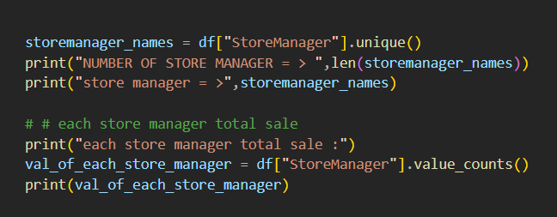
7. Store Manager Analysis
storemanager_names = df["StoreManager"].unique()
print("COUNT:", len(storemanager_names))
val_of_each = df["StoreManager"].value_counts()
grp_cashier_mgr = df.groupby(["Cashier","StoreManager"]).size()
print(grp_cashier_mgr)
# Bar chart: cashier vs manager
grp.unstack().plot(kind="bar")
plt.title("Cashier group with manager")
plt.ylabel("Count of cashier with different store manager")
plt.show()
Noah
₹59,357
53 transactions
Olivia
₹53,575
53 transactions
Mia
₹55,876
47 transactions
Liam
₹51,393
46 transactions

Slide 9
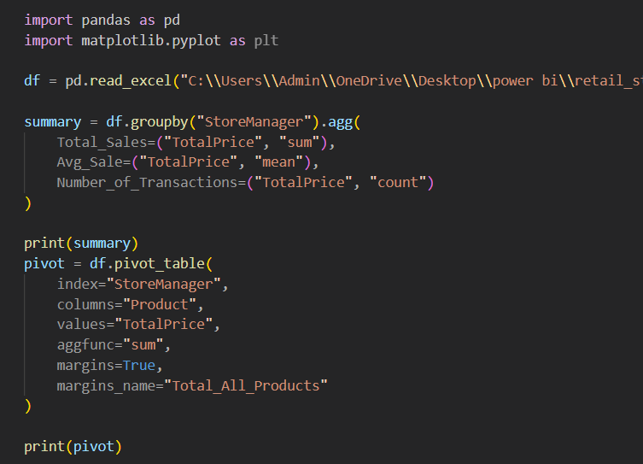
8. Summary Statistics & Pivot Table
summary = df.groupby("StoreManager").agg(
Total_Sales=("TotalPrice", "sum"),
Avg_Sale=("TotalPrice", "mean"),
Number_of_Transactions=("TotalPrice", "count")
)
pivot = df.pivot_table(
index="StoreManager",
columns="Product",
values="TotalPrice",
aggfunc="sum",
margins=True,
margins_name="Total_All_Products"
)
print(summary)
print(pivot)
Manager | Total Sales | Avg Sale | # Txns
Liam | 51392.69 | 1117.23 | 46
Mia | 55876.13 | 1188.85 | 47
Noah | 59356.69 | 1119.94 | 53
Olivia | 53574.86 | 1010.85 | 53
Pie chart (store manager sales)
and bar charts generated
showing distribution of
revenue across managers

Slide 10
Key Insights & Summary
🏪 Top Location
📦 Top Product
Store C generated highest revenue (₹82,530) — 37.5% of total
Phone had highest revenue (₹39,973); Tablet was lowest (₹14,154)
💳 Payment
👨‍💼 Top Manager
Gift Card was most popular (49 uses); Cash was least used (29)
Noah led in transactions (53) with ₹59,357 total revenue
🧾 Total Revenue
🔢 Dataset
₹2,20,200 across 199 transactions from 4 stores
7 products, 4 locations, 4 managers, 5 cashiers analyzed

