Slide 1
Impact Analysis of Population Density Growth on Real Estate
CS5617 - Data Science
Group 6
199324C – D.P.B.S.Gunasekara
199349G – C.W.Mohottala
199340V – K.P.S.Lakshani
189317A – M.N.K.Gamage

Slide 2
Problem Statement
Property rates in Sri Lanka are getting increased year by year in trending rate
Reasons:
Development of infrastructure facilities
Increase in population density
etc,
Suburb near Colombo city are getting crowded with high population density in recent years
Identifying the impact from population growth on real estate would help to predict future values and investment opportunities

Slide 3
Data Set
Population statistics over a century in census years from year 1871 to 2012
Land and inland water area
Real estate property prices over time 2011 to 2018

Slide 4
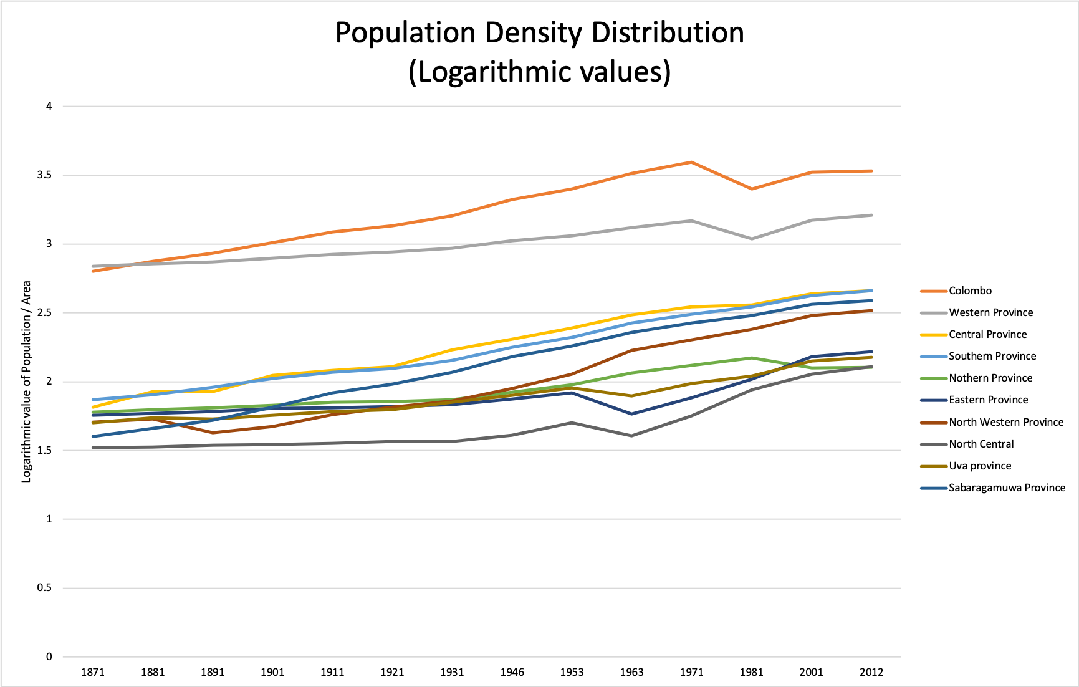
Data Representation
Population in the western province has increased rapidly mainly due to population growth in Colombo district

Slide 5
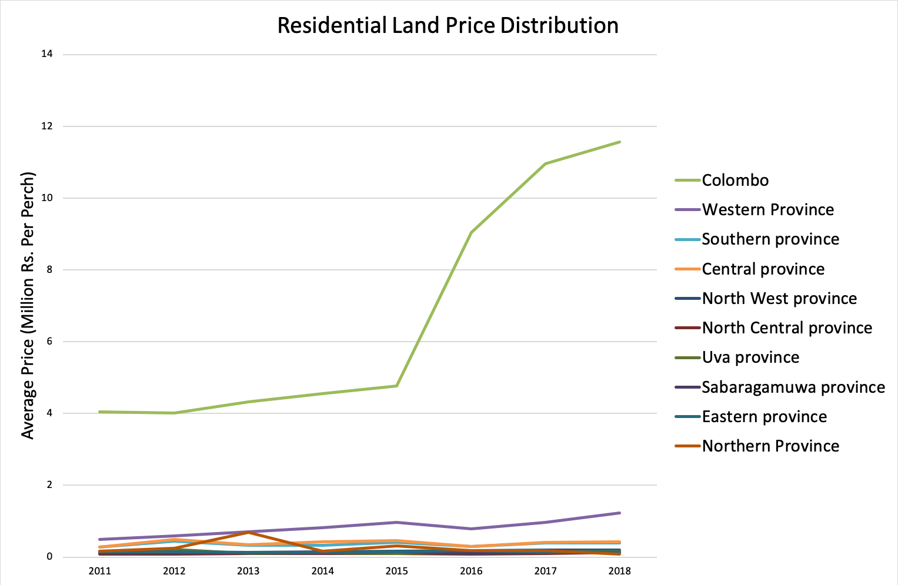
Data Representation
A rapid increase on residential land prices from 2015

Slide 6
Our Approach
Extracted population data from census years
Impute missing values
Apply linear regression model to interpolate values for required years
Extract region wise area data
Calculate population density growth over different regions
Extract real estate price data over past year
Calculate spearman correlation coefficient with population density

Slide 7
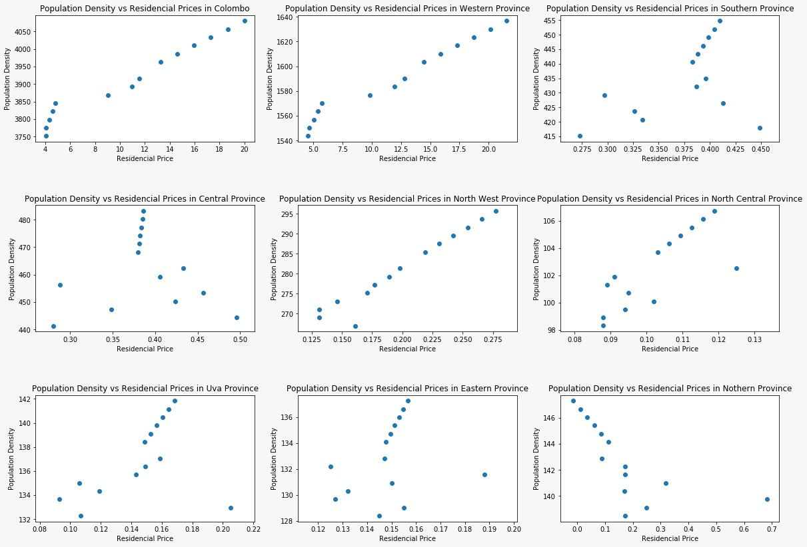
Residential Land Prices
Positive correlation on Colombo district, Western province and Northern province against population density

Slide 8
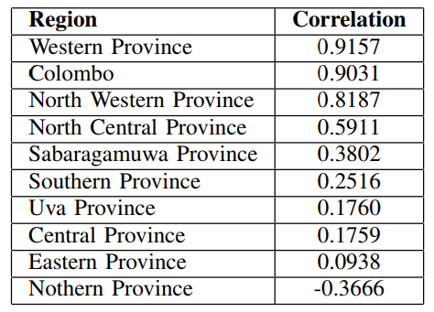
Residential Land Prices

Slide 9
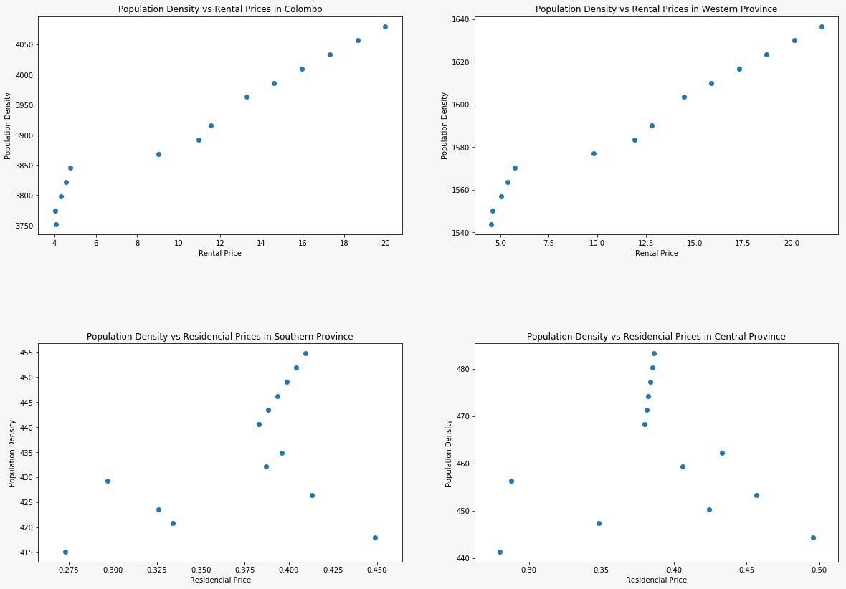
Property Rent Prices
Positive correlation between population density and property rent prices in western province and Colombo district

Slide 10
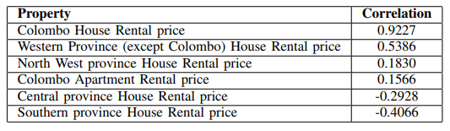
Property Rent Prices

Slide 11
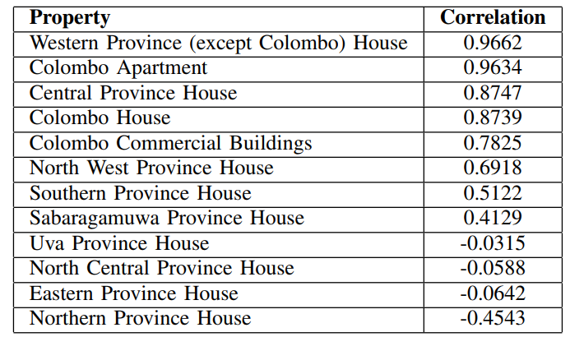
Property Sales Price

Slide 12
Conclusion
Positive Correlation between the population density and the Residential Prices in Western Province and North West Province
When the population density increases the correlation between the residential prices make more visible. Other factors plays insignificant impact.
In order to come up with more insightful predictions data must be collected and analyzed for fine grained geolocations

Slide 13
Thanks

