Slide 1
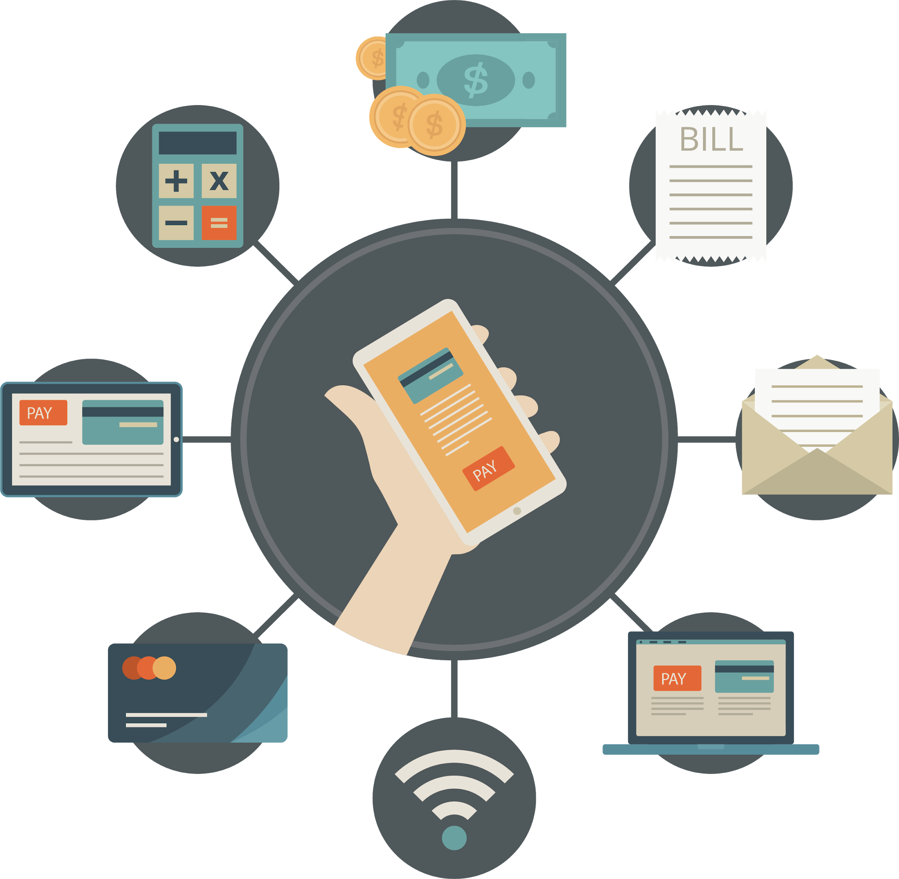
Mobile Banking Survey
199340V - K. P. S. Lakshani

Slide 2

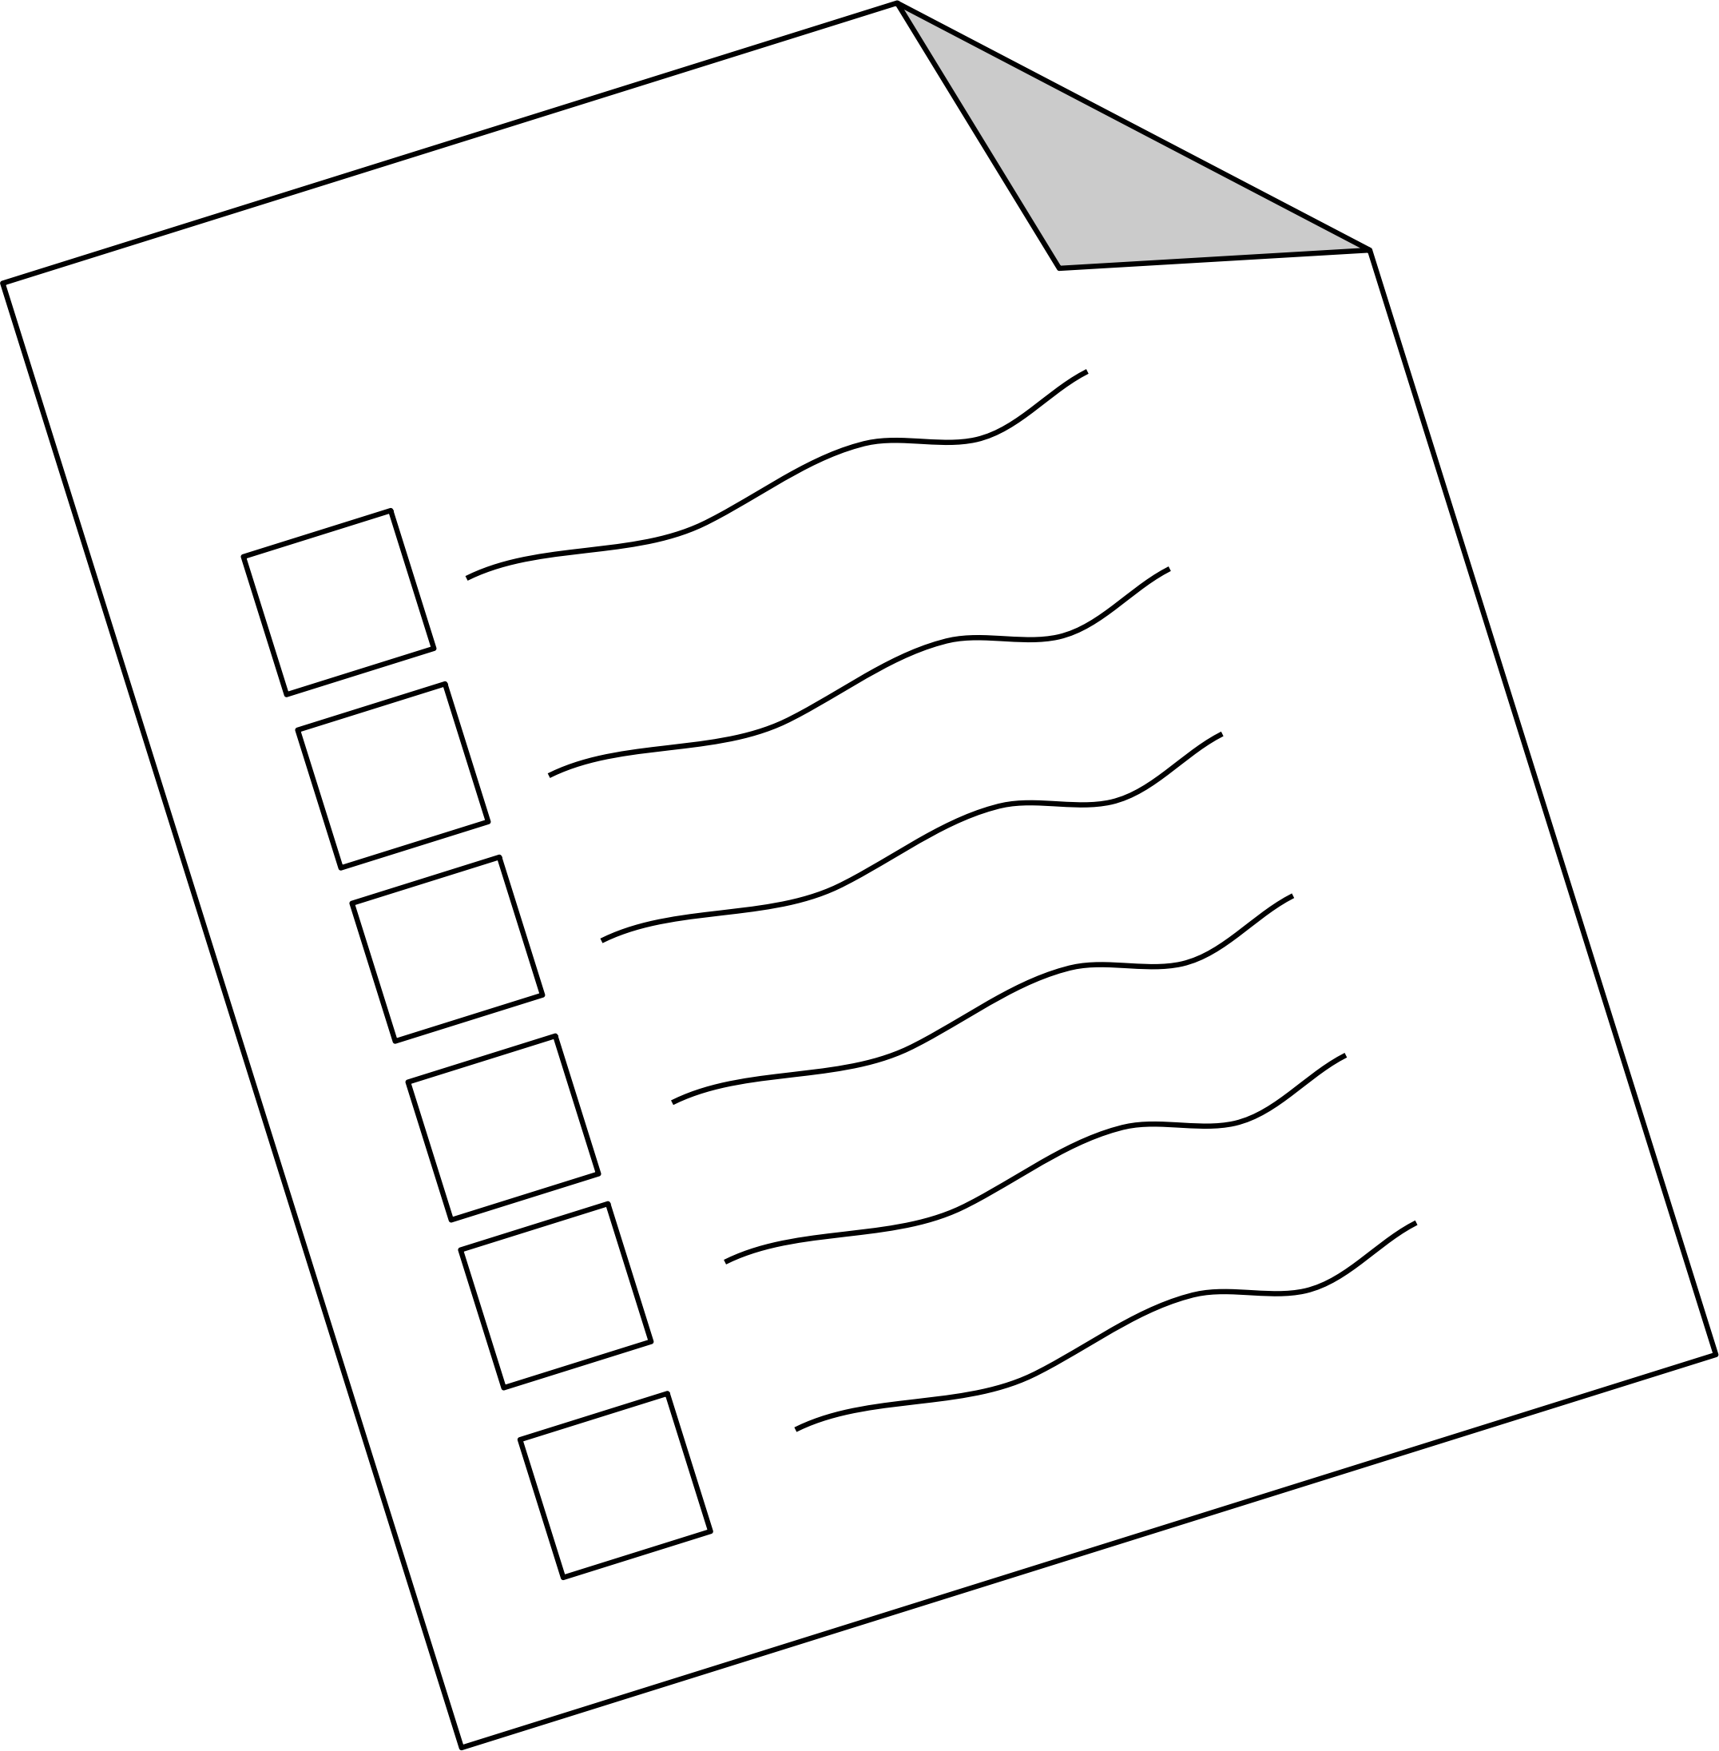
Data Collection
Number of responses: 75
Data collected districts: 12 out of 25 districts
Expected survey mode: Using google forms and paper survey
Conducted mode: Google forms
Dataset: https://github.com/shanikalakshani/CS5651-MobileBankingSurvey

Slide 3

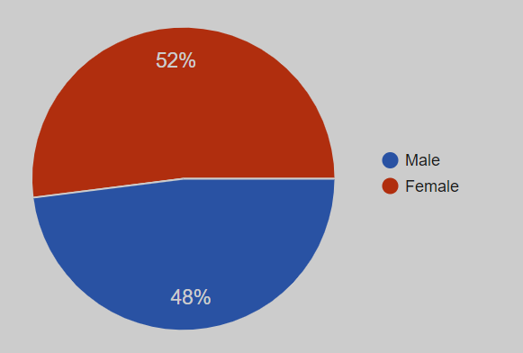
Gender
Observation:
Female population is slightly lower than the actual value of 57%

Slide 4
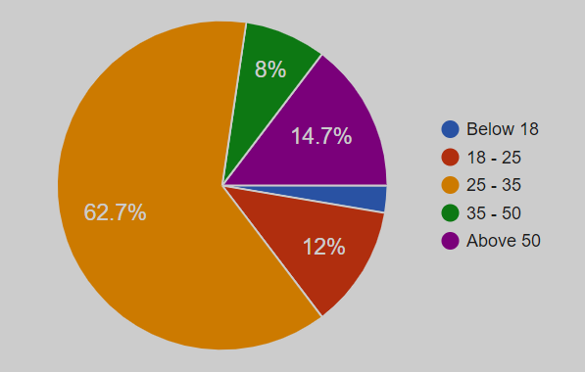
Age
Observation:
Majority of 62.7% belongs to age category 25-35

Slide 5

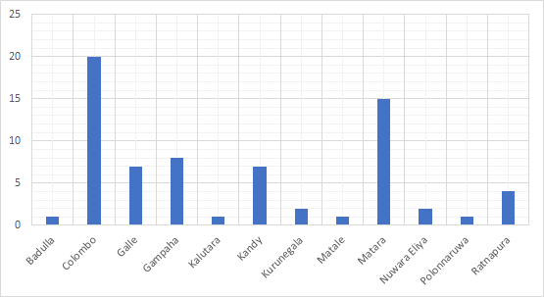
Location
Observation:
27% of respondents are from Colombo and 20% are from Matara

Slide 6

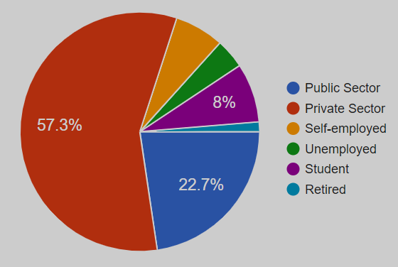
Occupation
Observation:
57.3% of total respondents work in private sector, which is higher than all the other sectors combined

Slide 7

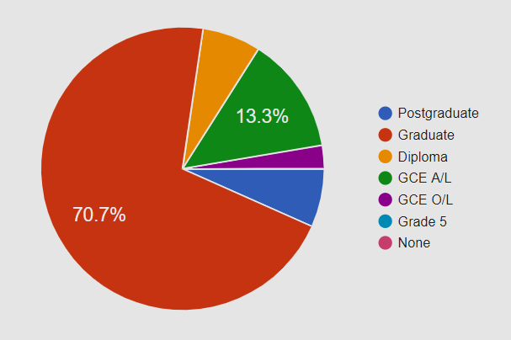
Education Level
Observation:
More than 75% of the respondents have university level education

Slide 8
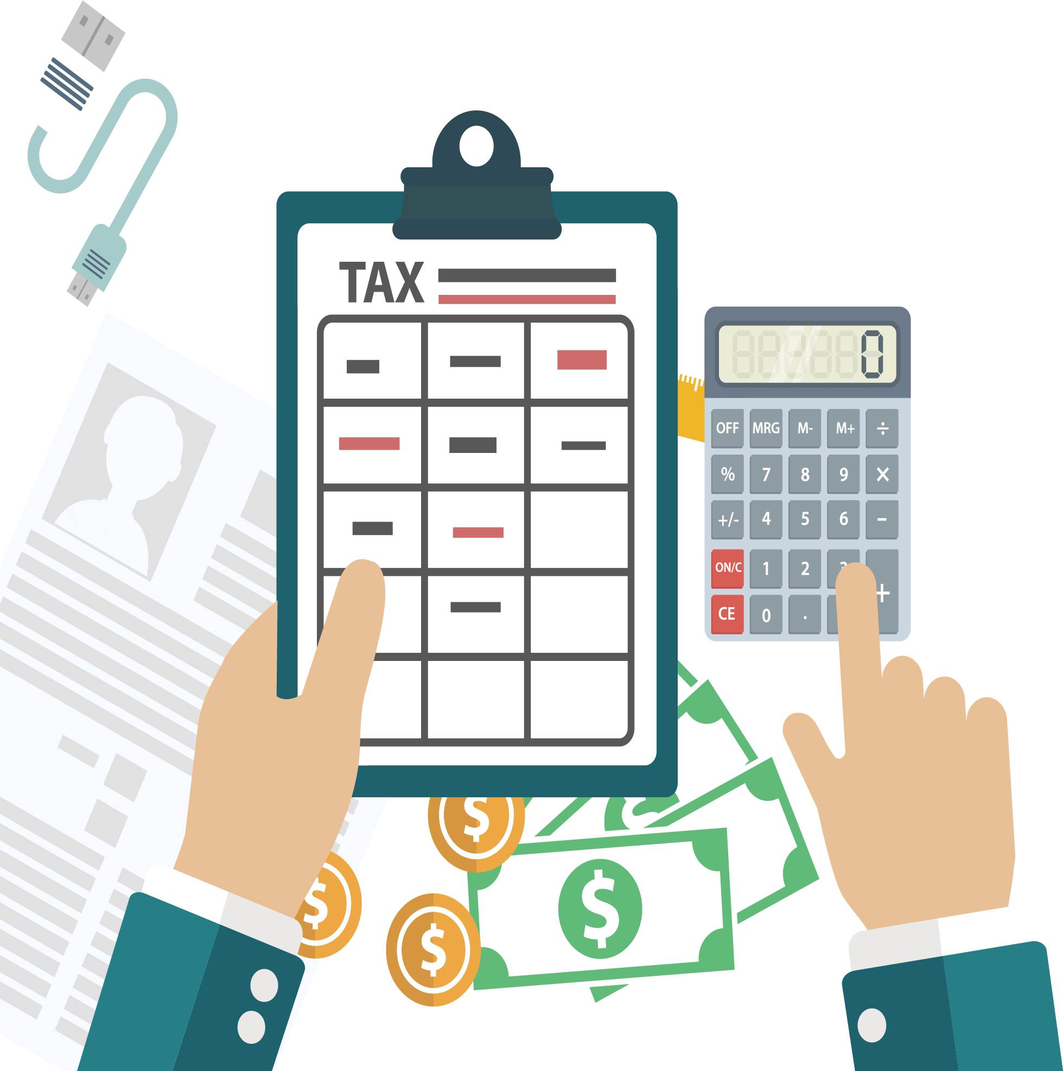
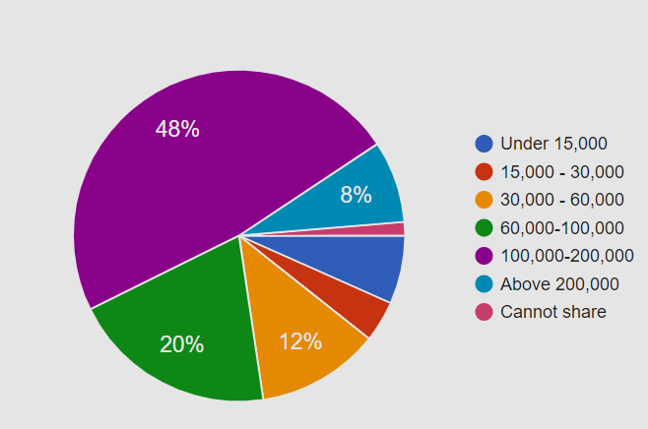
Income Level
Observation:
Income level of majority respondents is between Rs.100,000 - Rs.200,000

Slide 9
Statistical Analysis

Slide 10

Hypothesis Testing - Case 1
Does the data collected is sufficient to conclude that both male and female respondents are equally satisfied with the User Interface of mobile banking application?
H_{o}: p_{f} = p_{m}
H_{a}: p_{f} > p_{m}
p_{f}: probability of female respondents being satisfied with the UI
p_{m}: probability of male respondents being satisfied with the UI

Slide 11
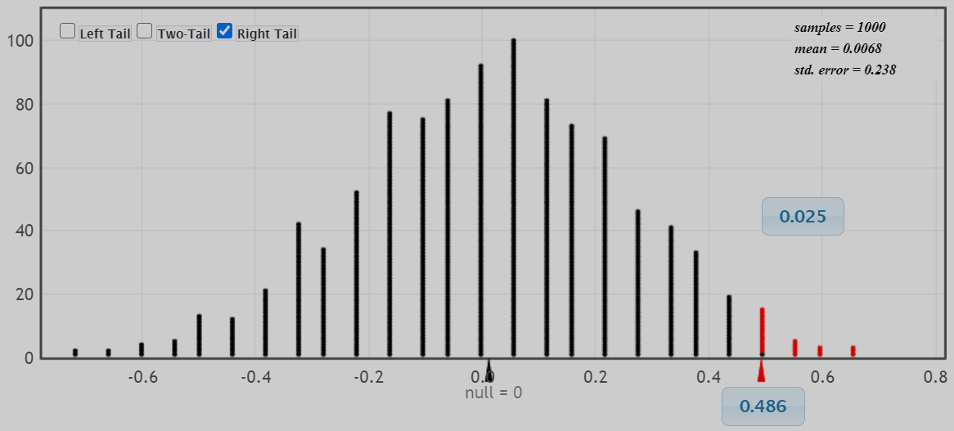

Slide 12
x̅₁ = 3 x̅₂ = 2.514 where n₁ = 39 and n₂ = 36
x̅₁ − x̅₂ = 0.486
p-value = 0.025
Considering the significance level, α = 0.05
Null hypothesis H_{o} can be rejected
Data collected is sufficient to conclude that female mobile app users are more satisfied with the user interface than male mobile app users

Slide 13
Hypothesis Testing - Case 2
Does the data collected is sufficient to conclude that both middle and high income respondents are equally satisfied with the level of data and information security provided by the bank? Here middle income is considered as income below Rs.100,000 and high income is above Rs.100,000
H_{o}: p_{m} = p_{h}
H_{a}: p_{m} > p_{h}
p_{m}: probability of middle income respondents being satisfied with data security
p_{h}: probability of high income respondents being satisfied with data security

Slide 14
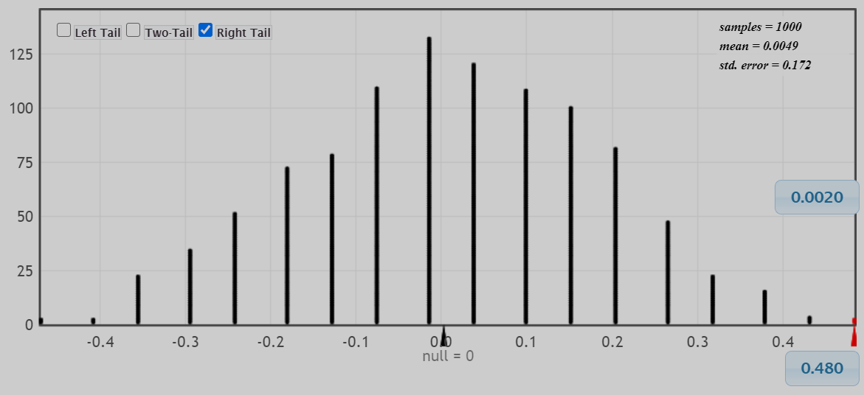

Slide 15
x̅₁ = 2.48 x̅₂ = 2 where n₁ = 33 and n₂ = 42
x̅₁ − x̅₂ = 0.48
p-value = 0.002
Considering the significance level, α = 0.05
Null hypothesis H_{o} can be rejected
Data collected is sufficient to conclude that mobile app users with middle income are more satisfied with the level of data and information security provided by the bank than mobile app users with high income

Slide 16

Conclusion
Income level has an impact on the banking services, where middle income users tend to use mobile app for Balance inquiry, Bill payment and Fund transfer, while high income users tend to use mobile app for Deposit management, in addition to other services
Female mobile app users are more satisfied with the User Interface of the application than male mobile app users
Majority of male mobile app users feel more satisfied because of the 24X7 availability and feasibility of mobile banking

Slide 17
Users with middle income are more satisfied with the level of data and information security provided by the bank than mobile app users with high income

Slide 18
Thank You!

