Slide 1
SHIFT TRACKER
Mobile Workforce Scheduling
with Conversational Reporting
React Native · Fastify · PostgreSQL · On-device-capable LLM
Student Name | Student ID | Module Code

Slide 2
CONTEXT
The problem
Shift work runs the service economy. Retail, hospitality, healthcare — hours vary weekly, staff are deskless.
Small operators still use spreadsheets, paper rotas and group chats.
A rota on a staffroom wall is invisible to anyone off site.
Swaps agreed in a chat leave no auditable record.
Paper attendance can't be reconciled against scheduled hours — pay disputes become one person's word against another's.
Commercial tools exist, but price per employee and lock the data away from the business that generated it.

Slide 3
SUMMARY
What Shift Tracker does
For employees
See your shifts, and the whole team's rota
Clock in and out with location awareness
Request time off; swap a shift with a colleague
Works offline — actions queue and replay
For managers
Build and staff the schedule
Approve time off and swaps in one queue
Dashboard of what needs attention today
Create staff accounts; reset passwords
The differentiator
Ask questions in plain English
"Who's on the morning shift tomorrow?"
"Who took the most time off this month?"
Answers come from live data, not a guess
Two role-aware apps in one codebase. Every authorisation decision is made server-side — the mobile client holds no database credential at all.

Slide 4
HOW IT FITS TOGETHER
Architecture
Mobile client
React Native + Expo
iOS and Android, one codebase
Offline cache + mutation queue
Holds NO database credential
REST API
Fastify on Node 24 (serverless)
The only component that
touches the database
Every authz decision made here
Data + Auth
PostgreSQL via Supabase
Row-level security as backstop
Managed authentication
Trigger-enforced integrity
AI
Ollama tool-calling
9 typed tools
Model never sees the DB
Relocatable to the edge
Single trusted boundary: a compromised or modified client can request no more than the API grants it.

Slide 5
TOOLS AND WHY
Technology stack
Client
React Native 0.81 / Expo SDK 54
TypeScript · Expo Router
TanStack Query — offline cache + queue
Zustand · React Hook Form + Zod
expo-location, -notifications, -secure-store
API
Fastify 4 · TypeScript · Node 24
Zod schema validation at the edge
Vitest — 100 automated tests
Deployed serverless on Vercel
Data & AI
PostgreSQL 17 (Supabase)
Supabase Auth · Row-level security
Ollama — gpt-oss:120b, tool calling
Resend — transactional email
Why one API, not microservices? Independent scaling and team autonomy are the costs' justification — neither applies to a project this size.
Why tool calling, not text-to-SQL? The model picks from typed operations it cannot go outside; our code runs the query.

Slide 6
NON-NEGOTIABLES
Security by design
No self-registration exists anywhere. Accounts are manager-created — an entire attack surface simply absent.
The device holds no database credential. Decompiling the app yields nothing; the service-role key is server-side only.
Temporary passwords are enforced server-side. Middleware refuses every route until the user sets their own — a UI prompt alone could be bypassed by calling the API.
The AI can never widen its own scope. No tool accepts a location ID; each re-derives it from the authenticated caller. A test asserts this.
Location never blocks clocking in. A missing or out-of-range reading flags for review — it never denies someone their wages.
Session tokens live in Keychain / Keystore, not general app storage.

Slide 7
USING THE APP
Walkthrough
• First sign-in and setting a password
• Employee — my schedule, the team rota, clocking in, requests
• Manager — dashboard, building the schedule, approvals, AI reports

Slide 8
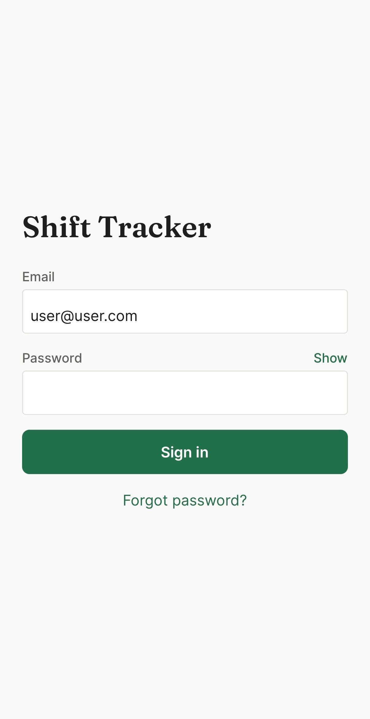
STEP 1 · ACCESS
Signing in
No self-registration exists. Managers create accounts; there is no sign-up route anywhere in the API.
A generated temporary password arrives by email. Confusable characters are stripped — no 0/O, 1/l/I, 5/S, 8/B — because it gets dictated across a counter.
Forgotten it? Self-service recovery emails a fresh one. The response is identical whether or not the address is registered, so the form cannot be used to discover who works here.

Slide 9
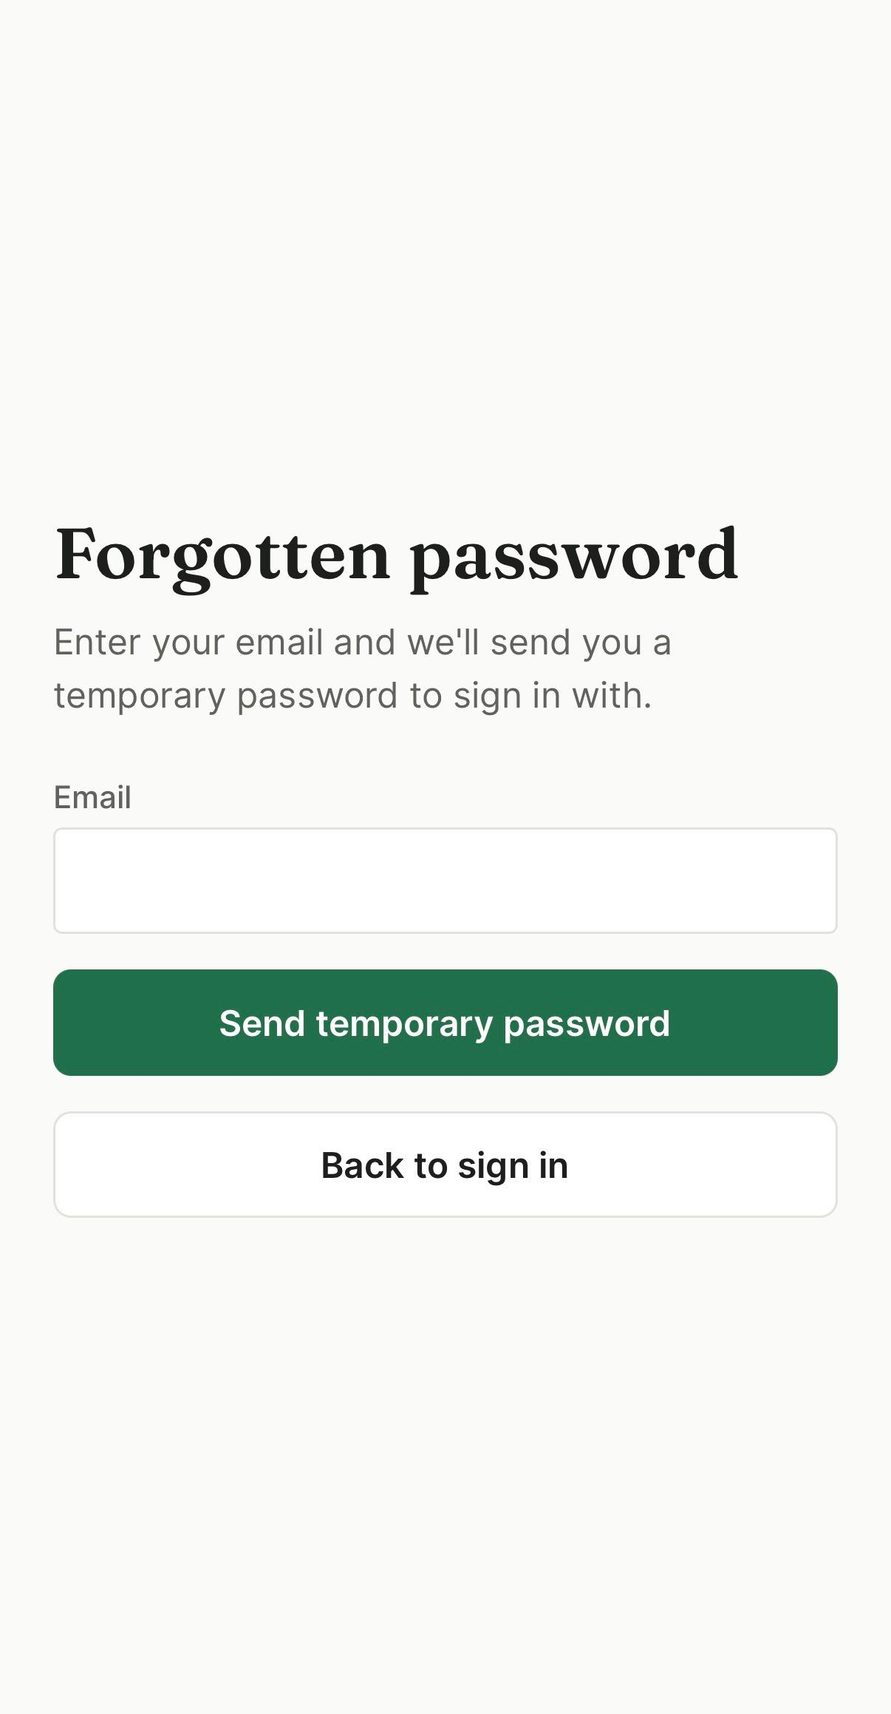
STEP 2 · ACCESS
Forgotten password
Self-service, no manager needed. Enter an email and a fresh temporary password is sent.
The response is identical either way. Registered or not, same message, same status — otherwise the form becomes a way to discover who works here.
The email is sent BEFORE the password changes. The reverse order would lock someone out of a working account whenever a send failed, with no way to learn the new password.

Slide 10
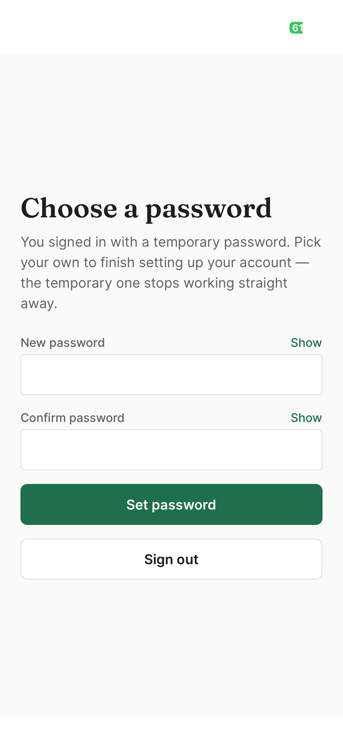
STEP 3 · ACCESS
Choose your own password
Not dismissible. No skip, no back, no tab bar.
Enforced by the API, not the screen. Middleware refuses every other route until it is done — a UI-only prompt could be bypassed by calling the API directly.
Confirmation required. The temporary password dies the instant this succeeds, so a typo would lock you out.

Slide 11
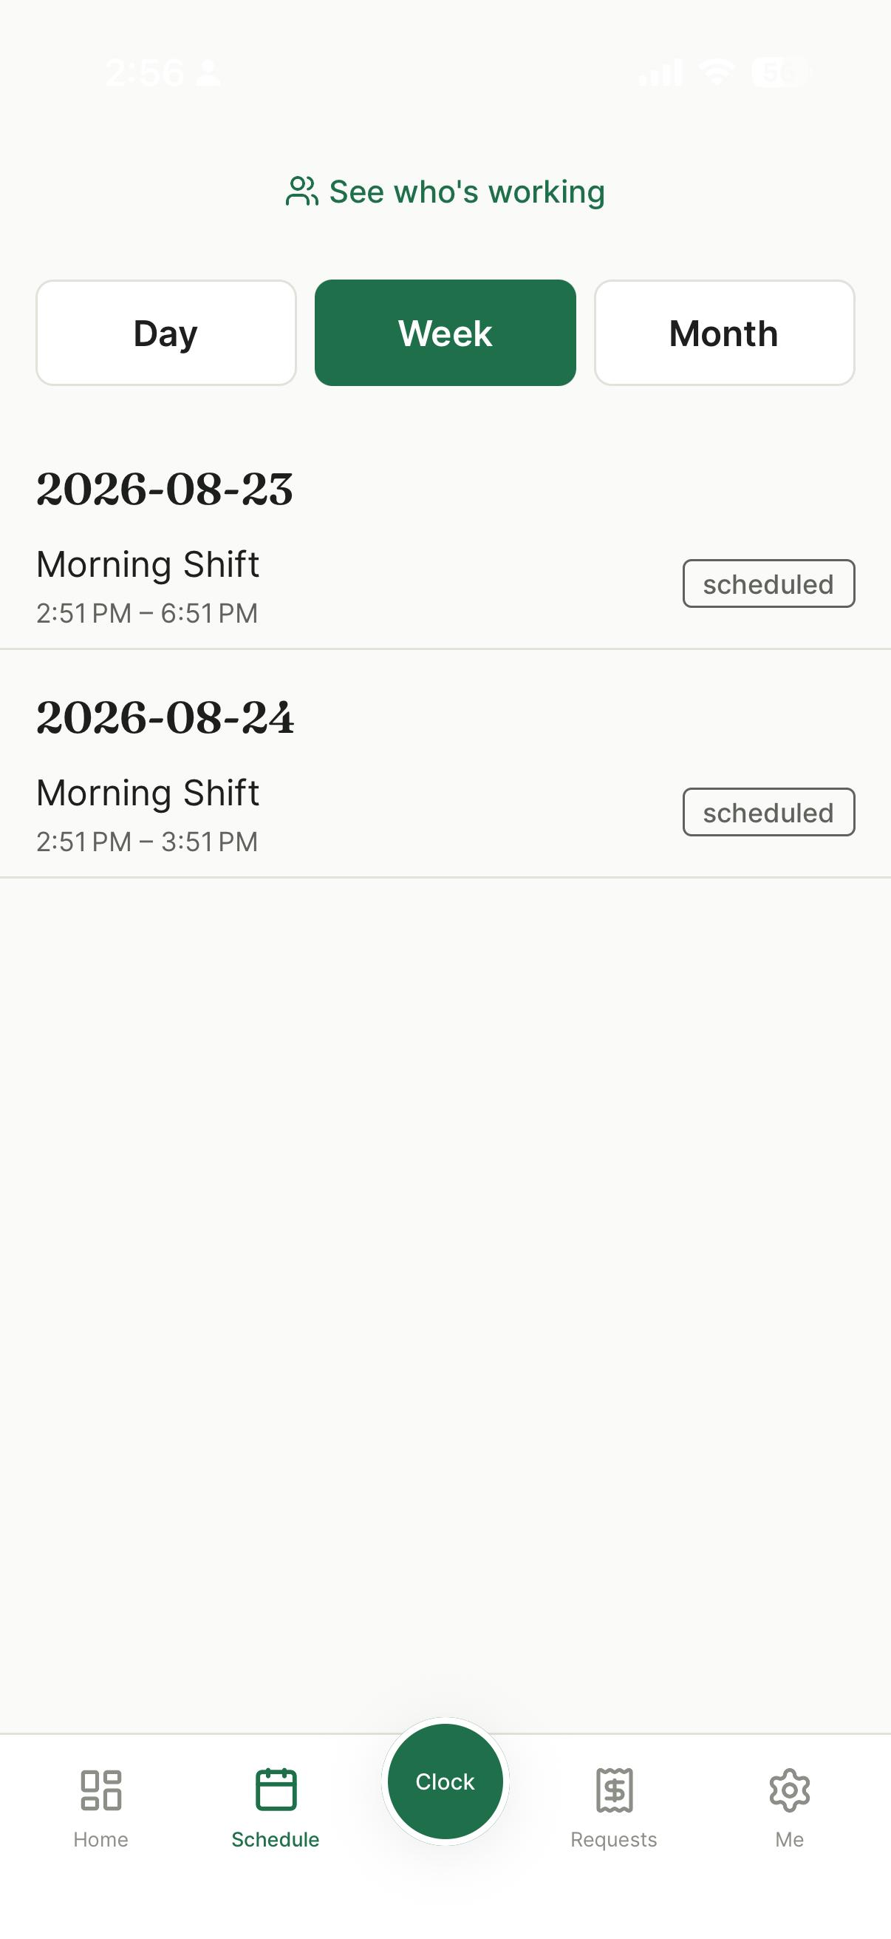
STEP 4 · EMPLOYEE
My schedule
Your own shifts, day / week / month.
Grouped by date with status badges.
Renders offline. The last synced schedule is cached, so a stockroom with no signal still shows your shifts.
See who’s working leads to the shared rota.

Slide 12
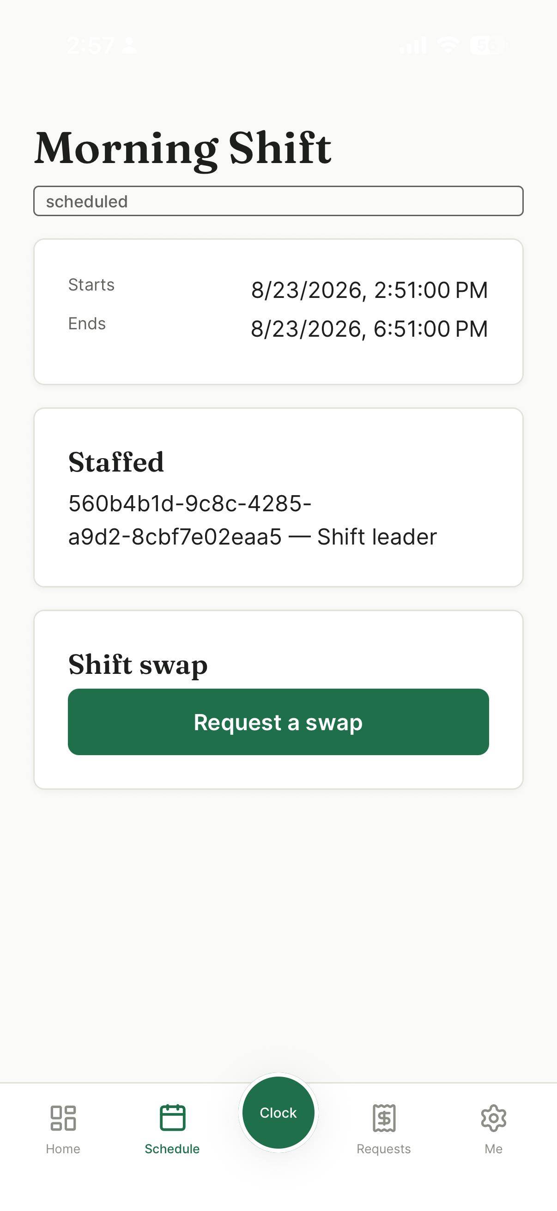
STEP 5 · EMPLOYEE
Shift detail and swaps
Times, status, and who else is staffed.
Request a swap with an eligible colleague. The list excludes anyone already booked that window — and excludes you, which was a real bug: with one employee on site, the only person offered was themselves.
Your colleague accepts, then a manager approves. Two gates, so no shift changes hands unnoticed.

Slide 13
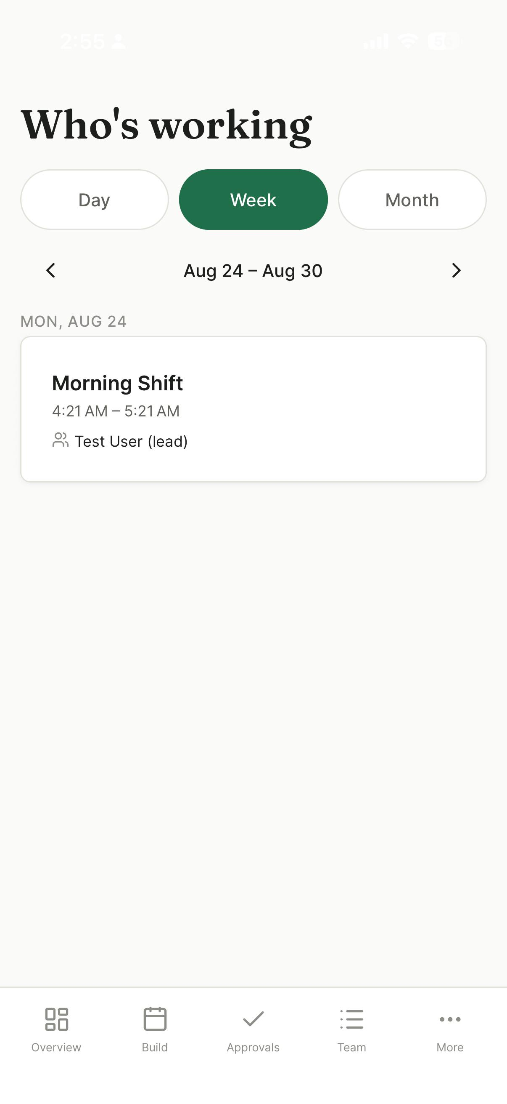
STEP 6 · EVERYONE
Who’s working — the shared rota
Every user sees the whole location. Shift name, start and end time, day, date, and who is on it.
Day / week / month, with paging. Tap the date label to jump back to today.
The shift leader is marked; an unstaffed shift is called out rather than blending in.
Grouped in the site’s timezone, not the phone’s, so the same shift lands on the same day for everyone reading it.

Slide 14
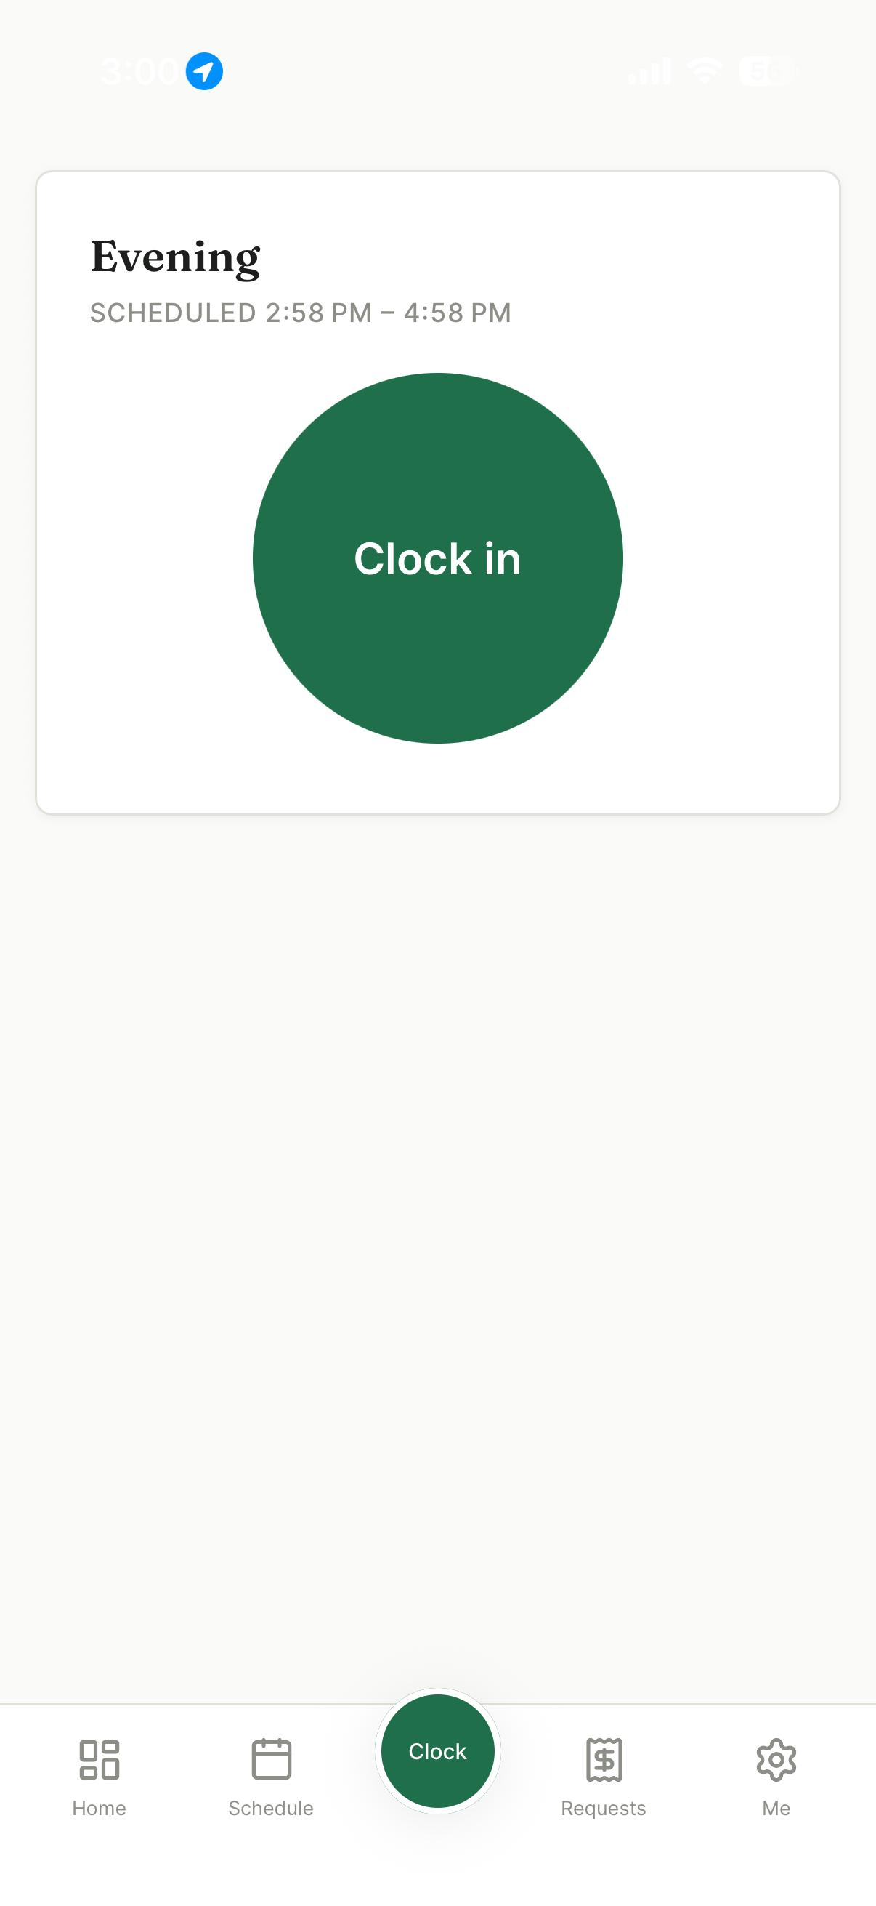
STEP 7 · EMPLOYEE
Clocking in
One button per shift. A split shift keeps its own independent clock state.
Location is checked, never enforced. Out of range — or no permission at all — still clocks you in, flagged for a manager. Refusing would be the harshest possible response to an unreliable signal.
Note the location indicator in the status bar. Requesting that permission at runtime was the fix for clock-in failing entirely.

Slide 15
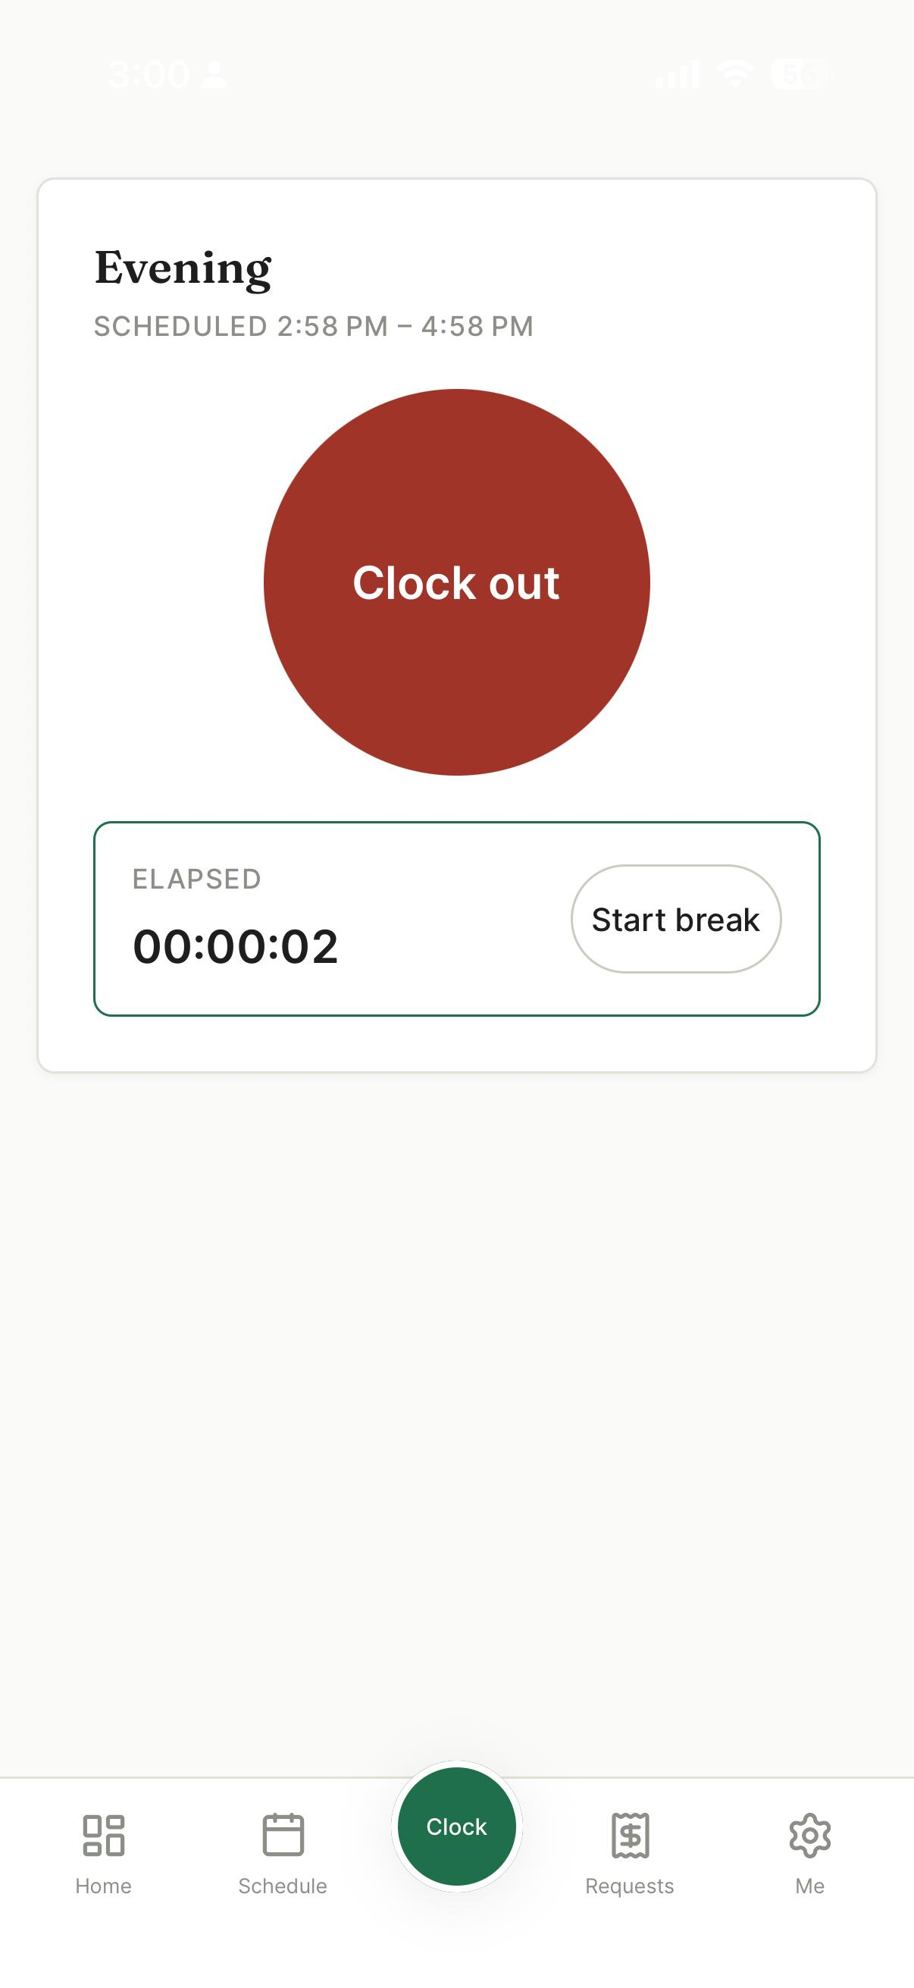
STEP 8 · EMPLOYEE
Clocked in: timer and breaks
Live elapsed time.
Break start and end recorded separately so paid and unpaid time can be separated later.
Offline-safe. An idempotency key means a replayed request returns the original entry instead of double-clocking you.

Slide 16
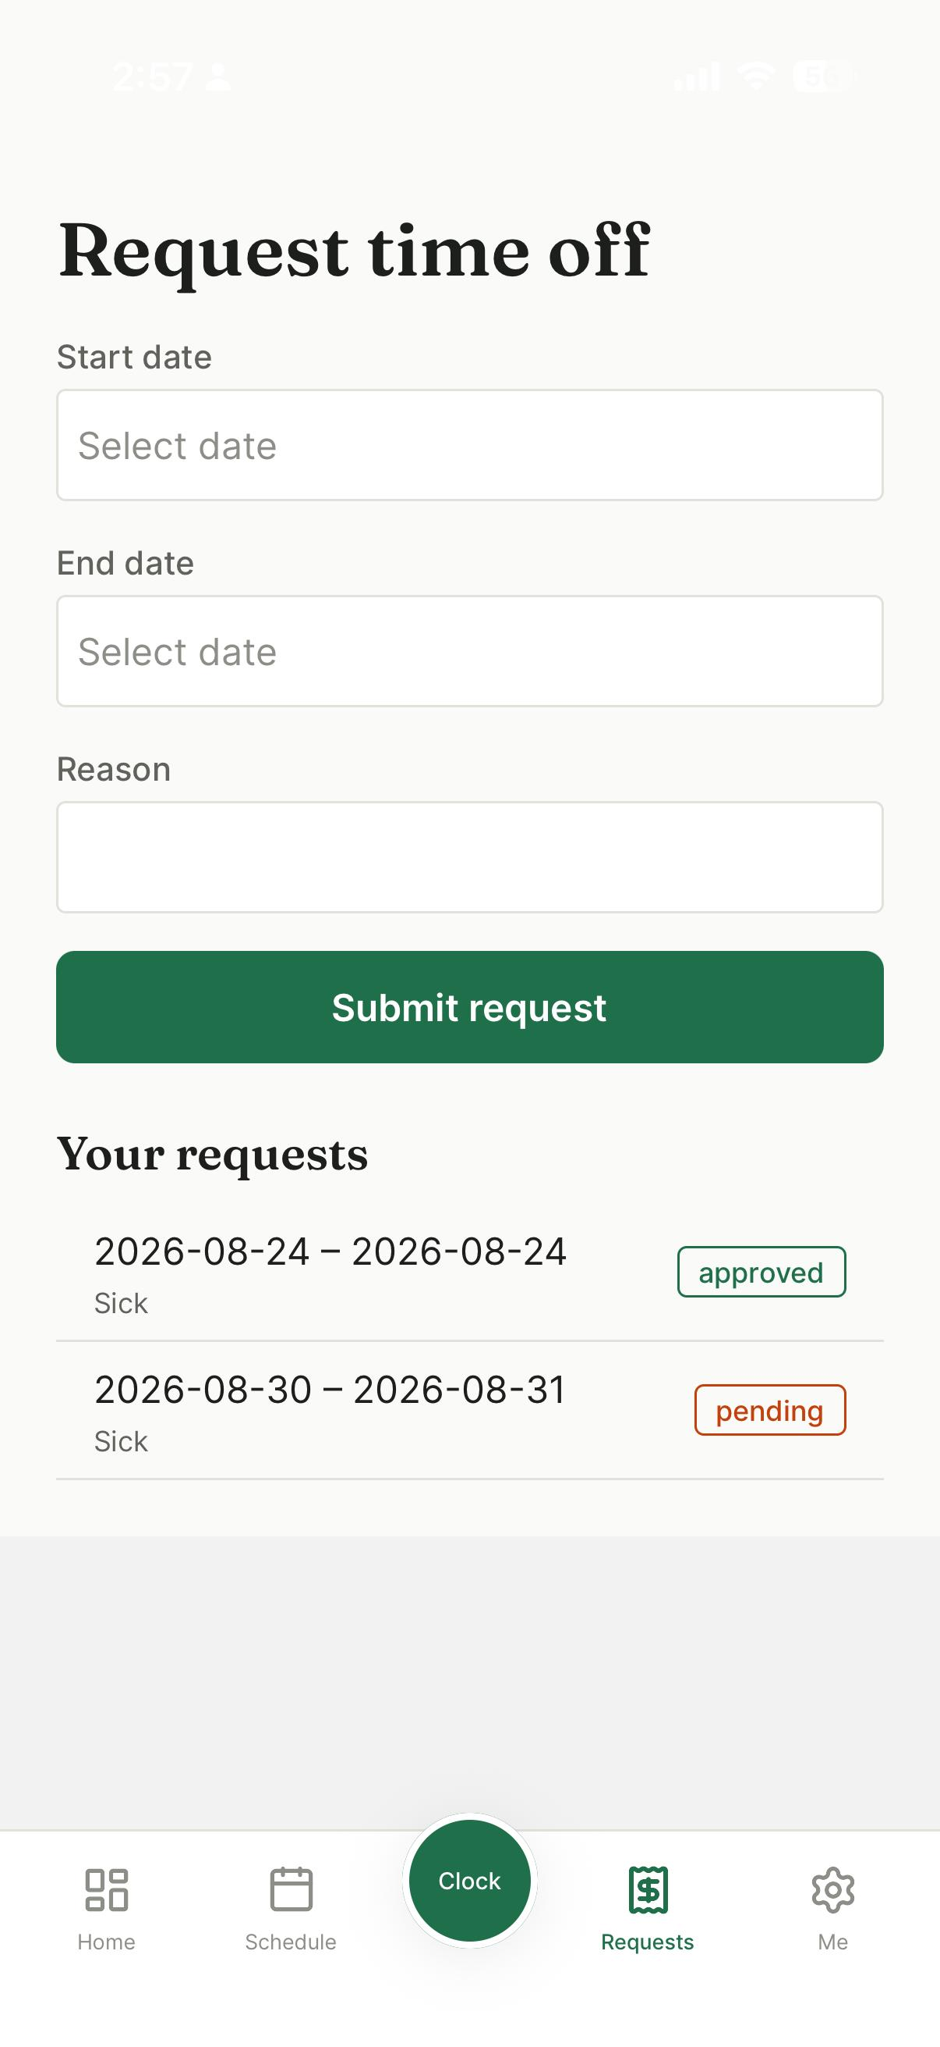
STEP 9 · EMPLOYEE
Requesting time off
Dates and a reason; the reason is required.
Track the outcome — approved, pending, denied.
An approved request blocks staffing over the same dates, so a manager cannot accidentally roster someone on leave.

Slide 17
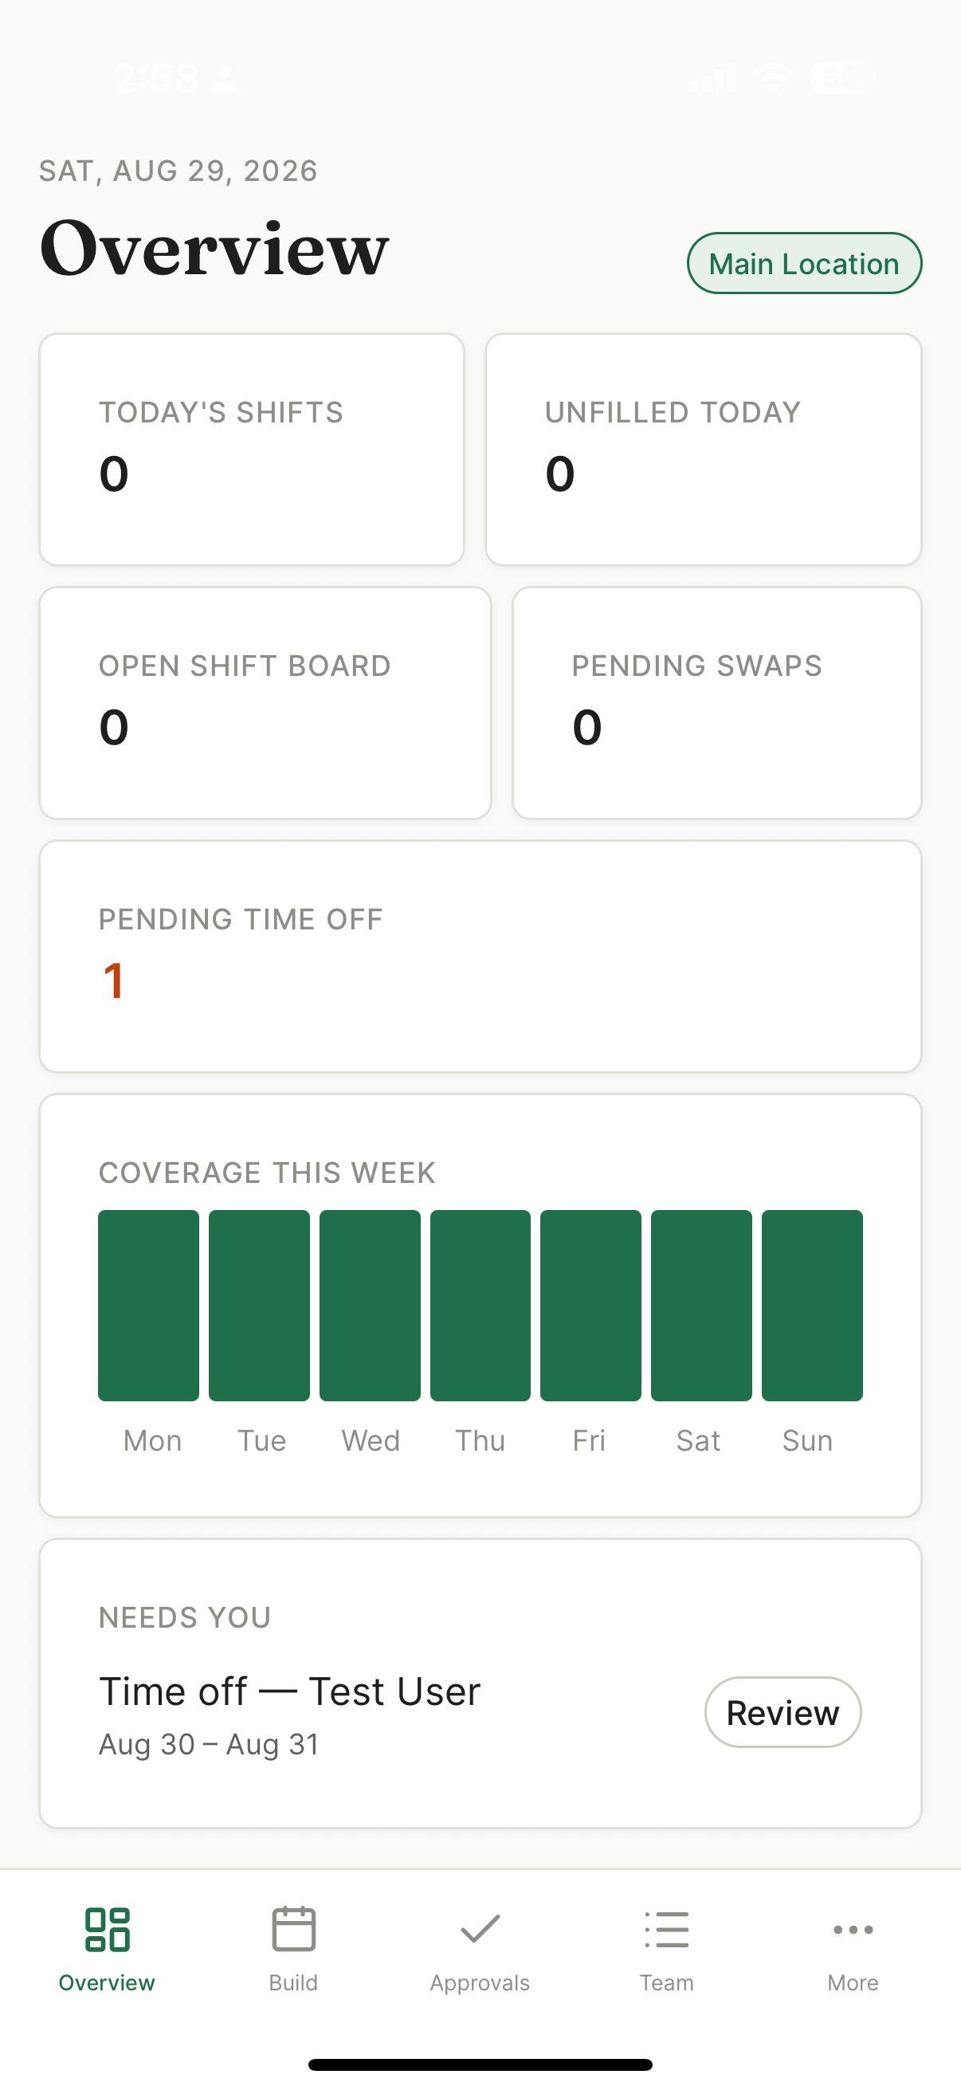
STEP 10 · MANAGER
Overview
Today at a glance. Shifts running, unfilled, open board, pending swaps and time off.
Coverage across the week. Staffed versus total, per day.
Needs you is the actionable list. Time off awaiting a decision, flagged clock-ins, unstaffed shifts.

Slide 18
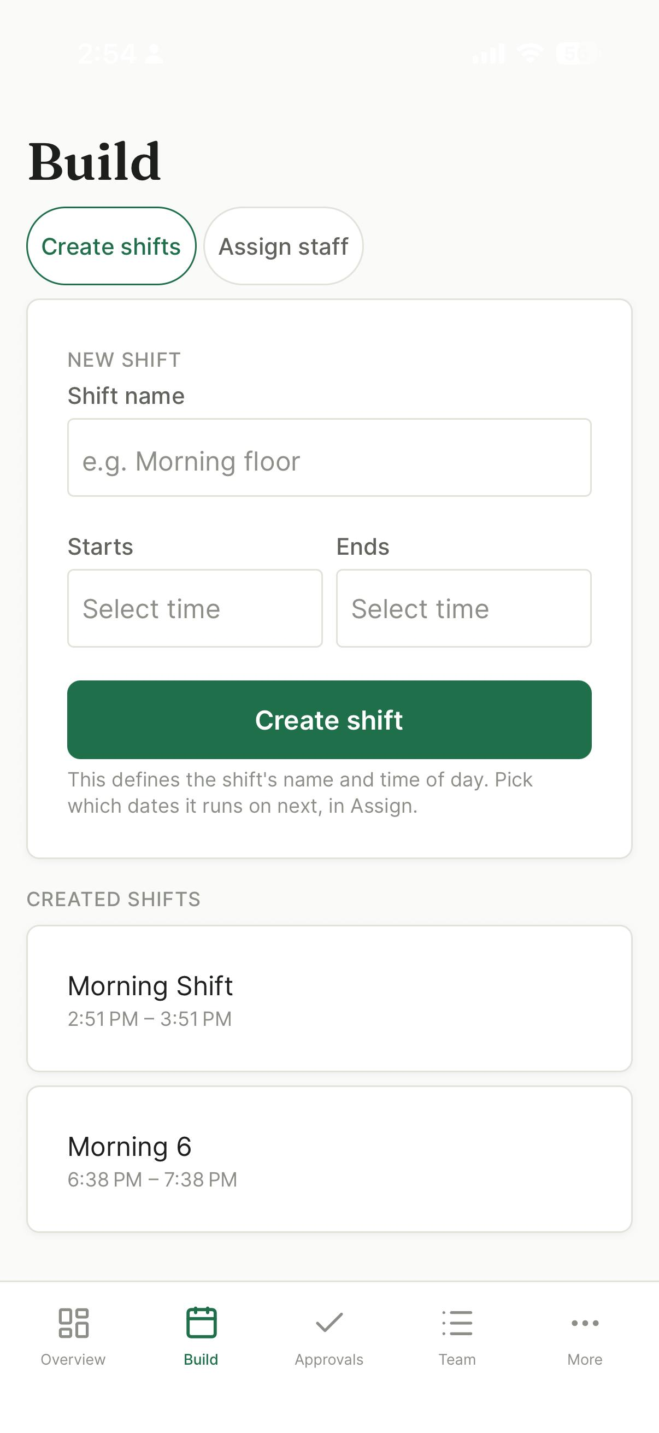
STEP 11 · MANAGER
Building shifts
Define the shift once — name and time of day.
Reusable. Which dates it runs on is a separate step, so a recurring pattern is not retyped.
Created shifts are listed underneath, ready to be assigned to dates.

Slide 19
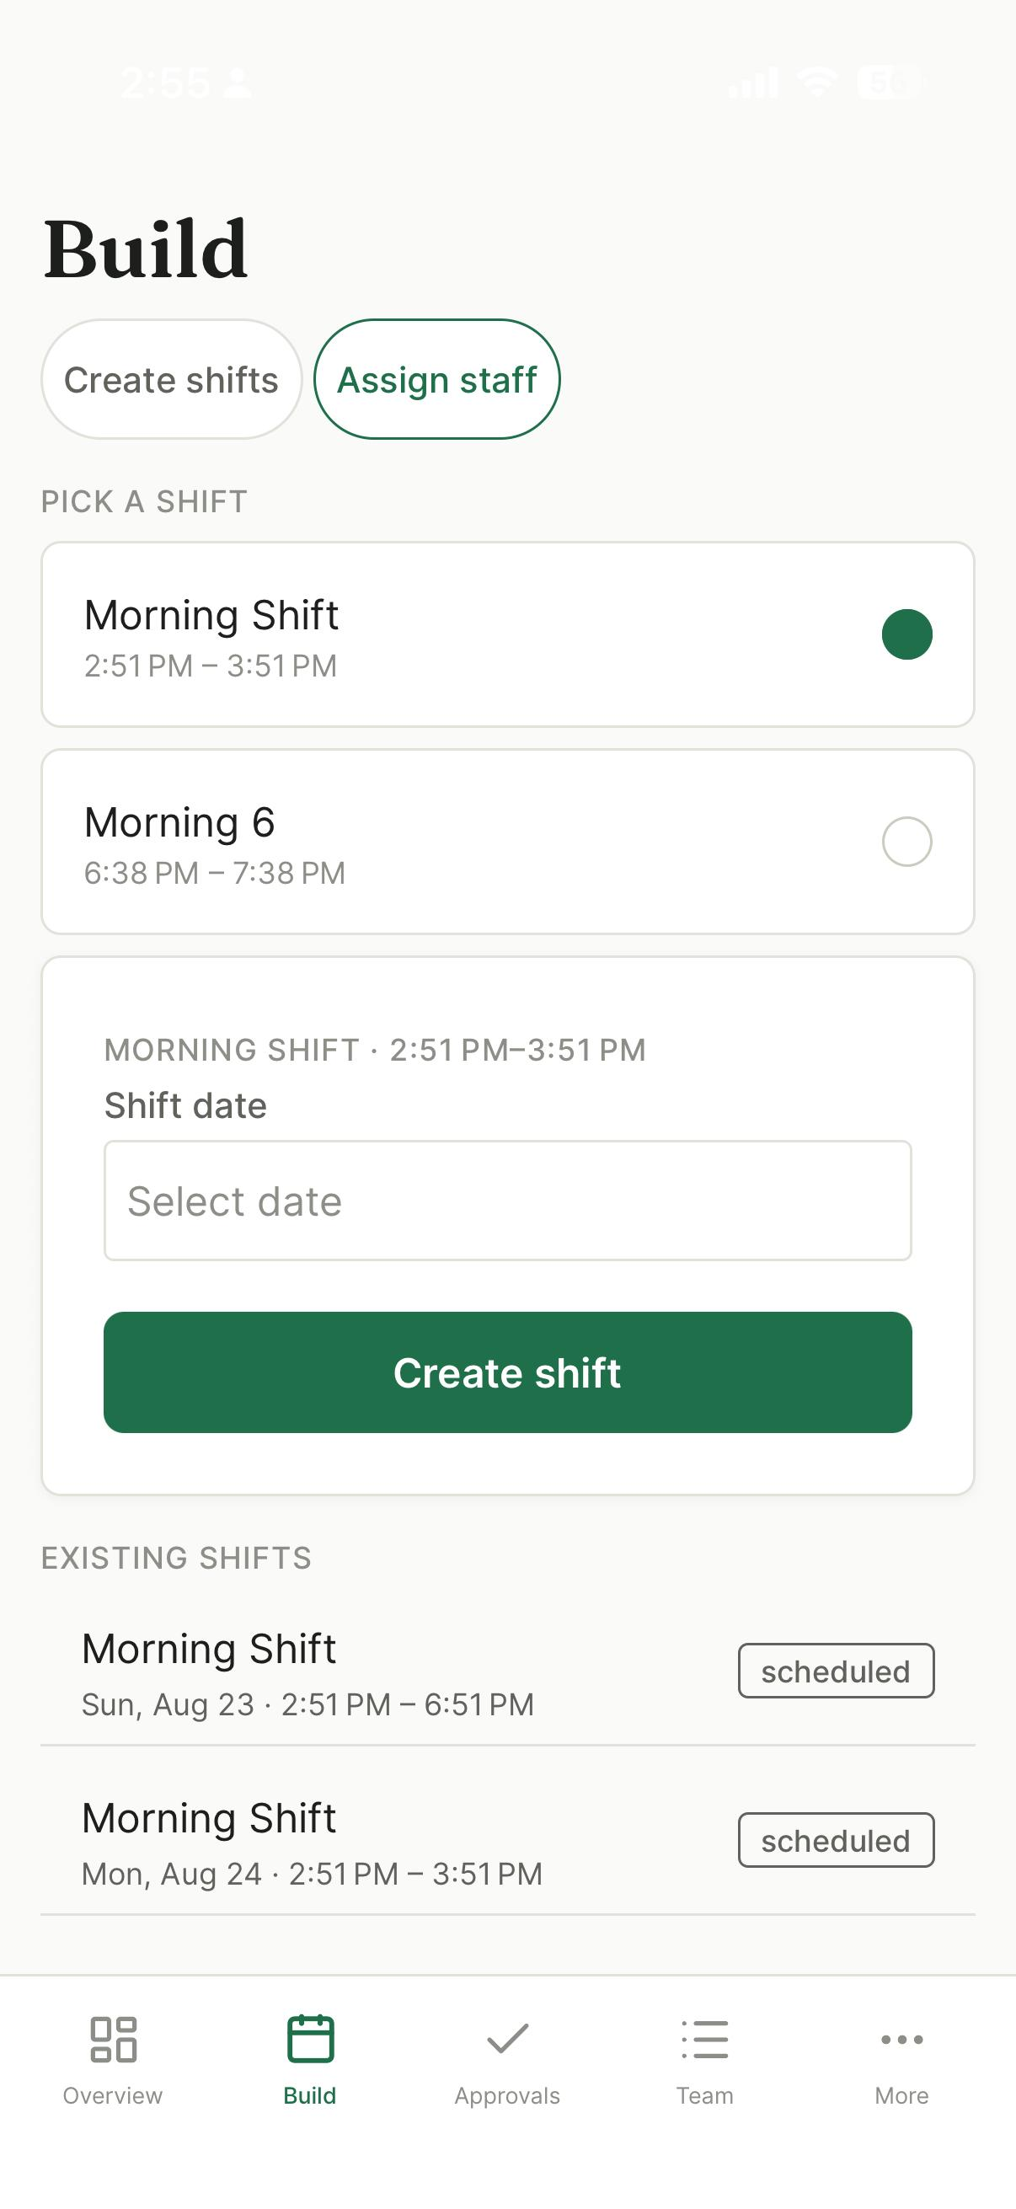
STEP 12 · MANAGER
Assigning to dates
Pick a shift, pick a date.
Existing shifts listed with status so duplicates are obvious before you create one.
Swipe an existing shift to delete — refused if anyone has already clocked in against it, since that is payroll history.

Slide 20
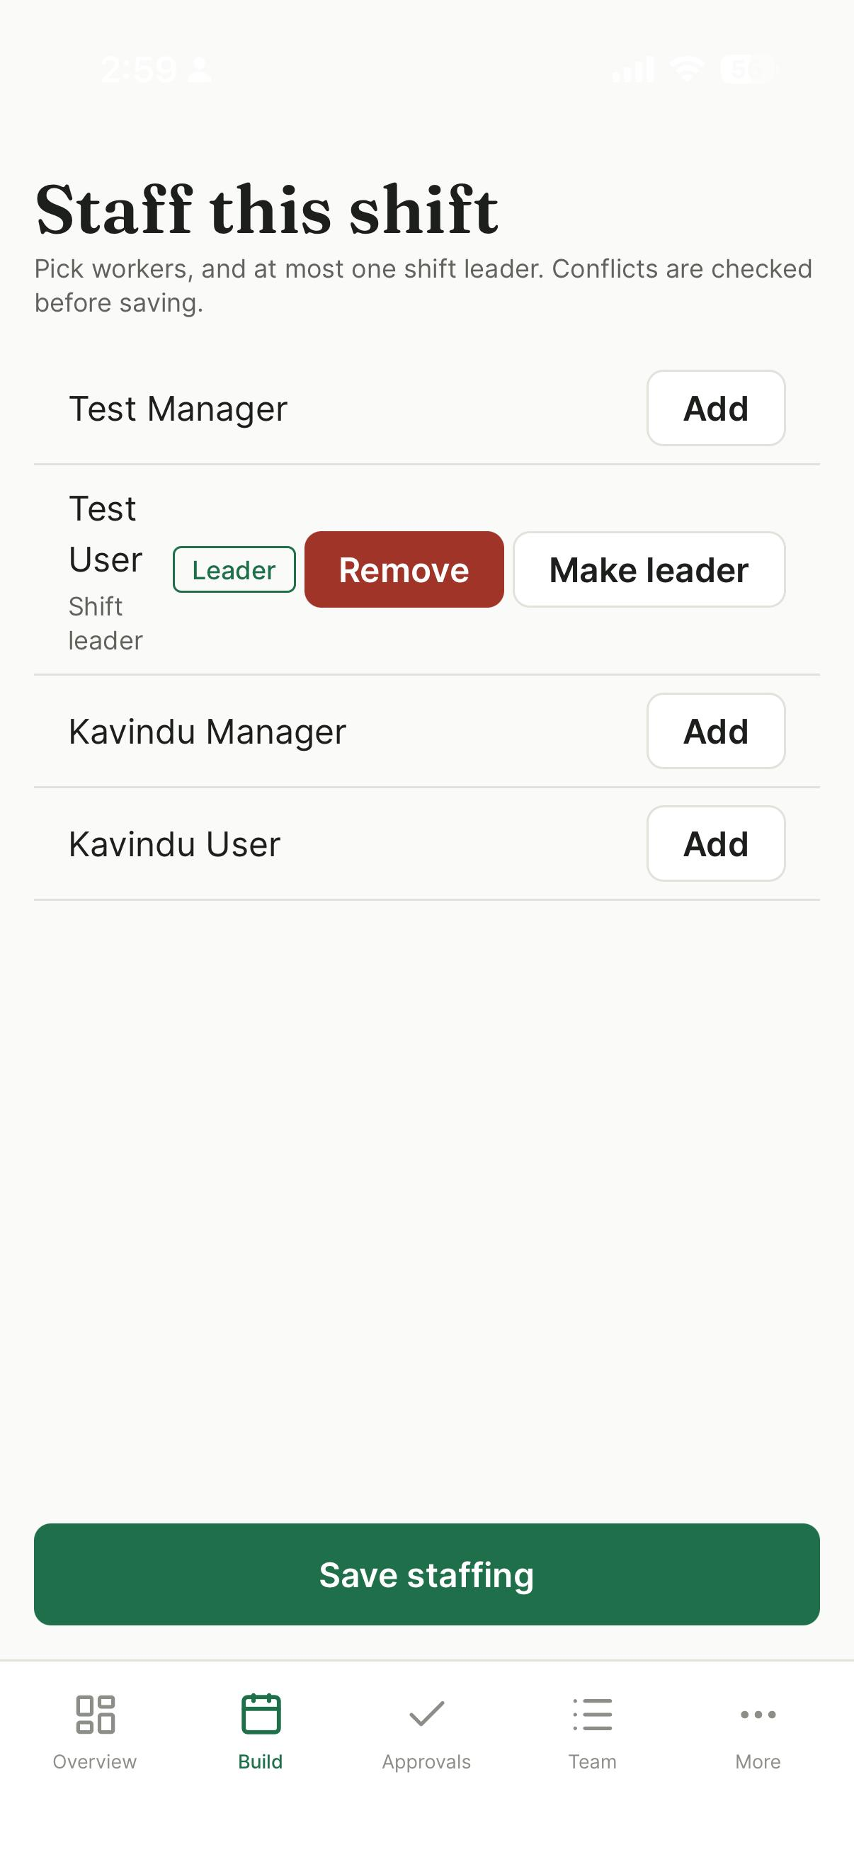
STEP 13 · MANAGER
Staffing a shift
Add or remove workers; nominate one leader. At most one, enforced by a database index rather than trusted to the UI.
Conflicts checked before saving. Double-booking, insufficient rest between shifts, and approved time off.

Slide 21
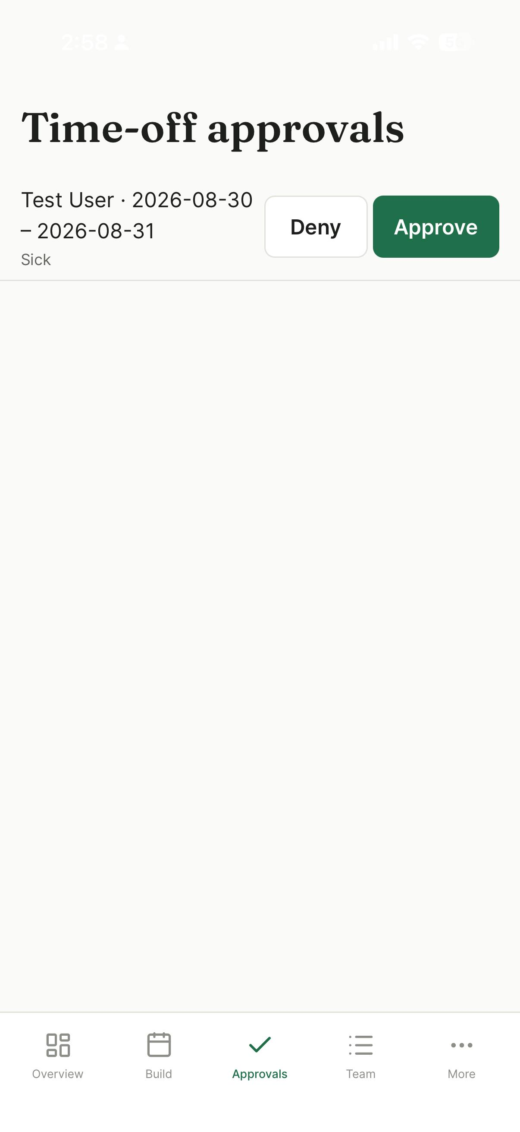
STEP 14 · MANAGER
Approvals
One queue per type — time off and swaps.
Approve or deny in a tap; the employee is notified by push.
Every affected screen refreshes together. Approving updates the queue, the employee’s list and the dashboard at once — previously each screen refreshed only itself.

Slide 22
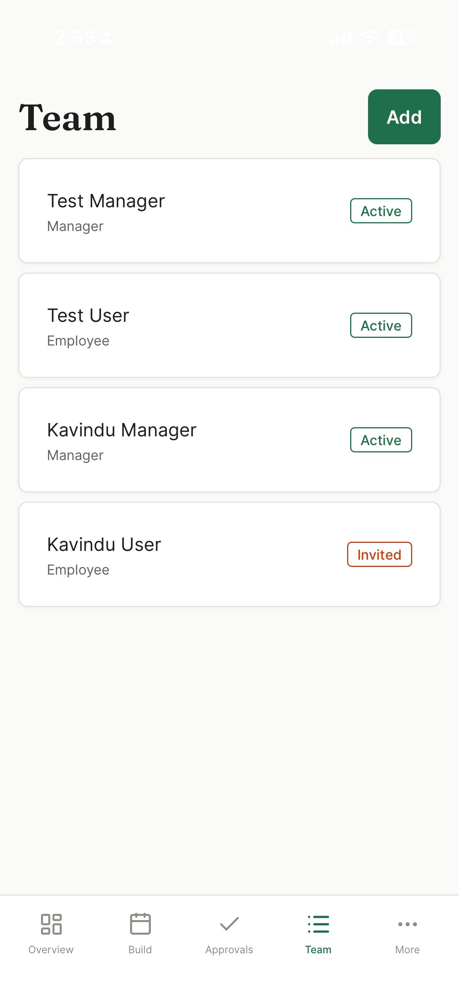
STEP 15 · MANAGER
The team
Everyone at the location, with role and status.
Invited marks an account that has not yet replaced its temporary password.
Tap through to edit pay or role, or issue a fresh temporary password.

Slide 23
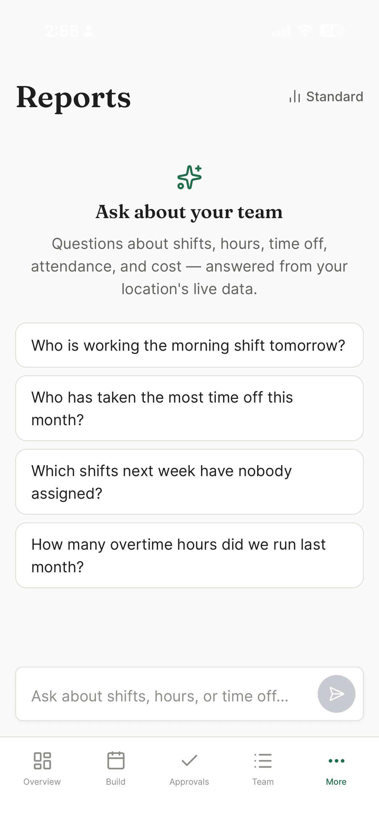
STEP 16 · MANAGER
AI reports — ask, don’t navigate
Replaces four fixed report screens. Those remain, one tap away under Standard.
Suggested questions make the scope visible. The honest problem with a bounded assistant is that a blank box tells you nothing about what it covers.
Answers come from typed lookups, not generated SQL. The model picks a tool; our code runs the query and re-derives the location from the signed-in user.
It declines what it cannot answer instead of inventing a figure.

Slide 24
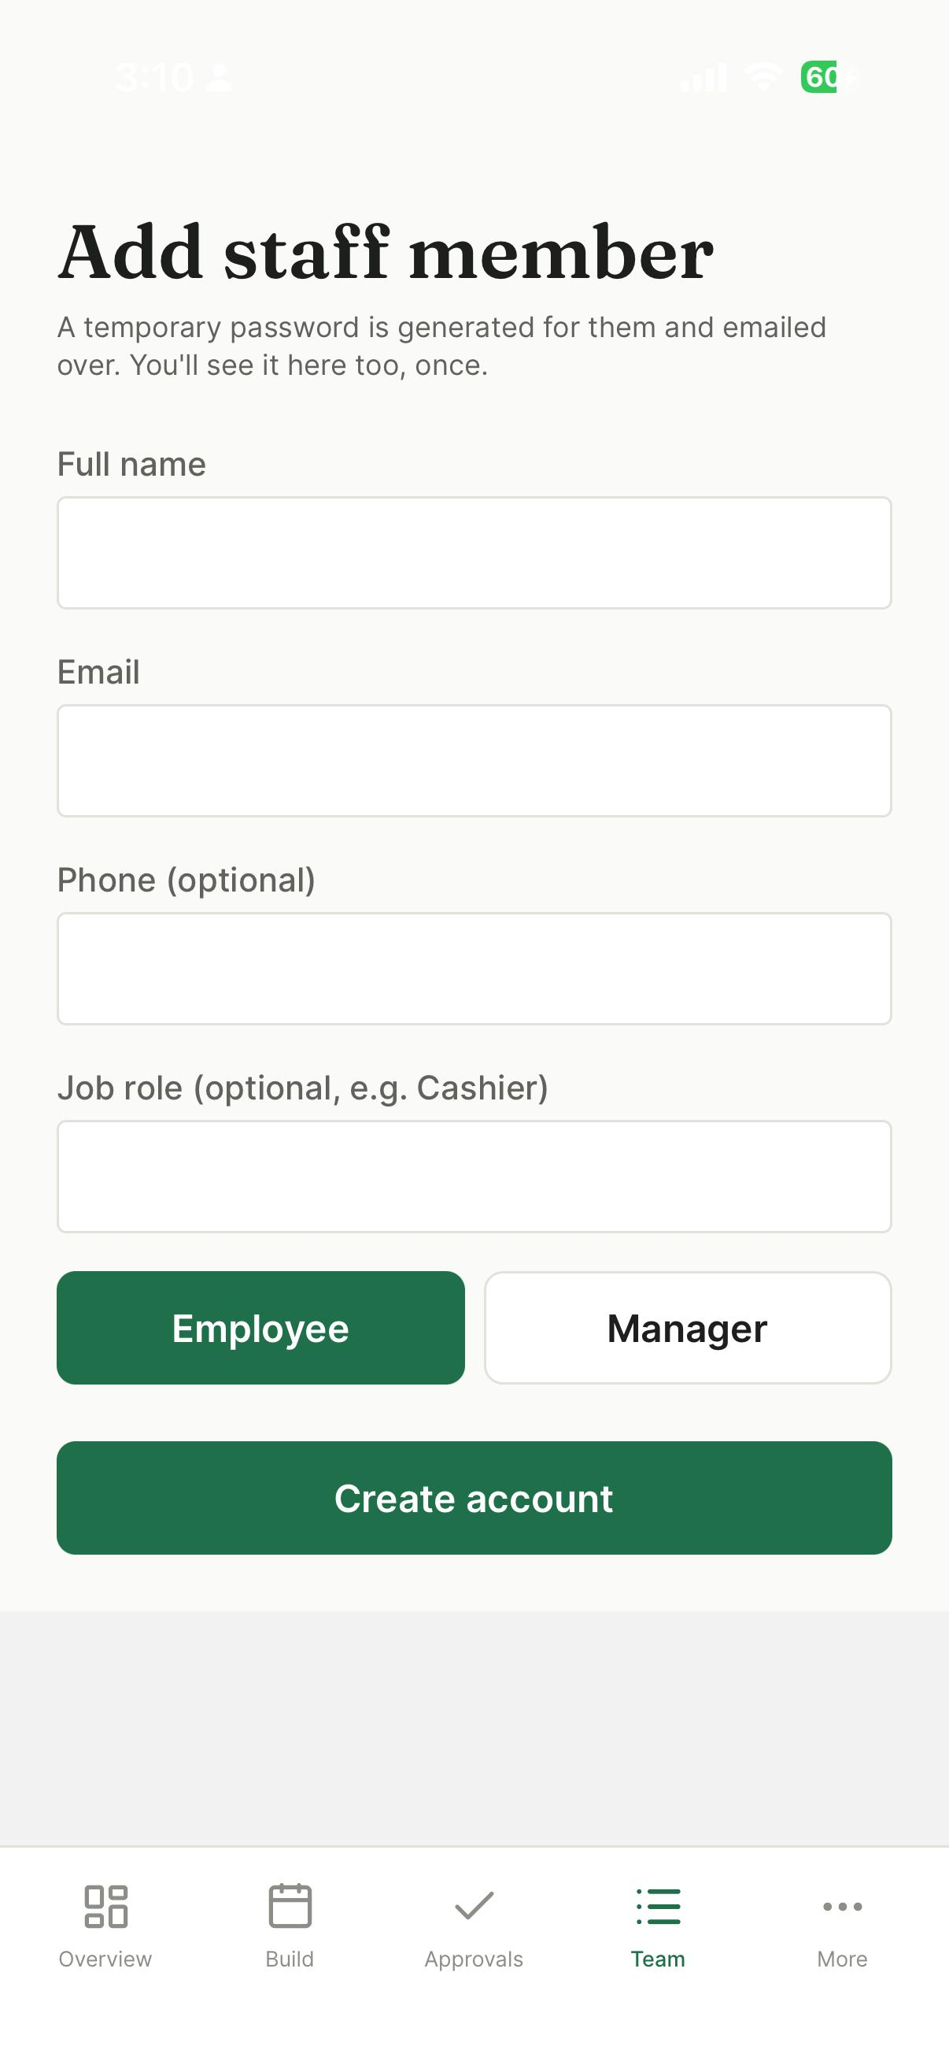
STEP 17 · MANAGER
Adding a staff member
Name, email, role, pay rate.
A temporary password is generated, emailed, and shown once on screen.
The on-screen copy is the point. Onboarding still works when email does not — an unverified sending domain took it down completely at one stage.

Slide 25
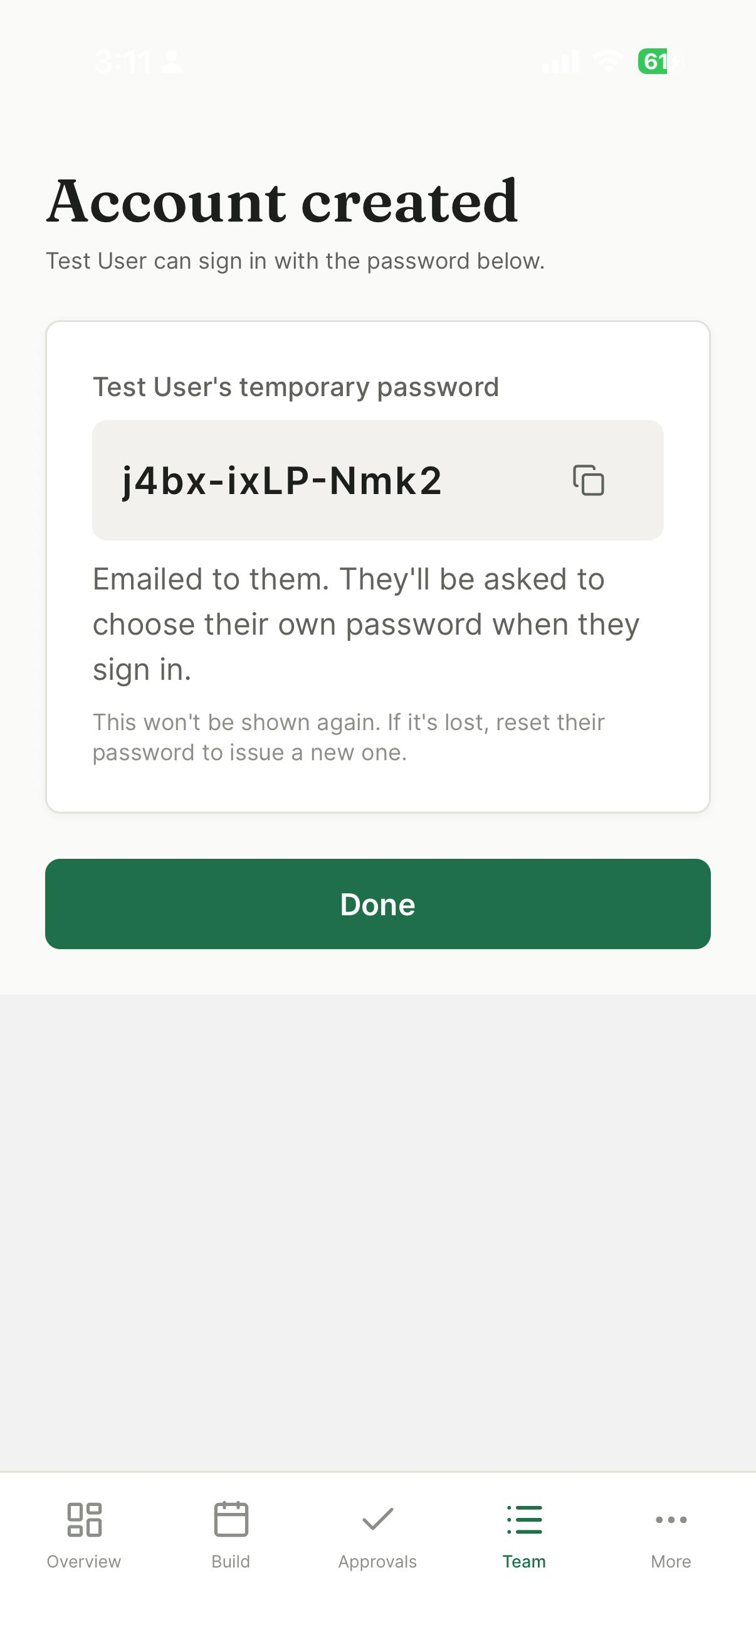
STEP 18 · MANAGER
The password, shown once
Readable exactly here, and never again. The server stores only a hash — a lost one is reissued, not recovered.
Copyable in a tap. It gets read out or pasted into a message.
Shown even when the email succeeded. Email is the unreliable half of onboarding; the manager holding the password is what keeps it working.

Slide 26
DOES IT HOLD UP?
Evaluation
Correctness
100 automated tests
Unit + integration
Business logic as pure functions
TypeScript + lint gates on both tiers
Performance
API reads well under 1s
(Nielsen's flow threshold)
AI answers ~1.5–2.5s end to end
Indexed on location + time range
Honest limits
No formal usability study (no SUS)
Single location per user
Rate limiting resets on cold start
Some flows untested on device
Failure and emptiness are now visually distinct — a queue that fails to load once looked identical to one that was genuinely empty, and that concealed a real defect.

Slide 27
WHERE IT GOES NEXT
Future work
Edge computing. Today a cloud model means employee names leave the business. Running a smaller model on-premises keeps data local — the model endpoint is one config value, so no code changes.
Retrieval-augmented generation. Ground answers in the company's own staffing policy, not just its schedule.
Demand forecasting. Move from reporting what happened to proposing a schedule before a manager builds one.
Extended reality. An AR overlay of who's covering which area; a spatial handover at shift change. The shift-area model already holds the context.
Nearer term. Multi-location support, platform-level rate limiting, biometric confirmation at clock-in.

Slide 28
Thank you
Questions?

