Slide 1
Movie review analysis
CAPSTONE PROJECT
Presented By:
DHANESH SHANJAI. MU
PONJESLY COLLEGE OF ENGINEERING
CIVIL DEPARTMENT

Slide 2
OUTLINE
Problem Statement
Proposed System/Solution
System Development Approach
Algorithm & Deployment
Result
Conclusion
Future Scope
References

Slide 3
Problem Statement
Create the following files:
movie.php (code to produce review pages for movies)
movie.css (the style sheet for your pages)
Your pages must match the appearance specified in this document. It would be difficult to produce a pixel-perfect representation of the page that matches the image shown here, and we do not expect you to do so. But your page should follow all of the styles specified in this document and should match the overall look, layout, and behavior of the page shown here as closely as possible.
You should base your movie.php on the tmnt.html you wrote in HW2. You can also reuse your style sheet, movie.css. The modifications you needto make to your HTML code are to cause it to read the movie information using PHP so that the same file can produce different movie review pages.

Slide 4
Proposed Solution
Based upon the film requested by the browser, you are to display a review of that film. Each film is stored in a directory whose name is the same as the film parameter. For example, the film princessbride stores its files in a folder named princessbride/. The files associated with each movie are the following:
info.txt
generaloverview.txt
generaloverview.png
review1 . txt, review2 . txt

Slide 5
System Approach
System requirements:
The minimum and/or maximum hardware and software specifications that a system or application must meet in order to function properly
Hardware requirements
Architecture.
Processing power.
Memory.
Secondary storage.
Display adapter.
Peripherals.

Slide 6
Algorithm & Deployment
Data input :
Movie Review Dataset
Load Text Data
Clean Text Data
Develop Vocabulary
Save Prepared Data

Slide 7
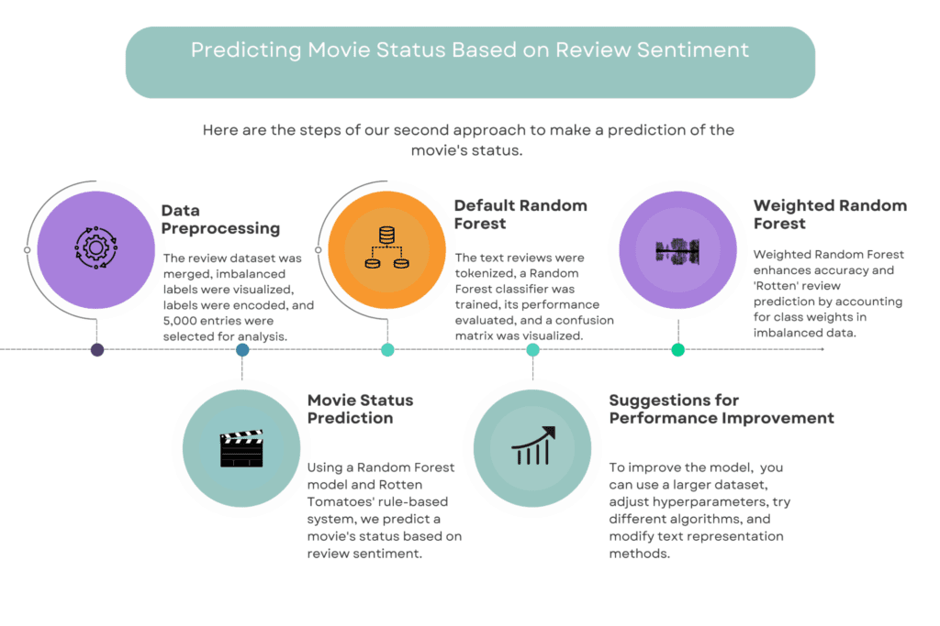
Result

Slide 8
Conclusion
We have taken a short excursion to find out what it takes to construct a movie script and then produce it into the final product of a movie. We did not discuss acting and movie stars in this book. Many people will say they get excited about a movie if a particular movie personality is in the movie. But do you? Is that the only reason you go to the movies, or is it a combination of the different elements that we have discussed? If it is only because of a movie star that you go to the movies, you would not have read this textbook. Historically, from a personal novice viewpoint, fans of a particular movie star will stop going to the movies to see this star, if the star has a bad string of movies in a row
The theme gives purpose to the movie.
The genre categorizes the movie but also indirectly shapes the characters and story, establishes the setting, and determines the plot.
The characters are expanded in order to act within the narrative structure of the story and plot.
The characters and their actions are further defined by their physiology, psychology, and sociology.

Slide 9
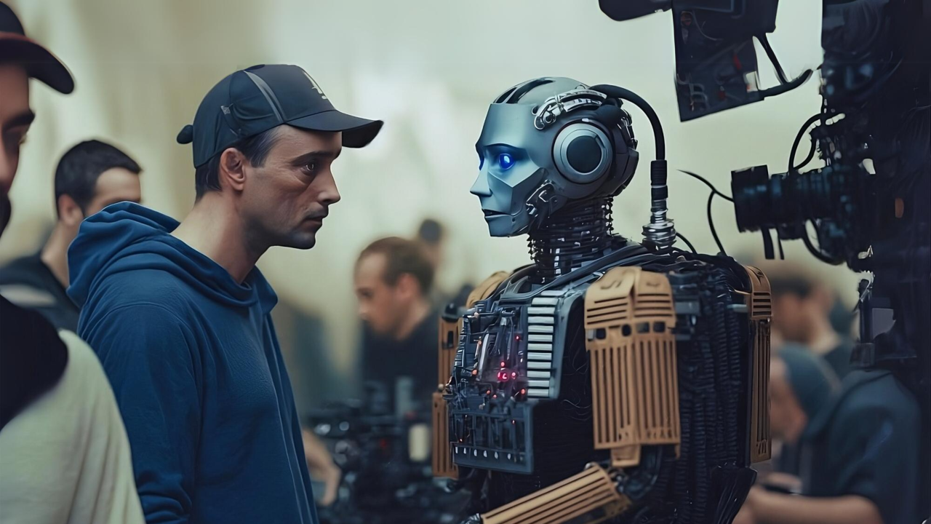
Future scope
The proposed solution lays the foundation for ongoing advancements in the movie review analysis optimaisation. Here are key areas for future exploration and enhancement:
Analyze the history of a user's preferences & suggest movies that other users with similar interests enjoy.

Slide 10
References
https://www.google.com/gasearch?q=kaggle%20dataset&tbm=&source=sh/x/gs/m2/5
https://www.google.com/gasearch?q=chatgpt&tbm=&source=sh/x/gs/m2/5
https://www.google.com/gasearch?q=vs%20code&tbm=&source=sh/x/gs/m2/5
https://www.google.com/gasearch?q=google&tbm=&source=sh/x/gs/m2/5

Slide 11
THANK YOU

