Slide 1
KEYLOGGER USING PYTHON
CAPSTONE PROJECT
Presented By:
1. Shanjanaa G-College Of Engineering, Guindy-Department of Information Science and Technology

Slide 2
OUTLINE
Problem Statement
Proposed System/Solution
System Development Approach
Algorithm & Deployment
Result
Conclusion
Future Scope
References

Slide 3
Problem Statement
In today's digital age, where cybersecurity threats loom large, one of the significant concerns is the proliferation of keyloggers, stealthy software tools designed to monitor and record keystrokes on a user's computer without their knowledge. Keyloggers pose a severe threat to individuals and organizations as they can capture sensitive information such as passwords, credit card details, and other personal data, leading to identity theft, financial loss, and privacy breaches.

Slide 4
Proposed Solution
The proposed system aims to develop a secure keylogger application to monitor and log keystrokes discreetly, thereby enhancing cybersecurity measures.The solution will consist of ,
COMPONENTS:
Data Collection:
Collect keystroke data in real-time, including key presses and releases, using the pynput library.
Store the collected data in both text and JSON formats for further analysis and security measures.
Data Preprocessing:
Clean and preprocess the collected keystroke data to remove any inconsistencies or unwanted characters.
Ensure data integrity and confidentiality through secure handling procedures.
Process:
Keystroke Capture:
The application captures keystrokes using event-driven programming.
on_press() and on_release() functions track key press and release events, respectively.

Slide 5
Proposed Solution (contd.)
Logging:
Captured keystrokes are logged into text and JSON files using generate_text_log() and generate_json_file() functions, respectively.
Keylogger Control:
Users can start and stop the keylogging process using the 'Start' and 'Stop' buttons in the GUI.
The start_keylogger() and stop_keylogger() functions control the keylogger's operation.
Deployment:
Develop a user-friendly GUI using the tkinter library to control the keylogging process.
Deploy the application on a user's system for local use.
Execution:
The application executes within a Tkinter main event loop (root.mainloop()).

Slide 6
System DEVELOPMENT Approach
System requirements:
Operating system: Windows, macOS, or Linux
Python version: 3.4 or later (recommended for full compatibility with libraries)
Permissions: May require administrative privileges to run, depending on system settings and intended use.
Sufficient disk space for storing log files
Adequate system resources (CPU, RAM) for running the application
Libraries required:
tkinter: Built-in Python library for creating graphical user interfaces (GUIs).
pynput: Third-party library for monitoring keyboard and mouse input (install using pip install pynput).
json: Built-in Python library for working with JSON data.
Additional considerations:
Accessibility: Ensure necessary keyboard libraries are accessible for screen readers and assistive technologies.
Ethical use: Keyloggers can be used for both legitimate and malicious purposes. Employ them ethically and with appropriate consent.

Slide 7
Algorithm & Deployment
ALGORITHM:
Keystroke Capture:
Using pynput.keyboard Library: The pynput.keyboard library allows the program to capture keyboard events in real-time, such as key presses and releases.
Callback Functions: Two callback functions, on_press(key) and on_release(key), are defined to handle key press and release events, respectively. These functions are invoked automatically whenever a key is pressed or released.
on_press() Function: When a key is pressed, the on_press() function is triggered. Within this function, information about the pressed or held key, represented by the parameter key, is appended to the keys_used list. This information typically includes the key's character representation or its keycode.
on_release() Function:When a key is released, the on_release() function is invoked. Similar to the on_press() function, information about the released key is appended to the keys_used list. The keys_used list effectively accumulates a sequence of keystrokes captured during the keylogging process.
Logging:
generate_text_log() Function: The generate_text_log(key) function is responsible for writing the captured keystrokes to a text file named 'key_log.txt’.
Upon invocation, this function opens the 'key_log.txt' file in write mode ('w+’).
It then writes the keystroke information, represented by the parameter key, to the file.

Slide 8
Algorithm & Deployment
Each new keystroke is appended to the file, effectively creating a log of all keystrokes captured during the session.
generate_json_file() Function: The generate_json_file(keys_used) function serializes the captured keystrokes into JSON format and writes them to a file named 'key_log.json’.
It opens the 'key_log.json' file in write-binary mode ('+wb’).
Using the json.dumps() function, it converts the keys_used list into a JSON-formatted string.
This JSON string is then encoded into bytes using the .encode() method and written to the file.
Storing keystrokes in JSON format provides a structured and machine-readable representation, facilitating easier parsing and analysis of the logged data.

Slide 9
Algorithm & Deployment
DEPLOYMENT:
User Interface (GUI):
The application's GUI is built using Tkinter, a standard GUI toolkit for Python.
A Tkinter window (root) is created with the title "Keylogger".
Labels (label) are used to display instructions for starting and stopping the keylogging process.
Buttons (start_button and stop_button) are provided to control the keylogger's operation.
Keylogger Control:
The start_keylogger() function initiates the keylogging process by creating a keyboard listener using keyboard.Listener from the pynput library.
The stop_keylogger() function stops the keylogging process by stopping the keyboard listener.
Main Event Loop:
The program enters the Tkinter main event loop (root.mainloop()), where it waits for user interactions.
During the event loop, the GUI updates in response to user actions, such as clicking the 'Start' or 'Stop' buttons.

Slide 10
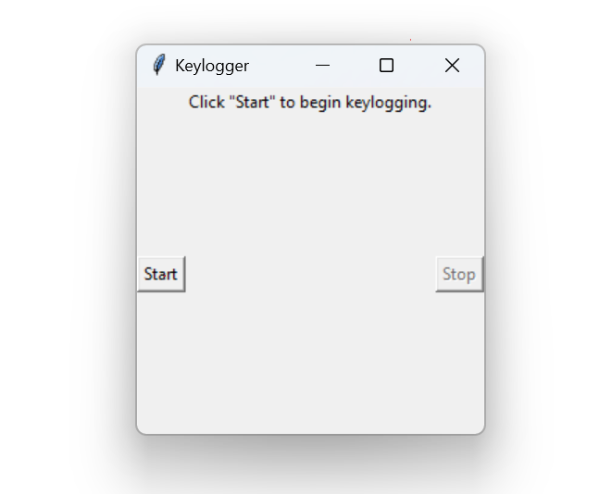
Result
The results demonstrate the effective operation of the keylogger application, showcasing its ability to capture keystrokes in real-time and log them into text and JSON files.

Slide 11
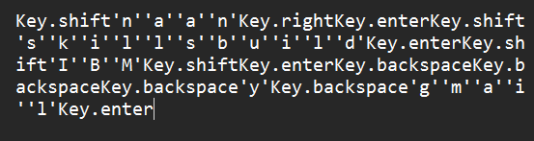
Result
Key_log file

Slide 12
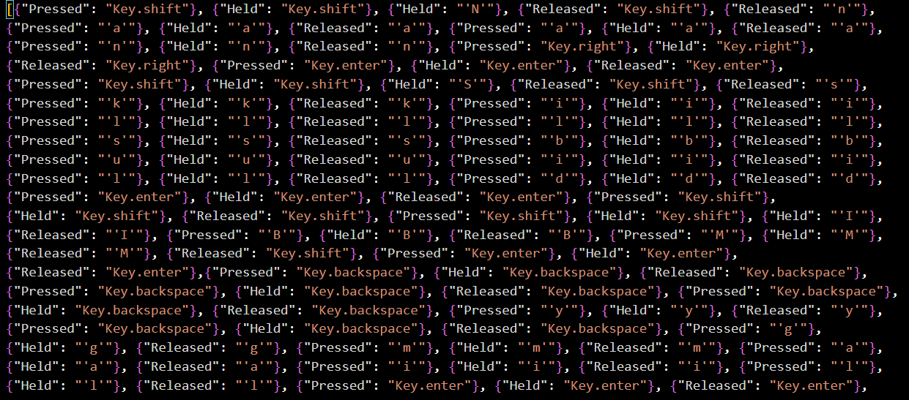
Result
Key_log JSON file

Slide 13
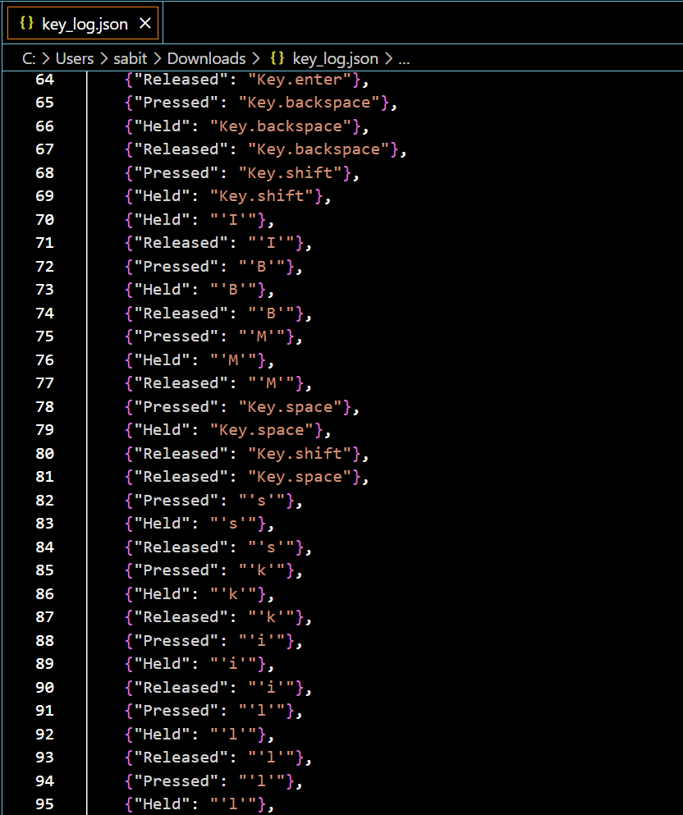
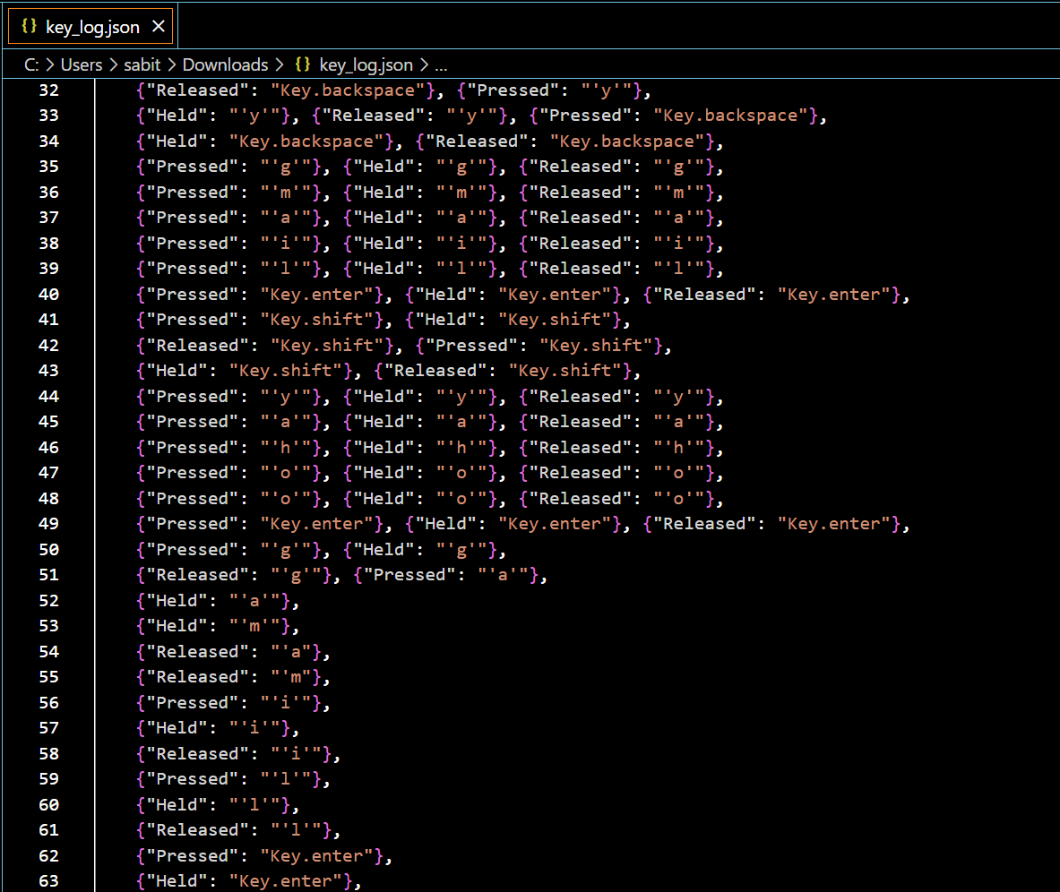
Result
Key_log JSON file

Slide 14
Conclusion
Keyloggers serve a vital role in cybersecurity by enabling threat detection and user behavior analysis. The proposed solution presents the implementation of a keylogger application using Python's Tkinter and pynput libraries showcases a functional approach to capturing and logging keystrokes in real-time.
This keylogger efficiently captures keystrokes in real-time, logging them into both text and JSON files. Its functionality extends to recording keystrokes into files, thus preserving a detailed record of user input. Moreover, its user-friendly interface enables users to initiate and terminate the keylogging process with ease. Its straightforward design renders it accessible for comprehension and deployment, contributing to its practical utility.

Slide 15
Future scope
To enhance and expand the keylogger system, several avenues can be explored:
Enhancing Security and Privacy Measures: Implement robust security and privacy measures to protect sensitive user data captured by the keylogger. This could involve encryption of logged data, secure transmission protocols, and user consent mechanisms to ensure compliance with privacy regulations and ethical standards.
Optimizing the Algorithm: Implement optimizations to improve the performance and efficiency of the keylogger algorithm. This could involve refining the event detection mechanisms, reducing resource consumption, and enhancing the logging process to minimize latency and ensure seamless operation.
Incorporating Additional Data Sources: Integrate real-time data sources such as mouse movements, application usage patterns, and network activity to provide a comprehensive overview of user behavior. This additional context can enrich the captured data and enhance its utility for threat detection and analysis.
User-Friendly Interface and Customization Options: Improve the user interface of the keylogger application to provide intuitive controls, customizable settings, and informative visualizations. This would enhance user experience and facilitate easier configuration and management of the keylogging process.

Slide 16
References
Keystroke Logging by Tom Olzak April 2008 https://www.researchgate.net/publication/228797653_Keystroke_logging_keylogging
Keyloggers software detection techniques
https://ieeexplore.ieee.org/document/7726880
A Simple Keylogger using Python
https://medium.com/@meetmeonmail04/a-simple-keylogger-using-python-ddc39d04b5ab
Black Hat Python: Python Programming for Hackers and Pentesters" by Justin Seitz
Python 3: Das umfassende Handbuch" by Stefan Beike and Bernd Klein

Slide 17
THANK YOU

