Slide 1
What is the Project?
Aether University’s Student Management System is a web-based platform to manage student profiles, course enrollments, and secure user access for students and admins.

Slide 2
Who is the Target Audience?
Target users include:
- University administrative staff
- Enrolled students at Aether University
- Educational institutions seeking lightweight management tools

Slide 3
What Problem Does It Solve?
The system streamlines:
- Manual data entry and student record handling
- Course registration processes
- Security concerns through login authentication

Slide 4
What Do We Want to Achieve?
To build a secure, user-friendly platform for academic institutions that simplifies operations and improves data accuracy.

Slide 5
Completed Features
- Admin dashboard
- Student dashboard
- Add/Edit/Delete students and courses
- Course enrollment system
- Login and registration

Slide 6
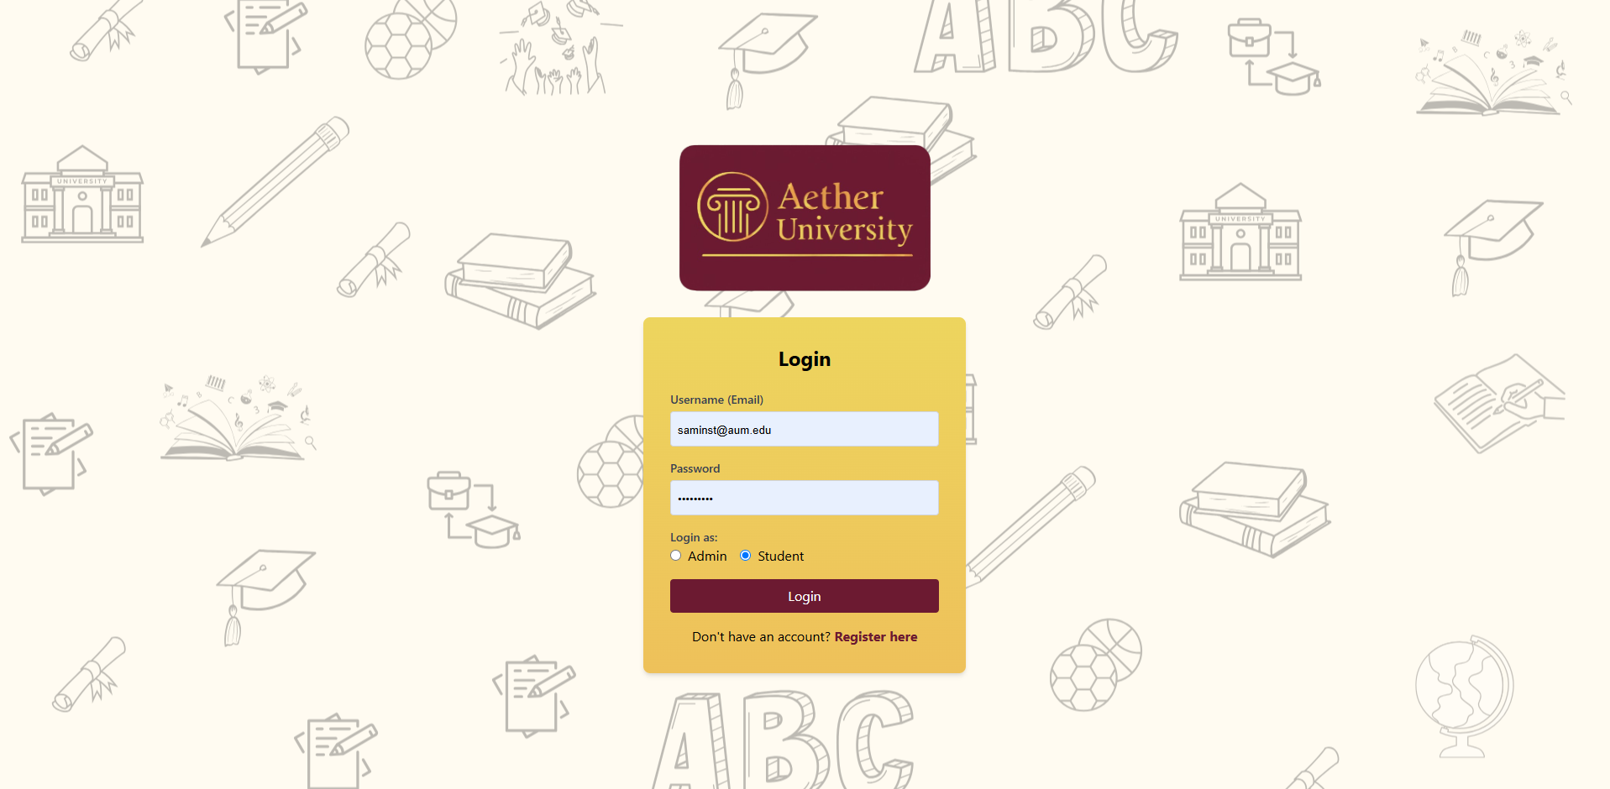
Login Interface

Slide 7
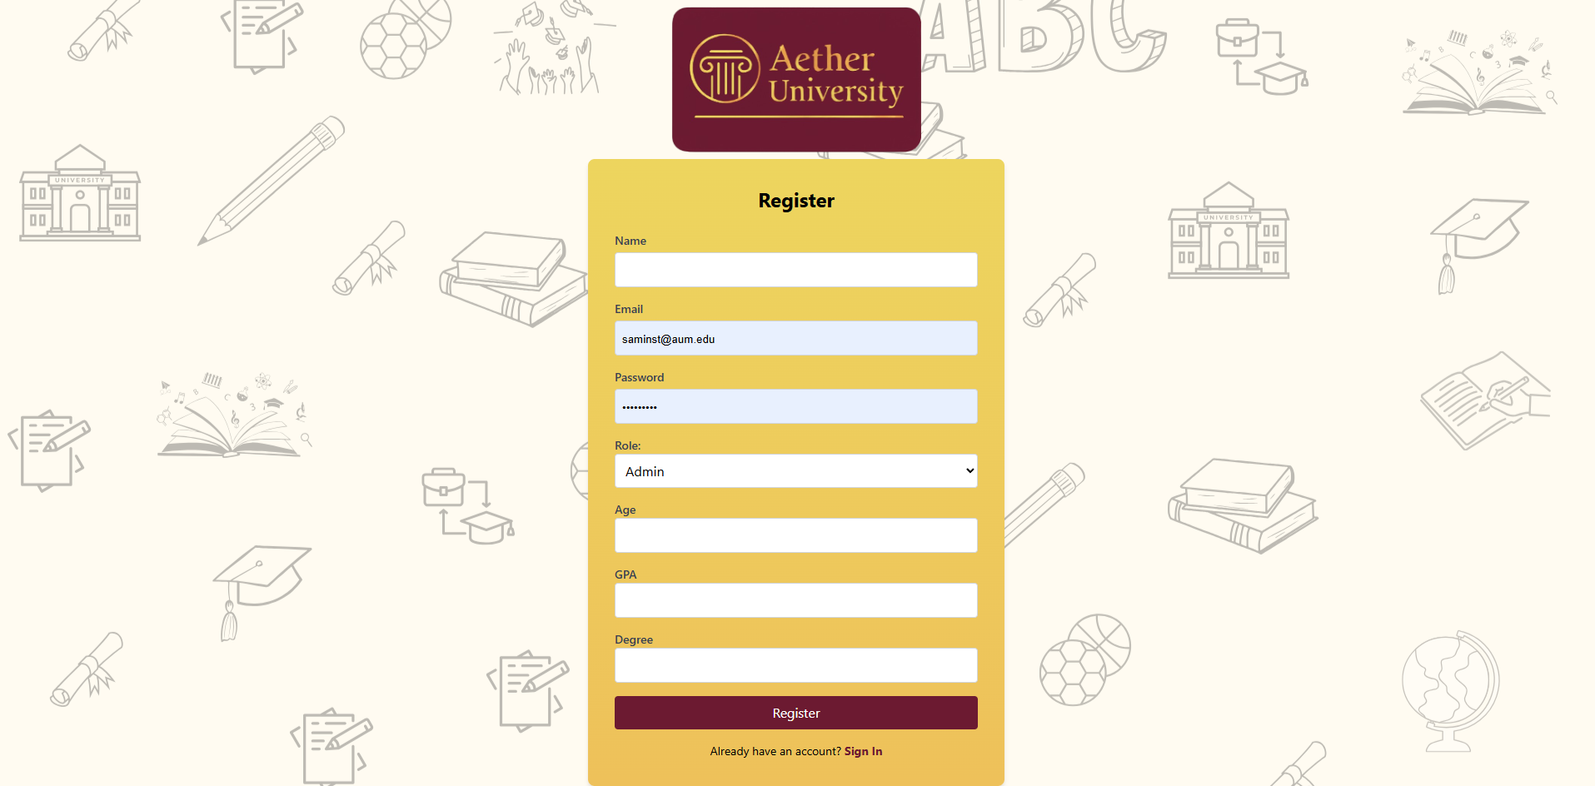
Register Interface

Slide 8
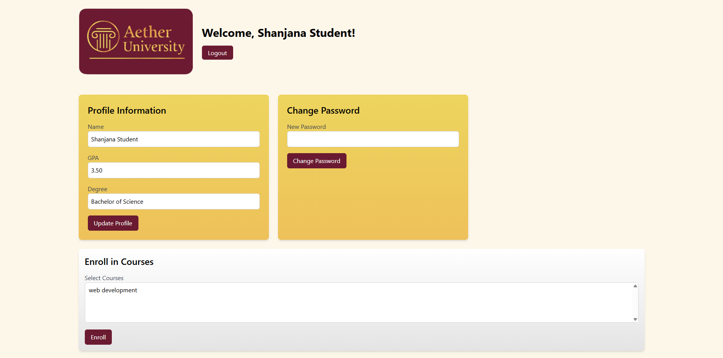
Student Dashboard

Slide 9
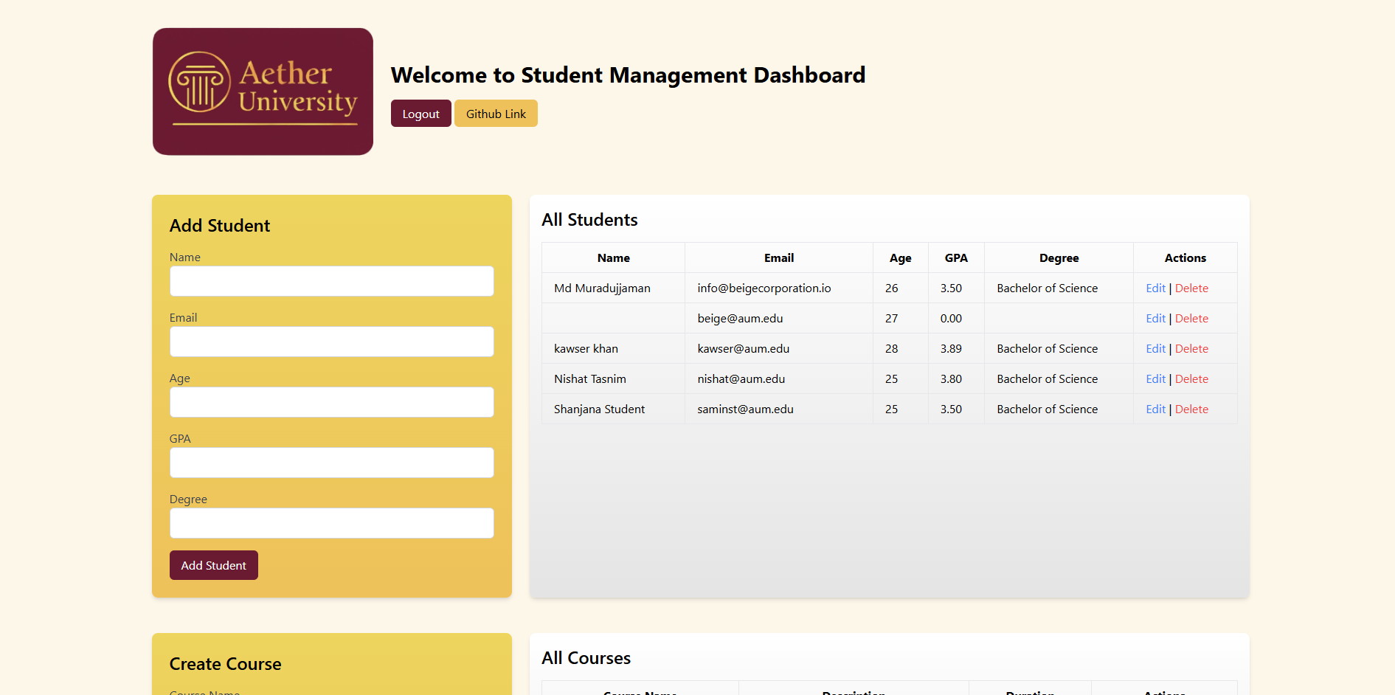
Admin Dashboard

Slide 10
How Will It Reach Users?
Marketing channels:
- University email announcements
- Campus posters with QR codes
- Partnership with academic platforms

Slide 11
Available Platforms
The system is web-based and accessible from:
- Desktops
- Laptops
- Tablets & Smartphones
(Responsive design ensures compatibility)

Slide 12
Brand Identity
- Brand Name: Aether University
- Slogan: Simplifying Student Success
- Logo: Scroll Pillar with Serif Font
- Colors: #EEC15A, #6A1A31

Slide 13
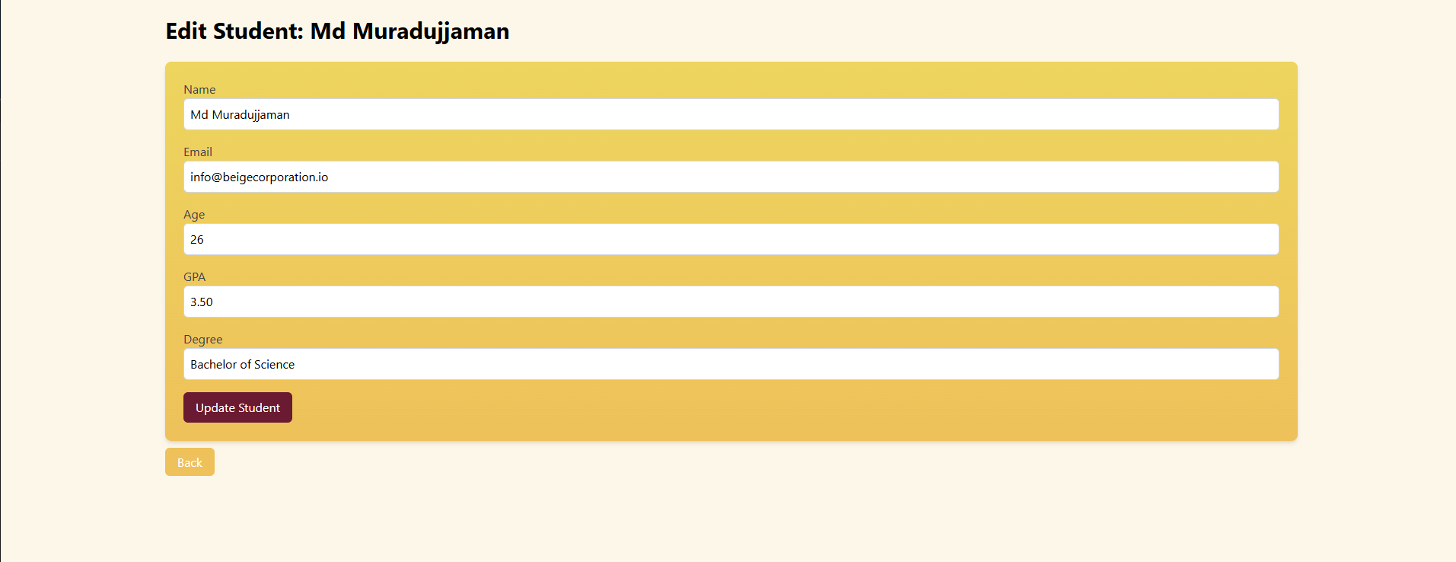
Edit Student Page

Slide 14
Architecture & Key Technologies
- PHP for server-side logic
- MySQL for database
- Tailwind CSS for UI
- HTML/JS for interactivity

Slide 15
Database & Infrastructure
- 4 core tables: admins, students, courses, student_courses
- XAMPP for local development
- Structure designed for scalability

Slide 16
Challenges Faced
- Database table mismatches
- Session handling bugs
- UI design complexity with Tailwind

Slide 17
Solutions Implemented
- Switched to separate student/admin tables
- Unified session logic
- Used utility-first CSS to simplify design

Slide 18
Security Considerations
- Passwords hashed with `password_hash()`
- Session-based role restrictions
- Redirect protection on all critical pages

Slide 19
Remaining Tasks
- Profile image upload for users
- Course grading system
- Admin reports & analytics dashboard

Slide 20
Expected Completion
- Beta: Within 1 week
- Final Release: 2 weeks after feedback

Slide 21
Thank You
Presented by: Shanjana Amin
Email: samin@aum.edu

