Slide 1
Aether University – Student Management System
Web-based Application for Admin & Student Operations

Slide 2
Introduction
Aether University's Student Management System is a web application designed for managing student profiles, course enrollments, and secure user access. Built using PHP and MySQL with a clean, responsive interface.

Slide 3
Admin Features
- Add/Edit/Delete students
- Create/Edit/Delete courses
- View student & course data
- Manage enrollments

Slide 4
Student Features
- Update profile (GPA, degree, name)
- Change password
- Enroll in available courses
- View enrolled courses

Slide 5
Technology Stack
- Frontend: HTML, CSS (Tailwind)
- Backend: PHP
- Database: MySQL
- Design: Custom Icons and Responsive Layout

Slide 6
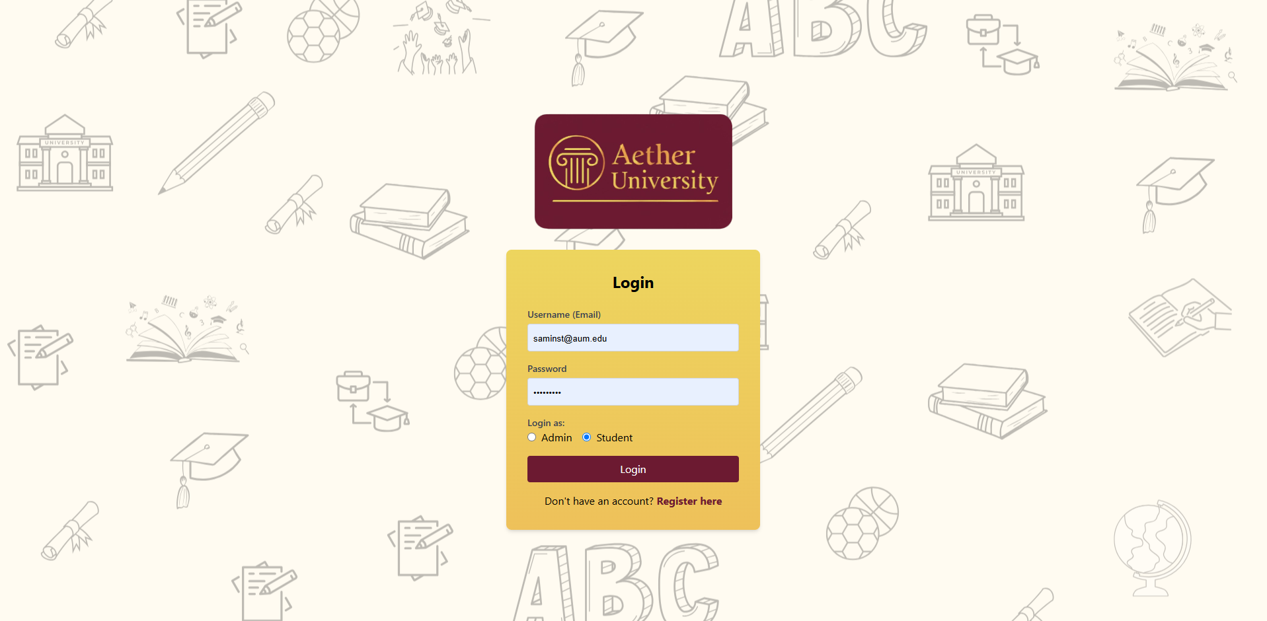
Login Interface

Slide 7
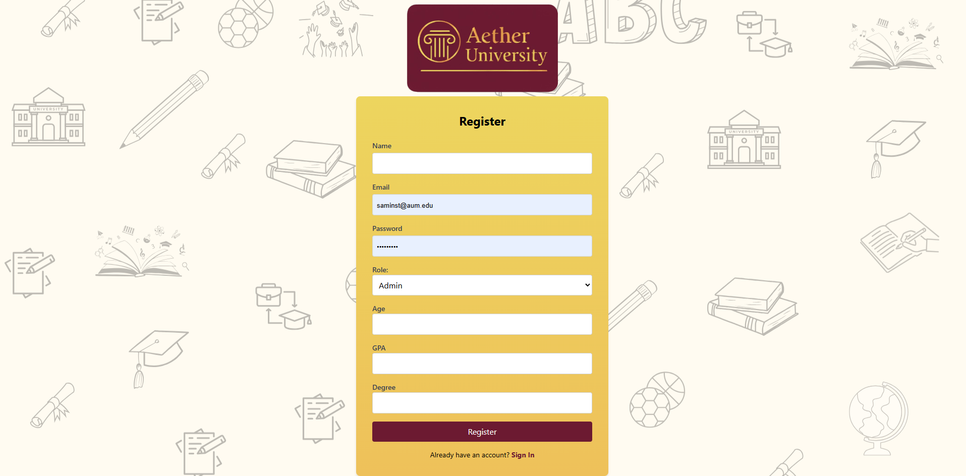
Register Interface

Slide 8
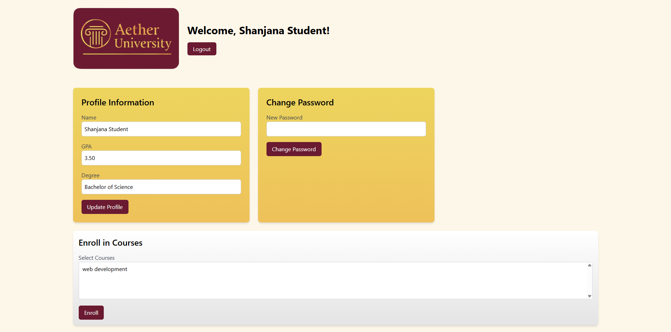
Student Dashboard

Slide 9
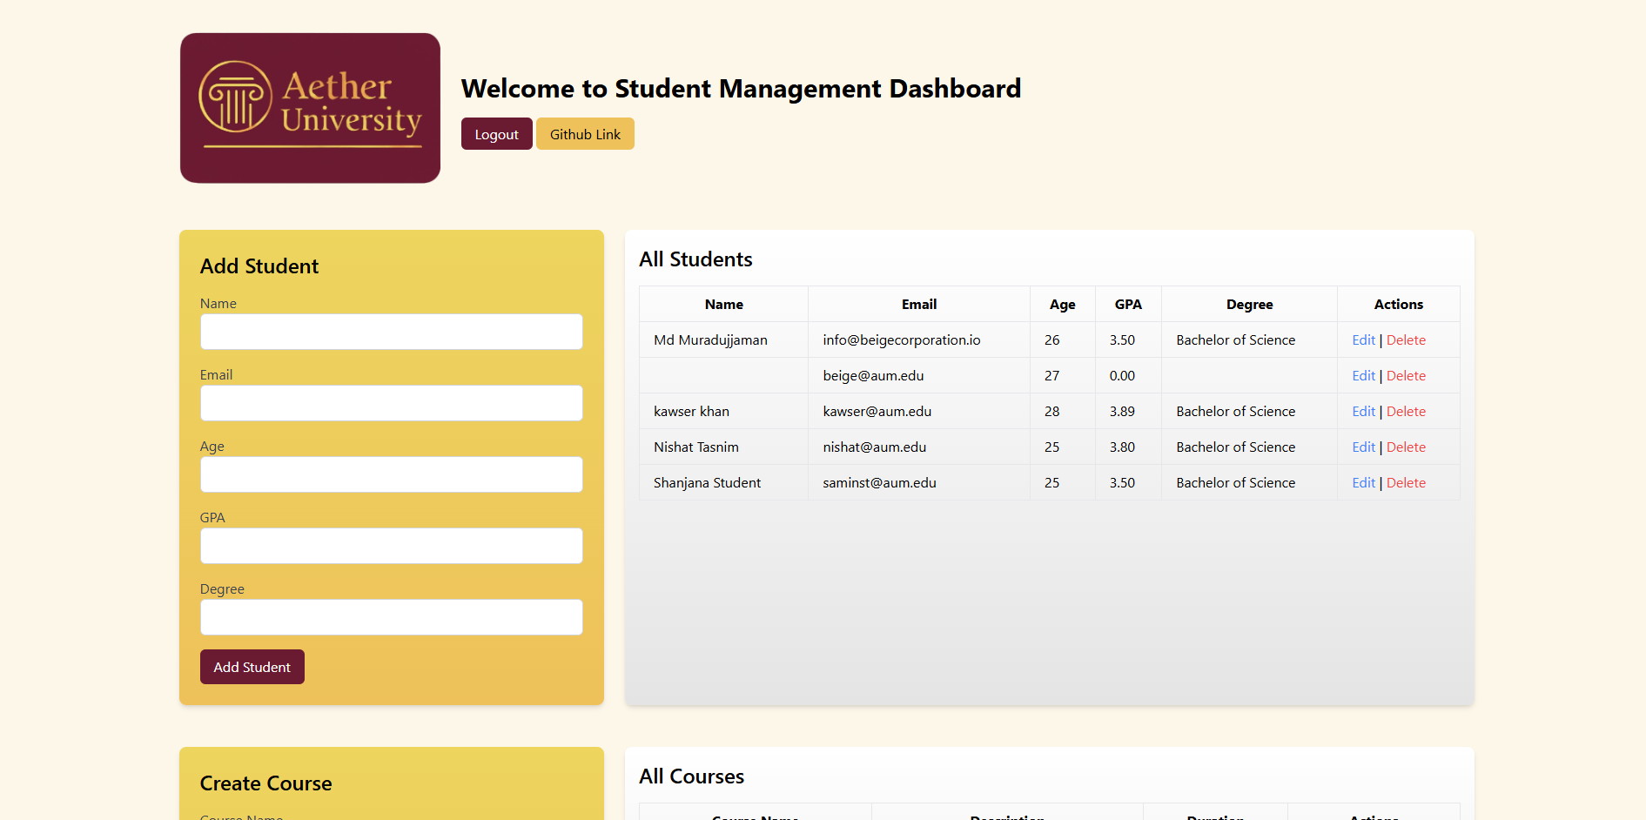
Admin Dashboard

Slide 10
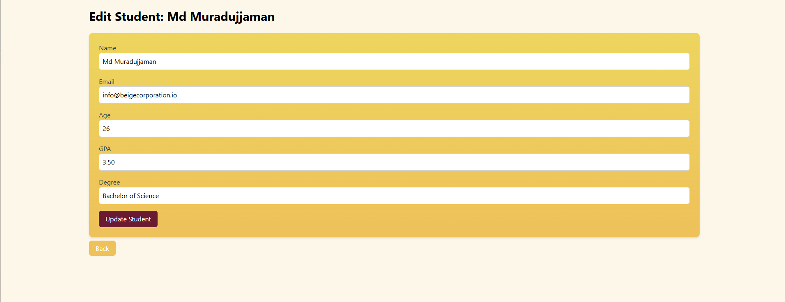
Edit Student Info

Slide 11
Thank You
Presented by: Aether University
Project Maintainer: Shanjana Amin
Email: samin@aum.edu

