Slide 1

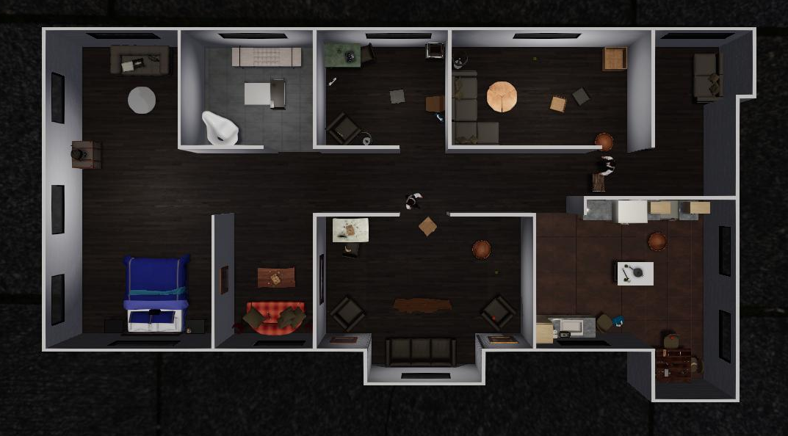
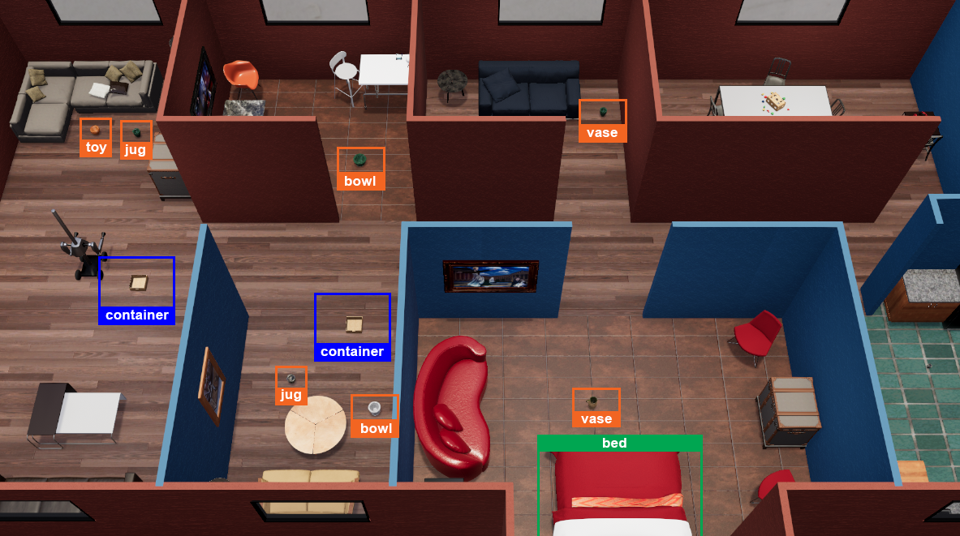

Alice
(GPT-4)
“I find a container.”
To pick up the bowl, I need to go to the kitchen
“I am going to the kitchen.”
Bob
(Human or LLM)
“There is a bowl in the kitchen.”
“OK, I am going to the living room.”

Slide 2
Bob
(LLM)
“Hi, Alice. I
found 3 target objects in the living room,
I remember
you were holding an empty container,
can you come here to pick them up while I go to explore other rooms?”
Alice
(Human/AI)
Tea tray
“OK, thanks for your information, I'll go to transport them.”
banana
apple
orange

Slide 3
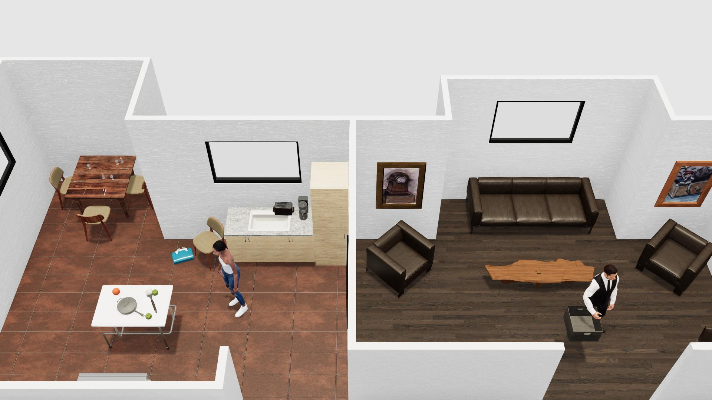
Alice
(LLM)
“Hi, Bob. I
found 3 target objects in the kitchen,
I remember
you were holding an empty container,
can you come here to pick them up while I go to explore other rooms?”
Bob
(Human/AI)
“OK, thanks for your information, I'll go to transport them.”
Orange
Apple
Apple
Tea tray
orange

Slide 4
Alice
(LLM)
“Hi, Bob. I
found 3 target objects in the kitchen,
I remember
you were holding an empty container,
can you come here to pick them up while I go to explore other rooms?”
Bob
(Human/AI)
“OK, thanks for your information, I'll go to transport them.”
Orange
Apple
Apple
Tea tray

Slide 5
Tea tray
banana
apple
orange

