Slide 1

Density Based Traffic Signal Controller
ECA Project Presentation
Presented by:
Jarin Tasnim (2252421001)
Rahbar-E-Tawsif (2252421057)
Shahariar Hossain (2252421085)
Shanjida Afrin (2252421087)
Department of Computer Science and Engineering (CSE)
Faculty of Science and Technology (FST)
Bangladesh University of Professionals (BUP)

Slide 2
contents
Introduction | 03
Background Study | 04-05
Research Gap | 06-07
Problem Statement | 08
Objectives | 09
Methodology | 10-12
Conclusion | 13
References | 14

Slide 3
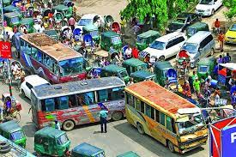
Introduction
Causes of traffic jam:
Lack of proper planning of city roads
Unplanned parking
Traffic rule violation
Lack of law implementation

Slide 4
Background study
KITS, Warangal (India): ECE students developed a density-based traffic system using IR sensors, Arduino, and LEDs. The system detects traffic density and gives green signal priority to the busiest lane. Infrared cameras were also included in the model.
University of Uyo (Nigeria): Students used IR sensors with PIC18F4550 microcontroller. Sensors were arranged with AND gates to detect vehicle presence, allowing the system to dynamically adjust signals based on real-time traffic.

Slide 5
Research gap
Due to budget and cost management only four IR sensors are used in each road. It would have been more accurate if we used more IR sensors.
Programming the microcontroller to do a specific function was a challenge since we still have little to no experience on programing.
Infrared cameras can be used to make the system more accurate and decisive. Further budget and governmental funds are necessary to implement infrared cameras on this system.
In our experimental model we are using the 5V-0.5A USB port of a laptop as a power source.
When this density based traffic system is applied in real life the microcontroller needs to be protected from dust and water. So, proper casing is required.
If AC power supply is used instead of battery than we will need to use a separate converter/adapter.

Slide 6
RESEARCH GAP
When the system is applied it will be best if both AC and battery source is used simultaneously due to load shedding.
Unfortunately, there is no way to forcefully make the light signals go green for VIP convoys. Under such circumstances police constables should take charge of traffic.
Fuses are to be used to protect the electric equipment used in this system from electric load shedding or fluctuation. Thus unnecessary short-circuit of the microcontroller and led light can be avoided, saving repair cost.

Slide 7
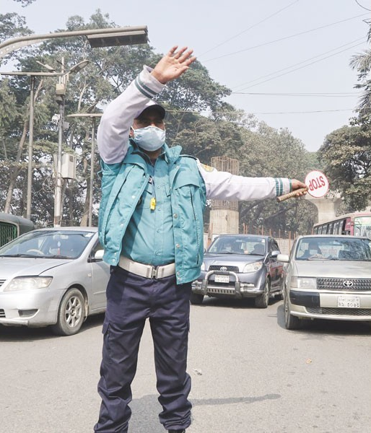
Problem statement
Phase sequence and durations for each road is not conventional.
Disobedience of traffic rules.
Abstract mind of traffic police.
Diversion of traffic to inadequate alternate routes.
Sound pollution caused due to unnecessary vehicle horns applied
in signals.

Slide 8
objectives
To digitalize the continuous process of traffic signal management.
To eradicate the issues caused by manually operated traffic signal systems. Most commonly observed problems in the streets of our country are corruption by law enforcing traffic police, inconsistent signaling, unnecessary traffic congestion and so on.
To reduce the need of traffic regulators in roads who can be deployed in other demanding fields.
To ensure even and smooth running of traffic taking the load into consideration.

Slide 9
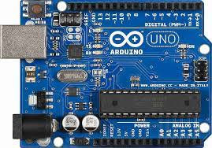
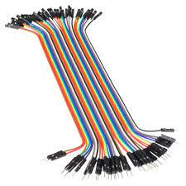
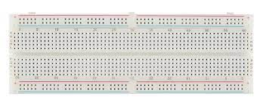
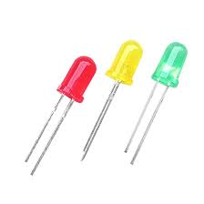
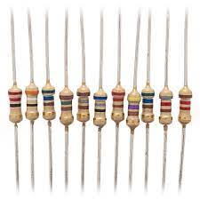
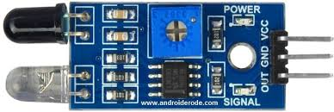
methodology
The components required for the project are –
Arduino Uno R3 (ATmega328P microcontroller)
Jumper Cables
IR Sensors
LED Bulbs
Power Source
Resistors
Breadboard

Slide 10
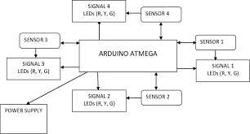
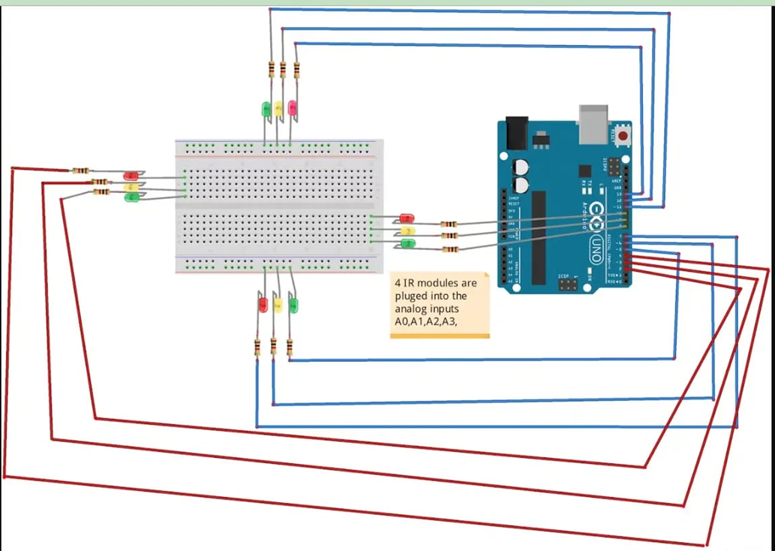
methodology
The whole system is powered by a 5V power supply. Four IR sensors are placed by four roads, one for each road. They detect the oncoming traffic. Based on their input the signal outputs change. Each IR sensor is interfaced to the microcontroller board. If the IR sensor senses obstacle in front, it is considered that traffic has taken station at that point.

Slide 11
methodology
All the components are connected to the microcontroller. The IR transmitters transmit the infrared rays and the IR sensors receive the returning rays given the traffic. Then the LED signals are automatically displayed accordingly.
Traffic
Logic 0
Green Light
Microcontroller
IR Transmitter
IR Receiver
No Traffic
Logic 1
Red Light

Slide 12
conclusion
Main agenda:
To provide sophisticated control and coordination for a smooth and safe traffic system.
To provide traffic managers with predictive insights about traffic flow speeds and traffic incidents.
To save our important time.
To modernize our traffic controlling system.
Our automated system reduces the problems we face in our daily life and makes it easier.

Slide 13
references
Sharma, E.P., Mishra, A. and Singh, K., 2015. Density Based Intelligent Traffic Control System Using IR Sensors. Image, 4(5).
Rishabh Gupta, 2021. Density Traffic Signal System using Microcontroller. Freaky Diodes
Mahmud, Khaled and Gope, Khonika and Mustafizur, Syed and Chowdhury, Syed., 2012. Possible Causes & Solutions of Traffic Jam and Their Impact on the Economy of Dhaka City. Journal of Management and Sustainability. 2. 10.5539/jms.v2n2p112.
Chanda, Jyoshna, 2021. Density Based Traffic Control System Using Arduino. 10.2319/ssrn.3917889
Udoakah, Ye-Obong and Okure, Inimfon-Abasi, 2018. Design and implementation of a density-based traffic light control with surveillance system. Nigerian Journal of Technology. 36. 1239. 10.4314/njt.v36i4.34.

Slide 14

THANK YOU FOR YOUR ATTENTION
ANY QUESTIONS?

