Slide 1
WELCOME Title: “Environmental Pollution: Causes, Effects, and Solutions"
Subtitle: "An Overview of Pollution's Impact on Our Planet"

Slide 2
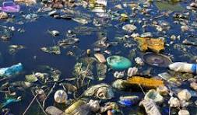
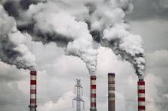
Introduction to Environmental Pollution
Definition: Environmental pollution is the introduction of harmful substances or energy into the environment at a rate that's faster than it can be dispersed, diluted, or stored
Types of Pollution:
Air Pollution
Water Pollution
Soil Pollution
Noise Pollution

Slide 3
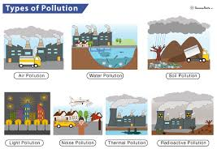
Types of Environment Pollution

Slide 4
Causes of Environmental Pollution
Industrial activities: Emissions of harmful gases, toxic waste.
Agricultural practices: Pesticides, fertilizers.
Deforestation: Loss of natural filters.
Urbanization: Overuse of resources and waste production.
Transportation: Vehicle emissions.
Visuals/Icons: Use images or icons representing factories, cars, agricultural practices, etc.

Slide 5
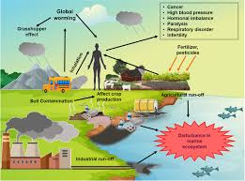
"Impact of Pollution on the Environment and Health"
On the Environment: Climate change, destruction of ecosystems, loss of biodiversity.
On Health: Respiratory diseases, waterborne diseases, increased cancer risk.
Global Impact: Sea-level rise, more frequent natural disasters.
Visuals/Icons: Consider adding infographics or visuals showing the Earth, wildlife, and human health.

Slide 6
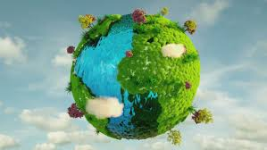
"Combating Environmental Pollution"
Solutions:
Sustainable practices: Recycling, renewable energy sources (solar, wind).
Reducing waste and emissions.Green transportation (electric vehicles).
Awareness and policies: Government regulations, global cooperation.
Conclusion: Emphasize the importance of collective action to reduce pollution and protect the environment for future generations.

Slide 7
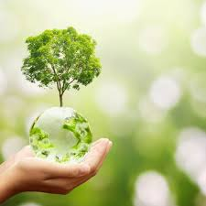
Thank You

