Slide 1
DBMS Architecture – Introduction
Early DBMS were monolithic systems where all functions were tightly integrated.
Modern DBMS follow a modular, client/server architecture.
Client Module:
• Runs on user machines
• Handles user interaction
• Provides GUI, forms, menus
Server Module:
• Handles data storage
• Manages queries, transactions, security

Slide 2
Data Model
A data model is a collection of concepts used to describe:
• Structure of the database
• Data types
• Relationships among data
• Constraints on data
It also includes operations for data retrieval and update.
Data models provide abstraction.

Slide 3
Categories of Data Models
Data models can be categorized according to the types of concepts they use to describe the database structure.

Slide 4
High-Level or Conceptual Data Models
High-level or conceptual data models provide concepts that are close to the way many users perceive data.
These models focus on the logical view of data rather than storage details.

Slide 5
Concepts Used in Conceptual Models
Conceptual data models use the following concepts:
• Entities
• Attributes
• Relationships

Slide 6
Conceptual Data Model – Example
Example: University Database
Entity: STUDENT
Attributes: Student_ID, Name, Course
Entity: COURSE
Attributes: Course_ID, Course_Name
Relationship: STUDENT enrolls in COURSE

Slide 7
Representational or Implementation Data Models
Representational data models provide concepts that are easily understood by end users but are closer to the way data is organized in computer storage.
These models hide many details of physical data storage.

Slide 8
Usage of Representational Models
Representational or implementation data models are used most frequently in traditional commercial DBMSs.

Slide 9
Types of Representational Data Models
Common representational data models include:
• Relational data model
• Network data model
• Hierarchical data model

Slide 10
Why Called Record-Based Models
Representational data models represent data using record structures.
Because of this, they are also called record-based data models.

Slide 11
Relational Model – Example
STUDENT Table
Student_ID | Name | Course
101 | Ravi | BCA
102 | Anita | BSc
Data is stored in the form of tables (relations).

Slide 12
Low-Level or Physical Data Models
Low-level or physical data models provide concepts that describe how data is stored on computer storage media.
These models focus on physical storage details.

Slide 13
Storage Details in Physical Models
Physical data models describe:
• Record formats
• Record orderings
• Access paths
Data is typically stored on magnetic disks.

Slide 14
Physical Data Model – Example
Student records stored as files on disk.
• Fixed-length or variable-length records
• Indexed using access paths
• Stored in disk blocks

Slide 15
Summary of Categories
High-Level Data Models:
• User-oriented
• Use entities and relationships
Representational Data Models:
• Record-based
• Used in DBMS implementations
Physical Data Models:
• Storage-oriented
• Focus on files and access paths

Slide 16
Database Schema
The description of a database is called the database schema.
It is specified during database design and is not expected to change frequently.
Example:
STUDENT(Student_ID, Name, Course)
COURSE(Course_ID, Course_Name)

Slide 17
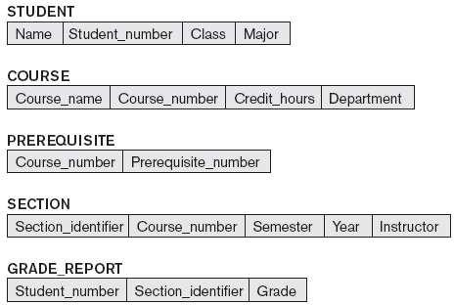
Figure: Schema diagram for the database

Slide 18
Schema Diagram
A displayed schema is called a schema diagram.
It displays only some aspects of a schema such as:
• Names of record types
• Data items
• Some types of constraints

Slide 19
Schema Construct
Each object in the schema is called a schema construct.
Examples:
• STUDENT
• COURSE

Slide 20
Database State or Snapshot
The data in the database at a particular moment in time is called a database state or snapshot.
It is also called the current set of occurrences or instances in the database.

Slide 21
Database State – Example
For the STUDENT schema construct, the database state contains:
Student_ID | Name | Course
101 | Ravi | BCA
102 | Anita | BSc

Slide 22
Schema and Database State
The distinction between database schema and database state is very important.
• When a new database is defined, only schema is specified.
• At this time, database state is empty.
• Initial state is created when data is loaded.
• Every update operation creates a new database state.

Slide 23
Role of DBMS and Metadata
The DBMS ensures every database state is valid.
A valid state satisfies the structure and constraints specified in the schema.
Schema descriptions and constraints are stored as metadata in the DBMS catalog.

Slide 24
Intension and Extension
The schema is sometimes called the intension.
The database state is called an extension of the schema.

Slide 25
Three-Schema Architecture
The goal of the three-schema architecture is to separate user applications from the physical database.

Slide 26
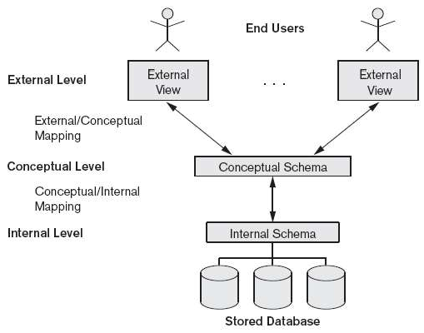
Figure: The three-schema architecture

Slide 27
Internal Level
The internal level has an internal schema.
• Describes physical storage structure
• Uses physical data model
• Describes storage details and access paths

Slide 28
Conceptual Level
The conceptual level has a conceptual schema.
• Describes structure of the whole database
• Represents community view of data
• Hides physical storage details
• Describes entities, relationships, constraints

Slide 29
External Level
The external level includes a number of external schemas or user views.
• Each schema shows the part of the database required by a user group
• Hides the rest of the database

Slide 30
Three-Schema Architecture – Processing
Each user group refers to its own external schema.
The DBMS transforms:
• External schema request → Conceptual schema request
• Conceptual schema request → Internal schema request

Slide 31
Data Independence
Data independence can be defined as the capacity to change the schema at one level of a database system without having to change the schema at the next higher level.

Slide 32
Types of Data Independence
There are two types of data independence:
1. Logical Data Independence
2. Physical Data Independence

Slide 33
Logical Data Independence
Logical data independence is the capacity to change the conceptual schema without having to change external schemas or application programs.

Slide 34
Logical Data Independence – Purpose
The conceptual schema may be changed to:
• Expand the database
• Change constraints
• Reduce the database

Slide 35
Logical Data Independence – Key Point
In a DBMS that supports logical data independence:
• Only view definitions need to be changed
• Only mappings need to be changed
External schemas and application programs remain unchanged.

Slide 36
Logical Data Independence – Example
Conceptual Schema Change Example:
STUDENT(Student_ID, Name, Course)
→ STUDENT(Student_ID, Name, Course, Email)
User views are not affected.

Slide 37
Physical Data Independence
Physical data independence is the capacity to change the internal schema without having to change the conceptual schema.
External schemas also need not be changed.

Slide 38
Physical Data Independence – Reason
Changes to the internal schema may be needed because:
• Physical files are reorganized
• Additional access structures are created
• Performance improvement is required

Slide 39
Physical Data Independence – Example
Examples of internal schema changes:
• Creating an index on Student_ID
• Changing file organization
• Adding access paths

Slide 40
Summary
Logical Data Independence:
• Change conceptual schema
• External schemas unaffected
Physical Data Independence:
• Change internal schema
• Conceptual schema unaffected

Slide 41
Database Languages and Interfaces
The DBMS must provide appropriate languages and interfaces for each category of users.

Slide 42
DBMS Languages
Once the database design is completed and a DBMS is chosen, the first step is to specify:
• Conceptual schema
• Internal schema
• Mappings between the schemas

Slide 43
Data Definition Language (DDL)
The data definition language (DDL) is used by the DBA and database designers to define schemas.
The DBMS has a DDL compiler that processes DDL statements and stores schema descriptions in the DBMS catalog.

Slide 44
DDL – Example
Example:
CREATE TABLE STUDENT (
Student_ID INT,
Name VARCHAR(30),
Course VARCHAR(20)
);

Slide 45
Storage Definition Language (SDL)
Storage definition language is used when there is clear separation between conceptual and internal levels.
• DDL specifies conceptual schema
• SDL specifies internal schema

Slide 46
View Definition Language (VDL)
View definition language is used to specify user views and their mappings to the conceptual schema.
In relational DBMSs, SQL is used as VDL.

Slide 47
VDL – Example
Example:
CREATE VIEW Student_View AS
SELECT Name, Course FROM STUDENT;

Slide 48
Data Manipulation Language (DML)
Data manipulation language is used for retrieval, insertion, deletion, and modification of data.

Slide 49
Types of DML
There are two types of DML:
1. High-level (Nonprocedural)
2. Low-level (Procedural)

Slide 50
High-Level DML
High-level DML specifies what data to retrieve.
• Set-oriented
• Declarative
• Can be interactive or embedded

Slide 51
High-Level DML – Example
Example:
SELECT * FROM STUDENT WHERE Course = 'BCA';

Slide 52
Low-Level DML
Low-level DML retrieves one record at a time.
• Embedded in host language
• Uses loops
• Record-at-a-time

Slide 53
Low-Level DML – Example
Example: DL/1 commands
GET UNIQUE
GET NEXT
GET NEXT WITHIN PARENT

Slide 54
Host Language
When DML is embedded in a programming language:
• Programming language is host language
• DML is data sublanguage
Standalone high-level DML is called query language.

Slide 55
Menu-Based Interfaces
Menu-based interfaces present lists of options.
• No need to remember syntax
• Popular in web-based interfaces

Slide 56
Forms-Based Interfaces
Forms-based interfaces display forms to users.
• Used for data entry
• Designed for naive users

Slide 57
Graphical User Interfaces (GUI)
GUI displays schema diagrammatically.
• Uses mouse
• Combines menus and forms

Slide 58
Natural Language Interfaces
Natural language interfaces accept queries in English or other languages.
• Translated into high-level queries
• Dialogue started if unclear

Slide 59
Speech Input and Output
Speech interfaces are used in limited vocabulary applications.
Examples:
• Telephone directory
• Flight information

Slide 60
Interfaces for Parametric Users
Parametric users perform repetitive tasks.
Examples:
• Bank tellers
• Balance inquiries

Slide 61
Interfaces for the DBA
DBA interfaces include privileged commands for:
• Creating accounts
• Granting authorization
• Changing schema
• Reorganizing storage

Slide 62
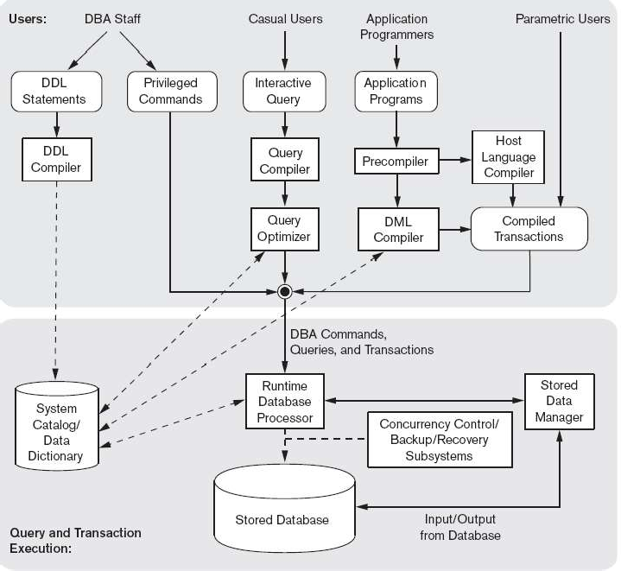
  The Database System Environment
    DBMS Component Modules

Slide 63
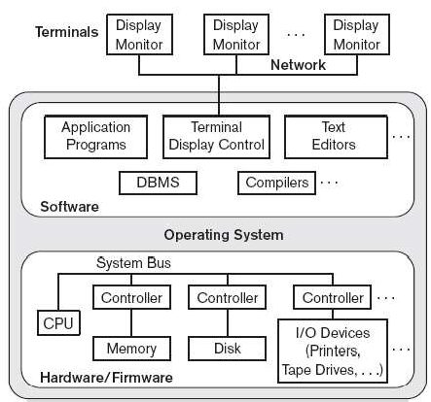
Centralized and Client/Server Architectures for DBMSs
    Centralized DBMSs Architecture
Fig. A physical centralized architecture

Slide 64
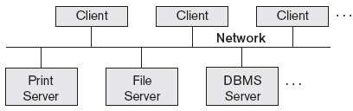
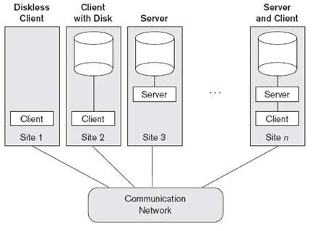
Basic Client/Server Architectures
Fig. Logical two-tier client/server architecture
Fig. Physical two-tier client/server architecture

Slide 65
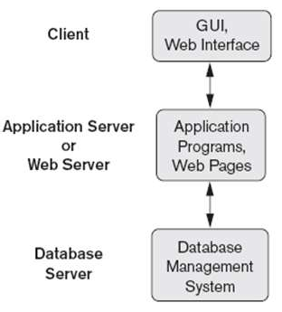
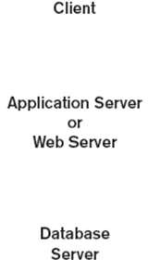
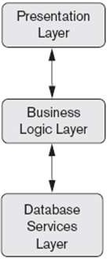
    Three-Tier and n-Tier Architectures for Web Applications
Fig. Logical three-tier client/server architecture
Fig. Logical three-tier client/server architecture

Slide 66
Classification of Database Management Systems (DBMS)
Based on data model, users, distribution, cost, access paths, and purpose

Slide 67
Introduction
A Database Management System (DBMS) can be classified based on several criteria such as:
- Data model
- Number of users
- Distribution of data
- Cost
- Access paths
- Purpose of use

Slide 68
1. Based on Data Model – Relational DBMS
Represents data as a collection of tables (relations).
Each table consists of rows (tuples) and columns (attributes).
Each table can be stored as a separate file.
Relationships are maintained using keys.
Uses SQL for querying.

Slide 69
1. Based on Data Model – Object-Oriented DBMS
Defines a database in terms of objects, their properties, and their operations.
Objects with the same structure and behavior belong to a class.
Classes are organized into hierarchies (or acyclic graphs).
Operations of each class are specified using predefined procedures called methods.

Slide 70
1. Based on Data Model – Hierarchical DBMS (Legacy)
Represents data as hierarchical tree structures.
Each hierarchy represents a number of related records.
Supports one-to-many (1:N) relationships.
Each child record has only one parent.

Slide 71
1. Based on Data Model – Network DBMS (Legacy)
Represents data as record types.
Represents a limited type of 1:N relationship called a set type.
A record can have multiple parent records.

Slide 72
1. Based on Data Model – Native XML DBMS
Uses hierarchical tree structures.
Combines database concepts with document representation models.
Data is represented as elements.
Uses tags to nest data and create complex hierarchical structures.

Slide 73
2. Based on Number of Users – Single-User DBMS
Supports only one user at a time.
Mostly used with personal computers (PCs).
Suitable for small-scale applications.

Slide 74
2. Based on Number of Users – Multiuser DBMS
Supports multiple users concurrently.
Allows simultaneous access to the database.
Used in organizational and enterprise environments.

Slide 75
3. Based on Number of Sites – Centralized DBMS
Entire database is stored at a single computer site.
All users access the database from the same location.

Slide 76
3. Based on Number of Sites – Distributed DBMS
Database and DBMS software are distributed over many sites.
Sites are connected through a computer network.

Slide 77
Types of Distributed DBMS
Homogeneous DDBMS:
Uses the same DBMS software at all sites.
Heterogeneous DDBMS:
Uses different DBMS software at each site.

Slide 78
4. Based on Cost – Open Source DBMS
Free to use and modify.
Supported by third-party vendors.
Examples: MySQL, PostgreSQL.

Slide 79
4. Based on Cost – Licensed DBMS
Different types of licensing models are available.
Standalone single-user versions (e.g., Microsoft Access) are sold per copy.
Advanced features like data warehousing, data mining, and support for additional data types are available at extra cost.

Slide 80
5. Based on Access Path Options
Some DBMSs are based on inverted file structures.
Inverted file structures improve data access and retrieval speed.

Slide 81
6. General-Purpose DBMS
Designed to support many different applications.
Flexible and reusable.
Examples include commonly used enterprise DBMSs.

Slide 82
6. Special-Purpose DBMS
Designed for specific applications where performance is critical.
Cannot be used for other applications without major changes.
Examples include airline reservation systems and telephone directory systems.

Slide 83
Mappings
The process of transforming requests and results between schema levels is called mapping.

Slide 84
Categories of Data Models
1. High-Level (Conceptual) Data Models:
• Close to human perception
• Use entities, attributes, relationships
• Example: ER model
2. Representational (Implementation) Data Models:
• Used in commercial DBMS
• Hide physical storage details
• Examples: Relational, Network, Hierarchical
3. Low-Level (Physical) Data Models:
• Describe physical storage
• Files, record formats, access paths

Slide 85
Database Schema
The database schema is the overall logical structure of the database.
• Defined during database design
• Specifies tables, attributes, relationships, constraints
• Stored in DBMS catalog
• Rarely changes

Slide 86
Schema Diagram & Schema Construct
Schema Diagram:
• Graphical representation of schema
• Shows entity names and attributes
Schema Construct:
• Each object in schema
• Examples: STUDENT, COURSE

Slide 87
Database State / Snapshot
Database state refers to the data stored at a specific time.
• Also called instance
• Changes after each update
• Each schema construct has instances

Slide 88
Schema vs Database State
Schema (Intension):
• Database structure
• Defined once
Database State (Extension):
• Actual data
• Changes frequently
DBMS ensures validity

Slide 89
Three-Schema Architecture
Separates user applications from physical storage.
Levels:
• External
• Conceptual
• Internal

Slide 90
External Level
• User-specific views
• Shows required data only
• Improves security

Slide 91
Conceptual Level
• Complete logical view
• Entities and relationships
• Independent of storage

Slide 92
Internal Level
• Physical storage
• Files, indexes
• Performance focused

Slide 93
Data Independence
Ability to change schema at one level without affecting next level.
Types:
• Logical
• Physical

Slide 94
Logical Data Independence
Change conceptual schema without changing external views.
Example:
• Add new attribute

Slide 95
Physical Data Independence
Change internal schema without changing conceptual schema.
Example:
• Create index

Slide 96
DBMS Languages
• DDL
• SDL
• VDL
• DML

Slide 97
Data Definition Language (DDL)
Defines database schema.
• Tables
• Constraints
• Stored as metadata

Slide 98
Storage Definition Language (SDL)
Defines internal schema.
• Storage structures
• Access paths

Slide 99
View Definition Language (VDL)
Defines user views.
• Maps views to conceptual schema
• SQL used

Slide 100
Data Manipulation Language (DML)
Used for data operations:
• Select
• Insert
• Update
• Delete

Slide 101
High-Level DML
• Non-procedural
• Set-oriented
• Example: SQL

Slide 102
Low-Level DML
• Procedural
• Record-at-a-time
• Example: DL/1

Slide 103
DBMS Interfaces
• Menu-based
• Forms-based
• GUI
• Natural language
• Speech
• Parametric
• DBA

